Slide 1
#22 Types of estuaries and River basin Arm model

Slide 2
Two types of estuaries you must be familiar with: Salt marshes and mangrove forests
Create a Venn diagram or a double T chart comparing and contrasting them in your notes.
You must find a minimum of 3 differences and 3 similarities, and draw a picture of both
Where to start:
Textbook page C117
http://marinebio.org/oceans/estuaries-salt-marshes-mangroves/

Slide 3
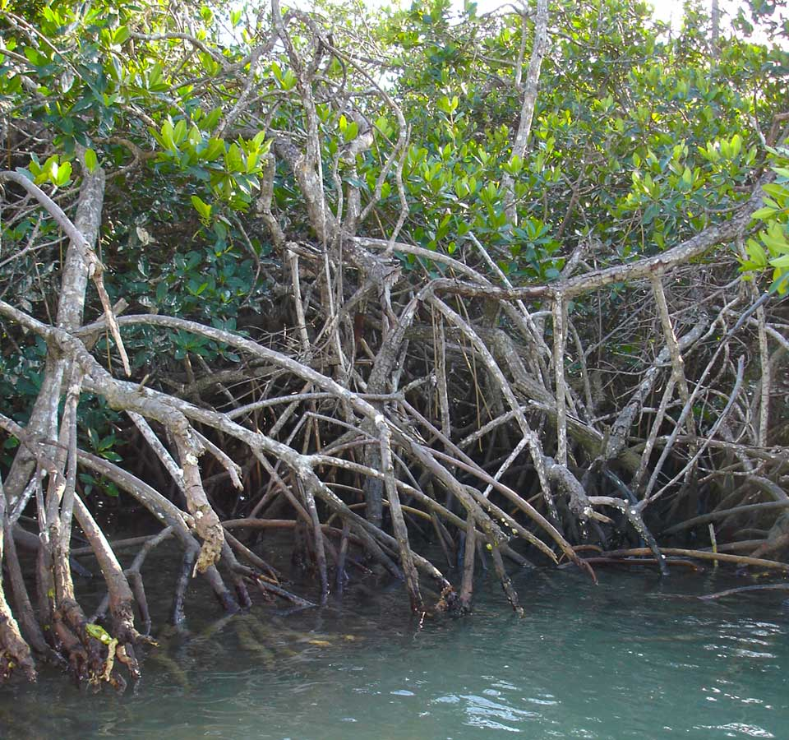
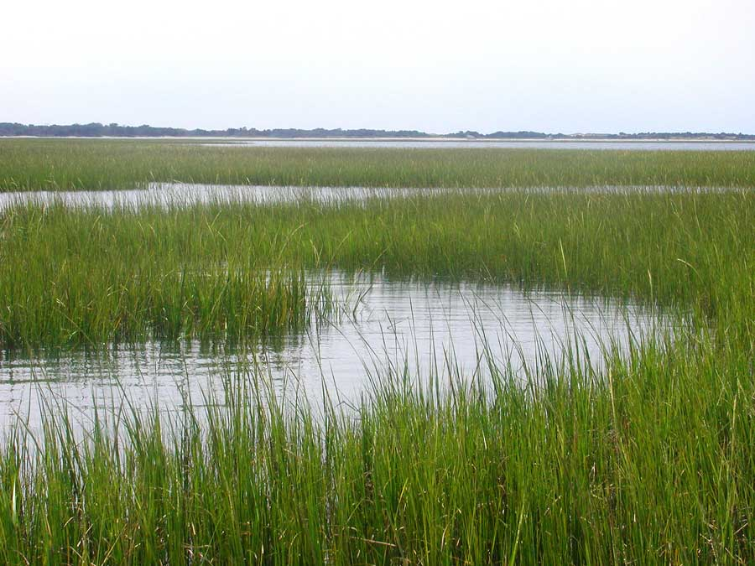
2 types of estuaries
SALT MARSHES
Atlantic Carolina coasts and cooler regions
Nutrient rich soil promotes growth of grasses
Protects shoreline from washing away
BOTH:
Great breeding area
Protects coastline
Great nurseries to plants
MANGROVES
Louisiana & gulf and warmer regions
Hurricane proof trees due to thick tree roots
Reduces erosion

Slide 4
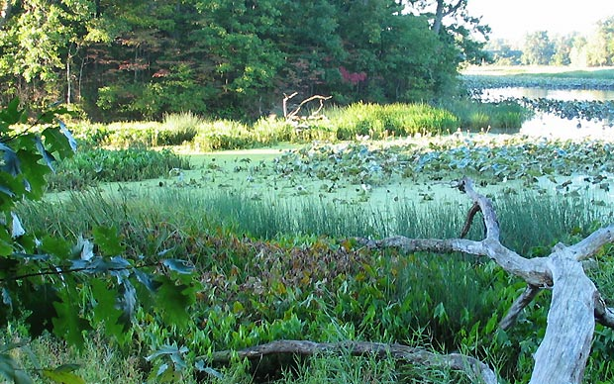
*Estuaries have….
Estuaries have twice the life because 2 ecosystems are colliding
Double the plant life
Double the nutrients
Double the breeding & feeding possibilities
https://oceanservice.noaa.gov/facts/estuary.html
(2mins)

Slide 5
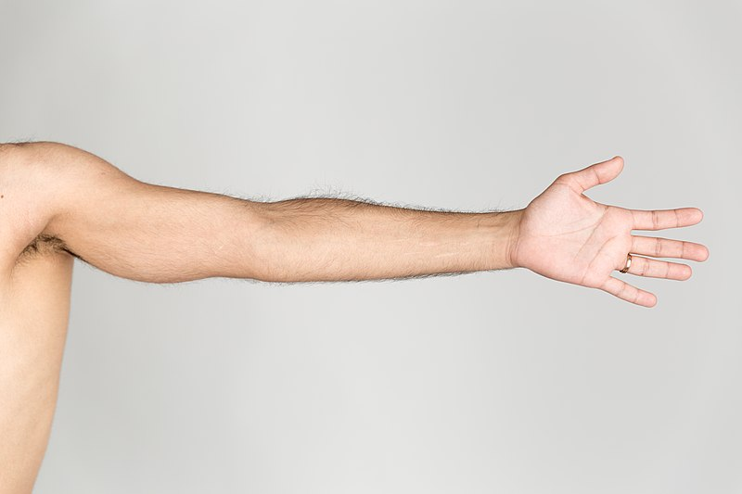
So lets draw a model representing a River basin
Remember that a riverbasin is all the land in which the tributaries and river flows on.
An extended arm is going represent the entire basin

Slide 6
So lets draw a model representing a River basin
The fingers:
They represent the tributaries. They are small bodies of moving water flowing off the mountain. You will find numerous tributaries within river basins. This is true because there are multiple ways water flows off mountains

Slide 7
So lets draw a model representing a River basin
The space in between fingers:
The spaces between fingers represent watersheds. Watersheds are the areas of land in which the tributaries flow down.
The fingers:
They represent the tributaries. They are small bodies of moving water flowing off the mountain. You will find numerous tributaries within river basins. This is true because there are multiple ways water flows off mountains

Slide 8
So lets draw a model representing a River basin
The space in between fingers:
The spaces between fingers represent watersheds. Watersheds are the areas of land in which the tributaries flow down.
River
The fingers:
They represent the tributaries. They are small bodies of moving water flowing off the mountain. You will find numerous tributaries within river basins. This is true because there are multiple ways water flows off mountains
The arm:
Eventually, tributaries will connect and join each other, turning into a larger body of water. This body of water is called a river.

Slide 9
So lets draw a model representing a River basin
The Body
Since a vast majority of water on our planet is salt water. It only makes since that a vast majority of your body represents the ocean
The space in between fingers:
The spaces between fingers represent watersheds. Watersheds are the areas of land in which the tributaries flow down.
OCEAN
River
The fingers:
They represent the tributaries. They are small bodies of moving water flowing off the mountain. You will find numerous tributaries within river basins. This is true because there are multiple ways water flows off mountains
The arm:
Eventually, tributaries will connect and join each other, turning into a larger body of water. This body of water is called a river.

Slide 10
So lets draw a model representing a River basin
The Body
Since a vast majority of water on our planet is salt water. It only makes since that a vast majority of your body represents the ocean
The space in between fingers:
The spaces between fingers represent watersheds. Watersheds are the areas of land in which the tributaries flow down.
OCEAN
River
The fingers:
They represent the tributaries. They are small bodies of moving water flowing off the mountain. You will find numerous tributaries within river basins. This is true because there are multiple ways water flows off mountains
The arm:
Eventually, tributaries will connect and join each other, turning into a larger body of water. This body of water is called a river.
The armpit:
This is an estuary. This is the location where freshwater rivers meet the salt water oceans

Slide 11
So lets draw a model representing a River basin
FRESHWATER
WATERSHEDS
OCEAN
River
TRIBUTARIES
ESTUARY
(MIX OF FRESH AND SALT WATER)
SALTWATER

