Slide 1
#25 Energy Pyramids

Slide 2
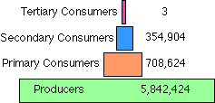
*Numbers Pyramid
The Numbers pyramid shows the number of individual organisms available for energy at each trophic level.
It can be used to illustrate how one population affects another.
The total numbers of individual organisms tend to decline as you move further up on the pyramid.

Slide 3
Energy Pyramids
https://www.youtube.com/watch?v=CReZd9OHEfs

Slide 4
Upcoming Dates
Thurs 5/11 – MOCK EOG (informal grade x2)
Fri 5/12 – Post Quiz
Tues 5/16 Ecology Test (Food Webs/Chains, Classification, Energy Pyramids, Population Density)

Slide 5
*Energy Pyramids
An energy pyramid shows the amount of energy that moves from one feeding level to another in a food web. Energy is measured in kilocalories (kcal) or joules (J).
Organisms use energy to perform life functions but only some of the energy from an organism obtained will be available to the next organism in the food web.
The "Rule of 10" says that only 10 percent of available energy passes from one trophic level to the next; the rest is released as heat.
The most energy available is located at the producer level of the pyramid.
As you move up an energy pyramid, each level has less energy available than the level below.

Slide 6
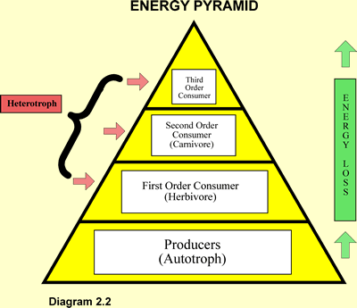
10% rule...
10%
90% lost as heat

Slide 7
10% rule diagrams...
10%
90% lost as heat

Slide 8
10% rule diagrams...
10%
90% lost as heat

Slide 9
How much energy is at each level? How much energy is lost as heat at each level?
? Cal
? Cal
? Cal
1000 Cal

Slide 10
How much energy is at each level?
9 Cal as heat
1 Cal
90 Cal as heat
10 Cal
100 Cal
900 Cal as heat
1000 Cal

Slide 11
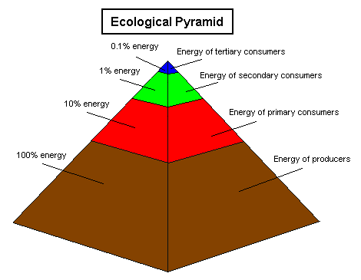
Energy Pyramid

Slide 12
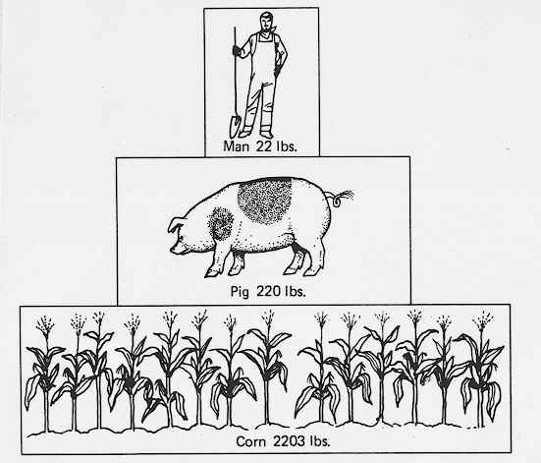
*Biomass Pyramid:
Biomass pyramids show the amount of biomass in each trophic level. Since the number of organisms is reduced in each trophic level, biomass should be reduced as well.
Biomass is the mass (weight) of living organisms.
Shows the amount of matter lost between trophic levels.
Measured in kg, grams or pounds

Slide 13
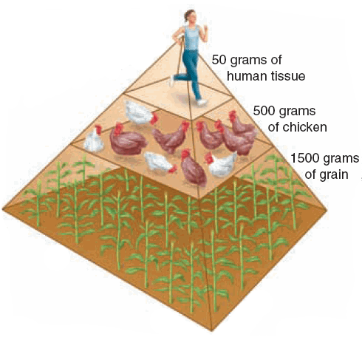
Biomass Pyramid

Slide 14
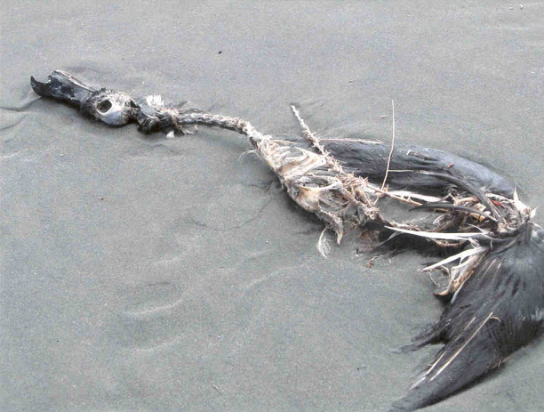
*Problems With Biomass Pyramid
Biomass pyramids can make a trophic level look like it has more energy than it really does.
For example:
A bird has a beak, feathers and a skeleton that would count as biomass although it does not contribute to the overall flow of energy into the next trophic level since these parts aren’t consumed.

Slide 15
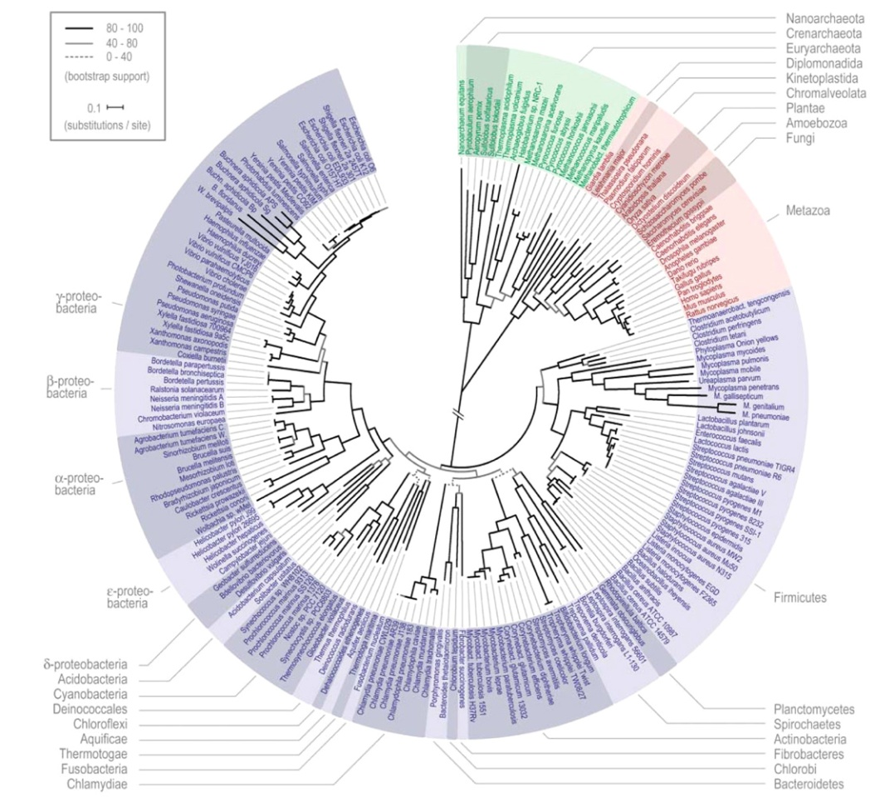
The End
or is it just the beginning?

Slide 16
Warm-up
Which energy level has the most energy?
Which energy level has the most organisms?
Which energy level has the least organisms?
Which energy level has the least energy?

Slide 17
Warmup:
 | Trophic Level | Autotroph or heterotroph | Producer, primary consumer, secondary consumer, tertiary consumer
Human
Snake
Giraffe
Deer
Algae
Jellyfish

