Slide 1
#38 Bohr Model and Electronic Configuration

Slide 2
*If you know the elements period and group location, then that helps determine how many shells the atom has, and the number of electrons in each shell.
For example: Lets look at Lithium
How many shells does it have?
Electrons?
End Goal:
Li

Slide 3
*Period # | # of shells | *Maximum Electrons
1
2
3
4

Slide 4
*ELECTRONIC CONFIGURATION
*Electronic configuration is a short-hand way of telling you how many electrons you have in each shell of an atom.
*You must completely fill the first shell before moving to the next shell.

Slide 5
Remember
1st shell - 2 electrons max
2nd shell - 8 electrons max
3rd shell - 8 electrons max
4th shell - 18 electrons max
And so on…
How many electrons does it have?
How many shells will it have?

Slide 6
*ELECTRONIC CONFIGURATION
Nitrogen has 7 electrons
Configuration:
N= 2,5
7
N
2 in 1st shell
5 in 2nd shell
2 + 5 = 7
14

Slide 7
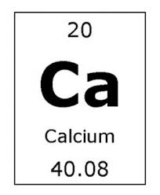
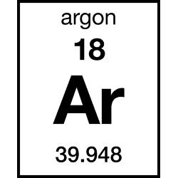
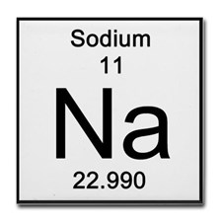
Write the Electronic configuration for these

Slide 8
Bohr Model
When drawing out an atom it is important to understand electronic configuration.
*The Bohr model is a visual representation of an atom showing all protons, electrons, neutrons, and electron cloud.
Ex: Beryllium Bohr model:
P= N= e=
Configuration:
P = 4
N= 5
4
5
4
Be= 2 , 2

Slide 9
Bohr Model
When drawing out an atom it is important to understand electronic configuration.
*The Bohr model is a visual representation of an atom showing all protons, electrons, neutrons, and electron cloud.
Ex: sulfur Bohr model:
Configuration:

Slide 10
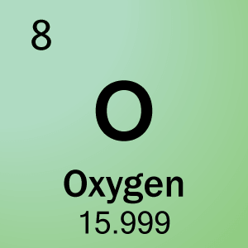
Bohr Models

Slide 11
Bohr Models

Slide 12
Bohr Models

Slide 13
Bohr Models

