Slide 1
#38 Electronic Configuration and Bohr Models

Slide 2
*If you know the elements period and group location, then that helps determine how many shells the atom has, and the number of electrons in each shell.
For example: Lets look at Lithium
How many shells does it have?
Electrons?
End Goal:
Li

Slide 3
*ELECTRONIC CONFIGURATION
Electronic configuration is a short-hand way of telling you how many electrons you have in each shell of an atom.
You must completely fill the first shell BEFORE moving to the next shell.

Slide 4
*Period # | *# of shells | *Maximum Electrons
1
2
3
4

Slide 5
Remember
1st shell - 2 electrons max
2nd shell - 8 electrons max
3rd shell - 8 electrons max
4th shell - 18 electrons max
And so on…
How many electrons does it have?
How many shells will it have?

Slide 6
*ELECTRONIC CONFIGURATION
Nitrogen has 7 electrons
7
N
14

Slide 7
*ELECTRONIC CONFIGURATION
Nitrogen has 7 electrons
Configuration:
N= 2,5
7
N
2 in 1st shell
5 in 2nd shell
2 + 5 = 7
14

Slide 8
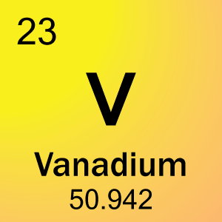
Lets try this one together

Slide 9
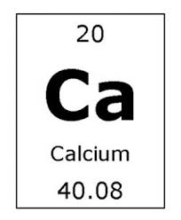
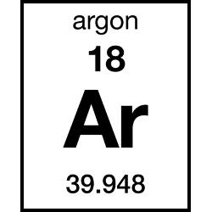
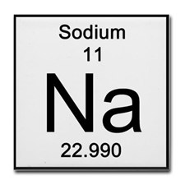
Write the Electronic configuration for these

Slide 10
Bohr Model
When drawing out an atom it is important to understand electronic configuration.
*The Bohr model is a visual representation of an atom showing all protons, electrons, neutrons, and electron cloud.
Ex: Beryllium Bohr model:
Configuration:

Slide 11
Bohr Model
When drawing out an atom it is important to understand electronic configuration.
*The Bohr model is a visual representation of an atom showing all protons, electrons, neutrons, and electron cloud.
Ex: sulfur Bohr model:
Configuration:

Slide 12
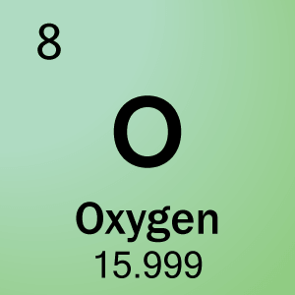
Bohr Models

