Slide 1
#35 Electronic Configuration and Bohr Models

Slide 2
Today’s goal
Todays goal is to be able to use information that we have previously learned and apply it to be able to draw atoms.
In order to this, you must know how to find an atoms P,N,e and be able to determine how many shells the atom will have
For example: Lets look at Lithium
Protons? Neutrons? Electrons?
How many shells does it have?
End Goal:

Slide 3
*ELECTRONIC CONFIGURATION
Electronic configuration is a short-hand way of telling you how many electrons you have in each shell of an atom.
You must completely fill the first shell BEFORE moving to the next shell.

Slide 4
*Period # | *# of shells | *Maximum Electrons
1
2
3
4

Slide 5
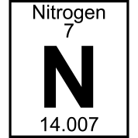
Remember
1st shell - 2 electrons max
2nd shell - 8 electrons max
3rd shell - 8 electrons max
4th shell - 18 electrons max
And so on…
How many electrons does it have?
How many shells will it have?

Slide 6
*ELECTRONIC CONFIGURATION
Nitrogen has 7 electrons
7
N
14

Slide 7
*ELECTRONIC CONFIGURATION
Nitrogen has 7 electrons
Configuration:
N= 2,5
7
N
2 in 1st shell
5 in 2nd shell
2 + 5 = 7
14

Slide 8
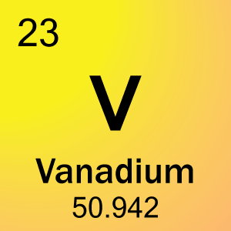
Lets try this one together

Slide 9
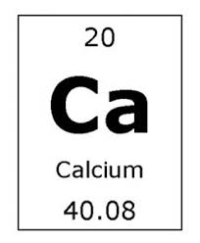
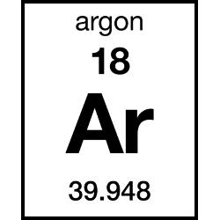
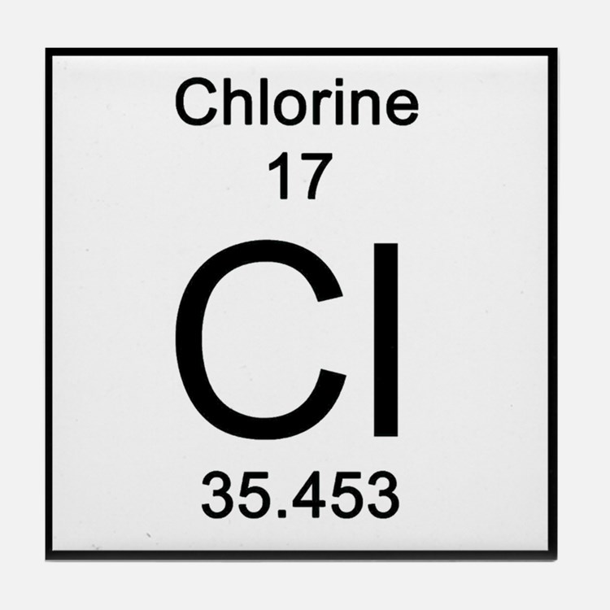
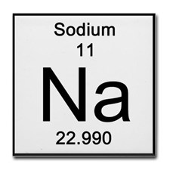
Write the Electronic configuration for these

Slide 10
Bohr Model
When drawing out an atom it is important to understand electronic configuration.
*The Bohr model is a visual representation of an atom showing all protons, electrons, neutrons, and the electron cloud.
Ex: Beryllium Bohr model:
Configuration:

Slide 11
Bohr Model
Ex: sulfur Bohr model:
Configuration:

Slide 12
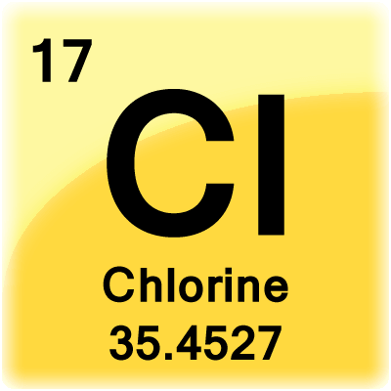
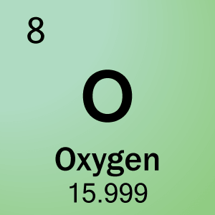
Bohr Models

