Slide 1
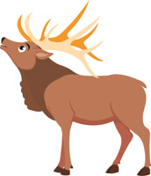
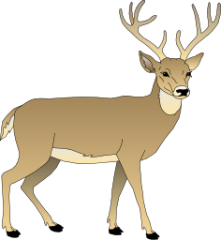
#77 Isolation leads to speciation notes

Slide 2
Warm-up
You’ve learned the four principles of natural selection. Define natural selection in one sentence without using the following words: variation, competition, overproduction, adaptation, evolve, and “Survival of the fittest”
How do mutations relate to natural selection?

Slide 3
100 greatest discoveries: Natural selection
https://www.youtube.com/watch?v=eG0wBklnFI4

Slide 4
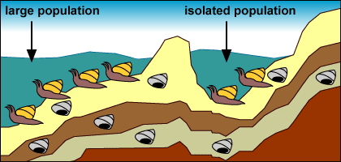
*Isolation
Isolation occurs when a physical barrier like mountains, rivers, and oceans prevents two populations of the same species from reproducing.
Isolation leads to speciation.

Slide 5
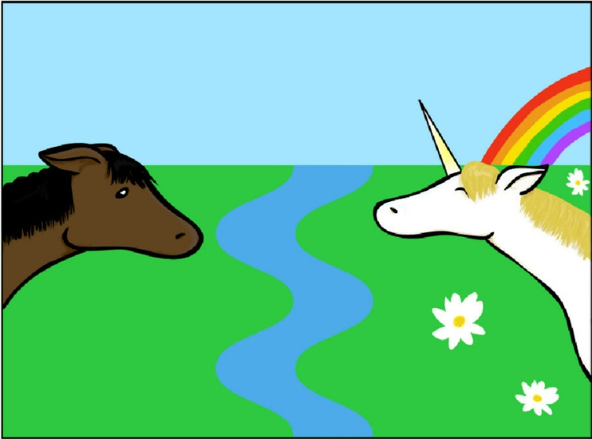
*Speciation
Speciation is when a species is isolated from the rest of the population causing both species to develop different genetic mutations and variations based on their new environment
After several generations of being isolated, the population will begin to look different from the original species. It may eventually become a new species, which can eventually make it unable to reproduce with the other species it evolved from

Slide 6
How speciation works
A physical barrier blocks/prevents some species within a population from mixing (this is isolation)
Time will pass, and the isolated population will reproduce offspring with variations (mutations).
Since the species are located in two different places, the species will evolve differently based off where they live.
The more favored traits will reproduce, eventually creating two different species that will no longer want to reproduce with each other when they come into contact again
https://www.youtube.com/watch?v=EmtIofdeUbc
Notes:
Video is 2:38 seconds

Slide 7
Copy and Color diagram in your notes

Slide 8
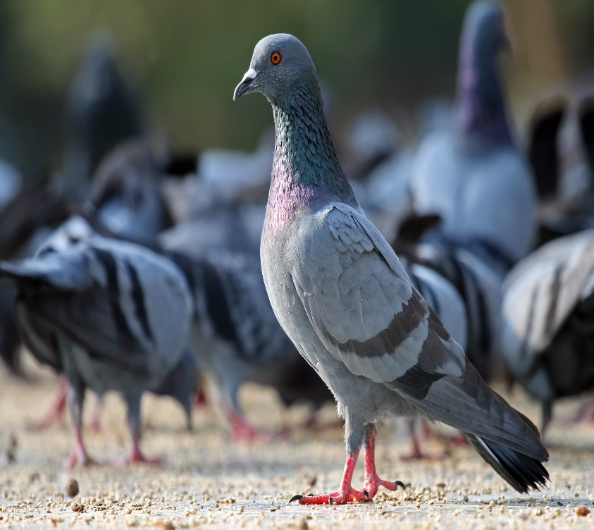
Remember evolution means change over time…
So is all evolution natural?
In the 1840s Darwin returned home from his voyage and created a new theory based off his hobby of breeding pigeons…
Darwin knew that breeders could produce new varieties of animals over time.

Slide 9
*Natural vs. Artificial Selection
Natural Selection
Artificial Selection
Natural is something made by nature
Nature decides the organisms with the best traits to survive and reproduce
Artificial is selective breeding by humans
Humans decides who/what lives or dies based traits they find more desirable
They hope its offspring will produce the same traits as well.

Slide 10
