Slide 1
#78 Analogous, homologous, and vestigial structures

Slide 2
Fossil evidence for evolution
Most evidence of evolution was originally found in fossils. Fossils can preserve the structure of organisms in sedimentary rock if conditions are just right.
One area of evidence of evolution is embryology, the study of embryos. When we compare embryos we can see shared characteristics of organisms throughout their developmental process.
If you look at the warm-up activity, you can see the similiarites between the organisms. For example all the organisms have folds in their neck area which are called gill pouches. These folds develop into gills for adult fish. And as we all know, chickens humans, etc. don’t have gills, scientist use the similarities in their embyros to suggest that the organisms are related.

Slide 3
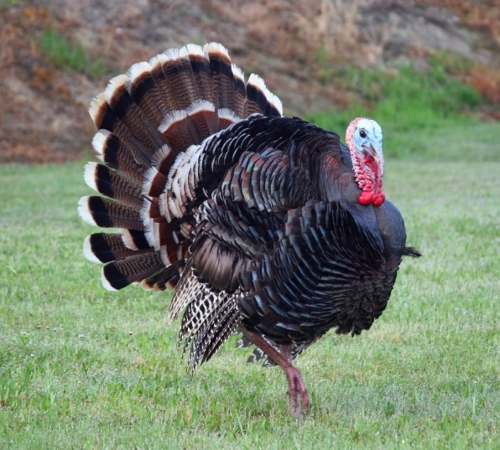
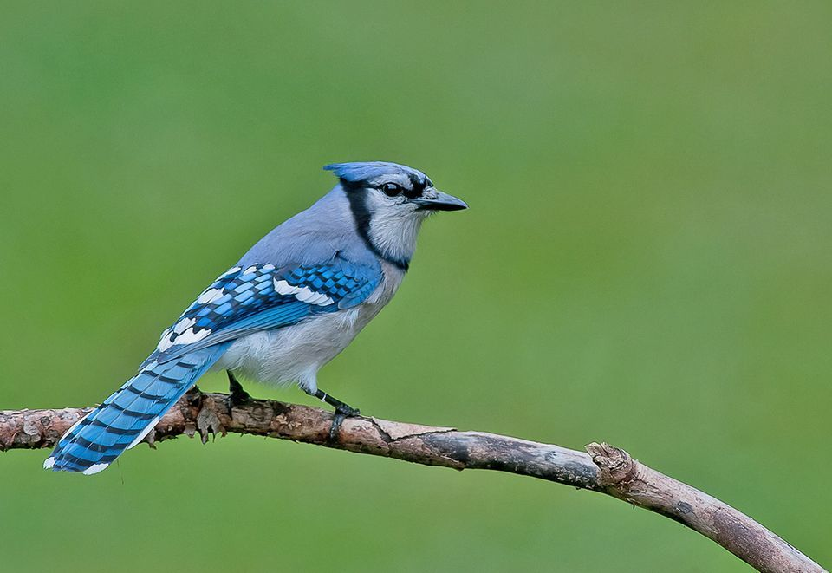
Structural and developmental evidence of evolution
What do these two organisms have in common?
If you said they both have feathers, you are correct.
The presence of feathers suggests that the two animals are related in some way. But how you ask…?

Slide 4
*Homologous Structures
Homologous structures: are body parts of organisms that have different functions but similar body structures that all derived from the same body part in a common ancestor
For example, mammals such as a humans arm, bat wing, and whale flipper all consist of very similar bones. (pictured on next slide)
Different functions, same ancestor structure

Slide 5
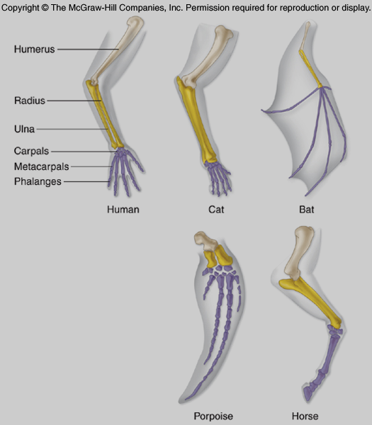
Homology of the bones of the forelimb of mammals

Slide 6
Homologous Structures

Slide 7
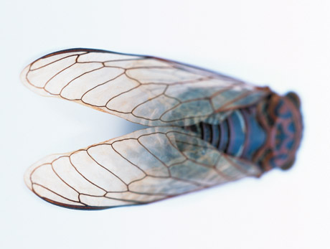
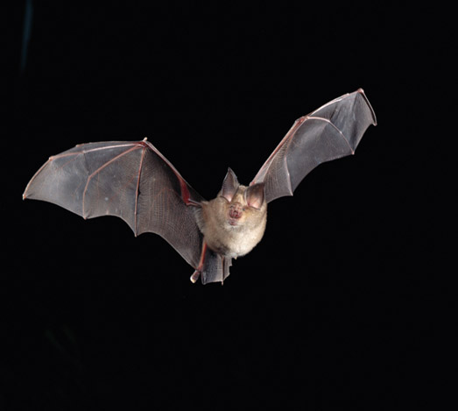
Homologous structures are different than Analogous Structures
*Analogous structures have a similar function but do not come from a common ancestor.
*Examples – bat wings and fly wings
Human hand
Mole foot
Fly wing
Bat wing

Slide 8
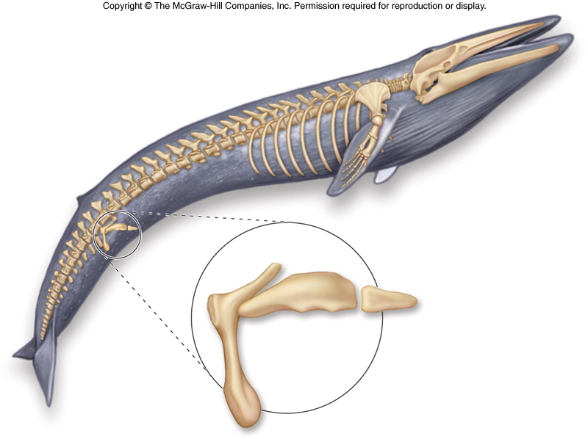
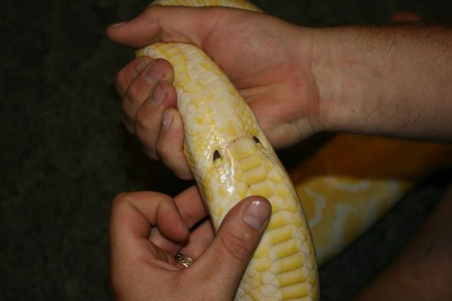
*Vestigial Structures
Vestigial structures have no apparent function, but resemble structures their ancestors possessed
Examples:
Leg bones in snakes and whales
Human tailbone, appendix, or wisdom teeth
Vestigial structures of a whale

Slide 9
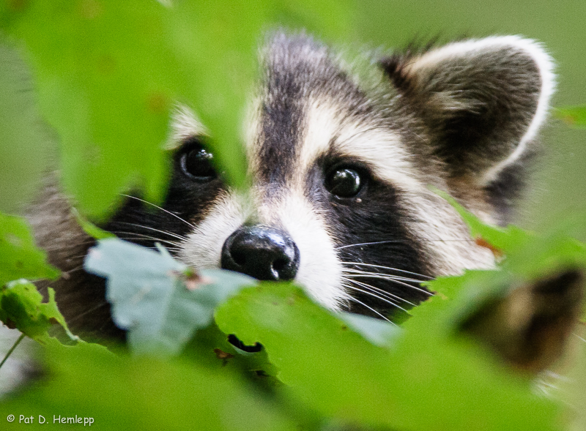
homologous or analogous structure???
INSECT EYES
MAMMAL EYES

Slide 10
homologous or analogous structure???
INSECT EYES
MAMMAL EYES

Slide 11
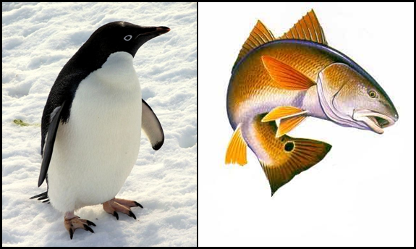
homologous or analogous structure???
PENGUIN FINS
FISH FINS

Slide 12
homologous or analogous structure???
PENGUIN FINS
FISH FINS

Slide 13
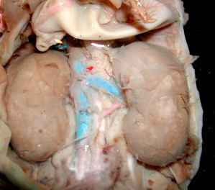
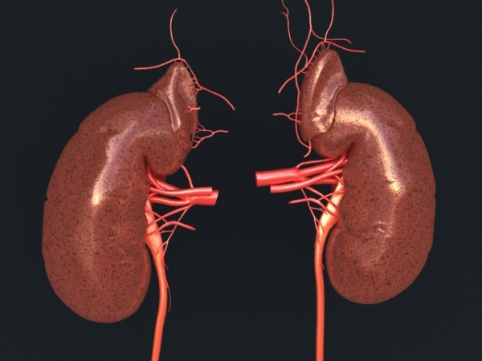
homologous or analogous structure???
HUMAN KIDNEYS
DOLPHIN KIDNEYS

Slide 14
homologous or analogous structure???
HUMAN KIDNEYS
DOLPHIN KIDNEYS

Slide 15
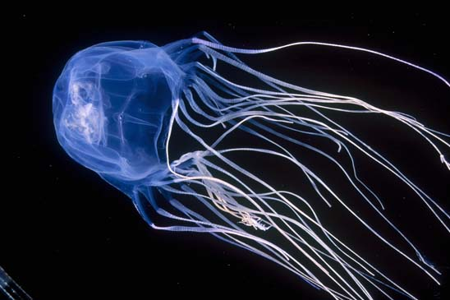
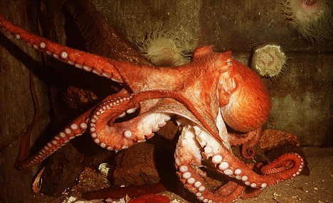
homologous or analogous structure???
JELLYFISH TENDRILS
OCTOPUS TENTACLES

Slide 16
homologous or analogous structure???
JELLYFISH TENDRILS
OCTOPUS TENTACLES

Slide 17
Concept check
How does common ancestry between two species support evolution
A slight change in a rabbits ability to hear its predators is an example of a ____________

Slide 18
warmup
In a minimum of three sentences explain how evolution leads to antibacterial resistance

