Slide 1
#17 Absolute Dating Notes take out your HW
Notes:
EQ How does the amount of initial material in a sample change as time increases?
NC standard - 8.E2.1

Slide 2
Answer the questions while viewing
What is radioactive decay?
What does it mean when something is stable or unstable?
What are some ways we use radioactive things?
http://www.youtube.com/watch?v=bLszCCLN-uw

Slide 3
Recap: Relative Dating
Used in geology to determine the order of events in relation to other events.
This doesn’t say anything about the exact age of rock layers or fossil remains
Known as the law of superposition

Slide 4
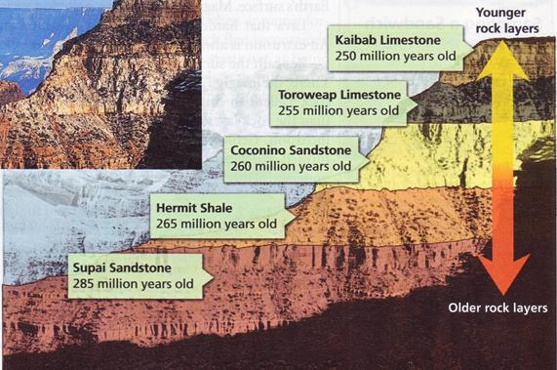
*Absolute Dating: a specific way to determine the age of an object or rock layer.

Slide 5
How Do We Find Absolute Age?
*Some atoms are unstable and breakdown over time in other more stable atoms. This process in going from unstable to stable is radioactivity.
*Stable = Does not decay
*Unstable= they decay

Slide 6
So what is Radioactive Decay?
*The rate of change, which is how fast something breaks down, is measured in Half-lives.
*A half-life is the amount of time it takes for something to divide in half.

Slide 7
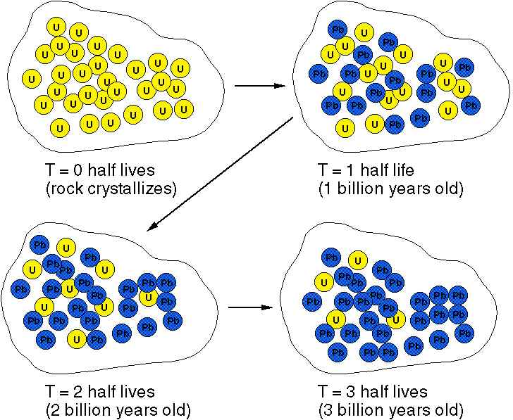
*How half lives work :

Slide 8
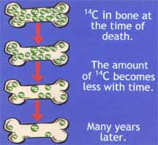
All living things contain carbon. This helps scientist when they are trying to determine the age of a fossil. The process used is called:
*Carbon 14 Dating – As organisms die, the carbon in its body will remain there until it decomposes or fossilizes.
*Since Carbon 14 has a relatively short half-live of 5,730 years, scientist calculate how much carbon is remaining in a fossil in order to determine the fossils age.
In order to do this, we must calculate the rate of decay of the organism.

Slide 9
Try this…
If radioactive isotope decayed every 25 days, after approximately 80 days, how many half lives would the isotope have gone through?
Half-lives | Time

Slide 10
Try this…
If you started with a 48mg sample and the object decayed every 14 years, how much of the item would remain after 70 years?
Time | Amount

Slide 11
Try This!!
If an element was found with 100 atoms of Carbon, which has a half life of 5730 years; how much Carbon will remain after 3 half lives?

Slide 12
*Special Type of Fossil
An Index Fossil is a fossil that was found in several widespread areas but only existed for a short part of the Earths history.
Index fossils help date the rock layer in which it was found in, as well as tell the relative age of rock layers that they surrounds it.
***Fossils that existed for a long period of time and are found in multiple rock layers within the geologic column ARE NOT INDEX FOSSILS***

Slide 13
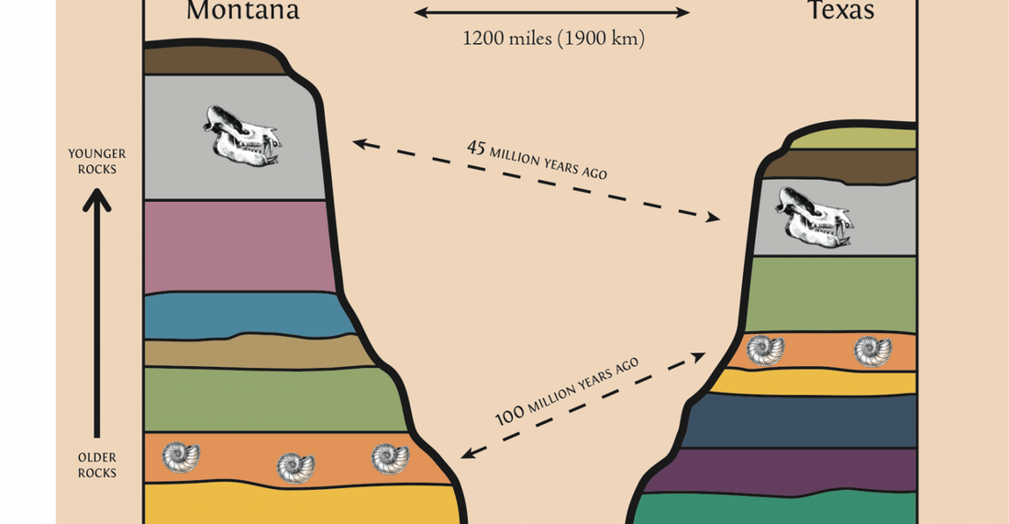
For example, when comparing to geologic columns from two different areas we can conclude that the two orange rock layers are the same age (~100 million) and that the two gray layers are the same age as well (~45 million) despite observing other differences within the rock layer.
That means all layers in between the orange and gray had to be older then 45 million years but younger than 100 million years

