Slide 1
Upcoming Dates
HYDROLOGY PT2 TEST NEEDS TO BE MADE UP BY TOMORROW WED 11/28
GREEK AND LATIN FLASHCARDS QUIZ 2 DUE FRIDAY 11/30

Slide 2
TOC Entries
#34 Bill Nye Atoms WS 11/26 #35 Atomic Structure and the arrangement of elements 11/27

Slide 3
Brainpop - Atoms
https://www.brainpop.com/science/matterandchemistry/atoms/

Slide 4
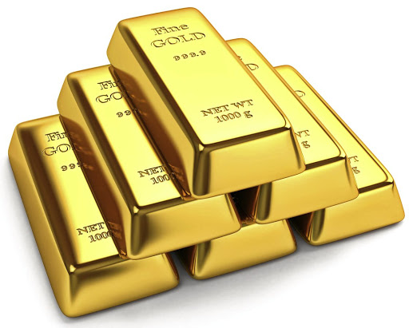
*Matter is anything that has mass and takes up space
All matter is made up of atoms.
An element consists of one type of atom that cannot be broken down into simpler substances by chemical or physical means.

Slide 5
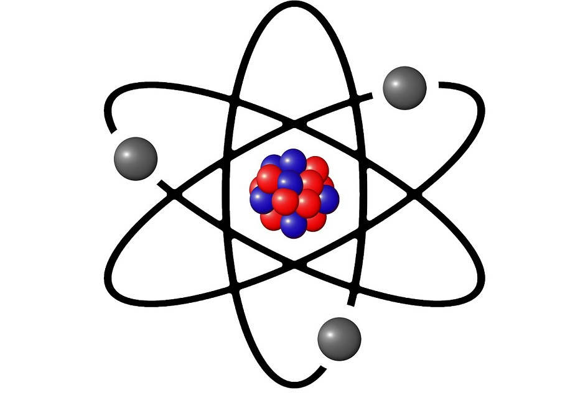
Subatomic Particles in an atom
*All atoms have three subatomic particles that helps determine the atoms identity.
The three subatomic particles are
protons, neutrons, and electrons.

Slide 6
*The 3 subatomic particles in an atom
Proton (P) : positively charged particle (+)
Neutron (N) :uncharged/no charge particle (=)
Electron (e): negatively charged (-) particle that moves/orbits around the nucleus of an atom

Slide 7
*Atom Arrangement (Copy the diagram)
HELIUM ATOM
Protons and neutrons are located in the nucleus (center) of the atom.
Shell or
electron cloud
proton
Nucleus
N
+
-
+
-
N
electron
neutron

Slide 8
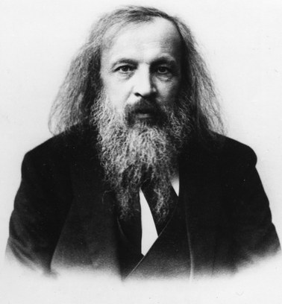
*Who established the arrangements of elements? Dmitri Mendeleev
In the 1860’s Dmitri Mendeleev created a periodic table where the elements were ordered by their atomic masses.
He did this by grouping elements together according to their similarities

Slide 9
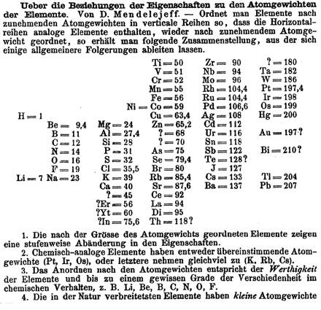
Mendeleev’s Published Periodic Table of Elements
Why do you think there are question marks here?

Slide 10
Mendeleev’s Predictions
Although Mendeleev’s Periodic Table of Elements had missing elements or “gaps,” he was able to predict the characteristics of these missing elements because of Periodic Law.
“Ekasilicon”
Germanium
Date Predicted | 1871 | Date Discovered | 1886
Atomic Mass | 72 | Atomic Mass | 72.6
Density | 5.5 g/cm³ | Density | 5.47 g/cm³
Bonding Power | 4 | Bonding Power | 4
Color | Dark Gray | Color | Grayish White
Notice how Mendeleev’s
predictions (orange column) were very
accurate when compared to Germanium’s actual characteristics (green column)

Slide 11
Mendeleev Cont.
He was very accurate in his predictions, which led the world to accept his ideas about periodicity and a logical periodic table.
Mendeleev wasn’t the first to arrange elements in a table, but he was the first to publish and make predictions about undiscovered elements
https://www.youtube.com/watch?v=BIwcBjIBOUc

Slide 12
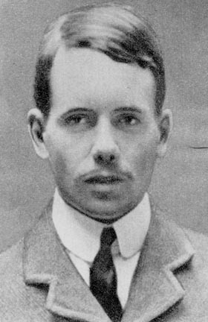
*Until…
In 1914, Henry Moseley revised Mendeleev’s periodic table by rearranging the elements by their atomic numbers
He concluded that the number of protons in an atom is its atomic number this arrangement is still used today!

Slide 13
*So what is the Periodic Table?
Periodic Table of Elements – are elements arranged by atomic number, that shows the patterns in their properties
this arrangement is called the periodic law

Slide 14
Atomic symbol
One or two letter abbreviation of an element. Written with a capital letter or a capital followed by a lower case if two letters
*ATOMIC STRUCTURE
Atomic number
the number of protons in an atom
He
2
Atomic mass
the number of protons and
neutrons in an atom
4
Helium
# of electrons = # of protons
Element Name
The name of the element

Slide 15
*How to determine the number of P, N, E’s in an atom
How would you find the # of protons, electrons, and neutrons in an atom?
Protons | Electrons | Neutrons
Look at the atomic # | #Protons is equal to #Electrons | Atomic mass minus atomic # (P+N) – (P) = N

Slide 16
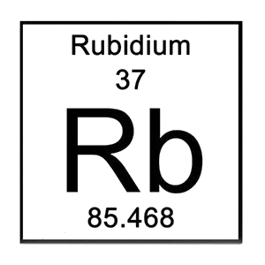
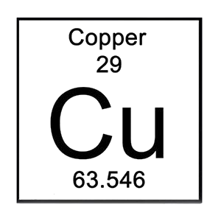
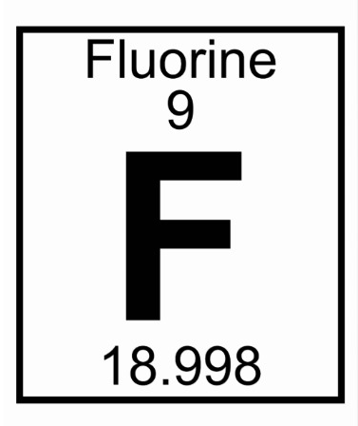
Round the atomic mass to nearest whole number and find the Protons, Neutrons, and electrons in the following atoms
P: P: P:
N: N: N:
e: e: e:

Slide 18
Write these questions down
What is an atom?
When atoms combine what do they make?
Protons? Neutrons? Electrons? What are they
Everything in the universe is either _______________ or _______________. The smallest pieces of matter are ____________________.
https://vimeo.com/184507793 - Bill Nye Atoms

