Slide 1
# 10 Disease Greek and Latin

Slide 2
Quiz Friday March 17th
Greek and Latin | English Meaning
Demos | People
Path | Disease
Septic | Infection
Karyo | Nucleus
Mut | Change
Rhea | Flow, discharge
Bactr | Stick, club
Cell | Storeroom, chamber
Contra | against
Greek and Latin | English Meaning
immuno | Safe, free
Fung | Mushroom, fungus
itis | Inflammation of
Epi | Before, upon, outside
Pan | All
Eu | True, good
Virus | Poison
Genic | Producing
Vectus | To carry

Slide 3
#11 Bacteria Microorganisms

Slide 4
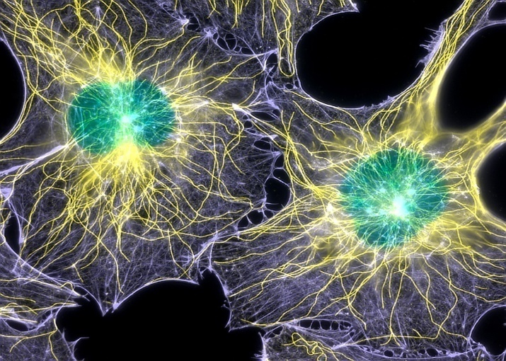
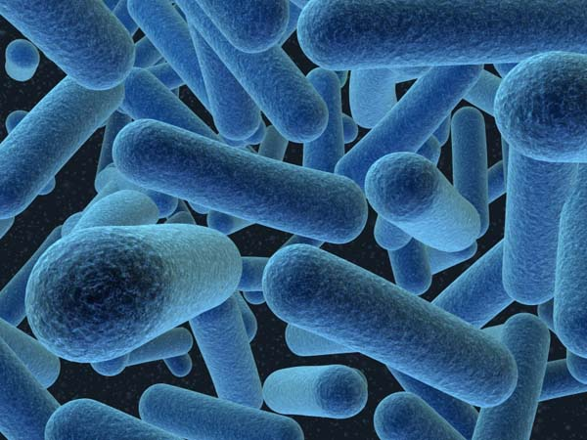
*Comparing and contrasting cells and bacteria
CELL
Eukaryotic
Multicellular or Unicellular
Reproduces through Mitosis
Smallest form of life
Animal/Plant Cells
BACTERIA
Prokaryotic
No nucleus
DNA floats
Unicellular
Very basic unit of life
Reproduces through binary fission

Slide 5
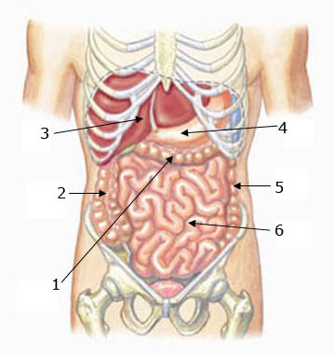
Where do bacteria live?
In your body… bacteria is located in your digestive track

Slide 6
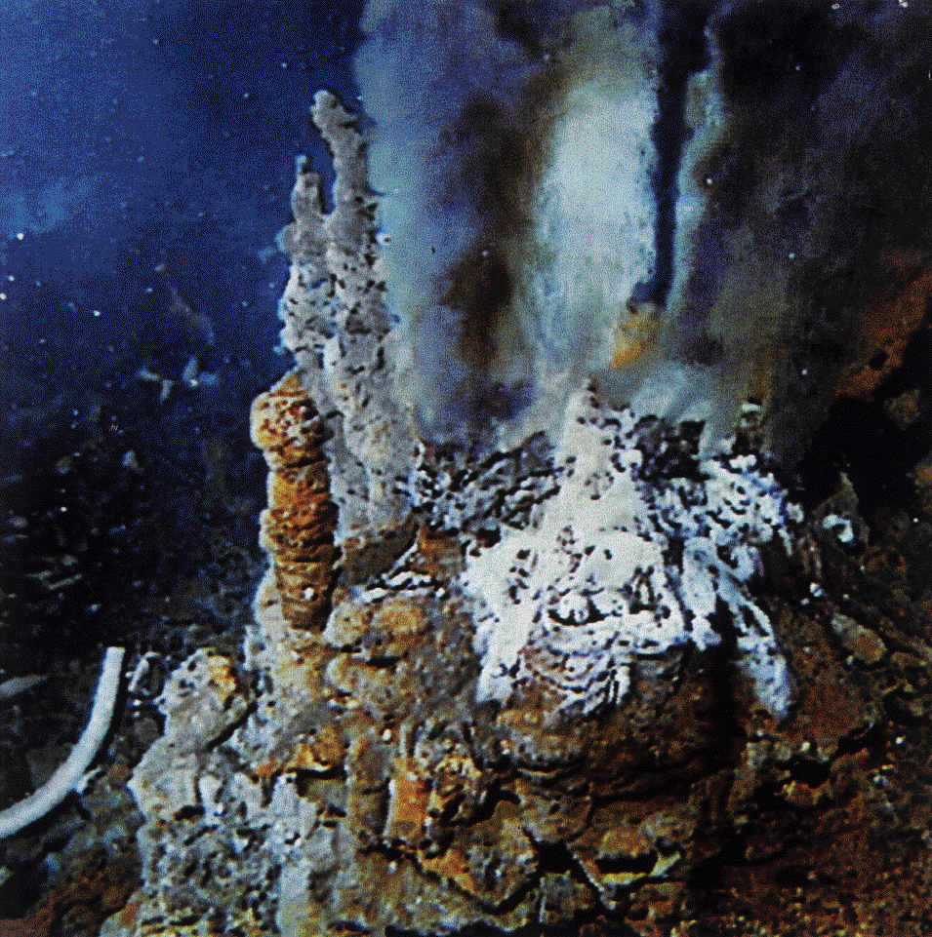
Where do bacteria live?
Underwater in Ocean Vents
What are these vents called?

Slide 7
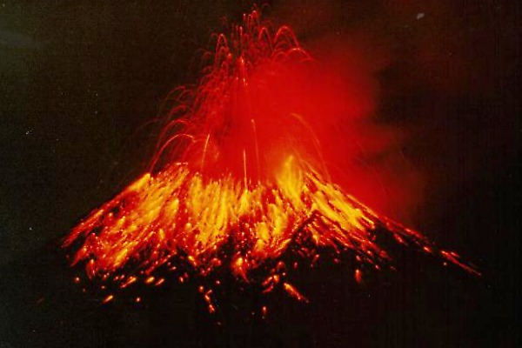
Where do bacteria live?
In hot places such as Volcanoes

Slide 8
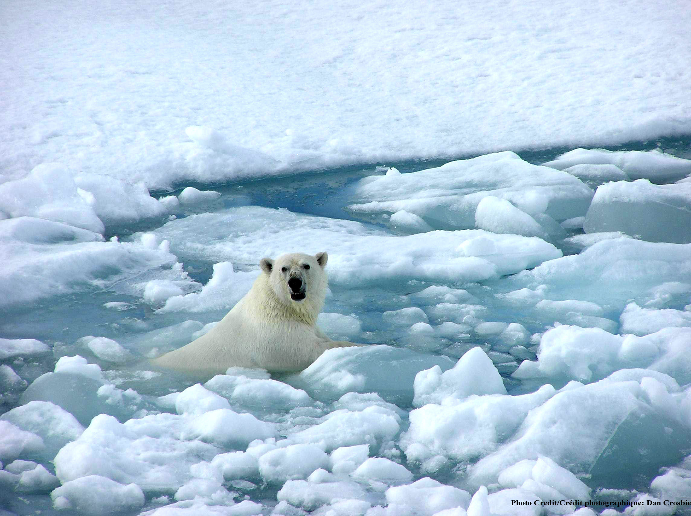
Where do bacteria live?
In extreme cold like Antarctica

Slide 9
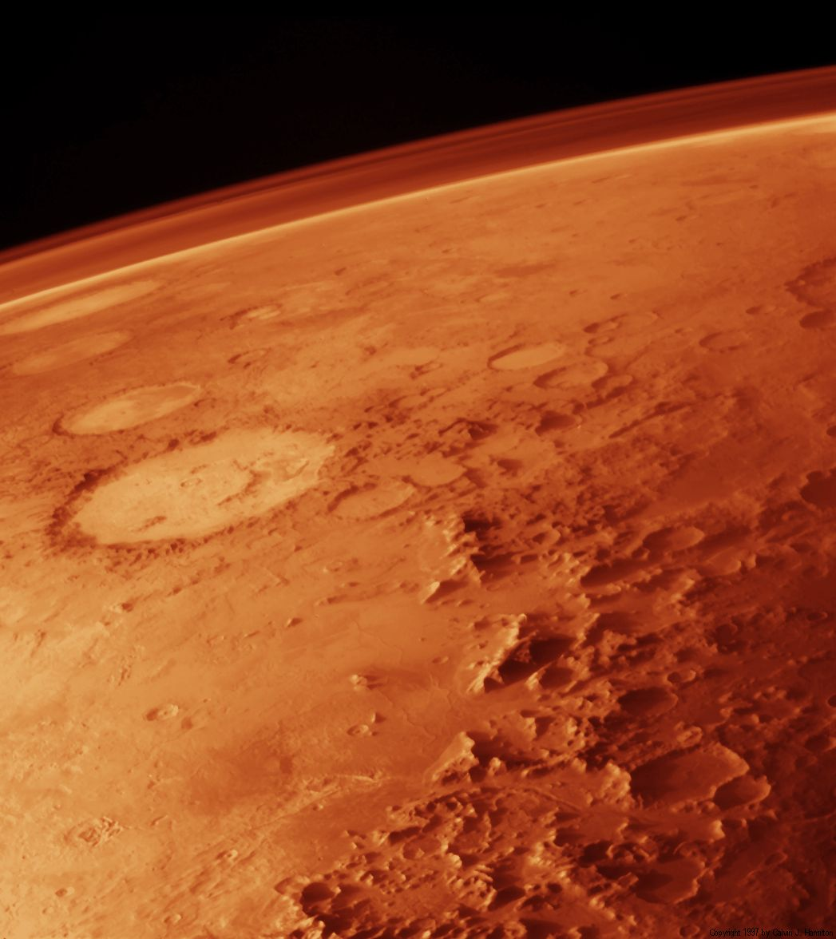
Where do bacteria live?
And even on other planets like Mars

Slide 10
*Where do bacteria live?
Bacteria can live with or without oxygen
Bacteria can survive by digesting minerals
Bacteria break down or ‘eat’ molecules

Slide 11
What do they look like?
Bacilli
*Three basic shapes:
Bacilli (rod-shaped)
Cocci (round shaped)
Spiral shaped
Some exist as single cells, others as cluster together
Cocci
Cluster of cocci
Spiral

Slide 12
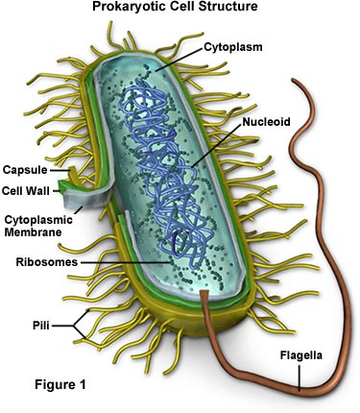
Bacteria are ALIVE!
What does it mean to be alive?
*Bacteria reproduce (make an exact copy of themselves in a process called binary fission)
They need to eat in order to survive

Slide 13
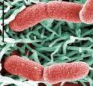
*How do bacteria eat?
Photosynthetic bacteria
Some make their own food from sunlight—like plants
Some are scavengers
Share the environment around them
Example: The bacteria in your stomach are now eating what you ate for breakfast
Some are warriors (pathogens)
They attack other living things
Example: The bacteria on your face can attack skin causing infection and acne
Harmless bacteria on the stomach lining
E. Coli O157:H7
is a pathogen

Slide 14
Discovery Ed. – killer outbreaks video
E.Coli 0157 – around the 25 min mark

Slide 15
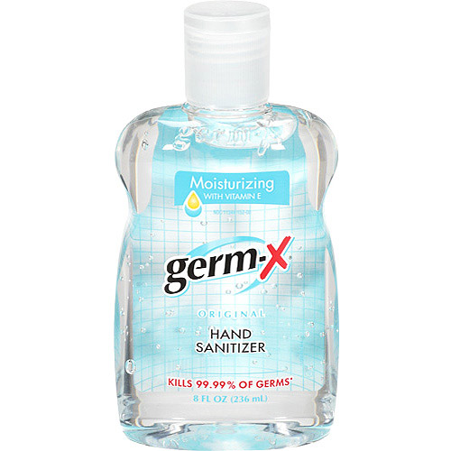
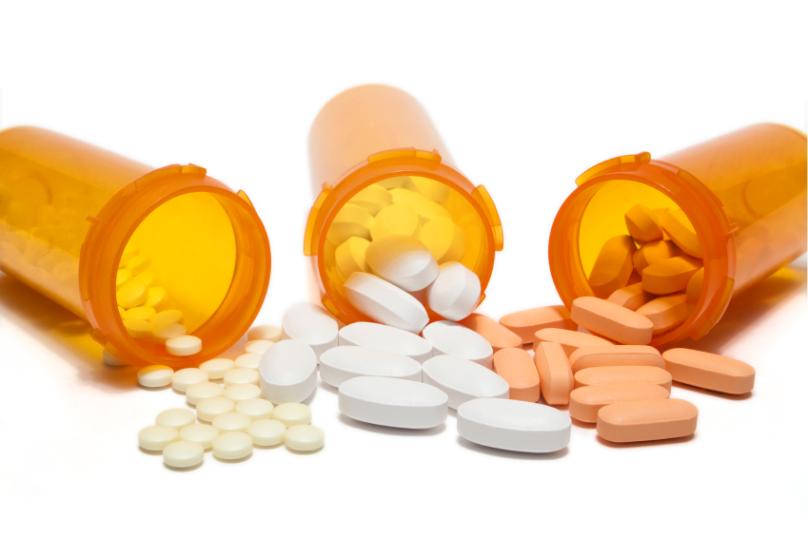
So how do you get rid of bad bacteria?

Slide 16
*How are bacteria treated?
Bacteria can be treated with antibiotics.
Antibiotics kills or slows the growth of bacteria, eventually allowing your white blood cells to eliminate the bacteria

Slide 17
Can you get rid of JUST bad bacteria?
Not necessarily… although you may think taking antibiotics only gets rid of bad bacteria, you can get rid of some good bacteria too!
Same with hand sanitizer! You’re sanitizing all things bad about bacteria, but at the same time, any positive bacteria are being scoured as well!

Slide 18
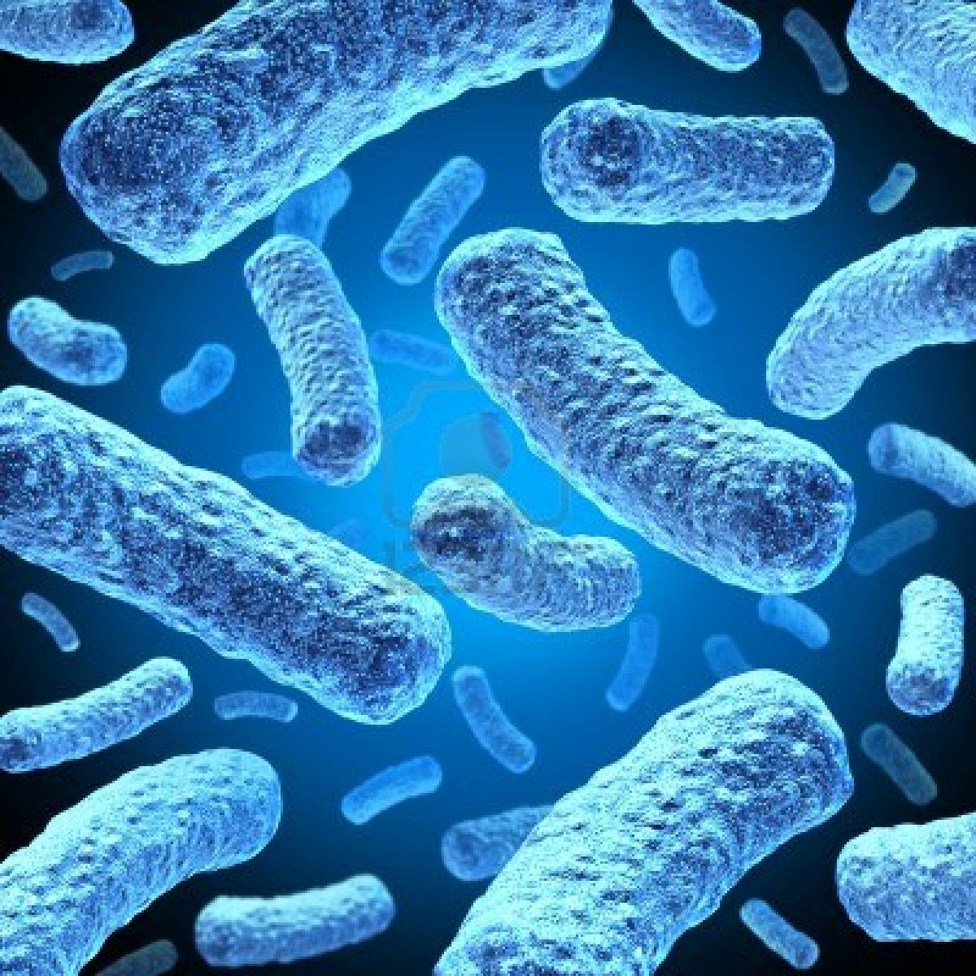
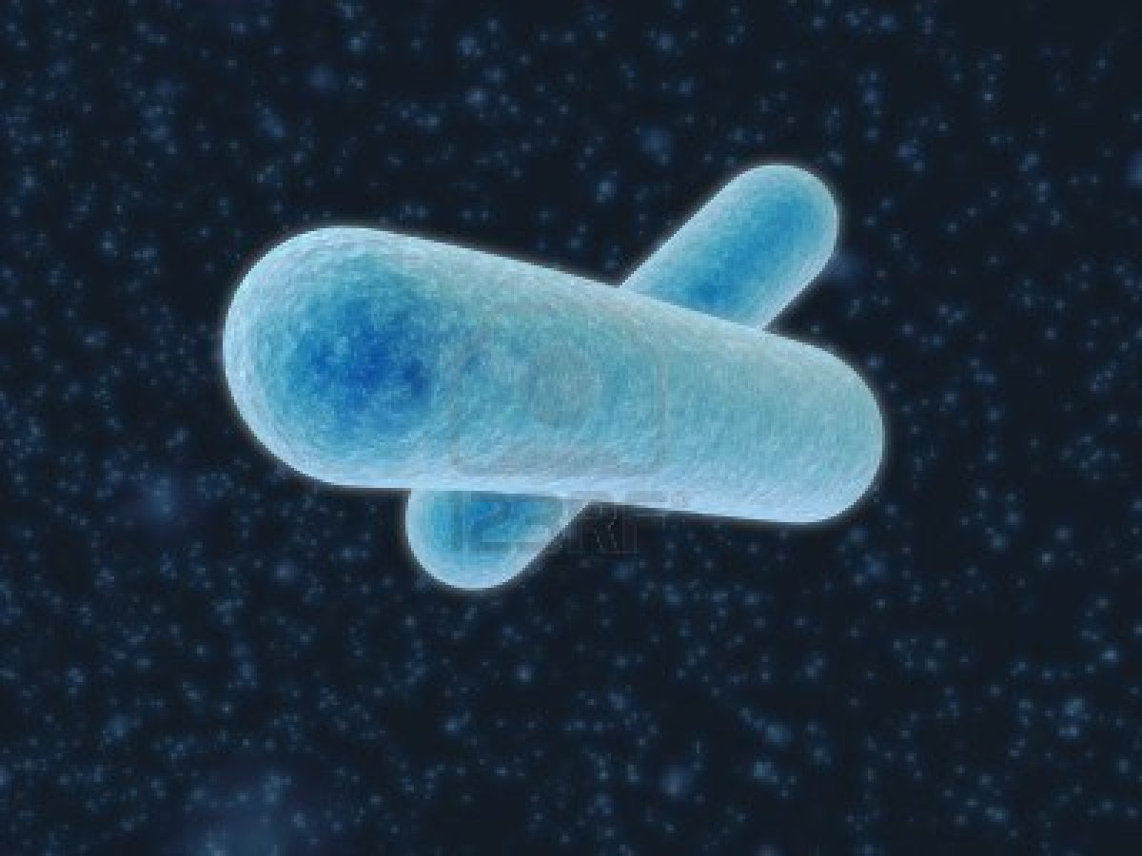
What’s left on your hands after you use hand sanitizer?...Should hand sanitizer replace soap and water?
IMMUNE
IMMUNE
IMMUNE
IMMUNE
IMMUNE
IMMUNE
IMMUNE
IMMUNE
IMMUNE
IMMUNE

Slide 19
Click picture for video
https://www.youtube.com/watch?v=znnp-Ivj2ek
Notes:
https://www.youtube.com/watch?v=znnp-Ivj2ek

Slide 20
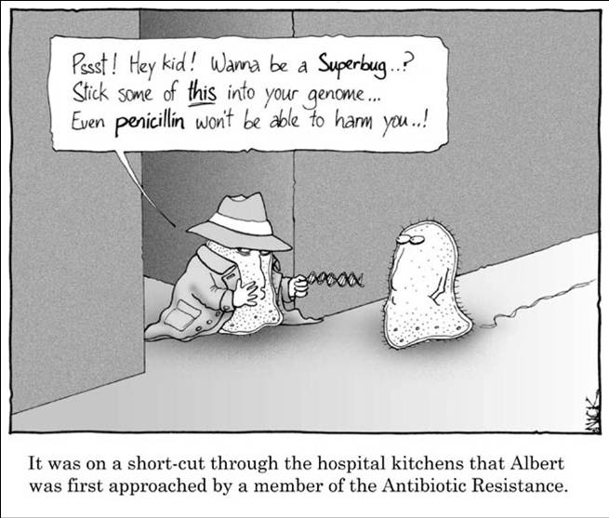
How does this cartoon pertain to antibacterial resistance?

Slide 21
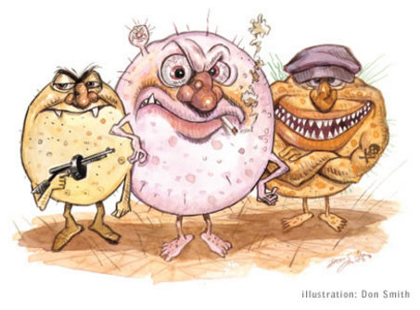
*ANTIBIOTIC RESISTANCE
Antibiotic resistance occurs when mutant bacteria survive an antibiotic treatment and give rise to a stronger, more resistant population.

Slide 22
*Overprescribing antibiotics and other medicines can be a potential problem in the long run and lead to antibiotic resistance.
What you can do:
-Let things that can naturally heal on their own do so

Slide 23
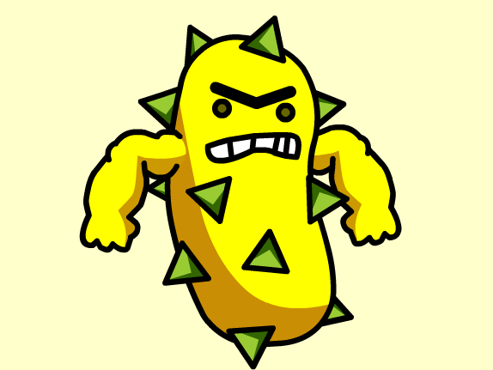
Brainpop
Notes:
https://www.brainpop.com/health/diseasesinjuriesandconditions/antibioticresistance/
User: hrms pw: patriot

