Slide 1
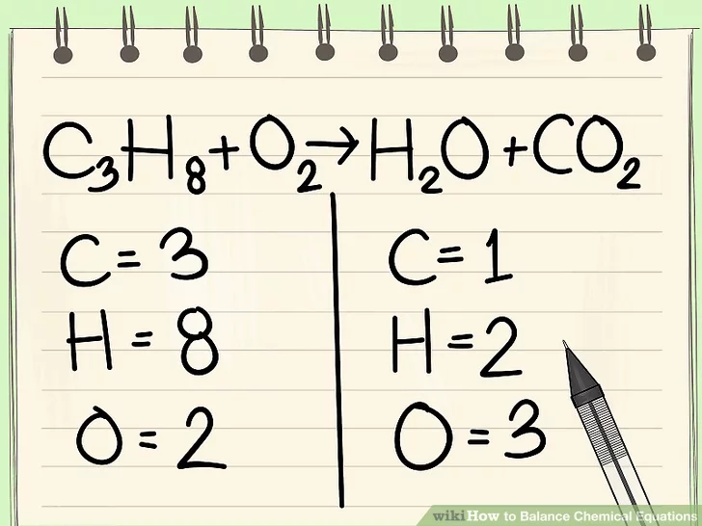
#50 Conservation of matter Notes for Balancing equations

Slide 2
Count the atoms
4 Ga(OH)₃
2 Na₂SO₄

Slide 3
https://www.brainpop.com/science/matterandchemistry/conservationofmass/

Slide 4
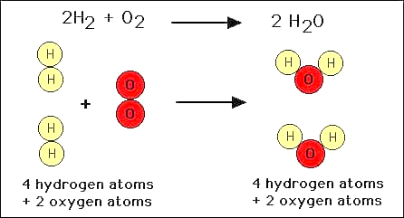
*Law of conservation of mass/matter
The Law of Conservation of Mass/Matter states that matter cannot be created or destroyed.
However, matter can be rearranged
This means that the number of atoms on reactant and product side of the reaction MUST BE EQUAL!

Slide 5
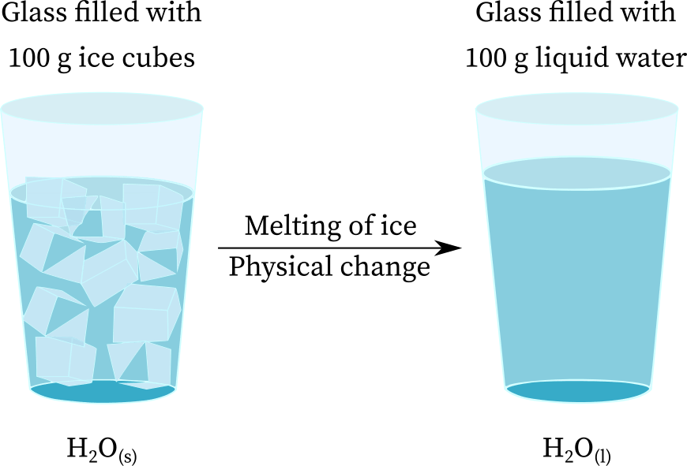
Why must everything be balanced?
Everything must be equal!
When matter goes through a physical or chemical change, the amount (or mass) of the substances that you begin with must equal the amount (or mass) of the substances that you end with because you are using the same atoms, just changing how/what the atoms are bonding with.

Slide 6
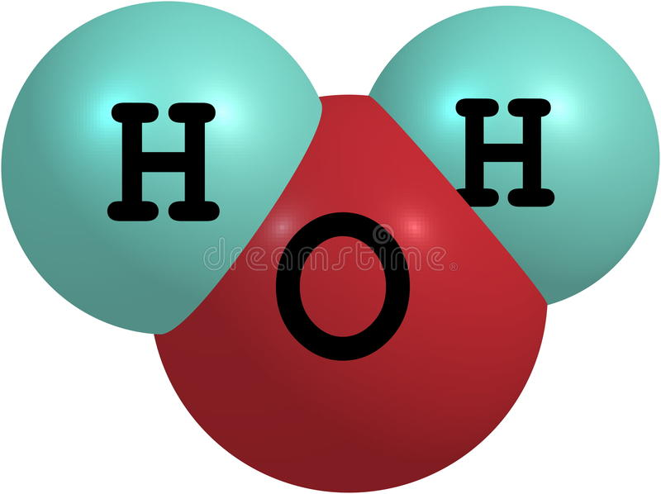
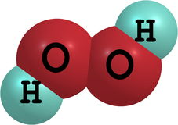
So how do I balance equations?
*When balancing equations, you CANNOT change the subscripts!
*If you change the subscript, you change the substance into something else
For example:
H₂0 - water H₂O₂ – hydrogen peroxide

Slide 7
*So how do you make reactions equal if you cannot change subscripts?
When balancing equations, you have to change/ add COEFFICIENTS to make both sides of the reaction equal
Please note: coefficients can only be added IN FRONT of the element or molecule. (You cannot add coefficients in between molecules that are already bonded together)

Slide 8
*Rules for balancing equations
Draw a line underneath the yield sign of the equation. Count ALL atoms on both sides of the equation.
Pick an element that is not equal on both sides and find the least common multiple.
Add coefficient to the chosen element and recount atoms
Repeat steps 2 and 3 for unbalanced elements and recount atoms. (Until all elements are even)
Re-write the balanced equation and box it in
Fe + Cl₂ → FeCl₃
Is it balanced?

Slide 9
Let’s try these two together
Na + Cl₂ → NaCl
Mg + N₂ → Mg₃N₂

Slide 10
Balance the equations
H₂ + O₂ → H₂O
Cr + O₂ → Cr₂O₃
NH₃ + O₂ → N₂ + H₂O
Na₃PO₄ + CaCl₂ → NaCl + Ca₃ (PO₄)₂
Mg(NO₃)₂ + K₃PO₄ → Mg₃(PO₄)₂ + KNO₃

Slide 11
You try
Cr + O₂ → Cr₂O₃

Slide 12
Na3PO4 + CaCl2 → NaCl + Ca3(PO4)2

Slide 13
extra

Slide 14
Bonus problem…
Mg(NO₃)₂ + K₃PO₄ → Mg₃(PO₄)₂ + KNO₃

