Slide 1
Benthic Zone (Deep Ocean)
By: Alexis J, Grace A, & Daisy B

Slide 2
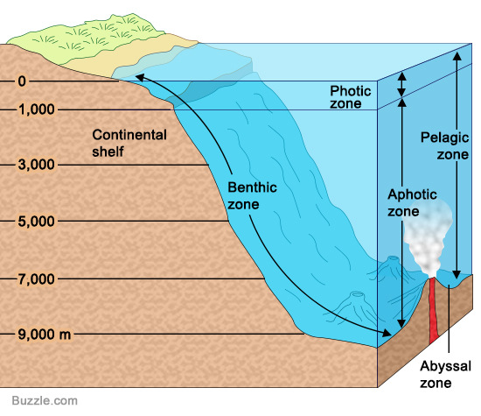
Explanation
The Benthic Deep Ocean is the bottommost layer. The Benthic contains mountains, trenches, flat muddy, sandy, and rocky areas. The Benthic Zone has low oxygen levels and low temperatures. There is little plant life. The animals that live in the Benthic are called Benthos.
Notes:
http://www.newworldencyclopedia.org/entry/Benthic_zone
https://microbewiki.kenyon.edu/index.php/Benthic_Zone

Slide 3
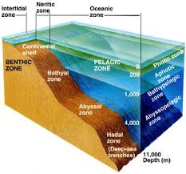
Depth
The depth of the Benthic zone reaches the floor, surrounding the sediment. It can reach depths of 19685.04 feet.
Notes:
https://watersheds.ca/wp-content/uploads/2016/02/Benthic-zone-Final.pdf
http://www.newworldencyclopedia.org/entry/Benthic_zone

Slide 4
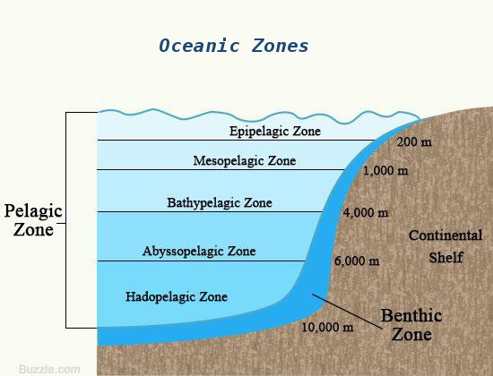
Location
The Benthic Zone is the lowest part in bodies of water, it is on the floor of the ocean.
Notes:
http://www.newworldencyclopedia.org/entry/Benthic_zone

Slide 5
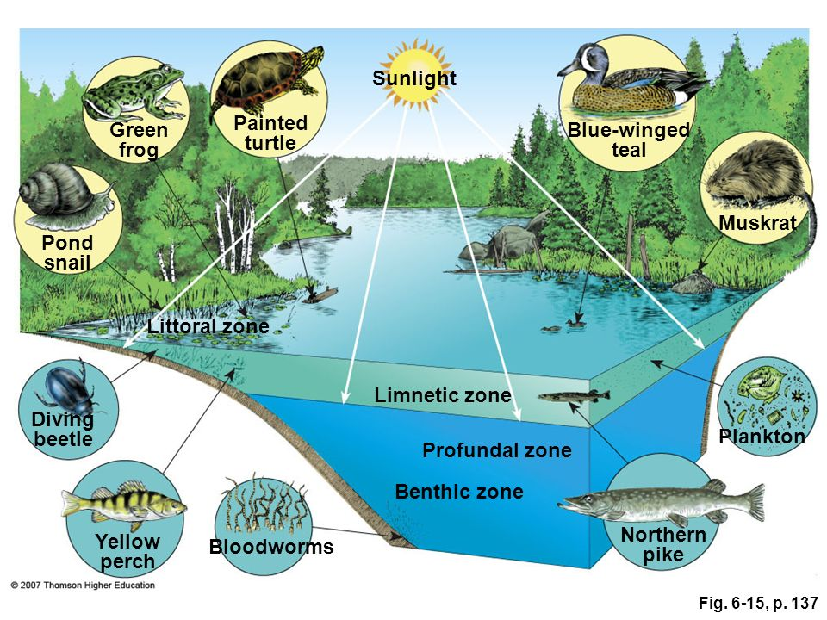
Sunlight
Light cannot reach the Benthic Zone since it is the bottommost layer. This means plants that need to go through photosynthesis cannot survive in this zone.
Notes:
https://ecosystemexperts.weebly.com/the-benthic-zone.html

Slide 6
3 Facts
Benthos and Benthic are greek terms for Benthic Zone, it means “depth of the sea”
As you go further and further into the ocean temperature drops and pressure increases which makes the Benthic Zone a limiting factor to live in. Humans wouldn’t be able to survive because the pressure is so great which is why the Benthic has not been greatly explored.
Molluscs, crustaceans, bivalves, sponges, echinoderms, flatfish, eels, and even some species of sharks are all found in the Benthic Zone.
Notes:
https://www.buzzle.com/articles/interesting-facts-about-the-benthic-zone.html

Slide 7
Animal life
The animals that live in the benthic zone are called benthos. Animals that are attached to the sea floor they include any animal that makes it home on the seafloor
Benthic fish have negative buoyancy that lets them just lay on the seafloor with no effort and they wait for their pray to be in reach of distance to attack
Most benthos eat decomposing matter for food
Physical adaptations are made so the fish have both their eyes on one side
Notes:
http://www.brighthub.com/environment/science-environmental/articles/60014.aspx

Slide 8
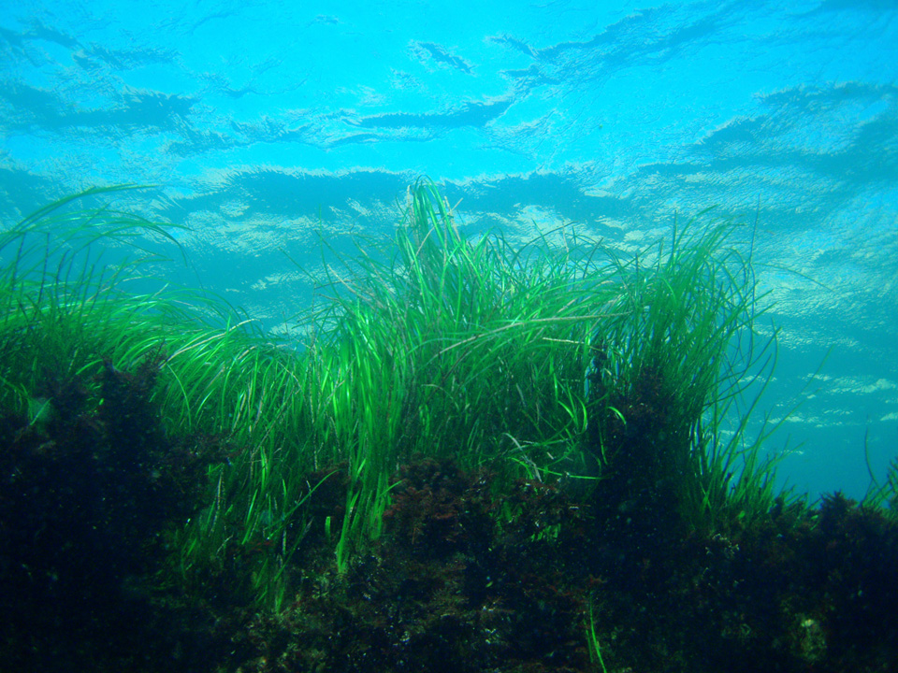
Plant life
Turtle Grass is a common type of seagrass, it can form large meadows.
Algae provides food for aquatic life, it doesn’t have seeds but haves spores. Spores are a single celled organism able to produce a new individual.
There are many different type and colors of algae, like red, yellow, and brown.
Notes:
http://www.nhptv.org/natureworks/nwep6j.htm
http://www.gardenguides.com/122803-plants-can-found-benthic-zone.html
https://www.merriam-webster.com/dictionary/spore

Slide 9
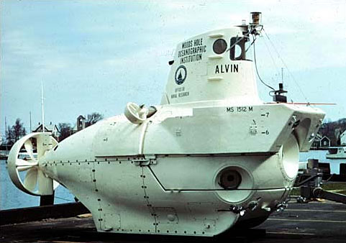
1977 Dive
During the 1977 dive scientists discovered the first deep-sea hydrothermal vents which helped explain the ocean's salinity and how Earth ventilates internal heat.
Located around the hydrothermal vents is a lush and rich community of exotic life consisting of tubeworms, large clams, white crabs, and other different exotic species
Notes:
http://www.nature.com/news/deep-sea-research-dive-master-1.11393
http://www.divediscover.whoi.edu/expedition6/
http://www.divediscover.whoi.edu/expedition9/
http://ocean.si.edu/ocean-videos/hydrothermal-vent-creatures

Slide 10
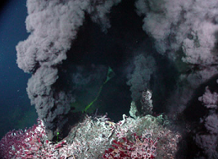
1977 Dive
The organisms inhabit around the hydrothermal vents because the hydrothermal vents spew warm and mineral-rich fluids, which lets the organisms use a process called chemosynthesis that allows them to get their food from the vents. Smaller organisms feed on the bacteria in the water, while the bigger organisms feed on the smaller organisms that feed on the bacteria.

Slide 11
Hydrothermal Vents and Cold Seeps
Hydrothermal Vents-
Cold Seeps-
Since sunlight cannot reach the Benthic Hydrothermal Vents which give out heated water that turns into currents of debris. Hydrothermal vents are also important because they house crabs, fish, shrimp, tubeworms, and giant clams.
Cold Seeps are where methane and hydrogen sulfide release into the ocean. Clams, mussels,shrimp,crabs, bacteria, and tubeworms live here and feed off of Archaebacteria which is a single celled organism.
Notes:
http://angelenamangieri.weebly.com/deep-oceanbenthic-zone.html

Slide 12
Questions
Where is the Benthic Zone located?
It is the lowest level of water and is the floor of the ocean
2) What do most benthos eat?
Decomposing matter
Clams
Grass
Tubeworms
3) What did scientists find during the 1977 dive?
Scientists found deep sea hydrothermal vents. These vent explained the ocean's salinity and how Earth ventilates internal heat.

Slide 13
Websites We Used
http://angelenamangieri.weebly.com/deep-oceanbenthic-zone.html
http://www.nature.com/news/deep-sea-research-dive-master-1.11393
http://www.divediscover.whoi.edu/expedition6/
http://www.divediscover.whoi.edu/expedition9/
http://ocean.si.edu/ocean-videos/hydrothermal-vent-creatures
http://www.nhptv.org/natureworks/nwep6j.htm
http://www.gardenguides.com/122803-plants-can-found-benthic-zone.html
https://www.merriam-webster.com/dictionary/spore
http://www.brighthub.com/environment/science-environmental/articles/60014.aspx
https://ecosystemexperts.weebly.com/the-benthic-zone.html
http://www.newworldencyclopedia.org/entry/Benthic_zone
https://microbewiki.kenyon.edu/index.php/Benthic_Zone
https://watersheds.ca/wp-content/uploads/2016/02/Benthic-zone-Final.pdf
http://www.newworldencyclopedia.org/entry/Benthic_zone
http://www.newworldencyclopedia.org/entry/Benthic_zone
https://www.buzzle.com/articles/interesting-facts-about-the-benthic-zone.html

