Slide 1
Benthic Zone (Deep Ocean)
By: Taylor Perry, Julianna Gumola, and Aidan Davy, Sophia Squier

Slide 2
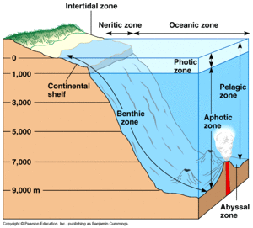
Depth:
The Benthic Zone is 3,281 feet to 29,528 feet deep.

Slide 3
Location:
There is a Benthic Zone in every body of water, whether it is a few inches down in a puddle or thousands of feet below the surface in the ocean
The Benthic zone refers to all water types; Salt, Brackish, and Freshwater.

Slide 4
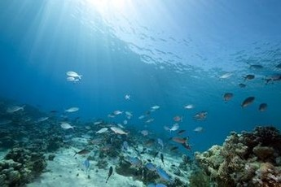
How much sunlight does this area get?:
The benthic zone is the lowest level of a body of water. It is all the way to the bottom of the ocean so because of the high depths, small amounts of sunlight can reach the bottom.
This causes temperatures to drop.

Slide 5
Three Facts:
Of about 10 million estimated species in the deep ocean, a majority are yet to be discovered.
If you flipped mount everest over, it wouldn't even come close to reaching the deepest part of the ocean.
The word Benthic comes from the greek word “benthos” meaning depth of the sea.

Slide 6
Hydrothermal Vents and Cold Seeps
Hydrothermal vents are hot springs on the ocean floor. The Benthic Zone can reach extremely low temperatures so the hydrothermal vents are responsible for sending heat and chemicals that plants use for energy. Some of the animals depend on the bacteria that comes out of the vents for food.
Cold seeps and Hydrothermal vents are important because there are limited amounts of sunlight in the Benthic Zone, so the animals depend on them because they need the warm air from hydrothermal vents and the cool air from cold seeps. Also, it’s their source of food.

Slide 7
Animal life:
The ocean floor is mostly sand and mud because of this many animals habitats are buried in the bottom.
Animals must adapt to the darkness and the high pressures in this zone.
Some examples are:Sponges, Cnidarians, Molluscs, whelks, Crustaceans, and starfish.

Slide 8
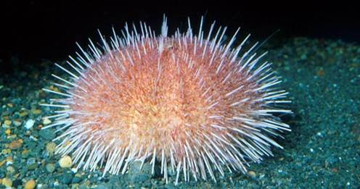
Plant life:
There are not many types of plants due to the lack of sunlight.
Chemosynthesis is when energy is created from chemicals that come out of the hydrothermal vents and that’s how the plants flourish.
There are different plants that flourish in this zone such as seagrass and red Algae

Slide 9
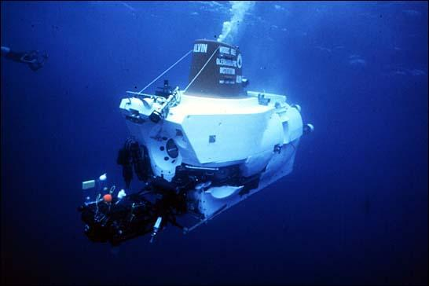
1977 Galapagos Rift Dive:
In 1977 three scientists took a man made submarine the Alvin down to the bottom of the Galapagos Rift
They discovered the first hydrothermal vents, in the pacific ocean.
They also found new sea life communities and learned more about the Benthic Zone.

Slide 10
Questions
What kind of conditions do the animals in the Benthic Zone have to adapt to?
How do animals use the Hydrothermal Vents to survive?
It’s where they get their food
It’s their form of sunlight
It is how they stay warm
Both b & c

Slide 11
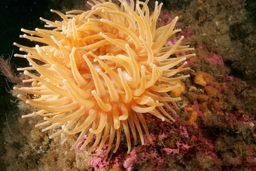
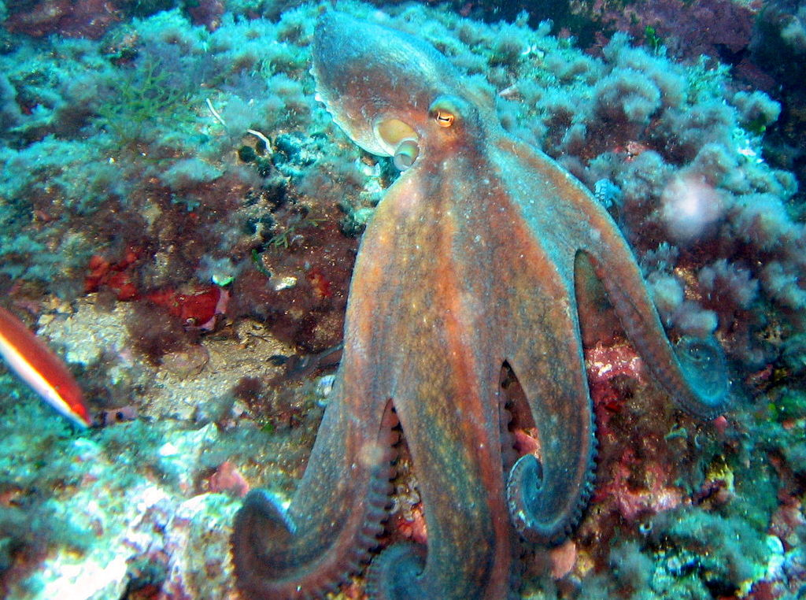
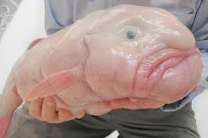
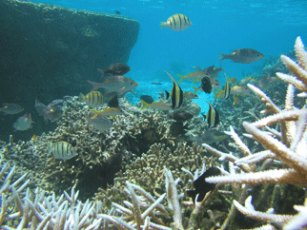
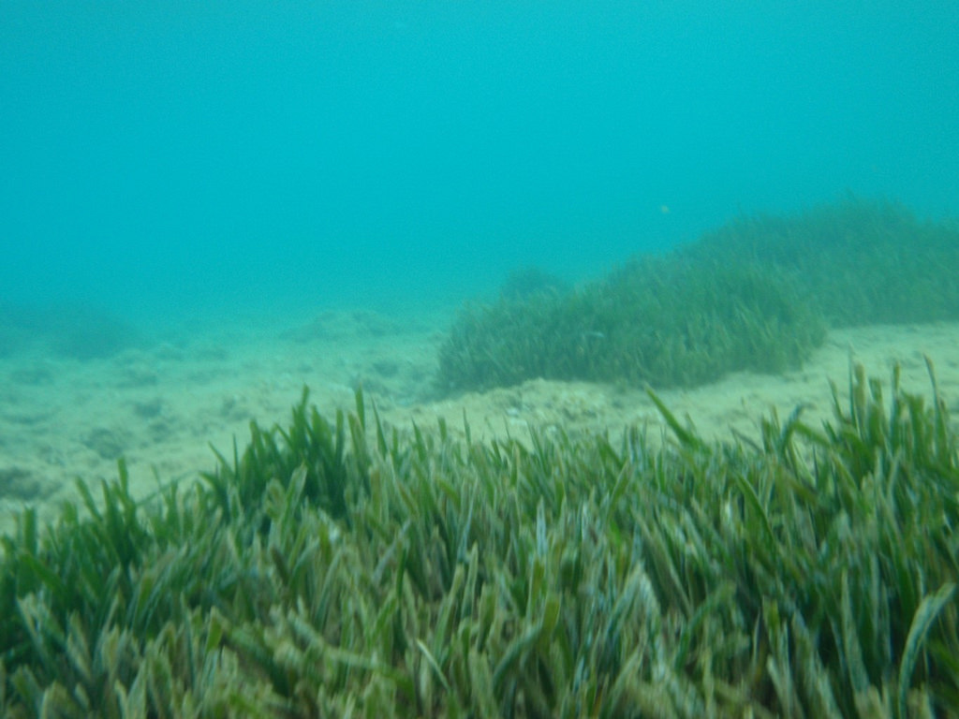
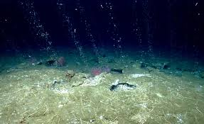
Pictures:

Slide 12
Sources we used:
www.newworldencyclopedia.org/entry/Benthic_zone
http://www.buzzle.com/articles/interesting-facts-about-the-benthic-zone.html
http://www.nhptv.org/natureworks/nwep6j.htm
http://www.newworldencyclopedia.org/entry/Benthic_zone
The Science TextBook
http://www.fisheries.is/ecosystem/marine-life/benthic-animals/
http://www.savethehighseas.org/deepsea/facts.cfm
http://www.underwateraudio.com/blog/10-deep-sea-secrets-mind-blowing-facts-about-the-ocean/

