Slide 1
#56 energy Recap
#57 Cell Theory Notes

Slide 2
*Cell theory
All living things are made up of cells
Cells are the smallest working units of all living things
All cells come from preexisting cells through cell division

Slide 3
*Definition of a Cell
A cell is:
The smallest unit that is capable of performing life's functions
Also known as the basic unit of life
Life functions = taking in nutrients and getting rid of waste
Major job of the cell is to make ______________
Protein!

Slide 4
*Two major types of cells
*Prokaryotic
*Eukaryotic
Which one do you think you are?

Slide 5
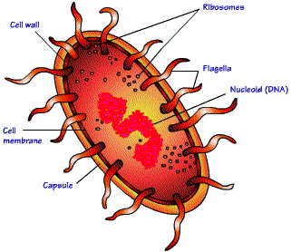
*Prokaryotic (we will discuss more in detail later)
Unicellular Organism
It has few internal structures that are NOT surrounded by membranes
Does not have a nucleus
For example: BACTERIA!

Slide 6
*Eukaryotic
Most living organisms are Eukaryotic
Eukaryotes are multicellular organisms whose cells contain organelles surrounded by membrane
Organelle – small organ like structures within a cell

Slide 7
*Two types of Eukaryotic Cells
Plant cells
Animal Cells

Slide 8
Instructions
Label the following
Create a key and label the following parts and colors
(if it will help label and draw a line to the organelles)
Tell the cell functions (what it is used for) on page 58 in your notebook
Also define chlorophyll
Cytoplasm – yellow
Mitochondria – purple
Nucleus – red
Nucleolus- blue
Ribosomes- orange
Cell membrane- light brown
Cell wall – dark green
Chloroplast – light green

Slide 10
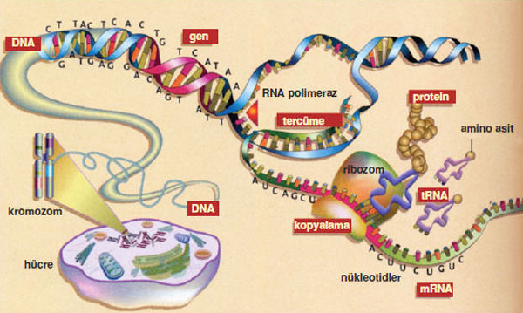
*Protein Synthesis
The process in ribosomes where proteins create different organelles.

Slide 11
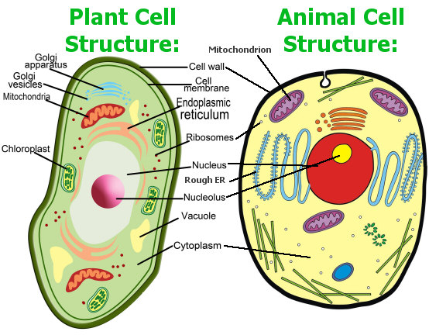

Slide 12
Can the functions of each part in the cell be compared to a factory?
http://www.youtube.com/watch?v=g4L_QO4WKtM

