Slide 1
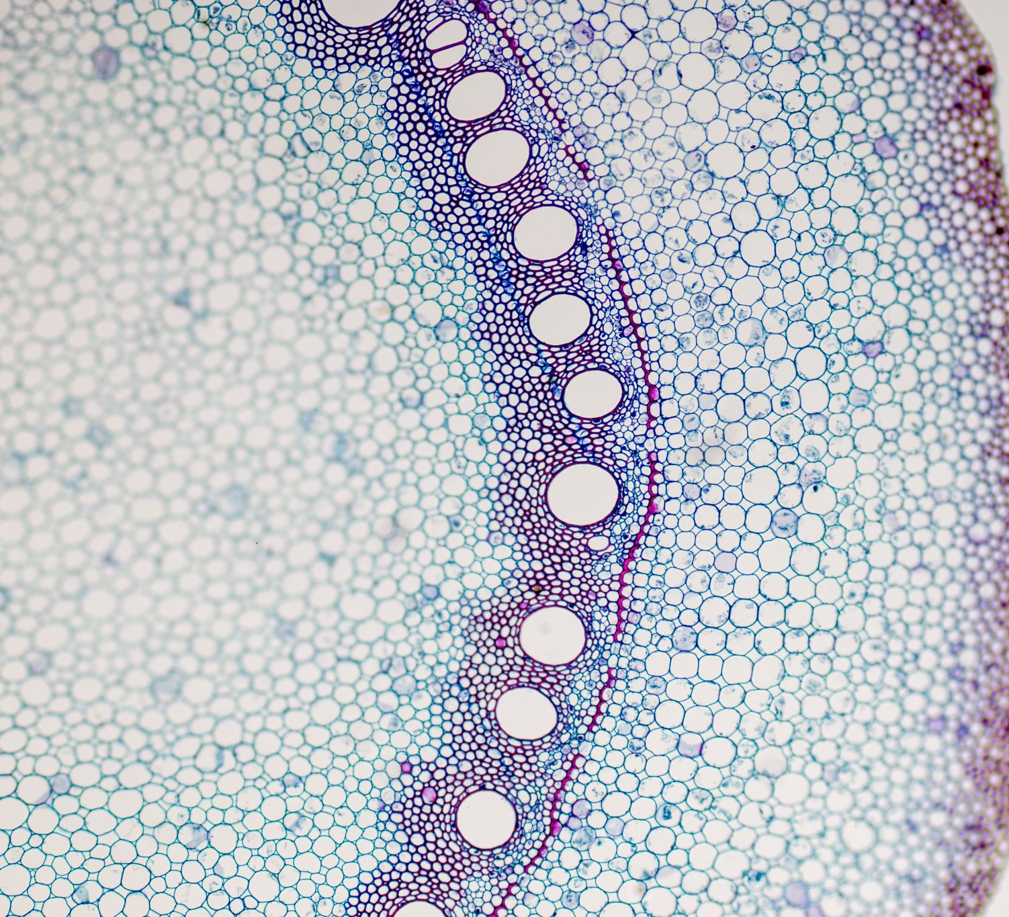
#55 Energy recap notes (half sheet handed out last week) #56 Cell theory Notes #57 Plant and animal cell functions and diagram

Slide 2
on page #56,
Read the Discovery Education article on the cell theory. After you have read the article answer the following questions
How did cells get their name?
What are the 3 parts of the original cell theory
What are the 3 new revisions that were added to the cell theory
Compare and contrast prokaryotic with eukaryotic cells and provide examples of each
What organelles does a plant cell have that an animal cell does not?

Slide 3
*What is a cell?
A cell is the smallest unit capable of performing life's functions.
Life's functions means being able to take in nutrients and get rid of waste.
Cells are also known as the most basic unit of life
The major job of cells is to make PROTEIN!!!

Slide 4
The Cell theory states:
All living things are made up of cells
Cells are the smallest working units of all living things
All cells come from preexisting cells through cell division

Slide 5
*Two types of cells
Prokaryotic Cells
Eukaryotic Cells
Eukaryotes are mostly multicellular organisms (contains more than one cell)
Most living organisms are Eukaryotic
Eukaryotic cells have a nucleus that surrounds the DNA within the cell
There are 2 types of eukaryotic cells:
Plant cells and animal cells
Unicellular (one celled)
It is simple and has few organelles
Does not have a nucleus, DNA floats around freely
Prokaryote example: BACTERIA!
Organelle – small organ like structures within a cell that carries out a specific task to maintain the functionality of the cell

Slide 6
Let’s look at animal and plant cells
For the next activity you will be completing
#57 Animal and Plant Cell functions and Diagrams
Read the next slide for the instructions

Slide 7
Grab an animal and plant cell Worksheet and do the following:
Part 2.
In the textbook on page E20-23, Define the following organelles in your notebook on page
#57 Animal and Plant Cell Functions and Diagrams
Cytoplasm, mitochondria, nucleus, ribosomes, cell membrane, cell wall, chloroplast, and chlorophyll
Write nucleolus definition in notes as well:
The Nucleolus is responsible for making ribosomes and transporting them to the cytoplasm
Part 1.
Look at the picture on the next slide and label the following organelles. After labeling them, color them according to my key below:
Cytoplasm – yellow. .
Mitochondria – purple .
Nucleus – red. .
Nucleolus- blue. .
Ribosomes- orange. .
Cell membrane- light brown. .
Cell wall – dark green. .
Chloroplast – light green .

Slide 8
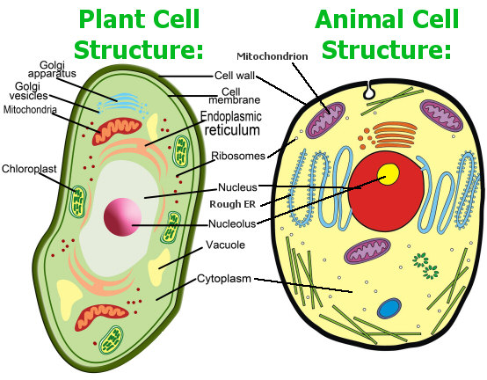

Slide 9
Glue the Colored diagrams in on a separate page from your definitions!!!!!

