Slide 1
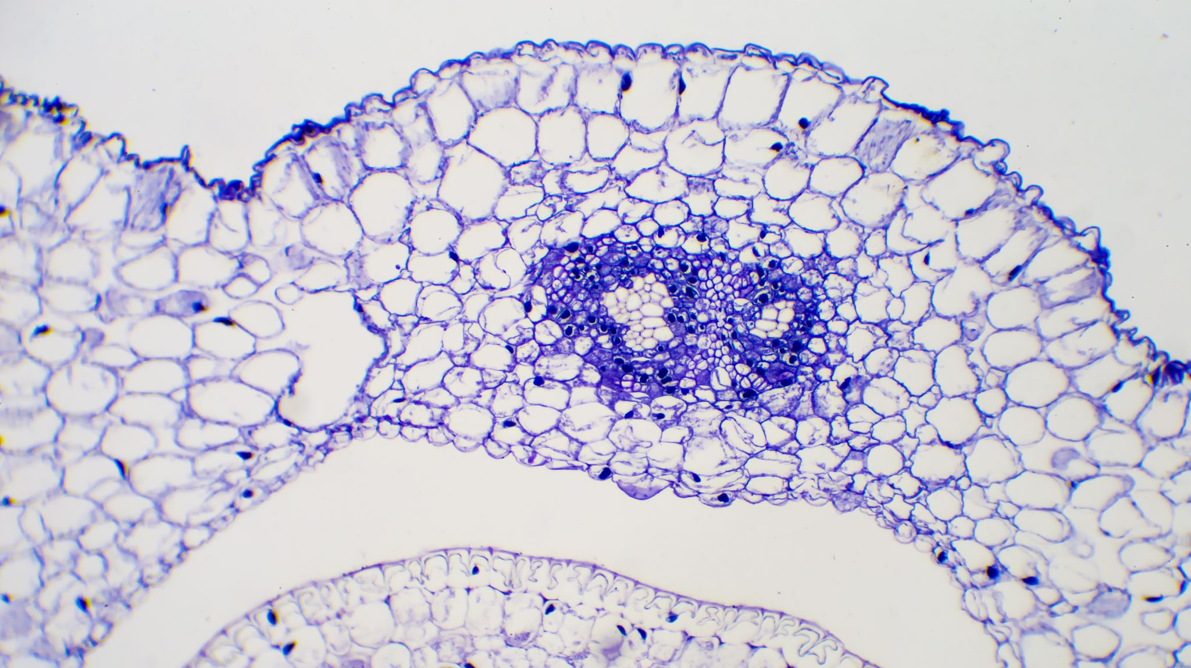
#58 Cellular Division Notes

Slide 2
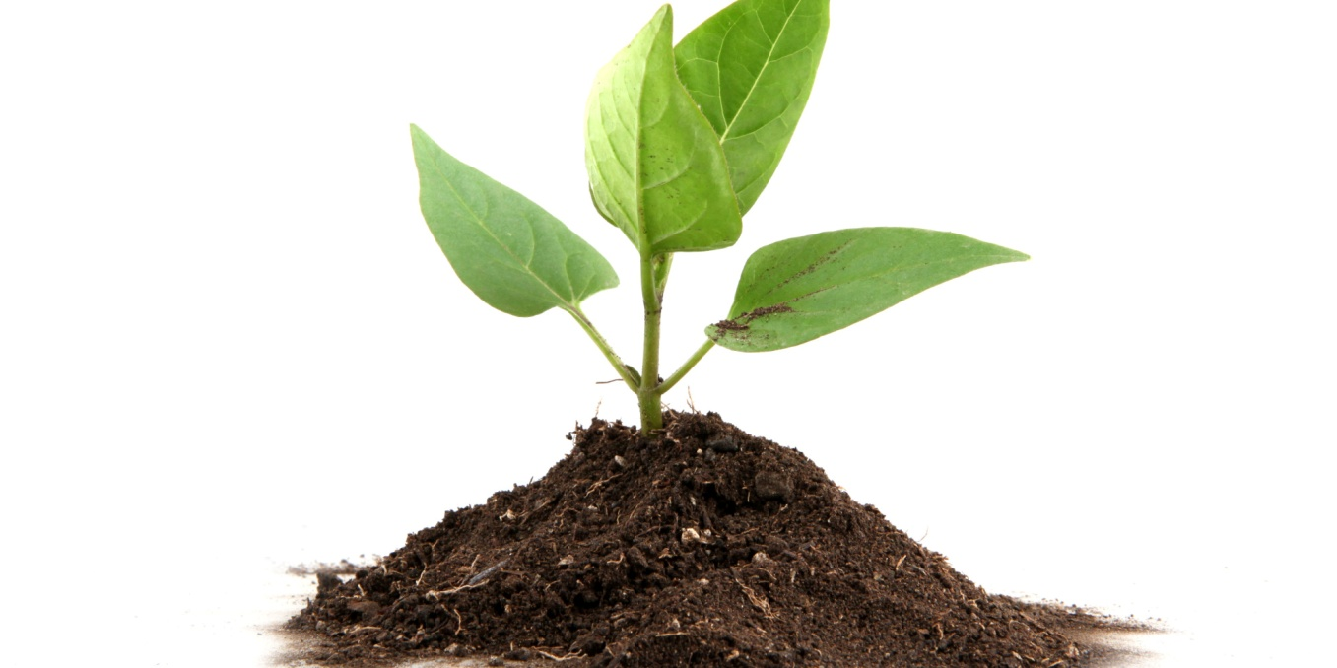
Cell Theory Recap
All living things are made up of cells
Cells carry out the functions needed to support life
Cells come from other pre-existing cells

Slide 3
Cell Theory 1 : All living things are made of cells
What have we learned to support this?

Slide 4
Two types of cells
Prokaryotic Cells
Eukaryotic Cells
Unicellular (one celled)
It is simple and has few organelles
Does not have a nucleus, DNA floats around freely
Prokaryote example: BACTERIA!
Eukaryotes are mostly multicellular organisms (contains more than one cell)
Most living organisms are Eukaryotic
Eukaryotic cells have a nucleus that surrounds the DNA within the cell
There are 2 types of eukaryotic cells:
Plant cells and animal cells
Organelle – small organ like structures within a cell that carries out a specific task to maintain the functionality of the cell

Slide 5
Cell Theory 2: Cells carry out the functions needed to support life
What evidence supports this?
So far we’ve learned that all cells are made up of smaller specialized parts called organelles.
Organelles are responsible for carrying out functions to keep the cell alive, repairing it when needed, and replacement of cells (reproduction).
We are going to learn more in detail what is required to keep the cell alive next class, but todays focus is going to be centered around the replacement of cells
This brings us to cell theory #3

Slide 6
*Cell theory 3: all cells come from pre-existing cells in a process known as cellular division
Cellular division is the process where a cell, often called a parent cell, divides to create identical daughter cells (multiple cells)
There are two ways cells divide to create new cells:
mitosis and meiosis

Slide 7
*Mitosis
The self-division of cells into two identical (genetically alike) cells.
Occurs in the nucleus. Applies to all cell types except reproductive cells.

Slide 8
For today’s lesson
You are going to make a foldable (shown on next slide) and explain the process of mitosis.
After you finish the foldable, you will then need to answer the assessment questions on the back and be prepared to turn this in for a grade.
After you finish the foldable, finish taking your notes watch the amoeba sisters video on this PowerPoint and complete the worksheet

Slide 9
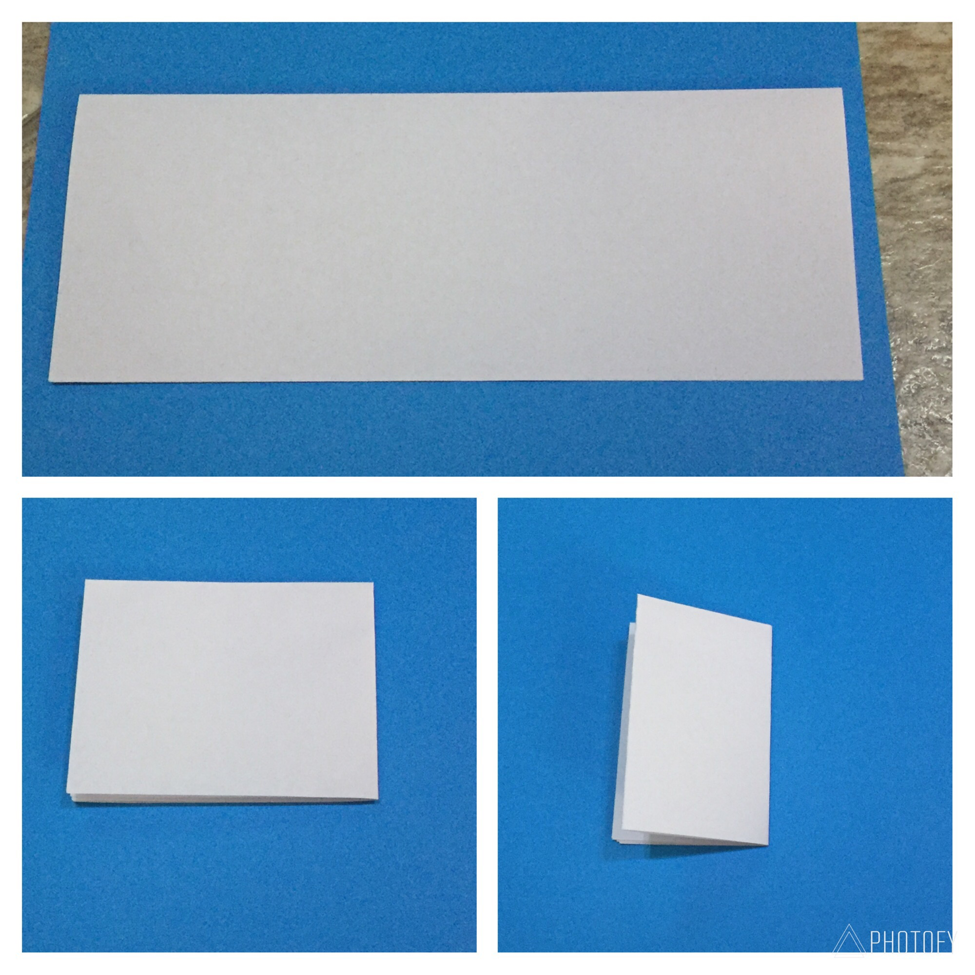
Making the foldable
1. Take a sheet of paper and fold it in half hotdog style
2. fold the paper in half hamburger style
3. then fold it once more hamburger style to make a foldable as shown in picture

Slide 10
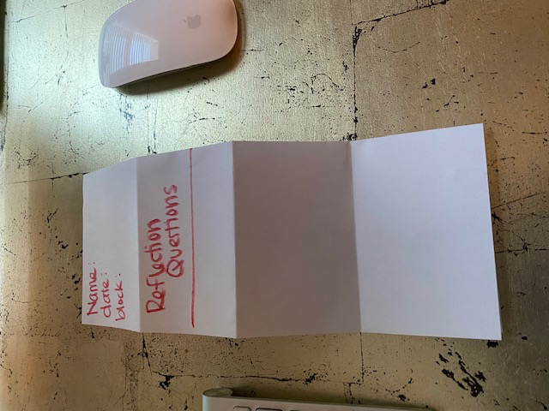
Front and back view of foldable

Slide 11
Divisions of cytoplasm

Slide 12
Mitosis Reflection: On the back of the graphic organizer.
The cell spends most of its time in which stage of the cell cycle? Describe this phase…
What is mitosis?
In which phase does a cell’s membrane disappear?
What happens to the chromosomes during anaphase?
What happens to a cell after cytokinesis?
Which process results from an increase in the number of cells that make up an organisms?
a) growth b) reproduction c) respiration d) digestion

Slide 13
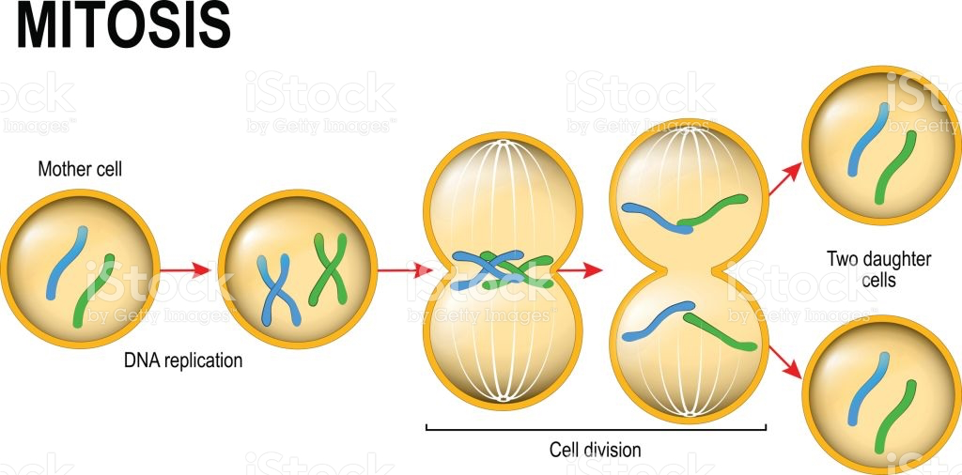
Amoeba Sisters Mitosis
Watch the video completely through one time. Play it again and pause as needed to complete the worksheet
https://youtu.be/f-ldPgEfAHI

Slide 14
*Meiosis
A special cell division process necessary for sexual reproduction cells.
Applies only to reproductive cells.

Slide 15
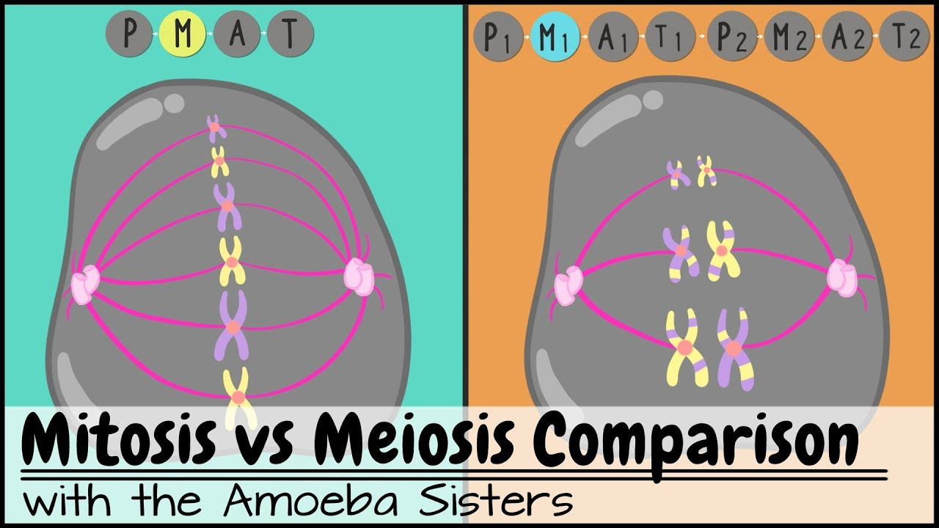
Mitosis vs meiosis
Watch the video to compare mitosis with meiosis
https://youtu.be/zrKdz93WlVk

Slide 16
Create a Venn Diagram in your notebooks and compare and contrast
Mitosis
Meiosis
Both

