Slide 1
#77 Darwin Natural selection ws #78 Natural selection Brainpop #79 Classification of Species

Slide 2
Recap…
So far we’ve learned how natural selection explains change over time. Species are required to adapt, compete, vary, and overproduce in order to develop new traits that they deem most desirable.
New species develop from ancestral species which displays the similarities and slight changes over the course of time.

Slide 3
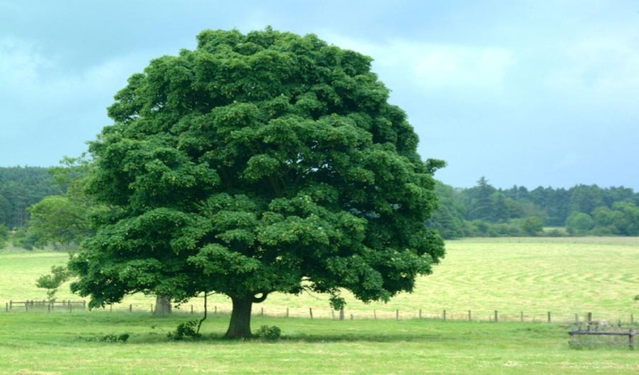
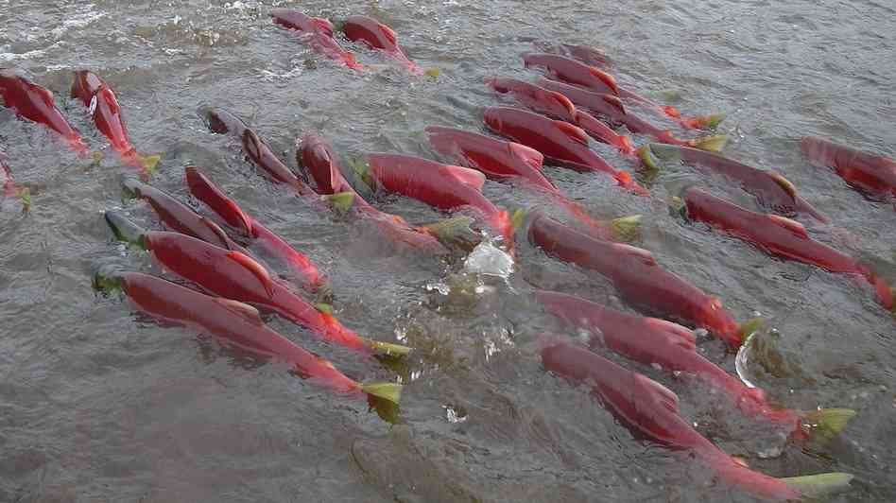
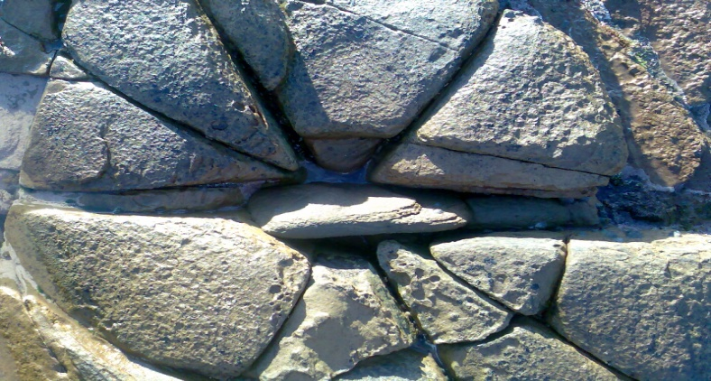
*Biotic
The living factors that affect an environment or ecosystem.
*Abiotic
The non-living factors that affect an environment or ecosystem.

Slide 4
Biotic or Abiotic?
Biotic!

Slide 5
Biotic or Abiotic?
Abiotic!

Slide 6
Biotic or Abiotic?
Abiotic!

Slide 7
Biotic or Abiotic?
Biotic!

Slide 8
Biotic or Abiotic?
Abiotic!
Unless you said the hand…

Slide 9
What are all the biotic and abiotic things in this picture?

Slide 10
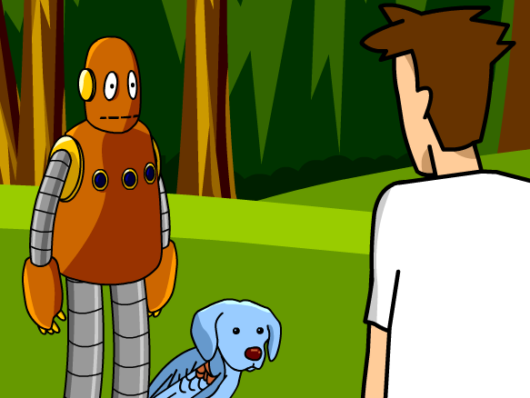
Classification Brain Pop

Slide 11
*Classifying Organisms
As the worlds knowledge of different kinds of organisms expanded, so did our need to organize and group organisms together.
Classification is the process of arranging organisms into groups based on similarities.

Slide 12
Taxonomy
*Taxonomy looking at the classification and giving universal names to species.
When scientists discover a new organism, they study it to determine where it fits in the classification system based off its relationships to living organisms.

Slide 13
TAXONOMY organizes LIFE down to the species!
KINGDOMS (the 5 kingdoms of life)
PHYLUM (each kingdom broken down into dozens of phyla)
CLASS (each phyla broken down further)
ORDER (each class broken down into smaller “orders”)
FAMILY (even more specific)
GENUS (only the most closely related species here)
SPECIES (only one SPECIFIC TYPE here!)

Slide 14
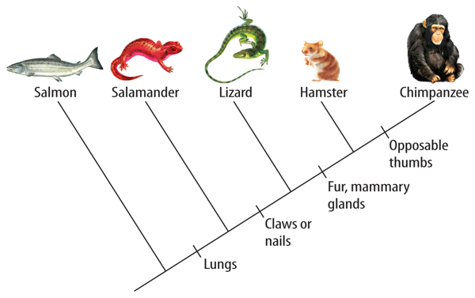
*Scientists use different evidence to classify organisms
Fossil evidence – shows how species evolved
Physical evidence – traits that tells a species apart
Genetic evidence – DNA that supports physical evidence
A phylogenetic tree is a family tree that shows a hypothesis about the evolutionary relationship amongst groups of organisms.
Notes:
Evolution of traits…

Slide 15
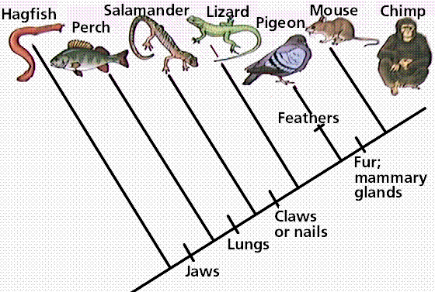
What animal is the chimp closely related to?
What animal is the chimp least related to?

Slide 16
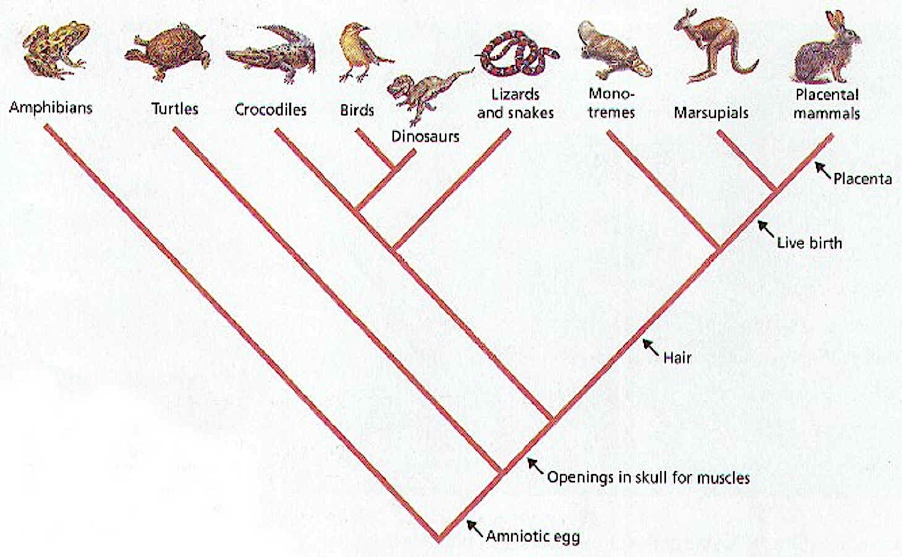
What is the closest relative of lizard and snakes?

Slide 17
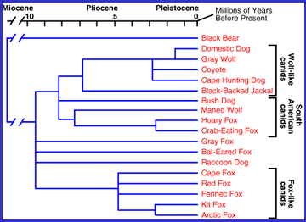
Look at this evolutionary tree. Can you answer some questions about it?

Slide 18
Does this evolutionary tree support that our dogs are direct descendants of gray wolves?

Slide 19
yes!

Slide 20
According to this evolutionary tree, are our dogs more related to foxes or coyotes?

Slide 21
COYOTES!

Slide 22
According to this evolutionary tree, what is our dog’s most distant relative shown here?

Slide 23
The BLACK BEAR!

Slide 24
*Is their an easier way to classify organisms?
A dichotomous key is a device for easily and quickly identifying an unknown organism.
The user is presented with a sequence of choices between two statements (usually yes or no) based on characteristics of the organism. By always making the correct choice, the name of the organism will be revealed.

Slide 26
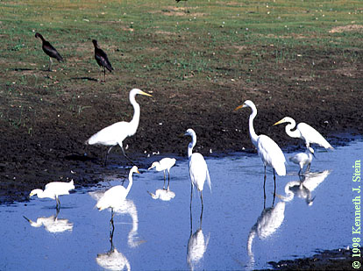
How ecosystems are structured
*Species - a group of organisms which can interbreed and produce fertile offspring

Slide 27
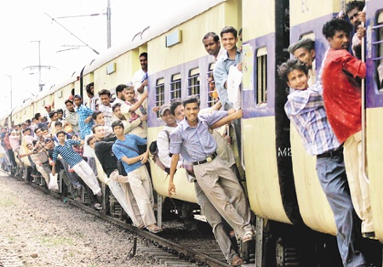
How ecosystems are structured
*Population - a group of organisms of the same species who live in the same area at the same time

Slide 28
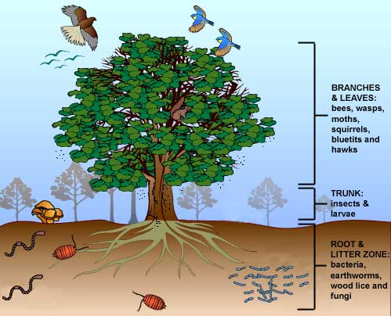
How ecosystems are structured
*Community - a group of populations living and interacting with each other in an area

Slide 29
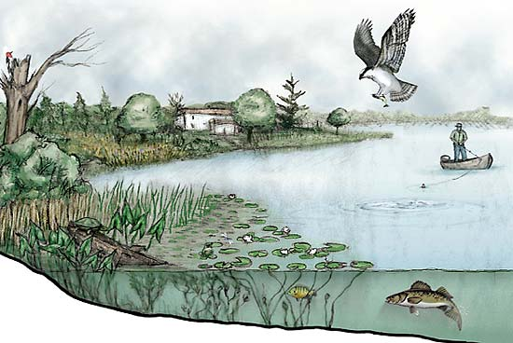
How ecosystems are structured
*Ecosystem - a system made up of organisms as well as the abiotic factors in the area.

Slide 31
EXTRA…Evolution lab
http://www.pbs.org/wgbh/nova/labs/lab/evolution/
Login in with google

Slide 32
http://www.pbs.org/wgbh/nova/labs/about-evolution-lab/educator-guide/

Slide 33
Warm-up
Complete the worksheet

Slide 34
Discussion point
If you had to classify life at Bailey, how would you do it?
Can we divide Bailey into 2 large groups
Can we divide those groups into subgroups?
Can we make more subgroups?

Slide 35
Example
ADULTS
KIDS
TEACHERS
ELA
MATH
SS
SCIENCE
SUPPORT STAFF
PRINCIPAL/ AP’s
OFFICE STAFF
CUSTODIANS
PARENTS
6th GRADERS
7TH GRADERS
8TH GRADERS
HORNETS
PANTHERS

Slide 36
Warmup
Classification is vital when grouping organisms and is commonly used throughout our daily lifes. Classify the content in your bookbag starting with the most vague and getting more descriptive within each groups.
heels
flats
toms
sperrys
running
bball
boots
dress
everyday
sports
casual
Shoes

