Slide 1
Recap…
So far we’ve learned how natural selection explains change over time. Species are required to adapt, compete, vary, and overproduce in order to develop new traits that they deem most desirable.
New species develop from ancestral species which displays the similarities and slight changes over the course of time.

Slide 2
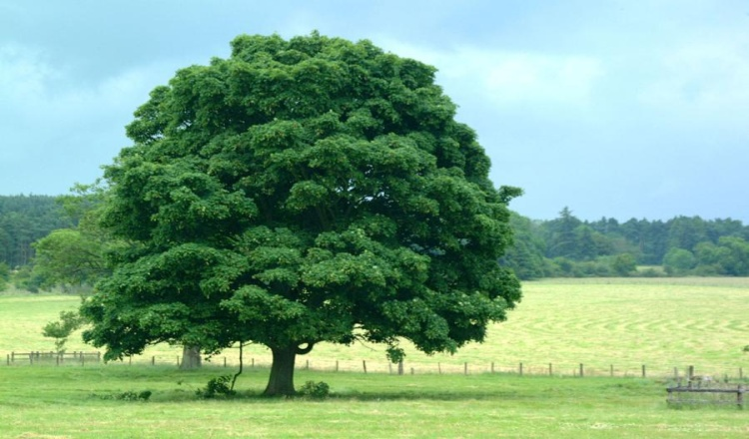
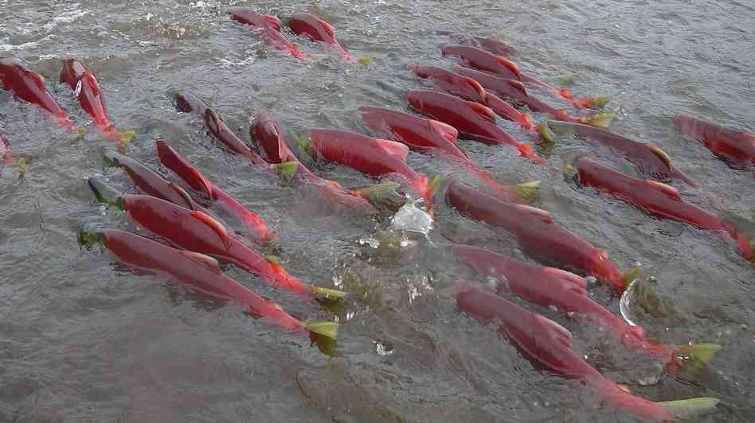
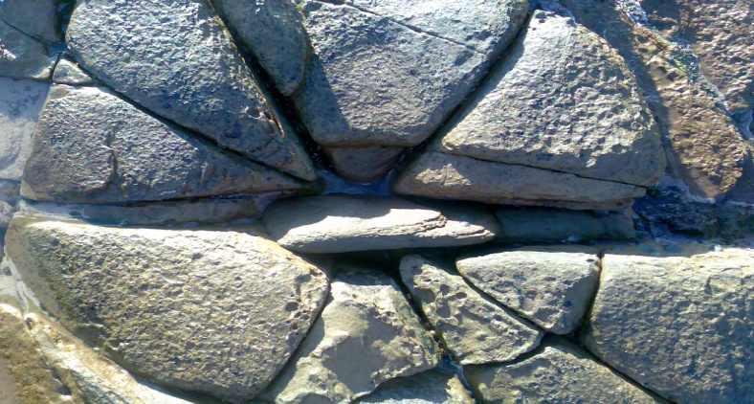

*Biotic
The living factors that affect an environment or ecosystem.
*Abiotic
The non-living factors that affect an environment or ecosystem.

Slide 3
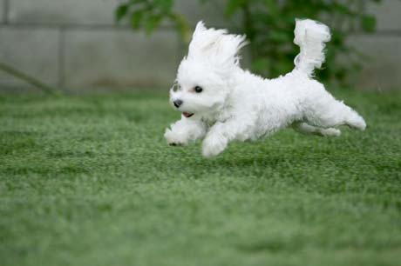
Biotic or Abiotic?
Biotic!

Slide 4

Biotic or Abiotic?
Abiotic!

Slide 5
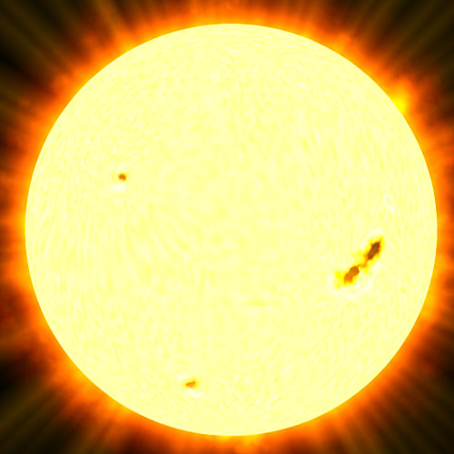
Biotic or Abiotic?
Abiotic!

Slide 6
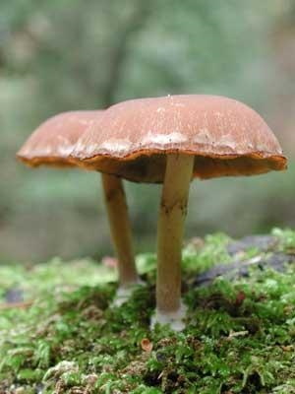
Biotic or Abiotic?
Biotic!

Slide 7
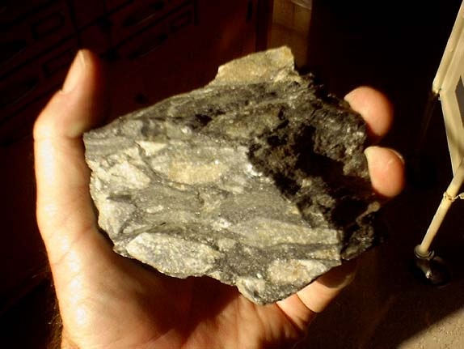
Biotic or Abiotic?
Abiotic!
Unless you said the hand…

Slide 8
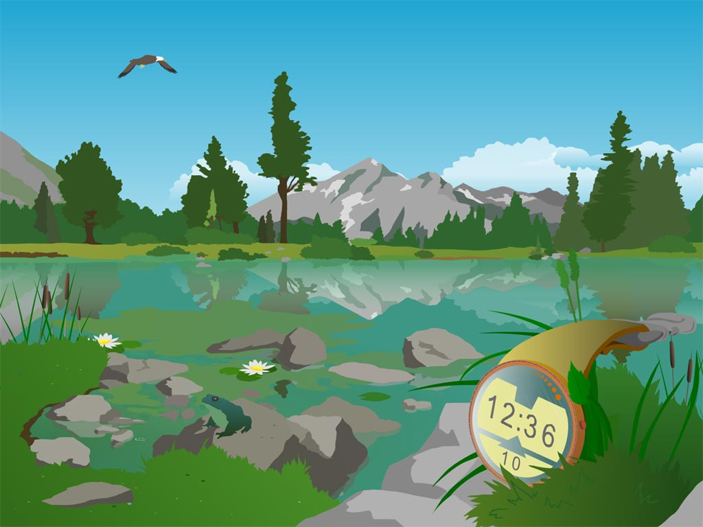
What are all the biotic and abiotic things in this picture?

Slide 9
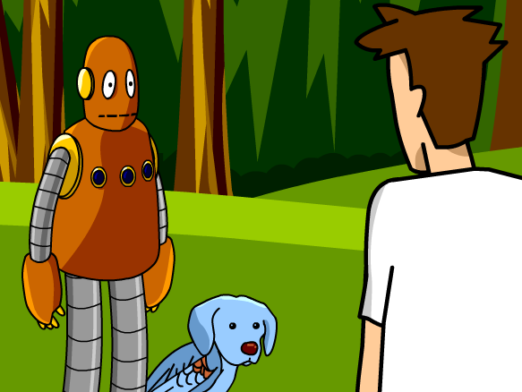
Classification Brain Pop

Slide 10
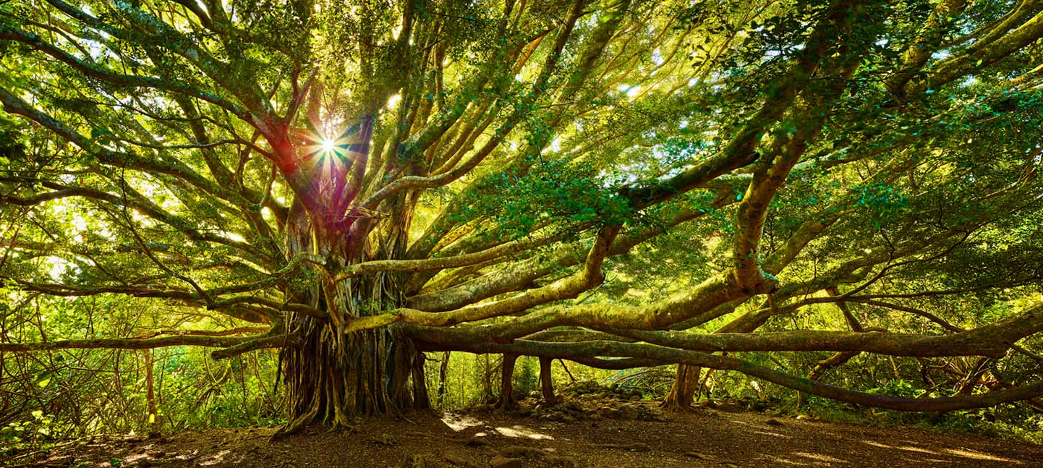
Evolutionary tree of life
What if I told you all organisms on earth can be compared to branches on tree? How can this be?

Slide 11
All organisms, several millions of years ago all came from the same common ancestor and over time evolved in different ways.
The several branches on a tree represents how organisms evolved differently. The tree trunk represents the common ancestor they all evolved from.
Today, we know of over 2 million different species and new species are discovered every day. How can we keep up with them?

Slide 12
*Classifying Organisms
As the worlds knowledge of different kinds of organisms expanded, so did our need to organize and group organisms together.
Classification is the process of arranging organisms into groups based on similarities.

Slide 13
Taxonomy
*Taxonomy involves the classification and universal naming of species in order to make sure no matter where on Earth you live, you can still name and identify a species.
When scientists discover a new organism, they study it to determine where it fits in the classification system based off its relationships to living organisms.

Slide 14
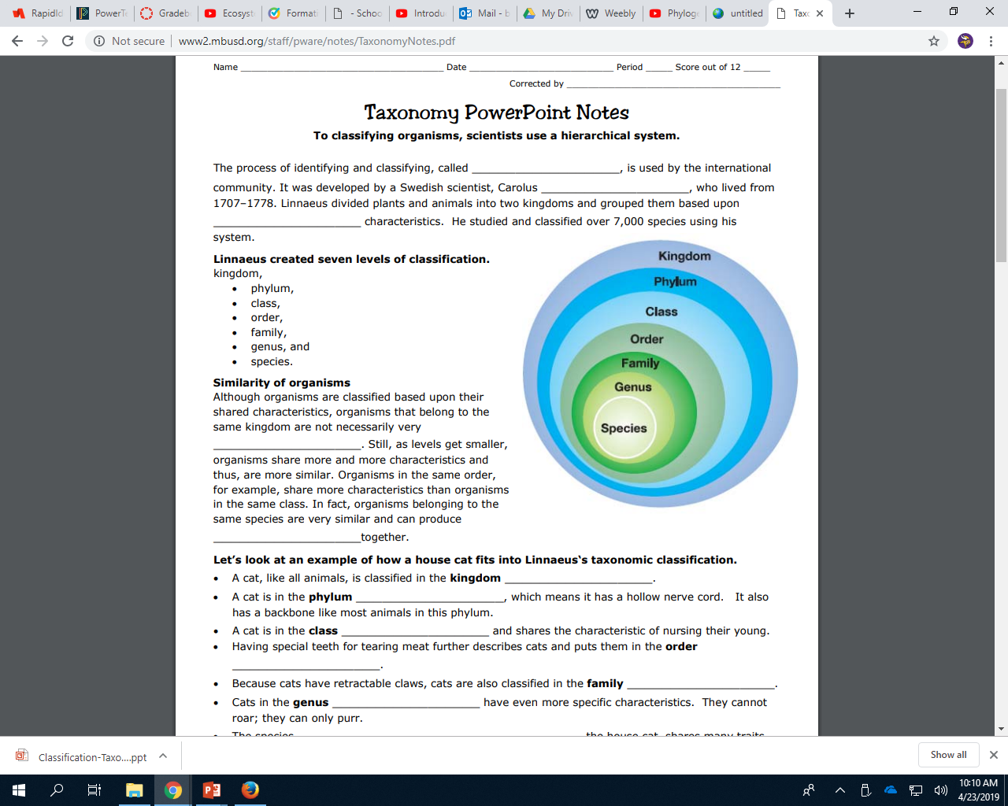
Brainpop Classification
https://www.brainpop.com/science/diversityoflife/classification/

Slide 15
TAXONOMY organizes LIFE down to the species!
KINGDOMS (the 6 kingdoms of life)
  PHYLUM (each kingdom broken down into dozens of phyla)
    CLASS (each phyla broken down further)
      ORDER (each class broken down into smaller “orders”)
        FAMILY (even more specific)
          GENUS (only the most closely related species here)
            SPECIES (only one SPECIFIC TYPE here!)

Slide 16
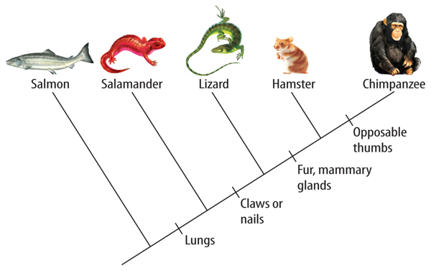
*Scientists use different evidence to classify organisms
Fossil evidence – shows how species evolved
Physical evidence – traits that tells a species apart
Genetic evidence – DNA that supports physical evidence
A phylogenetic tree is a family tree that shows a hypothesis about the evolutionary relationship amongst groups of organisms.
Notes:
Evolution of traits…

Slide 17
How to read a tree
This diagram shows a relationship between 4 relatives. These relatives share a common ancestor at the root of the tree.
Note that this diagram is also a timeline. The older organism is at the bottom of the tree.
The four descendants at the top of the tree are DIFFERENT species. This is called SPECIATION.

Slide 18
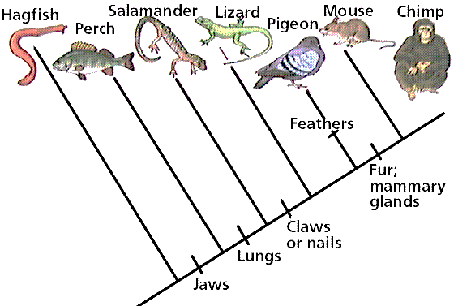
What animal is the chimp closely related to?
What animal is the chimp least related to?

Slide 19
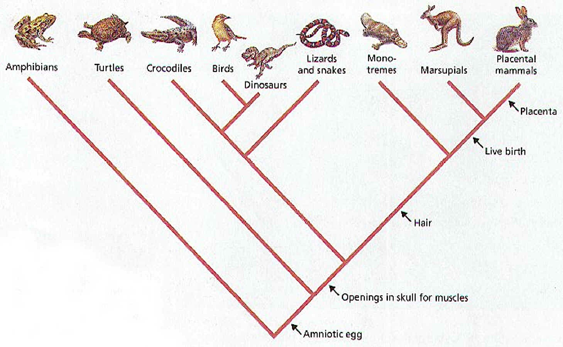
What is the closest relative of marsupials?
What is the closet relative of crocodiles?

Slide 21
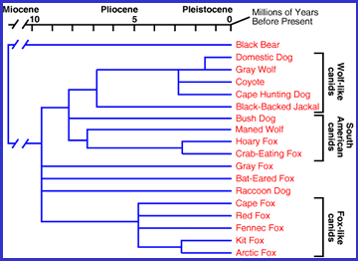
Look at this evolutionary tree. Can you answer some questions about it?

Slide 22
Does this evolutionary tree support that our dogs are direct descendants of gray wolves?

Slide 23
yes!

Slide 24
According to this evolutionary tree, are our dogs more related to foxes or coyotes?

Slide 25
COYOTES!

Slide 26
According to this evolutionary tree, what is our dog’s most distant relative shown here?

Slide 27
The BLACK BEAR!

Slide 28
*Is there away to classify or identify new organisms?
A dichotomous key is a device to easily identify unknown organisms.
The user is presented with a sequence of choices between two statements (usually yes or no) based on characteristics of the organism. By always making the correct choice, the name of the organism will be revealed.

Slide 29
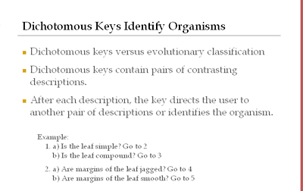

Slide 30
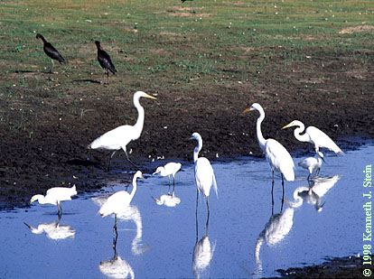
How ecosystems are structured
*Species - a group of organisms which can interbreed and produce fertile offspring

Slide 31

How ecosystems are structured
*Population - a group of organisms of the same species who live in the same area at the same time

Slide 32
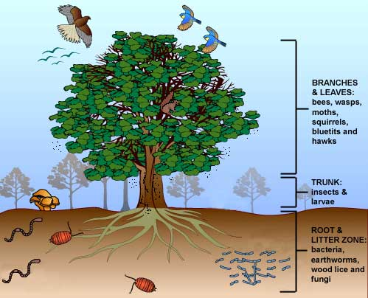
How ecosystems are structured
*Community - a group of populations living and interacting with each other in an area

Slide 33
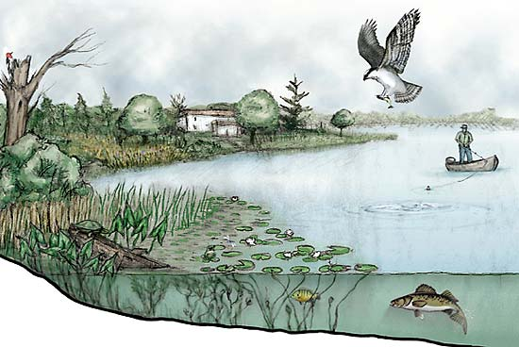
How ecosystems are structured
*Ecosystem - a system made up of organisms as well as the abiotic factors in the area.

Slide 35
EXTRA…Evolution lab
http://www.pbs.org/wgbh/nova/labs/lab/evolution/
Login in with google

Slide 36
http://www.pbs.org/wgbh/nova/labs/about-evolution-lab/educator-guide/

Slide 37
Warm-up
Complete the worksheet

Slide 38
Discussion point
If you had to classify life at Bailey, how would you do it?
Can we divide Bailey into 2 large groups
Can we divide those groups into subgroups?
Can we make more subgroups?

Slide 39
Example
ADULTS
KIDS
TEACHERS
  ELA
  MATH
  SS
  SCIENCE
SUPPORT STAFF
  PRINCIPAL/ AP’s
  OFFICE STAFF
  CUSTODIANS
PARENTS
6th GRADERS
7TH GRADERS
8TH GRADERS
  HORNETS
  PANTHERS

Slide 40
Warmup
Classification is vital when grouping organisms and is commonly used throughout our daily lifes. Classify the content in your bookbag starting with the most vague and getting more descriptive within each groups.
heels
flats
toms
sperrys
running
bball
boots
dress
everyday
sports
casual
Shoes

