Slide 1
#82 Competition and population dynamics

Slide 2
Somebody’s got to go!
No two species can occupy the same role/niche in an ecosystem for any length of time….
So leaves 2 options:
Fight
Or
Flight

Slide 3
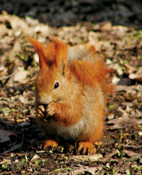
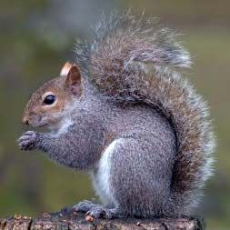
Until Americans introduced gray squirrels into parts of England in the early 20th century, red squirrels had been the only species of squirrel in the country. The gray squirrels were larger and bred faster and successfully competed for resources. Within a couple years of overlap in an area, the red squirrels disappeared. But why?

Slide 4
*Niche
A niche is an organisms job or role in the ecosystem .
When the niche of one organism in an ecosystem overlaps with the niche of another organism, it leads to
COMPETITION

Slide 5
Competition is the selection of a winner
Competition can be between individuals within the same species or with other individuals of a different species
Animals compete for a number of reasons. Things such as food, space, mates
Competition usually results in a decrease in the population of a species less adapted to compete for a particular resource.

Slide 6
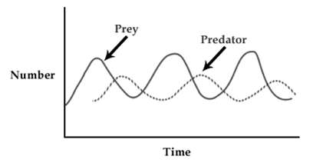
*Predation Competition
Predation (Predator-Prey Graph) – shows the relationship/interaction of one species catching and feeding off another species

Slide 7
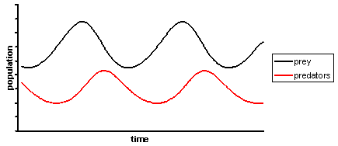
*Predator–prey graph
In order for the predators to survive, there must be more prey than predators.
The prey always increases before the predators do.
Notes:
To do: Write down how you could tell which line is the predator and which is the prey on a graph. Explain why the predator increases after the prey.

Slide 8
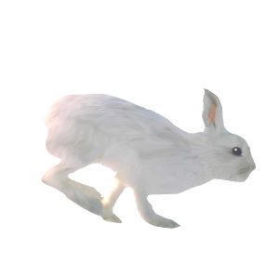
*Predator–prey cycle
Predator and prey population sizes follow a cycle.
What happens if the prey population increases?
normal prey population
prey population
increases
prey population
increases
predator population decreases
as less food
predator population increases
as more food
prey population decreases
because of more predators

Slide 9
No population can grow forever. Every population has a limit to its growth based off the number of available resources.
*A limiting factor prevents the continuing growth of a population within an ecosystem.
There are several things that can limit a population, we will learn the terminology in the following slides

Slide 10
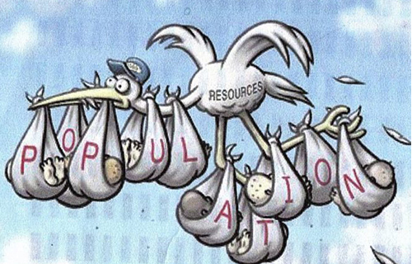
*Population limiting factors
Population growth rate is how fast a given population grows
Factors that influence this are:
Natality ( _____ rate)
Mortality ( ______ rate)
Emigration (the number of individuals moving _____________ a population)
Immigration (the number of individuals moving ____________ a population)
birth
death
away from
into

Slide 11
*Population Characteristics
Population Density:
The number of organisms per unit area
Spatial Distribution:
Dispersion: The pattern of spacing a population has within an area
3 main types of dispersion (copy the beige square examples beside the terms in your notes)
Clumped
Uniform
Random
The primary cause of dispersion is resource availability

Slide 12
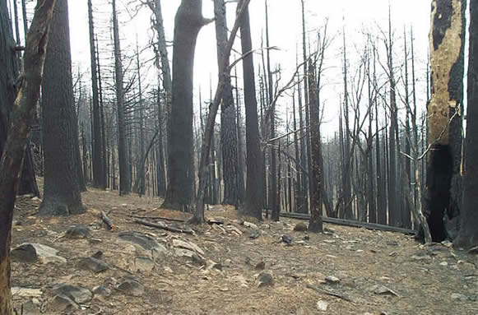
*Population Limiting Factors
Density-independent factors
Factors that limit population size, regardless of population density.
These are usually abiotic factors
They include natural phenomena, such as weather events
Drought, flooding, extreme heat or cold, tornadoes, hurricanes, fires, etc.

Slide 13
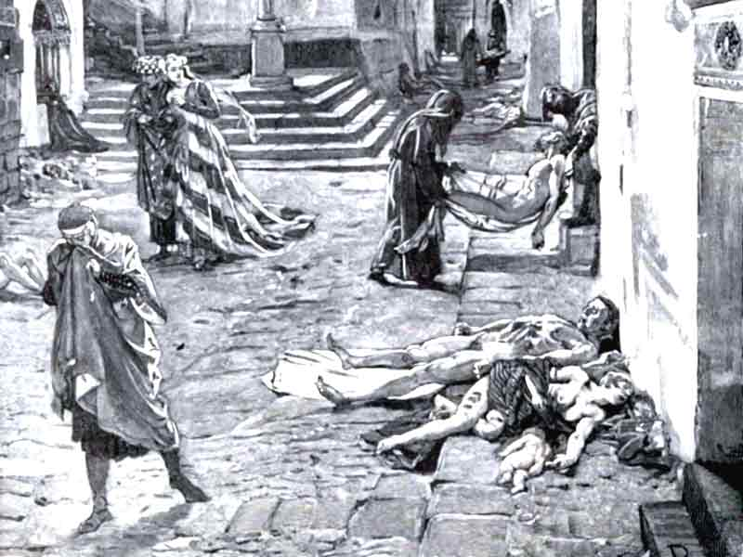
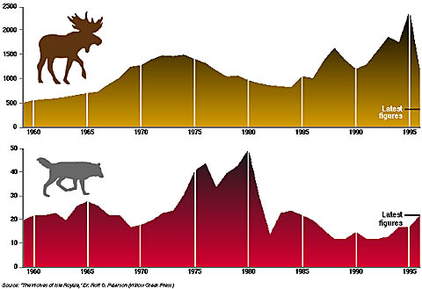
*Population Limiting Factors
Density-dependent factors
Any factor in the environment that depends on the population density
Usually biotic factors
These include
Predation
Disease
Parasites
Competition

Slide 14
Practice Problem
A team of biologists studied a population of box turtles in an Ohio woodlot for a period of ten years. They determined birthrate to be 40 per year, death rate to be 30 per year, immigration to be 3 per year and emigration to be 8 per year.
Calculate the population growth?
Was the population increasing or decreasing?
If the population started out at 150 box turtles and the area was 5 square miles, what was the population density?
What was the population density after 3 years?
What was the population density after 10 years?

Slide 15
Practice Problem #2
In 2001, the population of deer in Strongsville’s metroparks was 285 deer. That same year the birthrate was 56 and the death rate was 46. It was also observed that 35 immigrated and 20 emigrated.
What was the deer population at the end of the year?

Slide 16
Practice Problem #3
In 1990, the estimated population of grasshoppers is 926 on a 15 acre farm. The birthrate is measured at 315 grasshoppers per year and the death rate is 208 per year.
What is the growth rate?
If the population continues to grow in this same manner, what will be the population size in the year 2000?
c. Compare the population density of the grasshoppers in 1990 to the density in 2000. (this should be the difference between the 2000 and 1900 numbers

Slide 17
Symbiotic Relationships within ecosytems
A symbiotic relationship exists between organisms of two different species that live together in direct contact.
The balance is important in a symbiotic relationship. If the population of one of the organisms becomes unbalanced, both populations will fluctuate in an uncharacteristic manner.
Symbiotic relationships include parasitism, mutualism, and commensalism.

Slide 18
Parasitism
Parasitism is a symbiotic relationship in which one organism (the parasite) benefits at the expense of the other organism (the host).
In general, the parasite does not kill the host.
Some parasites live within the host, such as tape worms, heartworms, or bacteria.
Some parasites feed on the external surface of a host, such as aphids, fleas, or mistletoe.

Slide 19
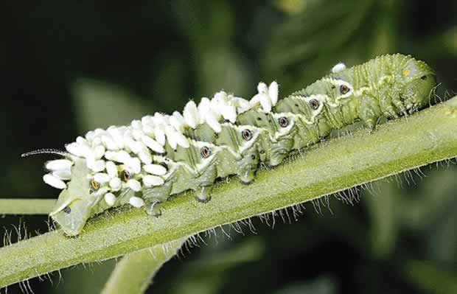
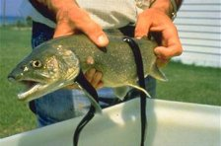
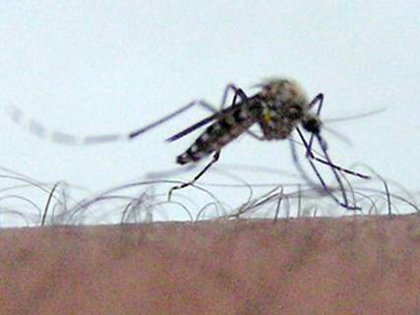
Wasp eggs on back of caterpillar.
Parasitism
Sea lampreys feed on fluids of other fish.
Mosquito biting a human.

Slide 20
Mutualism
Mutualism is a symbiotic relationship in which both organisms benefit. Because the two organisms work closely together, they help each other survive.
For example, bacteria, which have the ability to digest wood, live within the digestive tracts of termites; plant roots provide food for fungi that break down nutrients the plant needs.

Slide 21
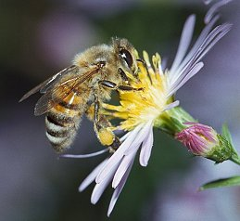
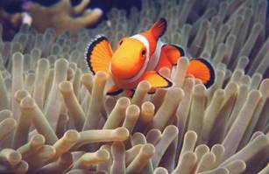

Slide 22
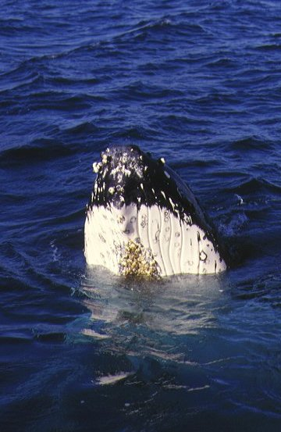
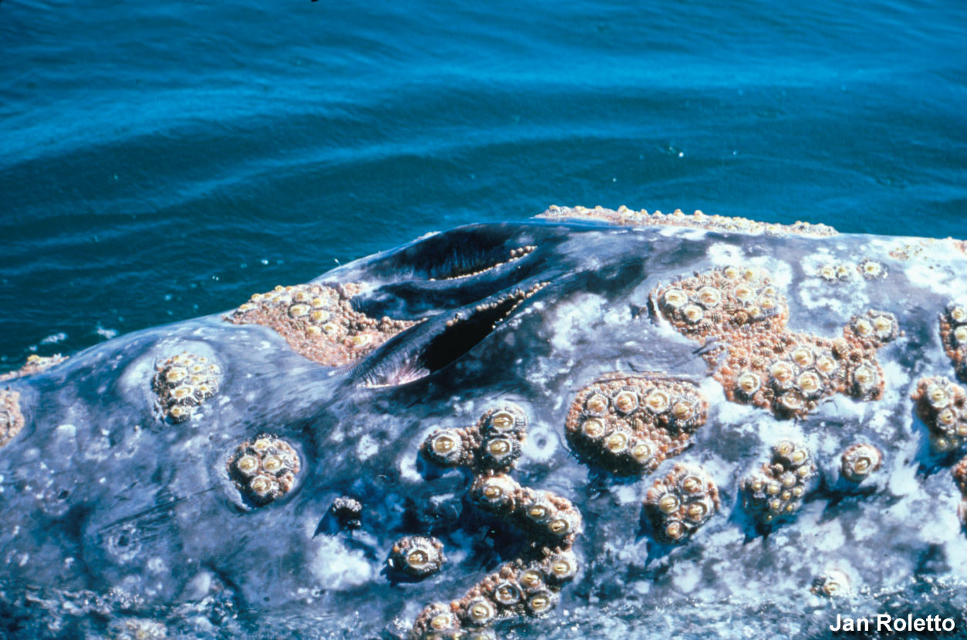
Commensalism—A symbiotic relationship in which one organism benefits and the other is unaffected
Example: barnacles on a whale

Slide 23
*In summary Symbiotic Relationships
Mutualism – both benefit
Parasitism – one benefits, one harmed
Commensalism – one benefits, one unaffected

Slide 24
Extra…

Slide 25
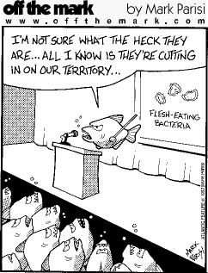
Remember…
In all environments, organisms with similar needs may compete with each other for resources, including food, space, water, air, and shelter.

