Slide 1
#81 Competition and population dynamics

Slide 2
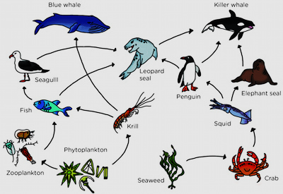
Warm-up
How many producers?
Primary consumers?
Secondary consumers?
Tertiary consumers?
What is/are the top carnivore(s)?
Is this an aquatic or terrestrial food web? How do you know
What abiotic factor is responsible for starting all food chains?

Slide 3
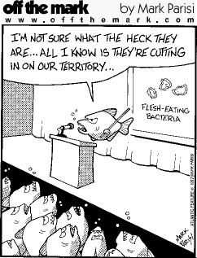
Remember…
In all environments, organisms with similar needs may compete with each other for resources, including food, space, water, air, and shelter.

Slide 4
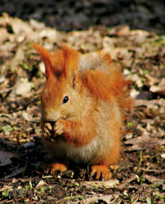
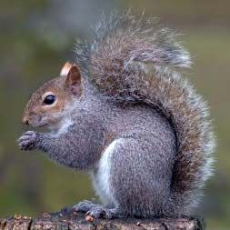
Until Americans introduced gray squirrels into parts of England in the early 20th century, red squirrels had been the only species of squirrel in the country. The gray squirrels were larger and bred faster and successfully competed for resources. Within a couple years of overlap in an area, the red squirrels disappeared. But why?

Slide 5
*Every organism has its niche
A niche comprises of both the place where an organism lives and the roles that an organism has in its habitat.
Niches explains the type of food the organism eats, how it obtains its food, and how it interacts with other organisms in the ecosystem.
Two different organism with identical niches cannot coexist in the same habitat.

Slide 6
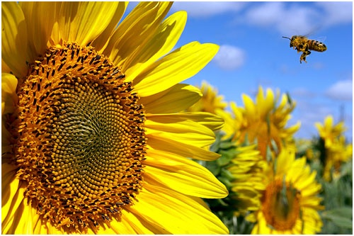
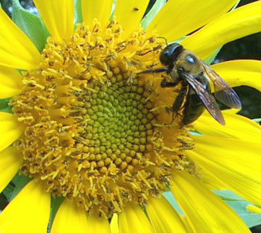
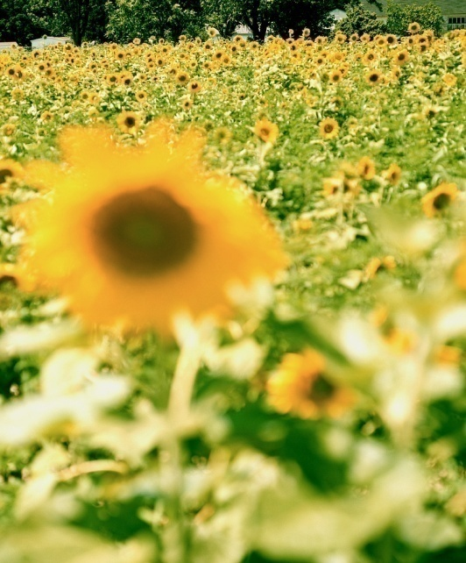
Example of a niche
The ecological niche of a sunflower growing in the backyard includes absorbing light, water and nutrients (for photosynthesis), providing shelter and food for other organisms (e.g. bees, ants, etc.), and giving off oxygen into the atmosphere.

Slide 7
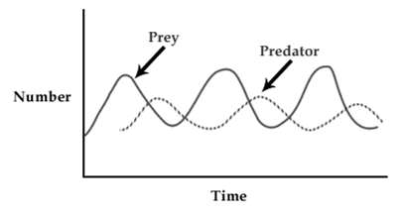
*Sometimes overlapping niches leads to:
Predation (Predator-Prey Graph) – shows the relationship/interaction of one species catching and feeding off another species
Competition usually results in a decrease in the population of a species less adapted to compete for a particular resource.

Slide 8
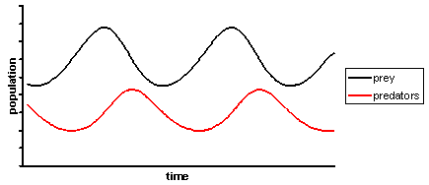
*Predator–prey graph
In order for the predators to survive, there must be more prey than predators.
The prey always increases before the predators do.
Notes:
To do: Write down how you could tell which line is the predator and which is the prey on a graph. Explain why the predator increases after the prey.

Slide 9
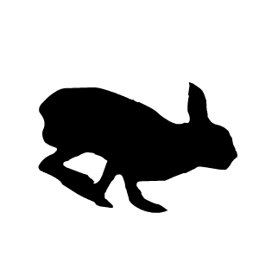
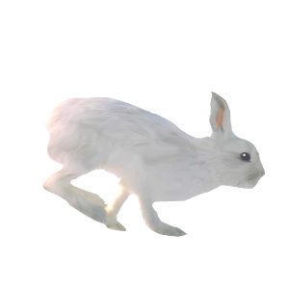
*Predator–prey cycle
Predator and prey population sizes follow a cycle.
What happens if the prey population increases?
normal prey population
prey population
increases
prey population
increases
predator population decreases
as less food
predator population increases
as more food
prey population decreases
because of more predators

Slide 10
No population can grow forever. Every population has a limit to its growth based off the number of available resources.
*A limiting factor prevents the continuing growth of a population within an ecosystem.
There are several things that can limit a population, we will learn the terminology in the following slides

Slide 11
*Population limiting factors
Population growth rate is how fast a given population grows
Factors that influence this are:
Natality ( _________ rate)
Mortality ( _________ rate)
Emigration (the number of individuals moving _____________ a population)
Immigration (the number of individuals moving ____________ a population)
birth
death
away from
to

Slide 12
*Population Characteristics
Population Density:
The number of organisms per unit area
Spatial Distribution:
Dispersion: The pattern of spacing a population has within an area
3 main types of dispersion
Clumped
Uniform
Random
The primary cause of dispersion is resource availability

Slide 13
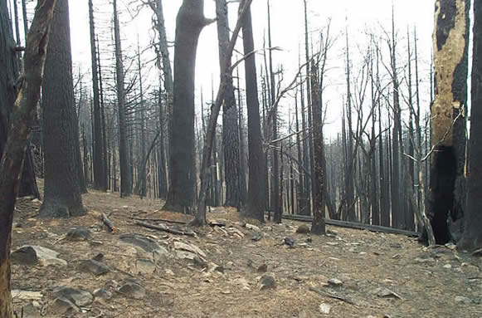
*Population Limiting Factors
Density-independent factors
Factors that limit population size, regardless of population density.
These are usually abiotic factors
They include natural phenomena, such as weather events
Drought, flooding, extreme heat or cold, tornadoes, hurricanes, fires, etc.

Slide 14
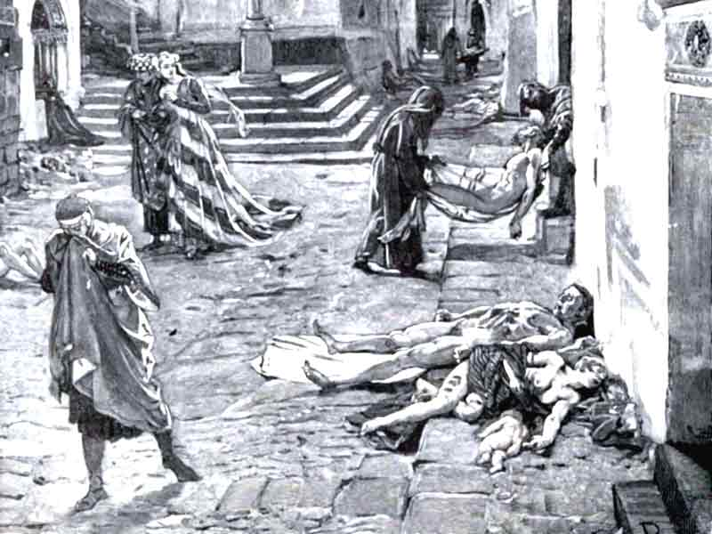
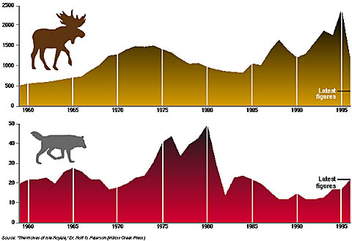
*Population Limiting Factors
Density-dependent factors
Any factor in the environment that depends on the population density
Usually biotic factors
These include
Predation
Disease
Parasites
Competition

Slide 15
Symbiotic Relationships within ecosytems
A symbiotic relationship exists between organisms of two different species that live together in direct contact.
The balance is important in a symbiotic relationship. If the population of one of the organisms becomes unbalanced, both populations will fluctuate in an uncharacteristic manner.
Symbiotic relationships include parasitism, mutualism, and commensalism.

Slide 16
Parasitism
Parasitism is a symbiotic relationship in which one organism (the parasite) benefits at the expense of the other organism (the host).
In general, the parasite does not kill the host.
Some parasites live within the host, such as tape worms, heartworms, or bacteria.
Some parasites feed on the external surface of a host, such as aphids, fleas, or mistletoe.

Slide 17
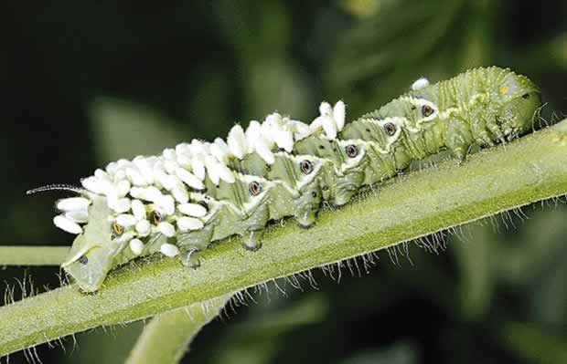
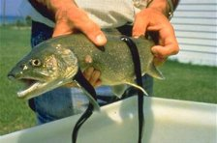
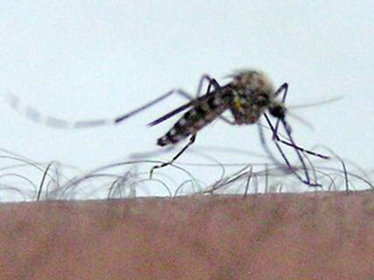
Wasp eggs on back of caterpillar.
Parasitism
Sea lampreys feed on fluids of other fish.
Mosquito biting a human.

Slide 18
Mutualism
Mutualism is a symbiotic relationship in which both organisms benefit. Because the two organisms work closely together, they help each other survive.
For example, bacteria, which have the ability to digest wood, live within the digestive tracts of termites; plant roots provide food for fungi that break down nutrients the plant needs.

Slide 19
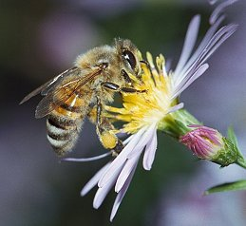
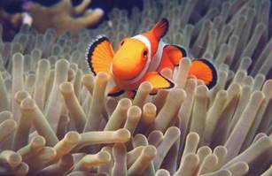

Slide 20
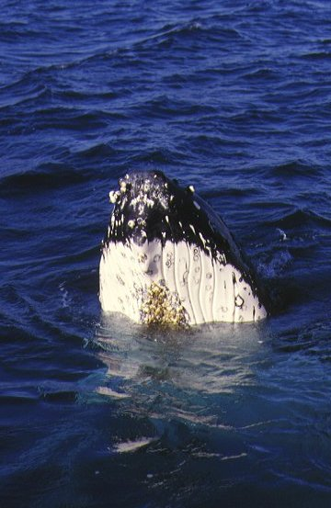
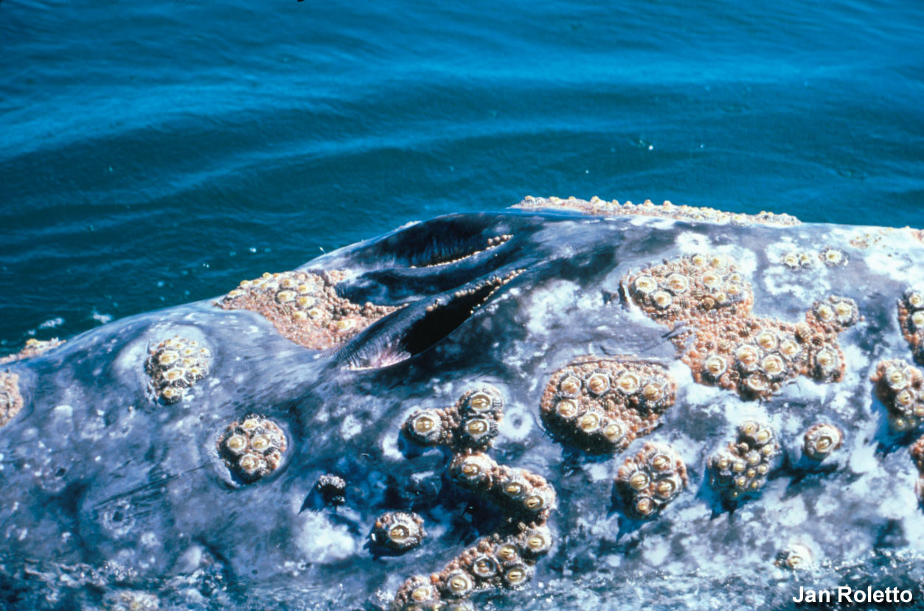
Commensalism—A symbiotic relationship in which one organism benefits and the other is unaffected
Example: barnacles on a whale

