Slide 1
#7 Soap Float Lab #8 Continental Drift & Plate Tectonics Notes ***Please Note – I am checking G/L flashcards Thursday***

Slide 2
Warm-up
Tell me in your own words Wegener’s theory.
https://www.youtube.com/watch?v=rDKiNwTwaNw

Slide 3
*What is Continental Drift?
Alfred Wegener hypothesized in 1912 that the Earths continents were once joined in a single landmass and they gradually moved apart.
The giant landmass was called Pangea

Slide 4
*What was his evidence
Fossils – Similar fossils of organisms found on different continents that are not connected to one another.
Climate – Climate change shows tropical plants in cold and icy places like Greenland and glacial streaks on rock layers in South Africa which has a warmer climate.
Rocks – Similar rocks layer formations on different continents.

Slide 5
Alfred Wegener and Continental Drift
https://www.youtube.com/watch?v=RgJZ0ySEKYg
7:36 animation clip

Slide 6
*Tectonic Plates
Scientists found in the mid 1900s that the lithosphere was broken into several large and small slabs of rock called tectonic plates.
Convection in the asthenosphere is responsible for moving the tectonic plates in the lithosphere.

Slide 7
Draw and label this diagram on the bottom of you paper

Slide 8
*So how did the continents get to their current position?
The force responsible for moving tectonic plates in the asthenosphere are convection currents.
Convection Currents occur within the asthenosphere when hot magma rises to the crust and pushes plates in separate directions. As the magma cools, it sinks back to the core to be heated up once again, continuing the cycle

Slide 9
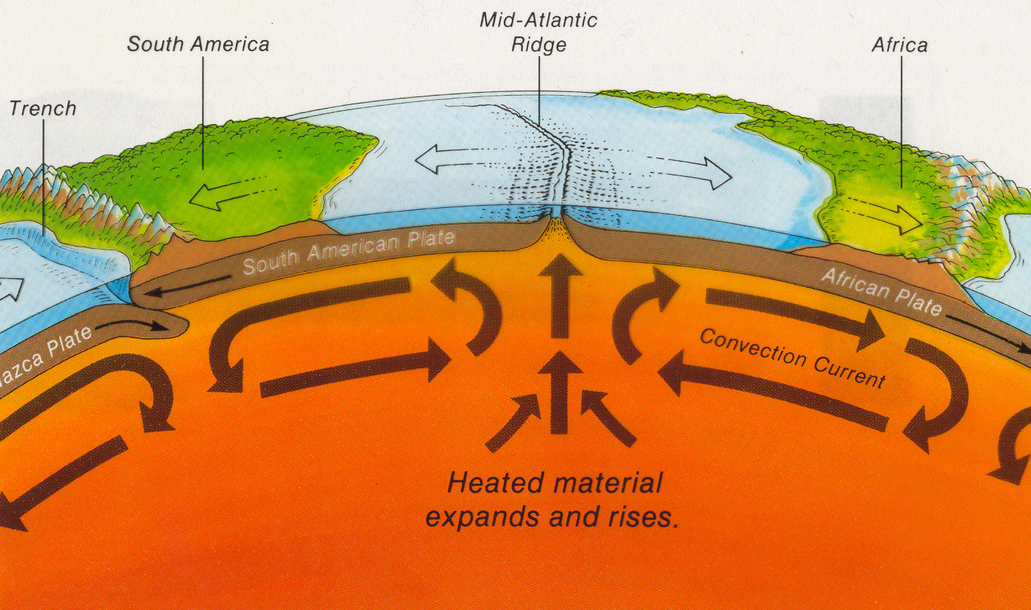
Convection Explained
https://www.youtube.com/watch?v=MmMX83diwl0

Slide 10
How did they prove how continents drift apart?
An American scientist named Harry Hess drilled down in the sea floor and proposed the seafloor spreading theory in 1962.
*The Sea floor spreading theory states that new crust is being created at mid-ocean ridges (which are large underwater mountains) and destroyed at ocean trenches.
This theory proved that the plates are moving/drifting along on a “conveyor belt” so Wegener’s idea on continental drift was correct.

Slide 11
PROOF THAT THE SEA FLOOR IS SPREADING
The oldest ocean floor rocks ever found are 180 million years old. Remember the Earth is 4.6 billion years old. This proves that ocean floor is being destroyed therefore all ocean floor rocks are young compared to the age of Earth.
The rocks closest to the ocean ridge were younger than the rocks found further from the ridge. This means that new rocks are formed at the ridges and push the older rocks away from the ridge.

Slide 12
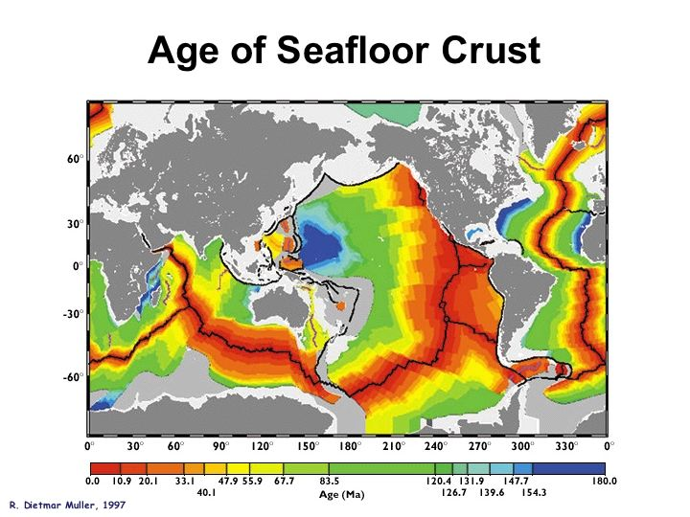

Slide 13
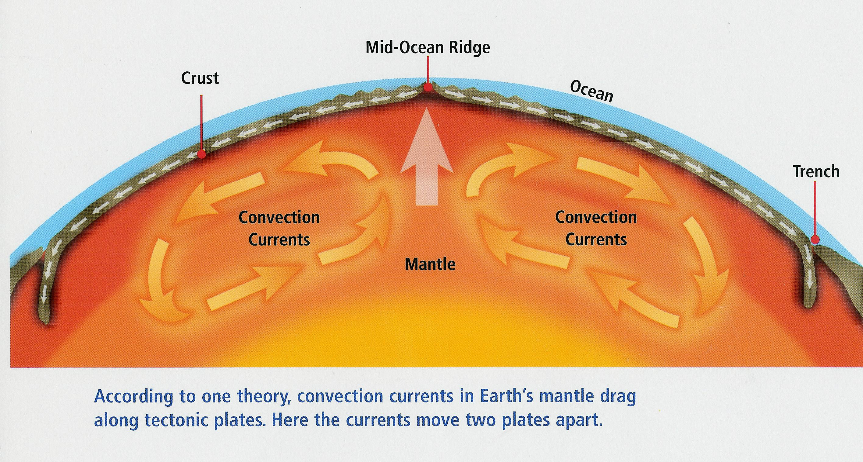
How is crust being destroyed?
*A process called subduction takes place at the ocean trenches. Here, oceanic crust gets pushed beneath continental crust towards the mantle and melts. This process destroys oceanic crust.

Slide 15
Warm-up
When Wegener first published his theory on continental drift, several scientists rejected his theory. Explain why?
Years later they accepted it because of a process called ____________.

