Slide 1
#9 Wegener and Hess Reading passage (do NOT glue in) #10 Continental Drift Notes

Slide 2
Warm-up
Summarize Wegener’s theory.
https://www.youtube.com/watch?v=rDKiNwTwaNw

Slide 3
*What is Continental Drift?
Alfred Wegener hypothesized in 1912 that the Earths continents were once joined in a single landmass and they gradually moved apart.
The giant landmass was called Pangea

Slide 4
*What was his evidence
Fossils – Similar fossils of organisms found on different continents that are not connected to one another.
Climate – Climate change shows tropical plants in cold and icy places like Greenland and glacial streaks on rock layers in South Africa which has a warmer climate.
Rocks – Similar rocks layer formations on different continents.

Slide 5
Alfred Wegener and Continental Drift
https://www.youtube.com/watch?v=RgJZ0ySEKYg
7:36 animation clip

Slide 6
*Tectonic Plates
Scientists found in the mid 1900s that the lithosphere was broken into several large and small slabs of rock called tectonic plates.
Convection in the asthenosphere is responsible for moving the tectonic plates in the lithosphere.

Slide 7
Draw and label this diagram on the bottom of you paper

Slide 8
*So how did the continents get to their current position?
The force responsible for moving tectonic plates in the asthenosphere are convection currents.
Convection Currents occur within the asthenosphere when hot magma rises to the crust and pushes plates in separate directions. As the magma cools, it sinks back to the core to be heated up once again, continuing the cycle

Slide 9
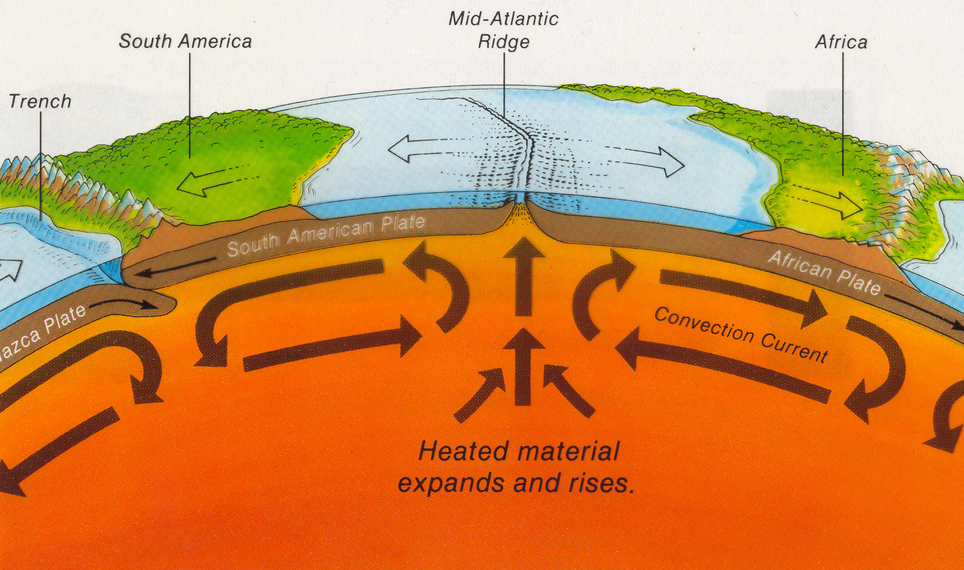
Convection Explained
https://www.youtube.com/watch?v=MmMX83diwl0

