Slide 1
UPDATE TOC: #46 Physical properties and changes #47 chemical properties and changes (section 3 review) #48 classifying phy/chem properties and changes #49 Counting Atoms Notes

Slide 2
If you recall from last week…
We mentioned that…
Chemical changes occurs when one or more substances are combined and change entirely to form new substances with new properties.
Today we are going to see how these changes are written, and learn how to count the number of atoms within each chemical bond.

Slide 3
Why do elements form chemical bonds?
Have you ever wondered why is water written as H₂O? Or why tablesalt is NaCl? What makes these atoms attracted to each other and why?
http://www.chem4kids.com/files/atom_bonds.html
Brainpop – Chemical Bonds
https://www.brainpop.com/science/matterandchemistry/chemicalbonds/

Slide 4
Chemical Bond
*A chemical bond is an interaction (joining together) that holds two or more atoms together to form new substances with different properties
The goal of atoms bonding is to get a complete or full outermost shell. This is called an Octet

Slide 5
*Stable or Unstable
Stable atoms: are non-reactive (do NOT want to bond with other atoms because they have a full outermost shell)
Unstable atoms: are reactive (they want to bond with other atoms because their outermost shell is not full)

Slide 6
How atoms bond
Atoms will either:
Share electrons to have a FULL outermost shell/energy level
Transfer (gain or lose) electrons to have a FULL outermost shell/energy level

Slide 7
*Chemical Equation Vocab
2H₂ + O₂ 2H₂O
*Coefficient – the # that is in front of the element or molecule and gets distributed to ALL associated elements or molecules (plus sign separates coefficients)
*Subscript – identifies the amount of atoms in an element (only applies to element it is behind)
*Reactant(s) – the starting material in a chemical reaction (on the left of chemical reaction)
*Product(s) – the substance formed from the chemical reactants ( on the right side of chemical reaction)
*Yield –shows the direction of reactions and separates the products from the reactants
Reactants
Products

Slide 8
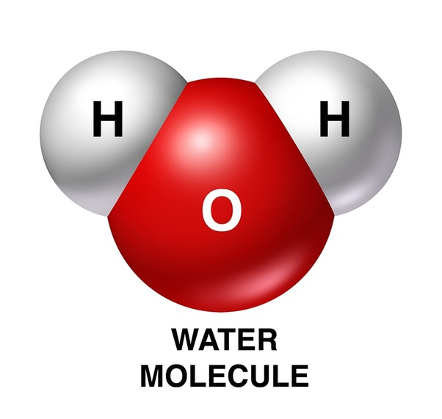
*rules for Counting atoms
When counting atoms you must always remember the subscripts behind each element.
A subscript tells how many atoms are present for each element.
If no subscript is written, then it is a understood one
H₂O There are 2 H and 1 O atoms in H₂O

Slide 9
*rules for Counting atoms
You must multiply the subscript by the coefficient in order to calculate the total number of atoms present in an equation
4 H₂O 4 x 2 = 8 therefore there are 8 H and 4 O

Slide 10
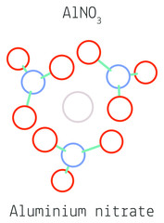
*rules for Counting atoms
If a molecule is written inside a parenthesis, you must multiply the subscripts inside the parenthesis times the subscript number outside the parenthesis times the coefficient
2 Al(NO₃)₃

Slide 11
When counting atoms remember…
The subscript behind the element
o2 = 2 Oxygen atoms
The coefficients distribute to every element its in front of (like in math 3(x +2)
4 H2O = 8 Hydrogen atoms and 4 Oxygen atoms
Parenthesis… multiply subscript inside the parenthesis by subscript outside the parenthesis then times that number by the coefficient if any
4 (NH3 )2
4. If there is no subscript or coefficient, then it is an UNDERSTOOD 1 (like in math x has an imaginary 1)
OH

Slide 12
Lets practice…
CO₂ 2 NH₃
C= N=
O= H=
Total atoms= total atoms=

Slide 13
Lets practice…
3 H₂O 4 Al(OH)₃
H= Al =
O= O=
H=
Total atoms= total atoms=

Slide 14
You try! Write down the molecules and count the # of atoms
NaOH | 4 HNO₃ | 4 Mg(OH)₂
MgCl₂ | 4 Li₂O | 2 CaCO₃
Li₂SO₄ | 2 (NH₄)₃PO₄ | 4 Al₂(SO₃)₃

Slide 16
Warm-up: count the atoms
2 CH3OH
2 Sr3(PO4)3
Sr =
P =
O =
Total atoms =

Slide 17
Write the name of the element in the 2nd column then using the octet rule list the amount of electrons each element would like to obtain to be full
Atomic Symbol | Element Name | VE Needed
C
H
Ne
S
Au
Cl
P
Br

Slide 18
Diagram on next slide
Fill in blanks with the following words:
Matter
Element
Homogeneous
Mixture
Substance
Compound
Heterogeneous

