Slide 1
#5 Bubble Lab #6 Density Notes

Slide 2
Warm-up
COPY THIS DOWN TO HELP WITH WARM_UP
Observation – the gathering of information by our 5 senses. (sight, smell, hearing, taste, and touch)
Inference – explanations for an observation you have made. They are usually based off prior knowledge and often can change when new observations are made

Slide 3
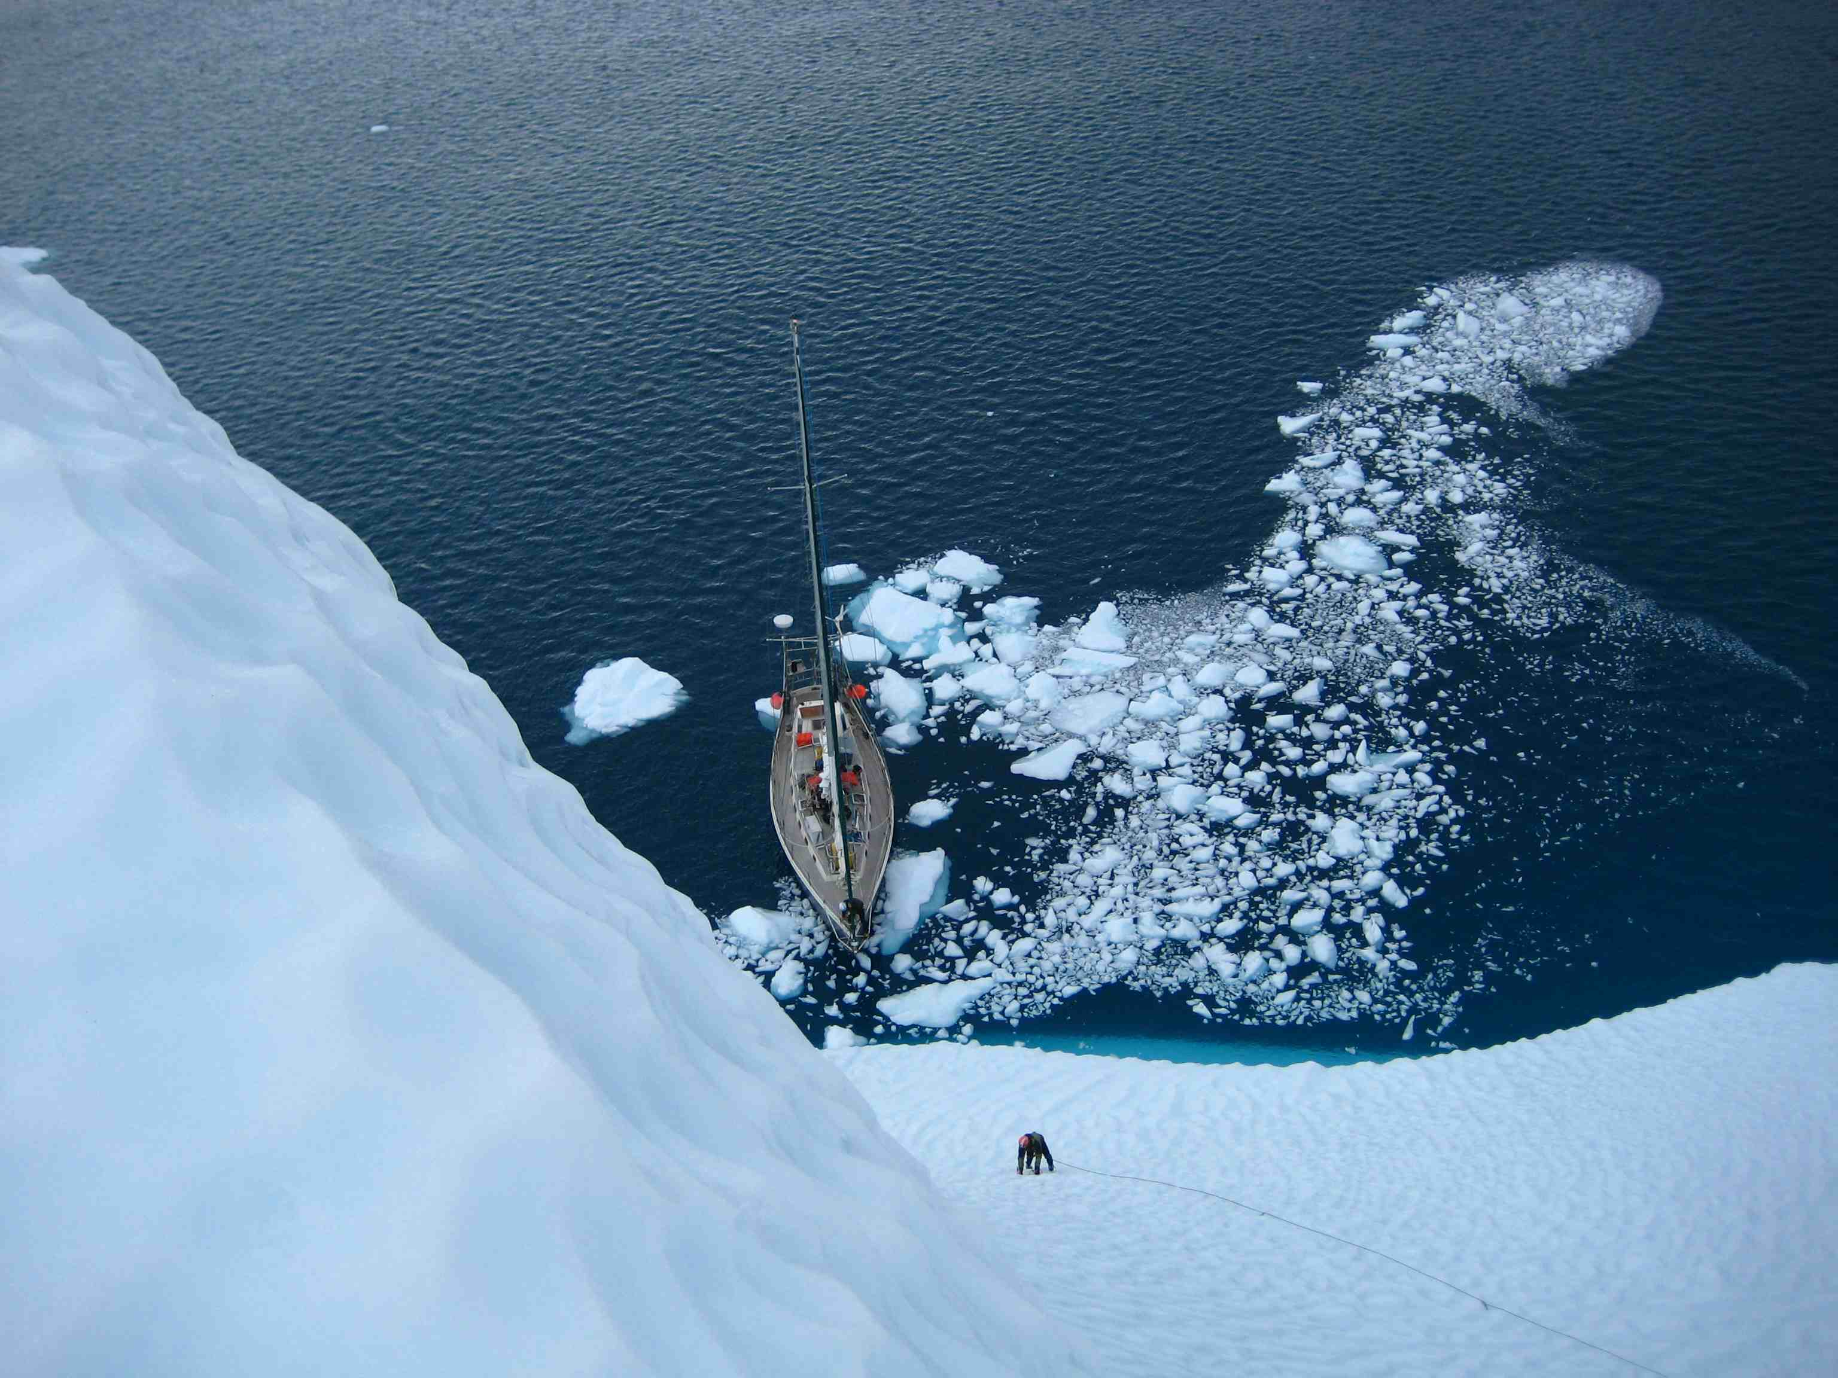
Write down 3 observations, 2 inferences, and 1 way this picture relates to density

Slide 4
Brainpop on matter, volume, density
https://www.brainpop.com/science/matterandchemistry/measuringmatter/
4 mins
Username: hrms pw: patriot

Slide 5
*Volume
Volume is the amount of room (space) an object takes up.
Volume is measured in cubic centimeters (cm³) or milliliters (mL)

Slide 6
*Mass
Mass is the measurement of how much “stuff” (atoms) are in an object, sort of like weight
Mass is measured in grams (g)

Slide 7
*Density
Density is the relationship between an object’s volume and its mass.
density is measured in grams over cubic centimeters (g/cm³) or grams over milliliters (g/mL)

Slide 8
Take a look at the two boxes below. Each box has the same volume. If each ball has the same mass, which box would weigh more? Why?

Slide 9
This box weighs more because it has more mass per volume
More mass inside of its volume
This property is called density

Slide 10
Density can tell you:
How close the atoms or molecules are to each other
More than “heaviness” - density includes how much space an object takes up!!
All substances have density including liquids, solids, and gases

Slide 11
Which one has a greater Mass? Volume? density?

Slide 12
Which one has a greater Mass? Volume? density? How do you know

Slide 13
*Density of pure water
Density of pure water = 1.0 g/cm³
If an object has a density greater the 1.0 g/cm³ it will sink in water.
If an object has a density less than 1.0 g/cm³ it will float in water.

Slide 14
Quick Question?
A object weighs 0.99 g/cm³ will this object sink or float? How do you know?
In order to calculate the density of an object we need to know the objects ______ and ________

Slide 15
How to read a density triangle
m
D
V
Notes:
Put your hand over what you are solving for in order to find the equations.
D= m / V
V= m/ D
m= D * V

Slide 16
Example
If the mass of an object is 144 g and it’s volume is 4 mL, what is it’s DENSITY?
144 g
m
4 mL
144 g
÷
D
V
4 mL

Slide 17
Density Equation Practice
A piece of wood has a mass of 20 grams and a volume of 30 cm³. What is the density of the wood? Will it float?

Slide 18
Density Equation Practice
A small rock has a density of 1.4 g/ cm³ and a mass of 70 grams. What is its volume? Will it Float? What part of the equation tells if it will or won’t?

Slide 19
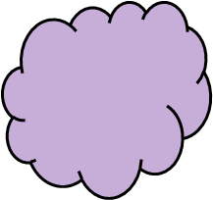
*How to find volume of irregular objects
?

Slide 20
*Using Water Displacement to Calculate Volume
Measure the level of the water in a container.
Insert an object in the water. Measure the level after the ball has displaced some of the water.
70 ml
60 ml
Initial water
30 mL
50 ml
40 ml
30 ml
20 ml
10 ml

Slide 21
*Using Water Displacement to Calculate Volume
Measure the level of the water in a container. 30 mL
Insert an object in the water. Measure the level after the ball has displaced some of the water. 39 mL
Subtract the difference between the raised water level from the initial water level.
39 - 30 = 9 mL
70 ml
The volume of the glob is 9 mL
60 ml
50 ml
40 ml
30 ml
20 ml
10 ml

Slide 22
Let’s Practice…
What is the density (g/mL) of 48 g of a metal if the metal raises the level of water in a graduated cylinder from 25 mL to 33 mL?

Slide 23
Keely Probe

Slide 24
Sample size of density
If you break a piece off of an object. ..Will it have a different density than the whole piece?

Slide 25
Sample size of density
If you break a piece off of an object. ..Will it have a different density than the whole piece?
NOOOOOOO!!! Density is based on total mass divided by total volume. When one changes, the other also changes, so the density stays the same!!!

Slide 26
Create the chart and solve
Density = 2 g/mL Volume = 25 mL | Density = 6 g/mL Volume = 42 mL | Mass = 4 grams Density = 2 g/mL
Mass 18 g Density = 12 g/ml | Density = 1.0 g/mL Volume = 3 mL | Density = 5 g/mL Volume = 45 mL
Mass = 12 g Volume = 13 mL | Mass =12g Volume = 16 mL | Mass = 12 g Volume =17 mL
Mass = 24.1 g Density 12.4 g/cm3 | Mass = 24.5 g Density = 22 g/cm3 | Density = 6.2 g/mL Volume = 12.4 mL

Slide 27
 | Trial 1 | Trial 2 | Trial 3
# Pennies

Slide 28
Write these instructions on HW Sheet
Solve each problem AND tell if it floats
No work = no credit

Slide 30
As the story goes, King Argo was given 3 pounds of gold. The king decided to use this gold to have a new crown made. He sent for his master crownmaker who took the gold and made a beautiful crown for the king. The king was very happy when he saw the crown, but when he put it on he was not sure if everything was right. He sent for his famous mathematician, Archimedes, and said, “Listen, Arch, I’ve got this problem. I gave the crownmaker 3 pounds of pure gold to make me a crown, but this thing feels a little strange. I also noticed that he just bought himself 200 new goats, and I’m a little suspicious that he may have stolen some of the gold. I want you to figure out if he did or not. If you can figure it out, I will give you however much gold is left out of the crown.” Archimedes was puzzled by this problem. The first thing he did upon returning home was to have a large bath drawn, because he loved to ponder problems in the bathtub. As he slipped into the bathtub he came up with a wonderful solution and yelled “EUREKA!!” as he ran to his laboratory to work out the problem. After an hour in the lab he had his answer ready for the king. He found out that although the crown weighed 3 pounds, it was not entirely made of gold. He realized that the crown was made of materials other than gold. Archimedes was able to do all of this without harming the crown.

Slide 31
Warm-up Activity
In this activity, you will play the part of Archimedes and will figure out the solution to this problem. Using the available materials create a demonstration for the king that will illustrate how to tell the difference between a crown made of pure gold and a crown made with other materials.
Write your results in a memo for his brother, who recently had a similar problem with his crownmaker. In your memo, explain step-by-step on the back of your sheet how you can determine if his crown is pure gold or not. Use illustrations when possible. GOOD LUCK!!!

Slide 32
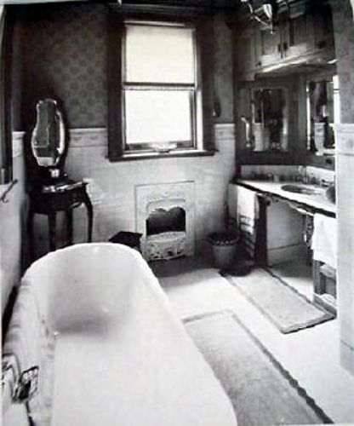
Materials
Water
Straws (pipes)
Popsicle sticks (wood)
2 spheres/cubes – crowns
Cups (sink or bathtub)
Twist tie (copper)
Glass mirror
Rug
Pen (writing utensil)

Slide 33
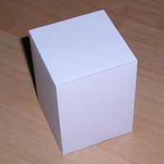
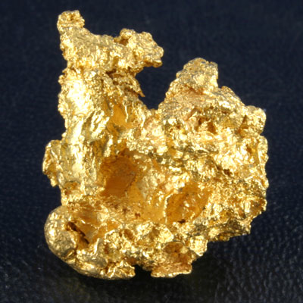
Volume and displacement
How do we find the volume of the figure on the left?
What about the one on the right?

Slide 34
Measuring volume…
Length X Width X Height
Start with a known volume place the irregular shape in and record the difference.

Slide 35
Volume displacement
A solid displaces a matching volume of water when the solid is placed in water.

Slide 36
Brainpop - buoyancy
https://www.brainpop.com/science/motionsforcesandtime/buoyancy/

Slide 37
#8 Penny Boat Lab
Grab a copy of the Penny Boat Lab page number 8 on your table of contents.
Wait for instructions before you begin

Slide 38
Extra Practice
Equation | Mass | Volume | Density | Sink/Float
 | 12 g | 0.5 cm³
 | 16 g |  | 0.2 g/cm³
 |  | 5 cm³ | 20 g/cm³
 | 0.9 g |  | 0.3 g/cm³
 | 6 g | 4 cm³
 | 8 g | 1.8 cm³
 |  | 13 cm³ | 9 g/cm³
 | 14.7 g | 15 cm³
 |  | 2 cm³ | 1.1 g/cm³
 | 17g |  | 3 g/cm³

Slide 39
Quick Question?
If I increase volume what happens to density?
If I decrease volume what happens to density?
If I increase mass what happens to density?
If I decrease mass what happens to density?
Notes:
D, I,I, D

Slide 40
*Density triangle
Volume
Density
Mass

Slide 41
*Density Triangle
Volume
Density
m
÷ ÷
V
×
D
Mass

