Slide 1
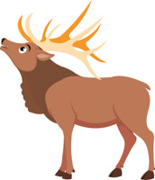
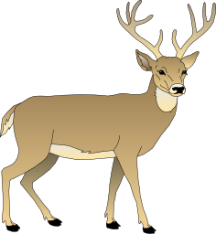
#74 Isolation leads to speciation notes

Slide 2
100 greatest discoveries: Natural selection
https://www.youtube.com/watch?v=eG0wBklnFI4

Slide 3
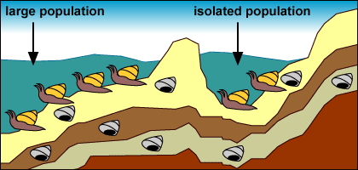
*Isolation
Isolation occurs when a physical barrier like mountains, rivers, and oceans prevents two populations of the same species from reproducing.
Isolation leads to speciation.

Slide 4
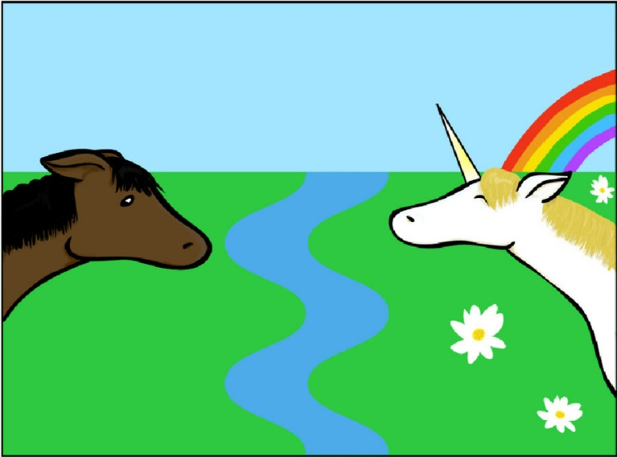
*Speciation
Speciation is when a species is isolated from the rest of the population causing both species to develop different genetic mutations and variations based on their new environment
After several generations of being isolated, the population will begin to look different from the original species. It may eventually become its own new species, making it unable to reproduce with the other species

Slide 5
How speciation works
A physical barrier blocks/prevents some species within a population from mixing (this is isolation)
Time will pass, and the isolated population will reproduce offspring with variations (mutations).
Since the species are located in two different places, the species will evolve differently based off where they live.
The more favored traits will reproduce, eventually creating two different species that will no longer want to reproduce with each other when they come into contact again
https://www.youtube.com/watch?v=EmtIofdeUbc
Notes:
Video is 2:38 seconds

Slide 6
Copy and Color diagram in your notes

Slide 7
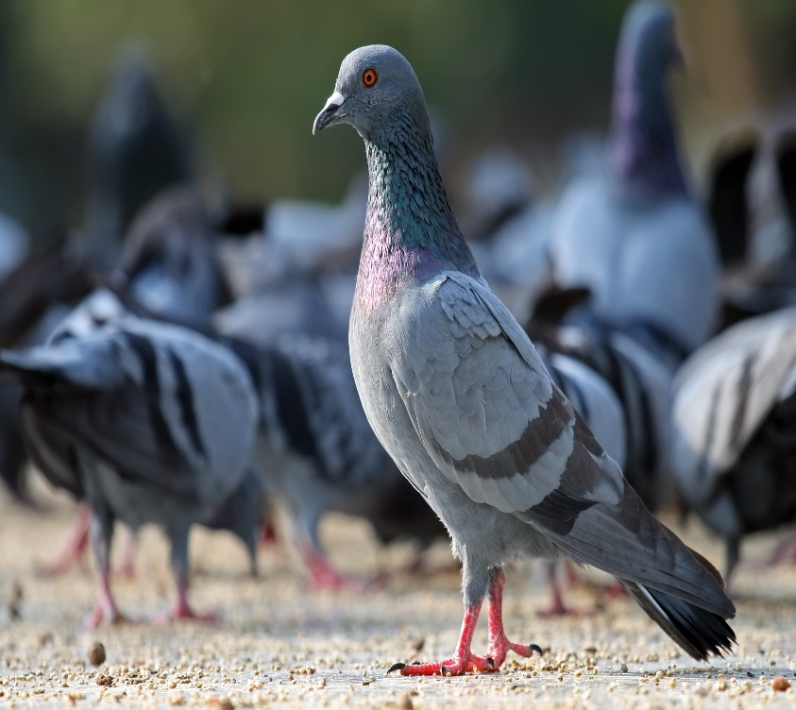
Remember evolution means change over time…
So is all evolution natural?
In the 1840s Darwin returned home from his voyage and created a new theory based off his hobby of breeding pigeons…
Darwin knew that breeders could produce new varieties of animals over time.

Slide 8
*Natural vs. Artificial Selection
Natural Selection
Artificial Selection
Natural is something made by nature
Nature decides the organisms with the best traits to survive and reproduce
Artificial is selective breeding by humans
Humans decides who/what lives or dies based traits they find more desirable
They hope its offspring will produce the same traits as well.

Slide 9
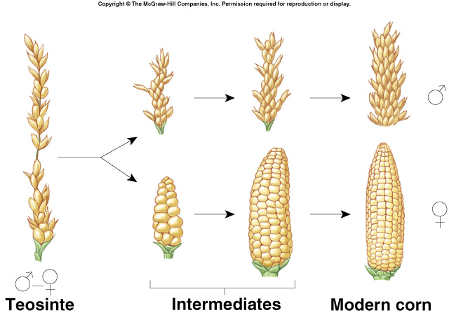
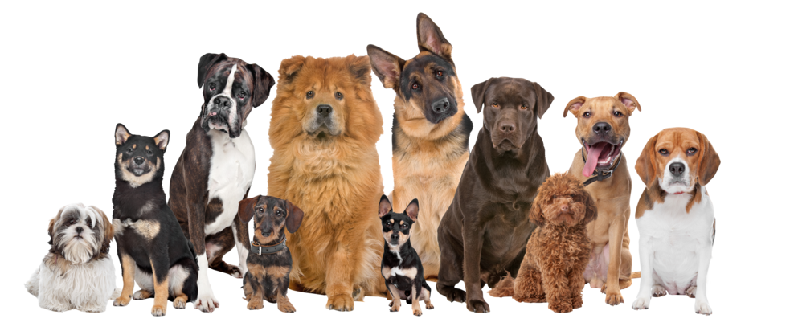
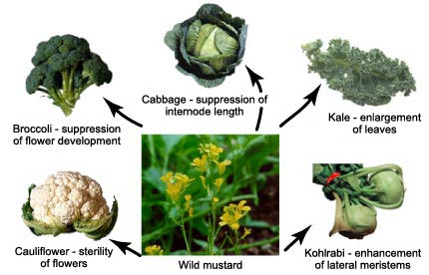

Slide 10
#75 Analogous, homologous, and vestigial structures

Slide 11
Fossil evidence for evolution
Most evidence of evolution was originally found in fossils. Fossils can preserve the structure of organisms in sedimentary rock if conditions are just right.
One area of evidence of evolution is embryology, the study of embryos. When we compare embryos we can see shared characteristics of organisms throughout their developmental process.
Lets see if we can look at embryos to see if we see any similarities

Slide 12
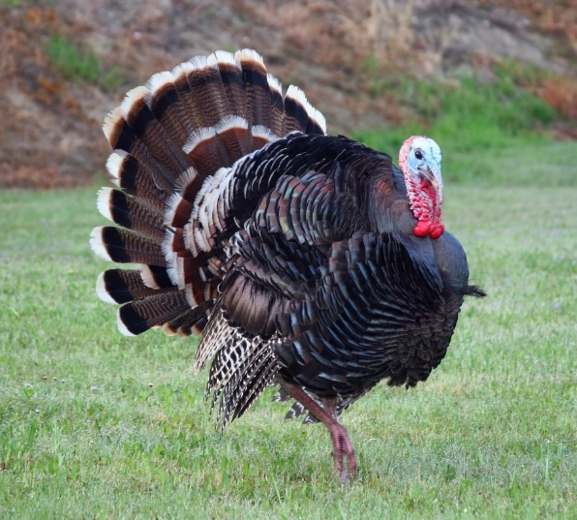
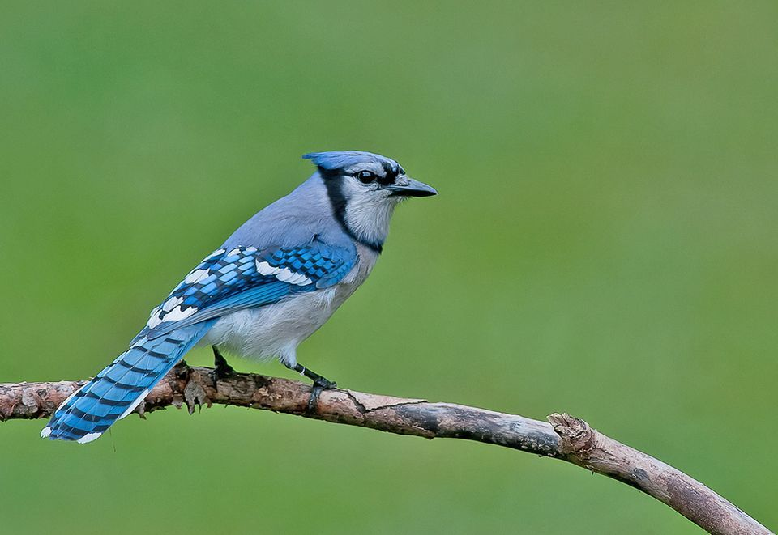
Structural and developmental evidence of evolution
What do these two organisms have in common?
If you said they both have feathers, you are correct.
The presence of feathers suggests that the two animals are related in some way. But how you ask…?

Slide 13
*Homologous Structures
Homologous structures: are structures with different appearances and functions that all derived from the same body part in a common ancestor
For example, mammals such as a humans arm, bat wing, and whale flipper all consist of very similar bones. (pictured on next slide)
Different functions, same ancestor structure

Slide 14
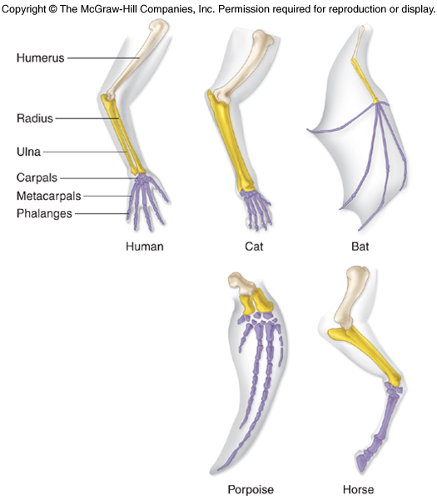
Homology of the bones of the forelimb of mammals

Slide 15
Homologous Structures

Slide 16
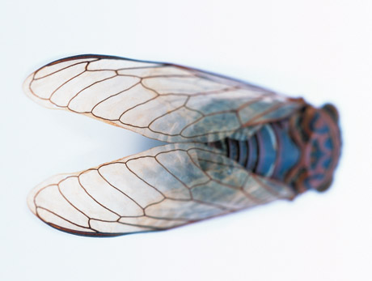
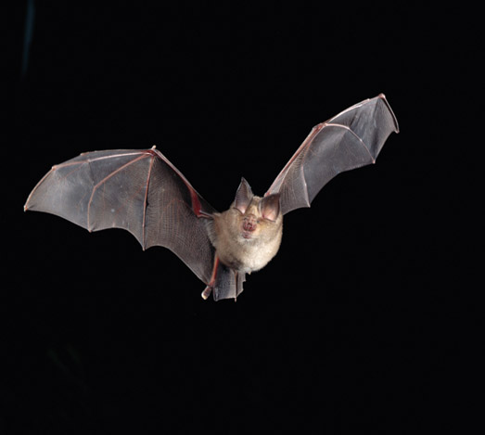
Homologous structures are different than Analogous Structures
*Analogous structures have a similar function but do not come from a common ancestor.
*Examples – bat wings and fly wings
Human hand
Mole foot
Fly wing
Bat wing

Slide 17
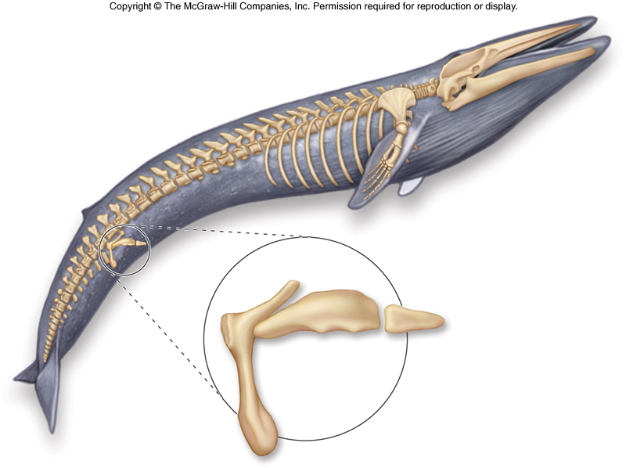
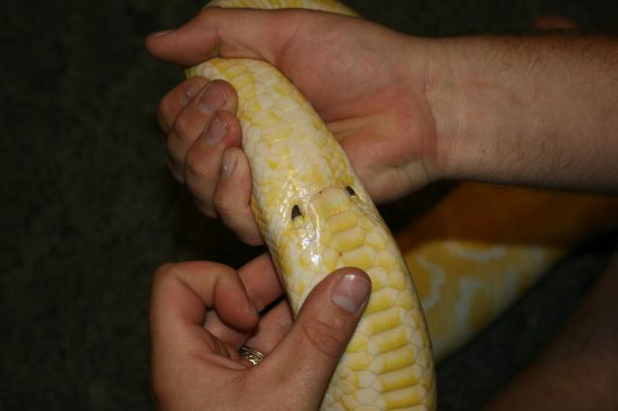
*Vestigial Structures
Vestigial structures have no apparent function, but resemble structures their ancestors possessed
Examples:
Leg bones in snakes and whales
Human tailbone, appendix, or wisdom teeth
Vestigial structures of a whale

Slide 18
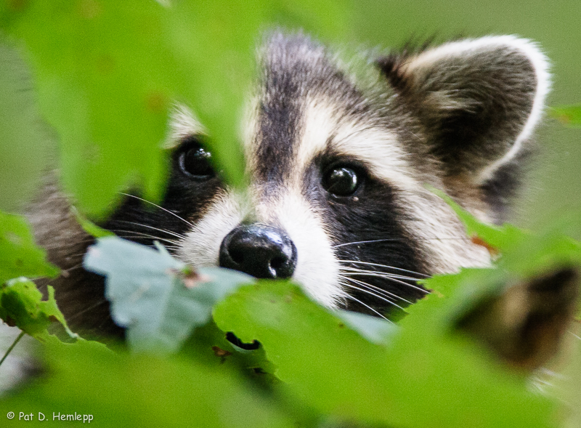
homologous or analogous structure???
INSECT EYES
MAMMAL EYES

Slide 19
homologous or analogous structure???
INSECT EYES
MAMMAL EYES

Slide 20
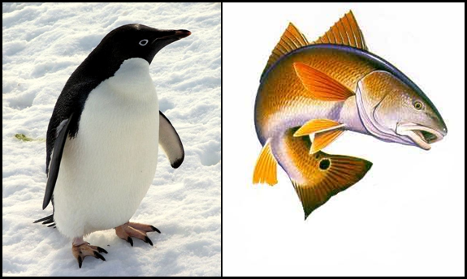
homologous or analogous structure???
PENGUIN FINS
FISH FINS

Slide 21
homologous or analogous structure???
PENGUIN FINS
FISH FINS

Slide 22
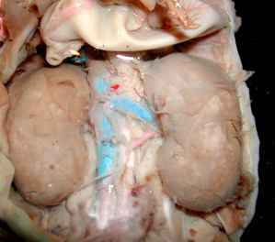
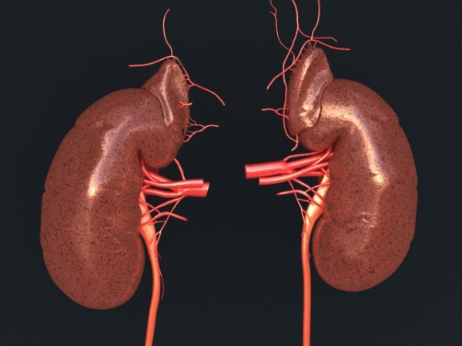
homologous or analogous structure???
HUMAN KIDNEYS
DOLPHIN KIDNEYS

Slide 23
homologous or analogous structure???
HUMAN KIDNEYS
DOLPHIN KIDNEYS

Slide 24
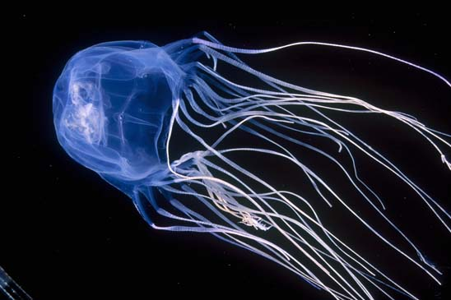
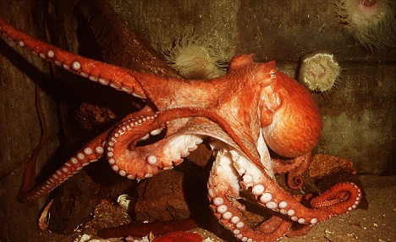
homologous or analogous structure???
JELLYFISH TENDRILS
OCTOPUS TENTACLES

Slide 25
homologous or analogous structure???
JELLYFISH TENDRILS
OCTOPUS TENTACLES

Slide 26
Concept check
How does common ancestry between two species support evolution
A slight change in a rabbits ability to hear its predators is an example of

Slide 27
warmup
In a minimum of three sentences explain how evolution leads to antibacterial resistance

