Slide 1
Upcoming dates: wed 3/20 – post quiz mon 3/25 – disease test + interim

Slide 2
#71 How disease spreads

Slide 3
Warm-up
In your notebook define and explain a way these relate to our current unit.
Pathology
Epidemiology
Biotechnology
Microbiology

Slide 4
Warmup
Suppose a bacterial colony is 30 & they split every hour. In how many hours will it take for their population to grow to 1,920 bacteria?
Assume that a bacterium can divide every 15 minutes. If you start with 2 cells, how many bacteria will be present in 2.5 hours

Slide 5
*So how are contagions spread?
Pathogen: any microbe that causes a disease
Carrier: An individual infected with a disease, can spread disease, regardless of them showing or not showing symptoms
HIV Postive? Or not?

Slide 6
*Disease Transmission
Contagion – A disease that is spread from one organism to another
Contagions are diseases that are contagious!
Example: the flu is a contagion because it can spread from one person to another

Slide 7
*How disease is transmitted
Air Borne
Water Borne
Human contact (skin to skin or blood to blood)
vector borne

Slide 8
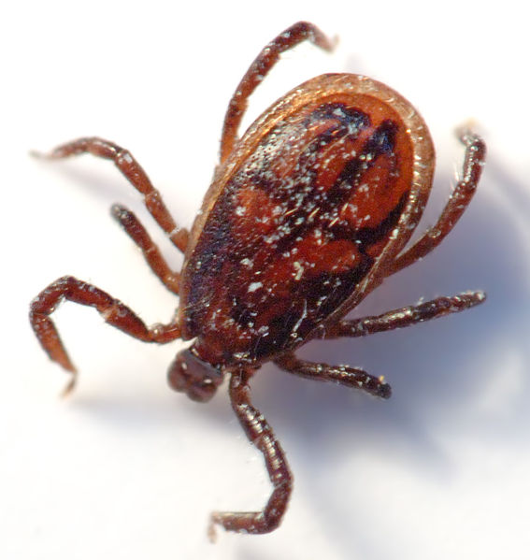
*Vector
A smaller organism that passes the disease from one organism to another
Fleas transmit the bubonic plague
Ticks transmit Lyme disease
Mosquitoes transmit malaria, yellow fever,
or West Nile Virus

Slide 9
https://www.youtube.com/watch?v=72KsjWUCUJQ
Notes:
https://www.youtube.com/watch?v=72KsjWUCUJQ

Slide 10
*If not passed from person to person its not a contagion
Examples of non-contagions:
Heart disease
Depression
Cancer
Asthma

Slide 11
Pandemic vs. Epidemic
An epidemic is when the number of people who become infected rises well beyond what is expected within a country or a part of a country.
*An epidemic is specific to one city, region or country

Slide 12
Pandemic vs. Epidemic
A pandemic is usually caused by a pathogen humans either have little to no immunity against. Since so little people are immune, the pathogen can easily spread around the world if it becomes easily transmissible in humans.
*A pandemic covers a much wider geographical area (more than one country, often worldwide. A pandemic also infects more people than an epidemic.

Slide 13
#72 – Infectious Disease spreadsheet

Slide 14
Pathogen chart worksheet
Fill out the chart with the appropriate information. We will go over the chart in class
If you do not complete this in class then it is homework

Slide 15
Disease Name | Type of Pathogen/Contagion (bacteria, virus, protist, fungi, or parasite) | Transmission : Airborne, waterborne, direct contact, or vector borne **if you pick vector, tell the organism that transmits pathogen | Treatment/Prevention (is this treated with antibiotics, vaccines, other, or nothing)
Strep Throat
Lyme Disease
Common Cold
West Nile Disease
Staph Infection
Ringworm
H1N1 Influenza
Malaria

Slide 16
Cholera Mapping Death Activity

Slide 17
Mapping Death Assessment questions
Describe what you see on the map you have marked with the locations of the deaths. Explain any trends you noticed about the placement of dots. (are they scattered, clumped, random, uniform)
Explain any other clues about the cause of disease.
Look at the information that you know about the victims, such as their ages and occupations. Are there any similarities in victims?
Based on the evidence of the cholera death locations shown on the map, state 3 hypothesizes or reasons that might explain how the disease spread. (A hypothesis is an idea or theory about how or why something happens).
Explain possible solutions to resolving the Cholera death problem

Slide 18
http://pandemic3.com/

