Slide 1
#18 Distribution of Water Notes

Slide 2
Warm-up
“Water, water, everywhere, Nor any drop to drink.” This is part of a stanza from the Samuel Taylor Coleridge’s poem, “The Rime of the Ancient Mariner.”
Explain what the quote means? Where do you believe most of our drinkable water comes from?

Slide 3
*The Earth is made of:
To: Water
~29%
~71%

Slide 4
*Water on Earth
3%
To: Drinkable
97 %

Slide 5
Demo
If I had a 1000 mL graduated cylinder that represented all water on earth. How much will I have to fill it to represent 97% saltwater
1000 mL = 100% of water on earth
_____ mL = saltwater
_____ mL = freshwater

Slide 6
*Freshwater %
~1%
To: Surface Water
~29%
~70%

Slide 7
Demo
Lets take a closer look at freshwater and break it down even more…
If 30 mL represents all freshwater on Earth
____ mL = frozen- ice and glaciers
____ mL = groundwater
____ mL = surface water
1000 mL = 100% of water on earth
970 mL = saltwater
30 mL = freshwater

Slide 8
*Surface Water %
2%
11%
87%

Slide 9
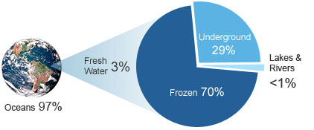
THE EARTH:
71% Water
29% Land

Slide 10
*What is the difference between salt vs freshwater?
Salt water is water that contains dissolved salts and other minerals in the water.
Freshwater – water that has no taste, color, or smell. Freshwater is important for all life, despite it being scarce on the Earth.

Slide 11
Why is the ocean salty?
https://www.usgs.gov/special-topic/water-science-school/science/why-ocean-salty?qt-science_center_objects=0#qt-science_center_objects
Salt in the ocean comes from ____________________.
Mention how land contributes salt in saltwater as well as how hydrothermal vents put salt in water

Slide 12
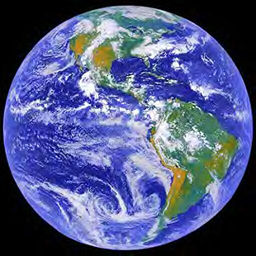
Why does water stay on Earth…
*The Earth is a closed system. A closed system means that we have a layered atmosphere that prevents mass or energy from escaping out of our atmosphere

Slide 13
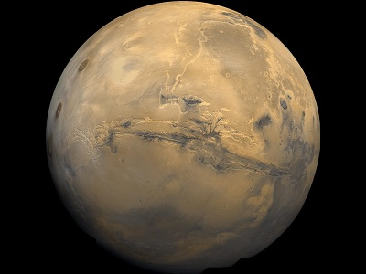
So is there a such thing as an open system?
*Open Systems have no layers/atmosphere preventing exchange of mass or energy. This means anything can enter and exit.

Slide 14
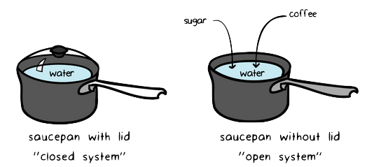
Open closed system example

