Slide 1
Upcoming Dates

Slide 2
Upcoming Dates
Tues 12/17– Post quiz
Thurs 12/19 – chem 1 test
Thurs 12/19– notebook check

Slide 3
#38 Chem 1 mid unit quiz #39 Elements compounds mixtures reading passage #40 Elements, compounds, mixture notes

Slide 4
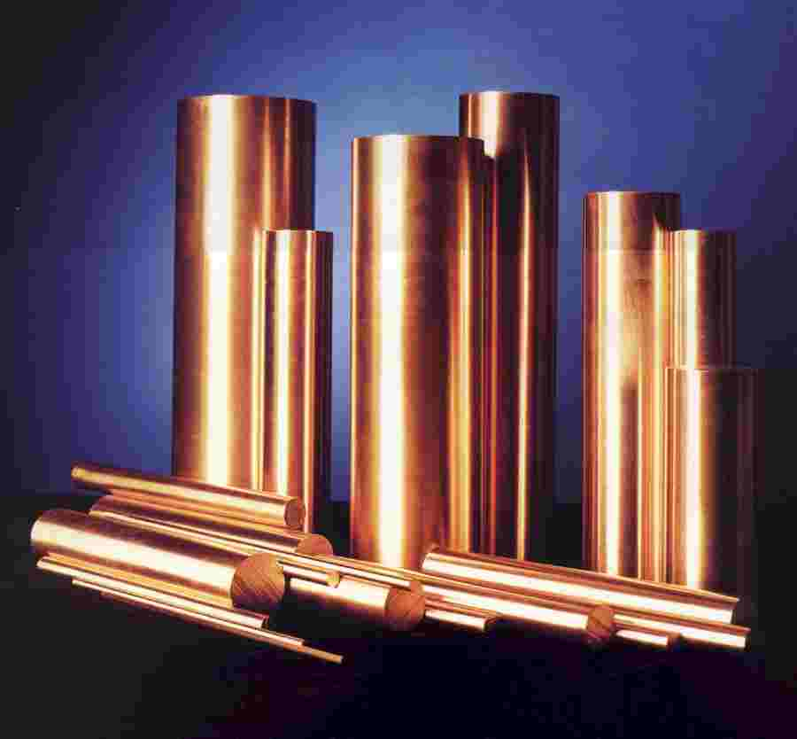
*Element
Elements are composed of one kind of atom, which are listed and found on the periodic table

Slide 5
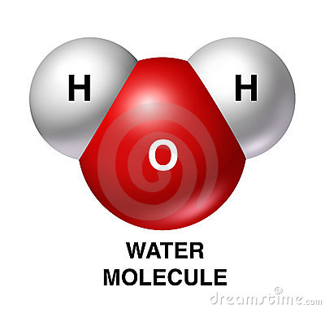
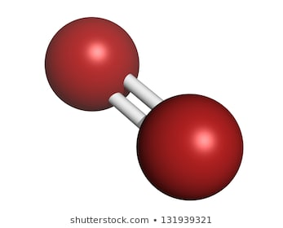
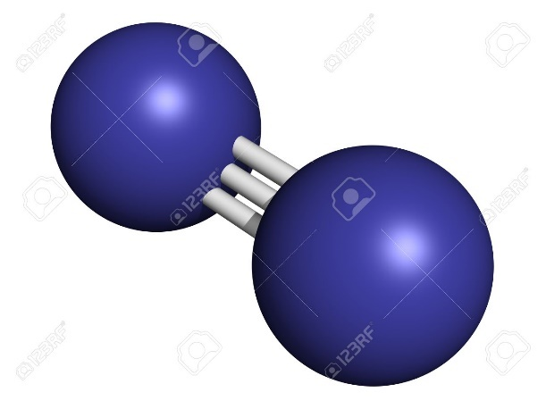
*Molecule
A molecule is formed when any two or more atoms join together chemically.
For example:
O2 N2 H2O

Slide 6
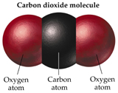
*Compound
A compound is a substance made up of atoms of two or more different elements joined by chemical bonds.
Compounds cannot be separated physically
Ex. H2O

Slide 7
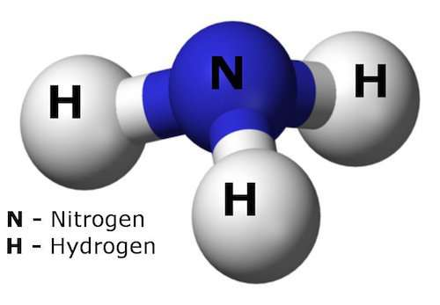
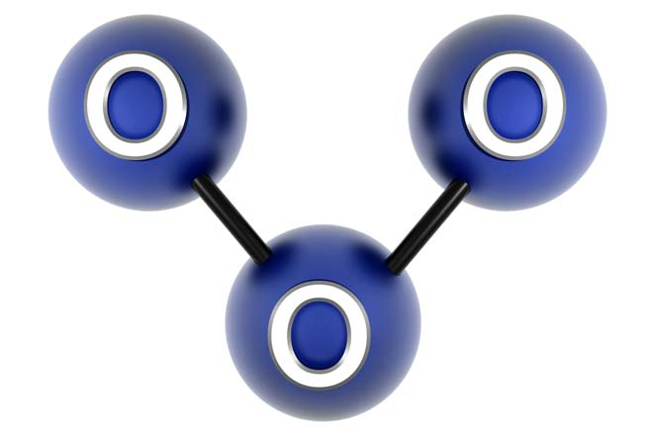
Are all of these compounds?

Slide 8
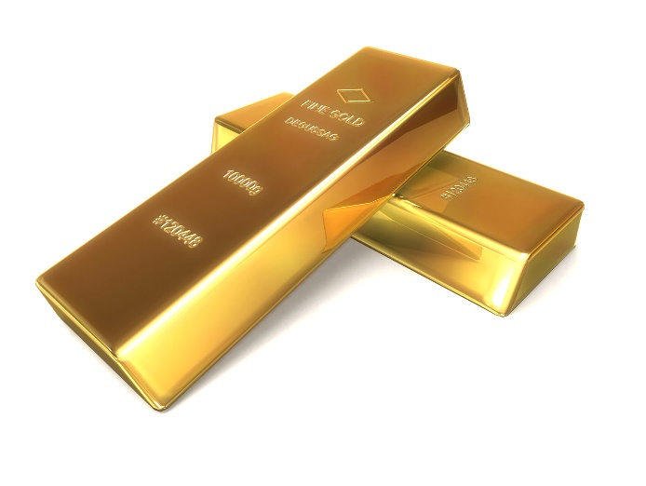
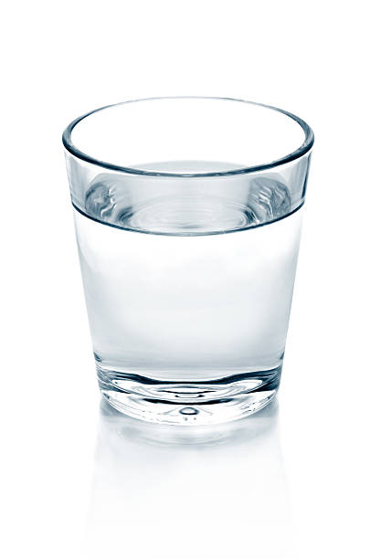
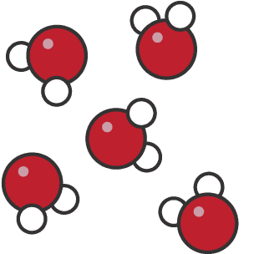
*Pure substance
A pure substance is a substance made of only one type of atom or one type of molecule.
Examples are:
A block of gold (Au) glass of water (H20)

Slide 9
Explain which is true:
All molecules can be compounds but not all compounds can be molecules
Or...
All compounds can be molecules but not all molecules can be compounds

Slide 10
*Mixture Solutions
Mixtures are combinations of two or more different elements or molecules that are combined together.
These solutions can be separated by physical means such as filtration, sifting, or evaporation
There are two types of mixtures:
-Heterogeneous
-Homogeneous

Slide 11
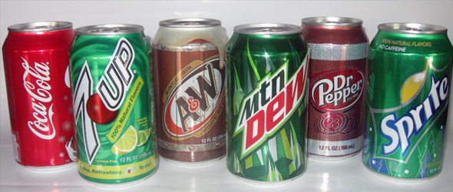
*Homogeneous Solution
A homogeneous solution contains more than one type of matter and is the same throughout
(you cannot see the different parts of the mixture)
For example:
Soft drinks

Slide 12
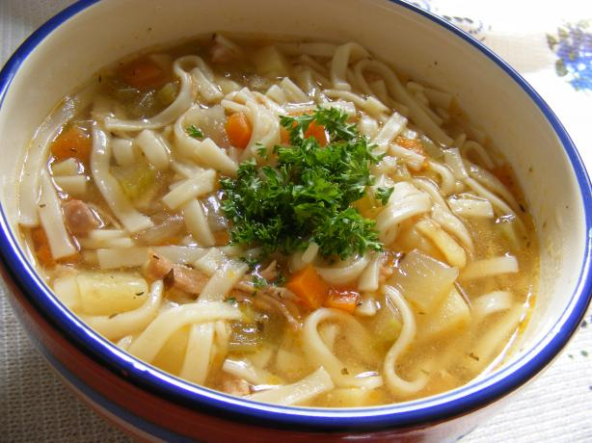
*Heterogeneous solution
A heterogeneous solution contains more than one type of matter and is not the same throughout
(you can see the different parts of the mixture)
For example:
Chicken noodle soup

Slide 13
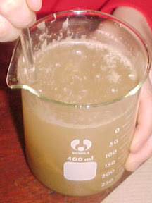
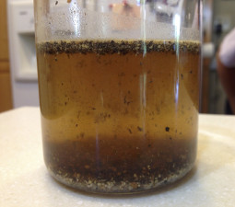
*So what happens when things don’t mix well?
A suspension is when dissolved particles (solute) are larger than the solvent they are being mixed in. This causes the liquids to appear cloudy or murky.
Examples:
-Muddy water
-sand and water

Slide 14
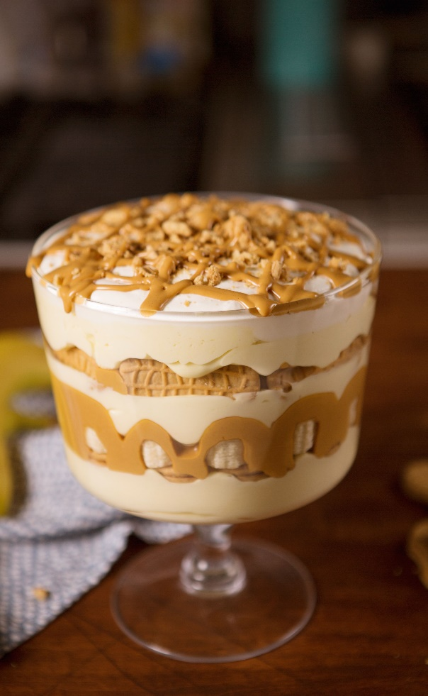
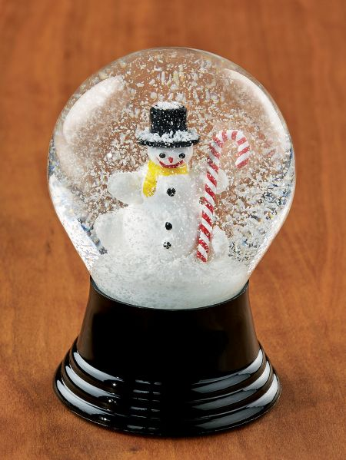
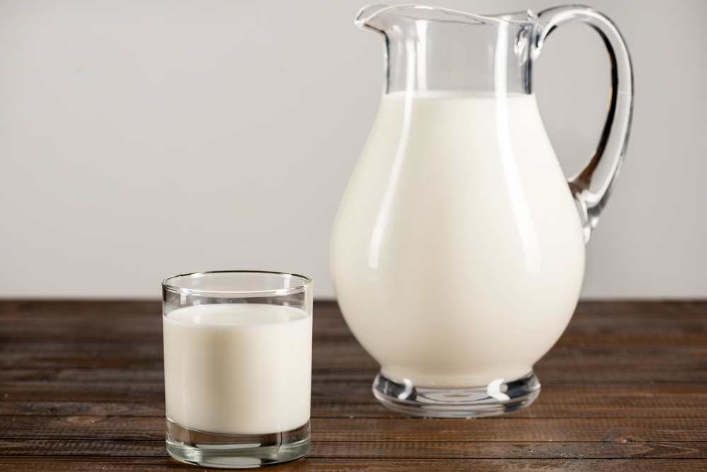
Classify the following: Ho.M, He.M, or Sus.

Slide 15
Elements, Compounds, Mixtures Song
Mr. Lee Rap
http://www.youtube.com/watch?v=B0d-fzj9oMQ

Slide 16
Ted Ed – molecules and mac salad ~4 min
https://www.youtube.com/watch?v=Vt7lN4QPU0k&vl=en

Slide 17
Extras…

Slide 18
Mixtures vs. compounds
Mixtures | Compounds
Made of elements, compounds, or both | Made of elements
No change in original properties of components | Change in original properties of components
Separated by physical means | Separated by chemical means
Formed using any ratio of components | Formed using a set ratio of components

Slide 19
Diagram on next slide
Fill in blanks with the following words:
Element
Homogeneous
Mixture
Substance
Matter
Compound
Heterogeneous

Slide 21
Warm-up
How can we tell the difference between elements, compounds, and mixtures. What do they look like and give an example of each

