Slide 1
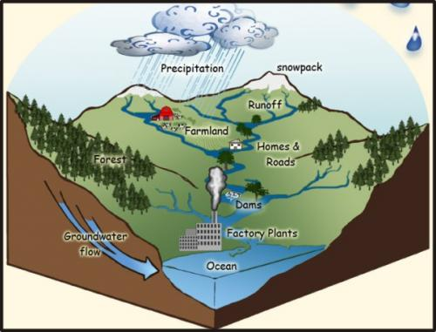
#24 Groundwater AEIOU #25 Exploring Watersheds

Slide 2
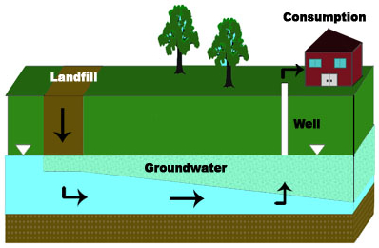
Is the land above a water table permeable or impermeable? How do you know?
Water will trickle down within the spaces of rock until it reaches what?
According to this diagram, how do we access groundwater?
Explain what the diagram is trying to environmentally warn us about?

Slide 3
A-E-I-O-U
A – AIM (What is the purpose of this video? How does it relate to what we are learning?)
E – EMOTION (describes how a part of the video made you feel)
I – INTERESTING
O – OH! (A fact or something said that surprised you.)
U – UMM? (a question you may still have after watching the video)
Grab a copy of the AEIOU Chart
You will be filling this out as we watch the video clip on Wake County, NC well-water
https://www.youtube.com/watch?v=DKi9_jMSITI

Slide 4
Recap…

Slide 5
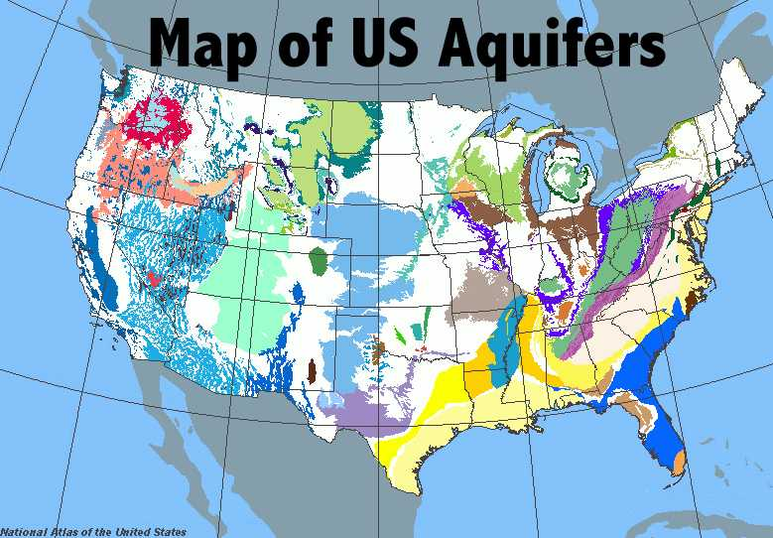
Some water hits land and seeps into the ground in aquifers that we can access by springs and wells. But what about the water that isn’t absorbed in the ground?
If the water doesn’t get absorbed into the ground, then it is called run-off.

Slide 6
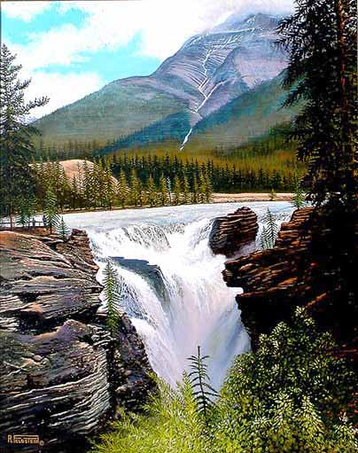
*Where does runoff go?
A drainage basin is the large area of land where water travels from a higher to a lower elevation until it makes it to the ocean.
These can also be called river basins.

Slide 7
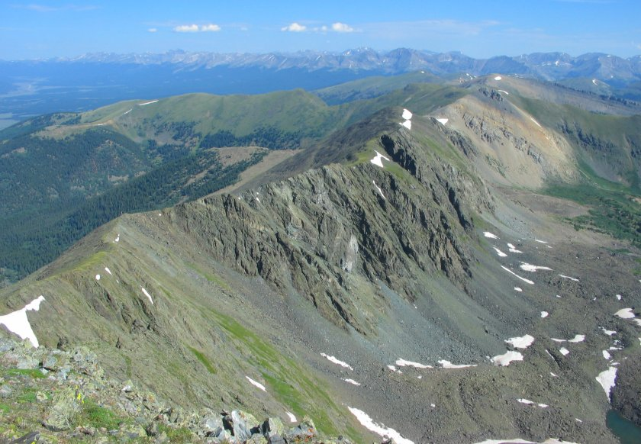
*Where does runoff go?
As precipitation falls back down towards the Earth due to gravity, mountain ranges (higher elevations) are responsible for forcing water to choose a direction in which it will flow down.
A divide is the mountain peak separating one drainage basin from another
The path in which water drains down from mountains are called tributaries or watersheds. There are several watersheds within each drainage basin.

Slide 8
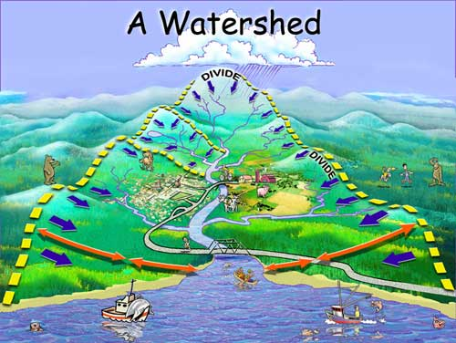
Watersheds flow in a downward direction trying to make it to the ocean.
*Watersheds will eventually meet and connect with other watersheds and feed into a river. This river of water is called a river basin.

Slide 10
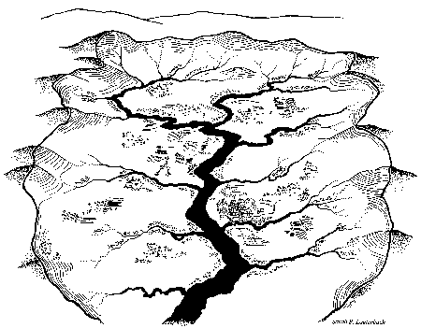
Here is an example of River or Drainage Basin. Let’s identify the watersheds
How many smaller watersheds are in this river/drainage basin?
At least 9, maybe more?
Notes:
https://mrsgeographyblog.wordpress.com/2017/03/10/pop-up-drainage-basin/#jp-carousel-1832

Slide 11
Explanation of Watersheds – Watersheds! (5:21)
https://www.youtube.com/watch?v=2pwW2rlGIa8
Watersheds quick and fast explanation
https://www.youtube.com/watch?v=QOrVotzBNto#action=share
(1:17)

Slide 12
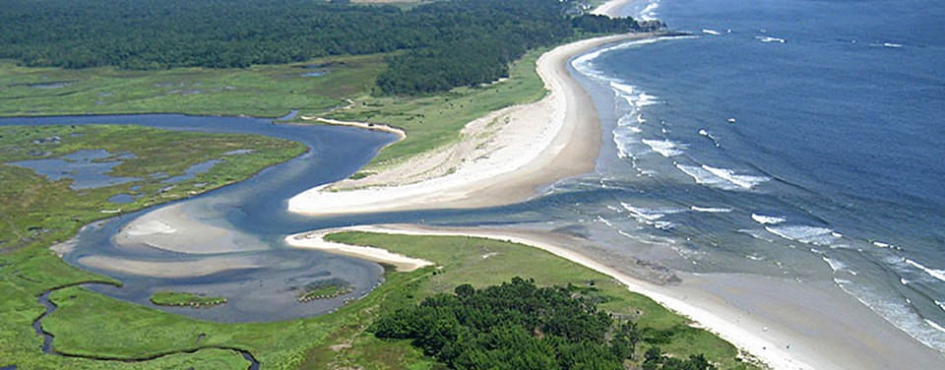
After the freshwater runs off the mountain and into rivers, its goal is to still make it to the saltwater ocean. The area in between where freshwater meets saltwater is called an estuary.

Slide 13
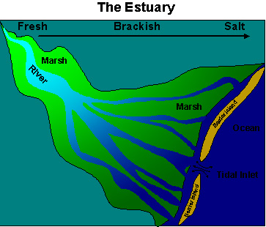
*Estuaries
Estuaries are where freshwater (from rivers, streams, creeks) meets saltwater (ocean)
Also known as brackish water
Estuaries have twice the life because 2 ecosystems are colliding

Slide 14
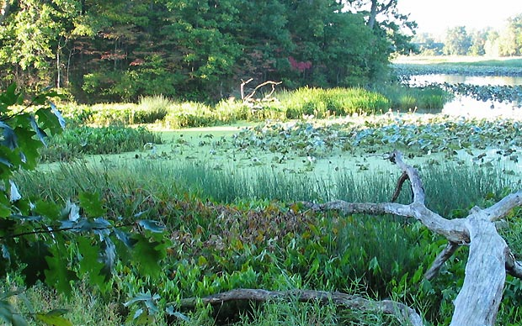
*Estuaries have….
Double the plant life
Double the nutrients
Double the breeding & feeding possibilities
https://oceanservice.noaa.gov/facts/estuary.html
(2mins)

Slide 15
So lets draw a model

Slide 16
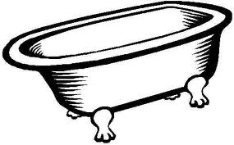
River Basin Analogy….
A bathtub catches all water falling within its’ sides, sending it down the drain and eventually to a large treatment plant. This is similar to drainage basins because water falls within surrounding land, to a central river and out to an estuary or ocean.

Slide 17
Two types of estuaries you must be familiar with: Salt marshes and mangrove forests
Create a Venn diagram or a double T chart comparing and contrasting them in your notes. You must find a minimum of 3 differences and 3 similarities
Where to start:
Textbook page C117
http://marinebio.org/oceans/estuaries-salt-marshes-mangroves/

Slide 18
2 types of estuaries
SALT MARSHES
Atlantic Carolina coasts and cooler regions
Nutrient rich soil promotes growth of grasses
Protects shoreline from washing away
BOTH:
Great breeding area
Protects coastline
Great nurseries to plants
MANGROVES
Louisiana & gulf and warmer regions
Hurricane proof trees due to thick tree roots
Reduces erosion

Slide 19
*Salinity – is the amount of dissolved salts within a body of water.
The saltier the water, the more saline
CONCEPT CHECK
Salinity increases as you move from(what area) _______________ to (what area)________________. How do you know?

