Slide 1
Exploring watersheds continued

Slide 2
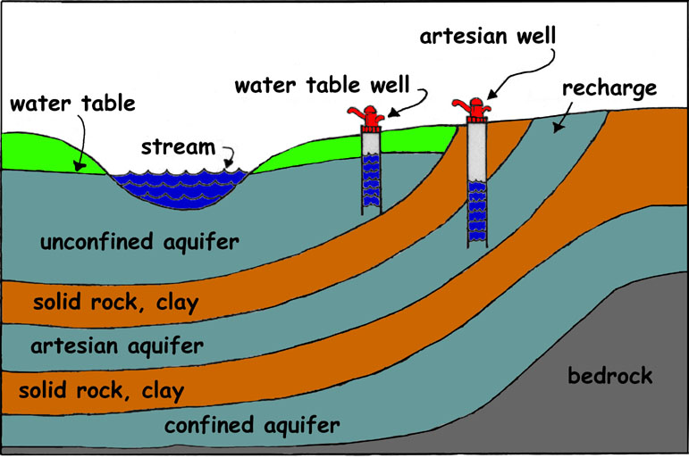
Concept Check
Explain how water gets into a confined aquifer
How many impermeable layers are in this picture?
Define saturated zone. What layer represents this?
Define unsaturated zone. Where in the diagram is this modeled
What is the water table?
confined

Slide 3
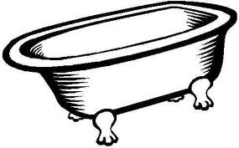
River Basin Analogy….
A bathtub catches all water falling within its’ sides, a River basin sends all the water falling on surrounding land into a central river and out to an estuary or ocean.

Slide 4
There are two types of estuaries you must be familiar with
In your textbook turn to page C117 and read about salt marshes and mangroves
Create a venn diagram comparing and contrasting them in your notes

Slide 5
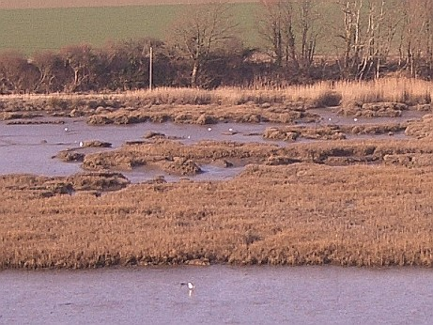
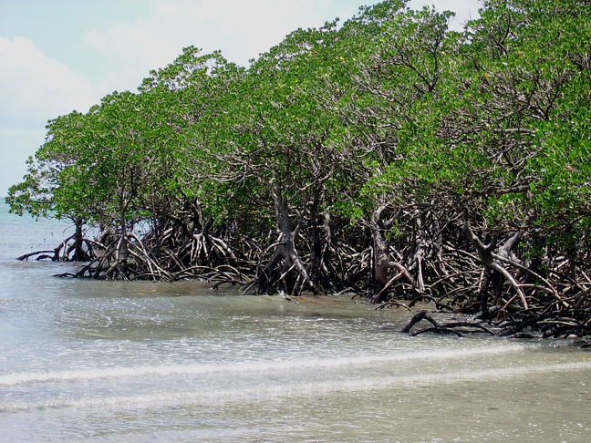
2 types of estuary:
SALT MARSH
*Atlantic Carolina coasts
Stinky cord grass
Absorbs tons of moisture
MANGROVES
*Louisiana & gulf
Hurricane proof trees
Absorbs tons of moisture

Slide 6
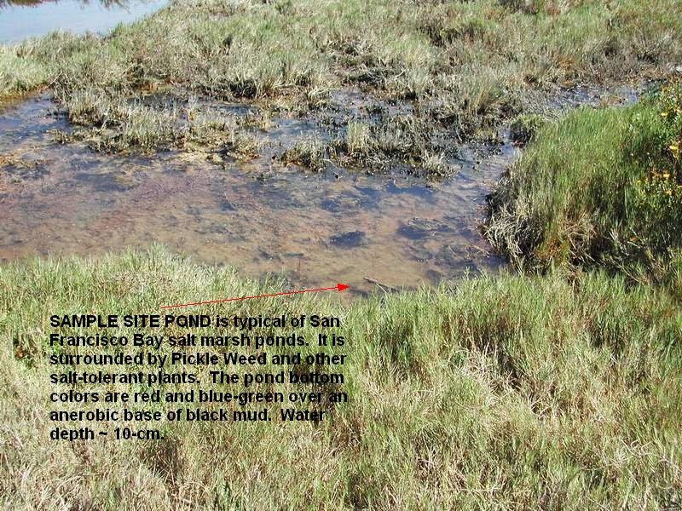
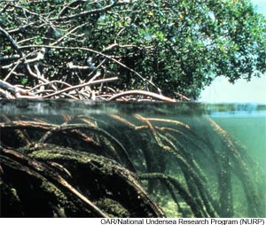
2 types of estuary:
SALT MARSH
Atlantic Carolina coasts
*Nutrient rich soil promotes growth of grasses
MANGROVES
Louisiana & gulf
*Hurricane proof trees due to thick tree roots
Absorbs tons of moisture
Great breeding grounds--nursery

Slide 7
2 types of estuaries
SALT MARSH
Atlantic Carolina coasts
Nutrient rich soil promotes growth of grasses
*barrier against waves
*Great breeding grounds
MANGROVES
Louisiana & gulf
Hurricane proof trees due to thick tree roots
*Great nursery

Slide 8
Examples of eating relationships/ food chains

Slide 9
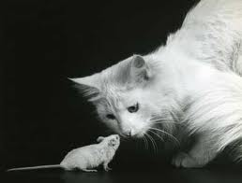
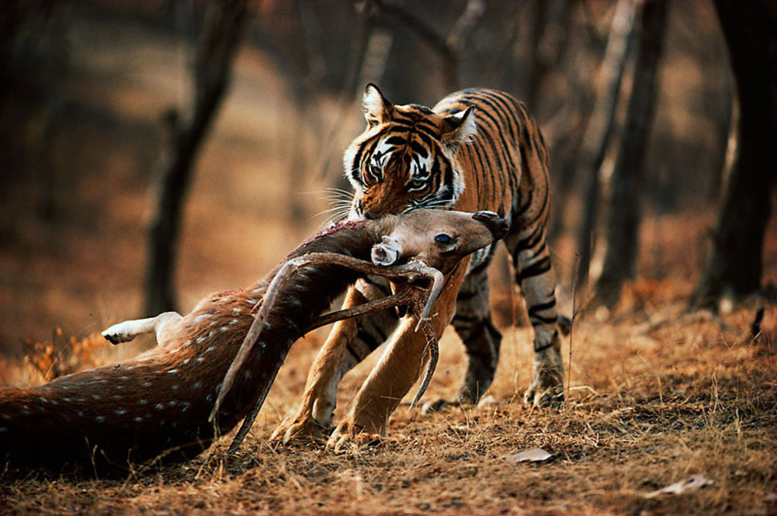
Terrestrial-Terrestrial

Slide 10
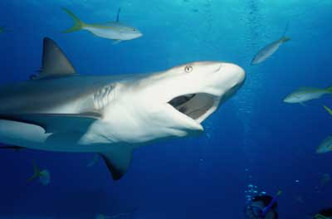
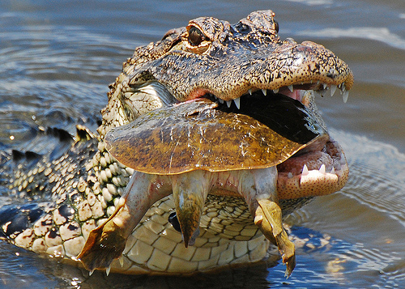
Aquatic-Aquatic

Slide 11
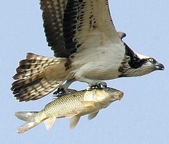
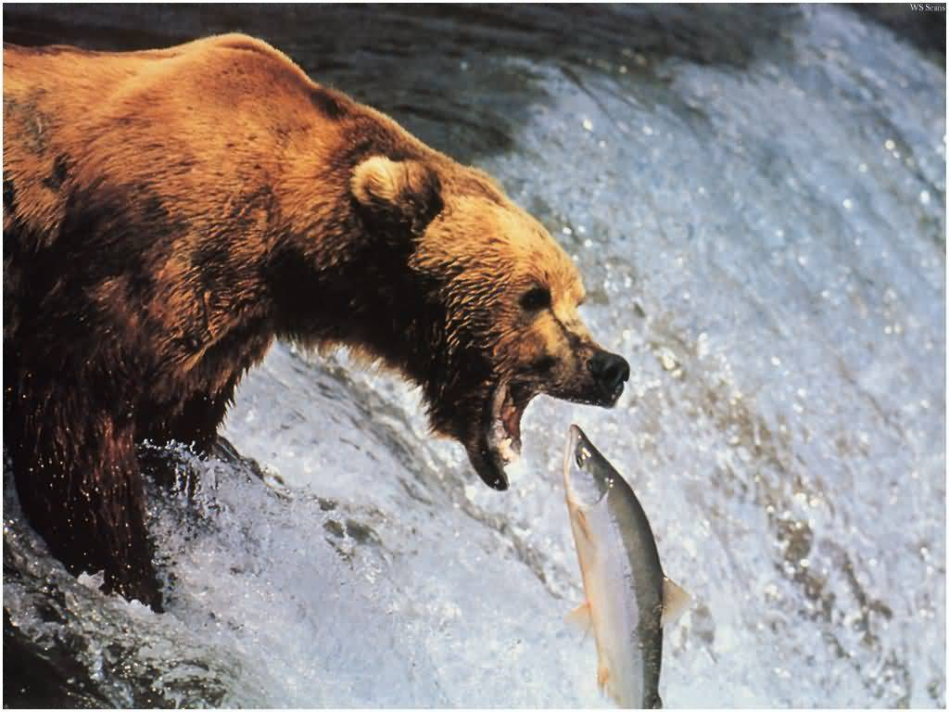
Terrestrial-Aquatic

Slide 12
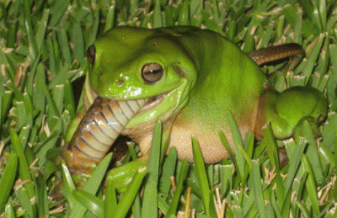
Aquatic-Terrestrial

Slide 13
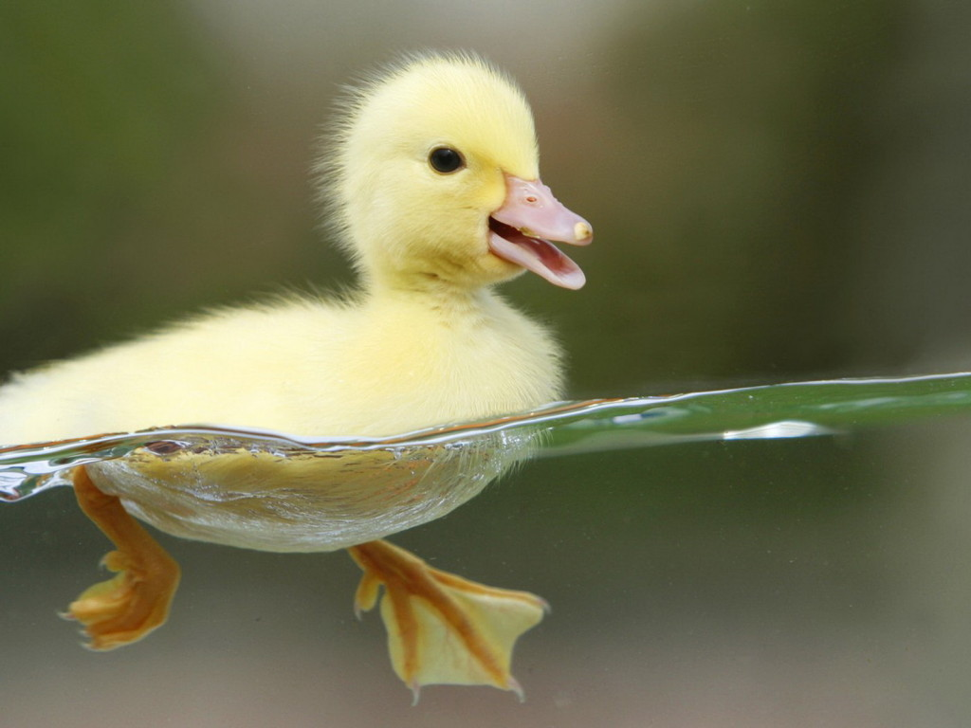
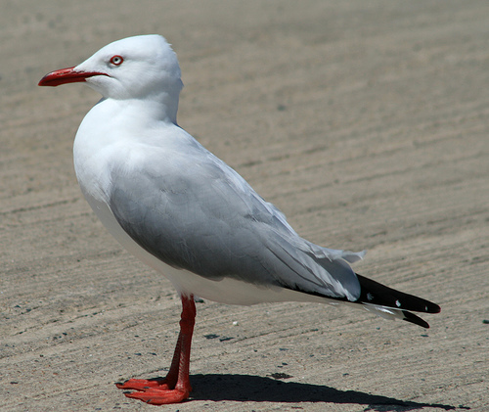
Then what are these two? (Hint: they’re the same type…)

Slide 14
Concept Check
Use the problem below to support your answer | What happens to density if mass increases? | What happens to density if volume increases? | So when…
D = m/V D = 200/20 D = 10
m
D =
V

Slide 15
Summing everything up
https://www.youtube.com/watch?v=al-do-HGuIk

