Slide 1
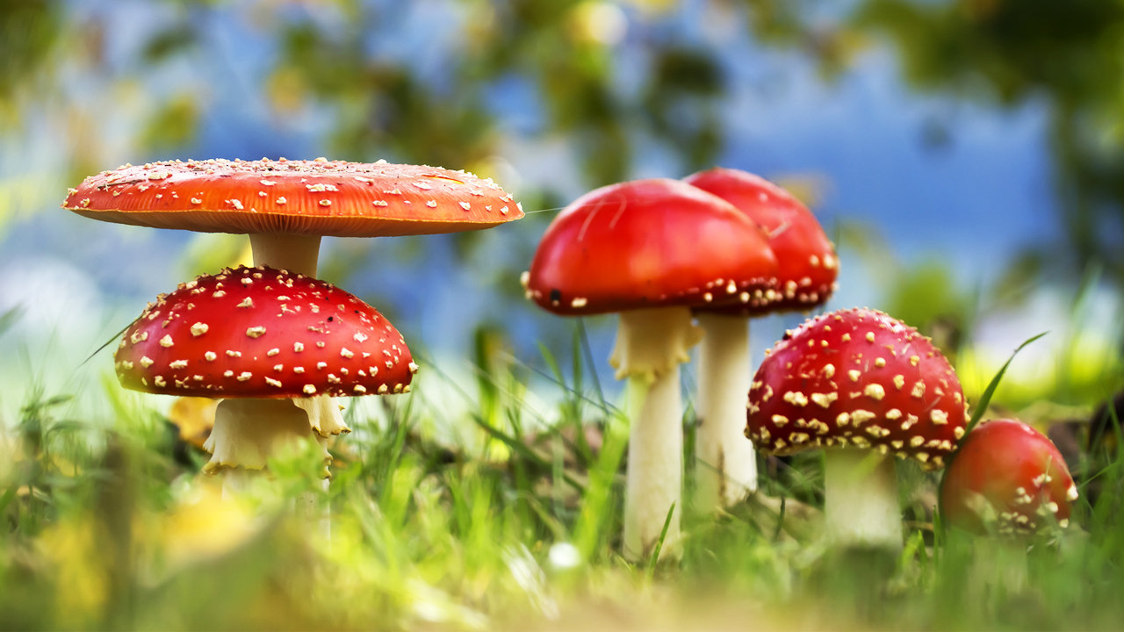
#69 Fungi and Protozoa Pathogens Notes

Slide 2
Warm-up
In about two to three sentences explain what’s going on in this film
https://www.youtube.com/watch?v=XuKjBIBBAL8

Slide 3
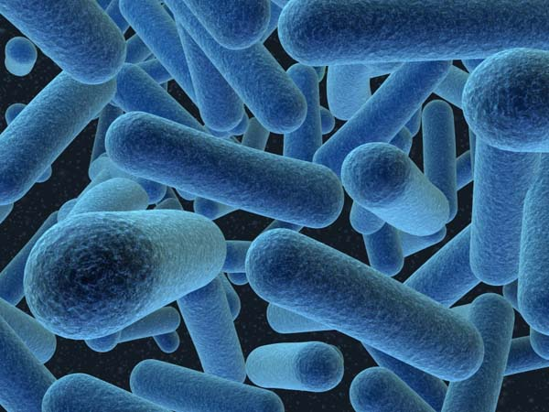
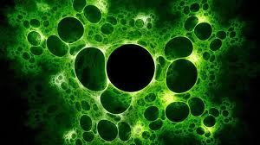
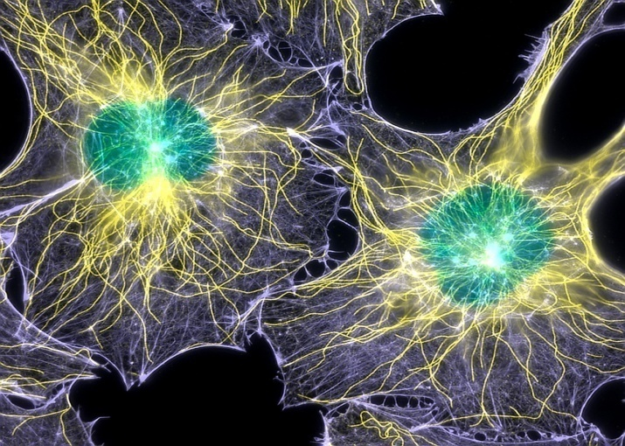
Bacteria Viruses Cells
Prokaryotic
No nucleus
DNA floats
Unicellular
Very basic unit of life
Reproduces through binary fission
Not made of cell(s)
Not living
Uses other cells to reproduce it’s own DNA/RNA
Mostly harmful
Most are Eukaryotic
Multicellular or Unicellular
Reproduces through Mitosis
Smallest form of life
Animal/Plant Cells

Slide 4
But WAIT! There’s MORE!

Slide 5
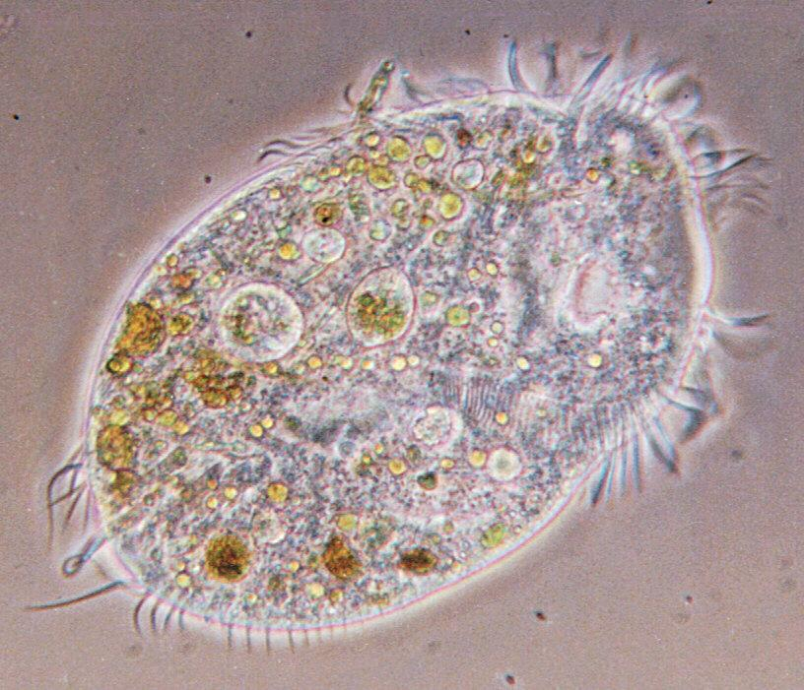
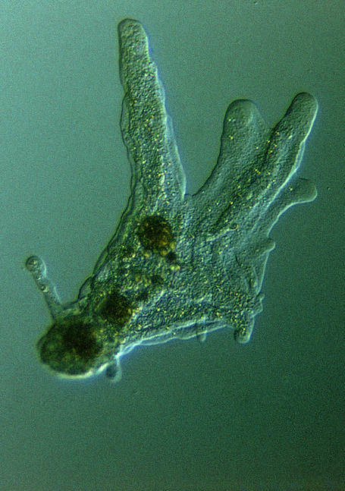
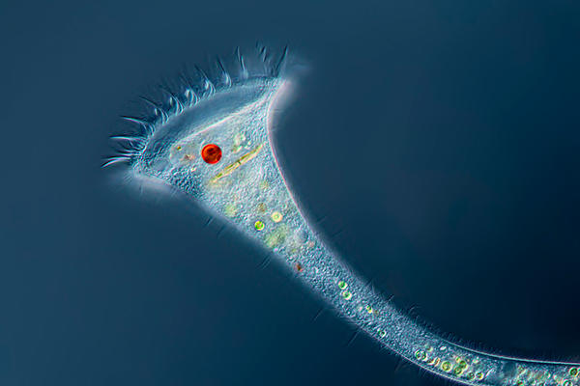
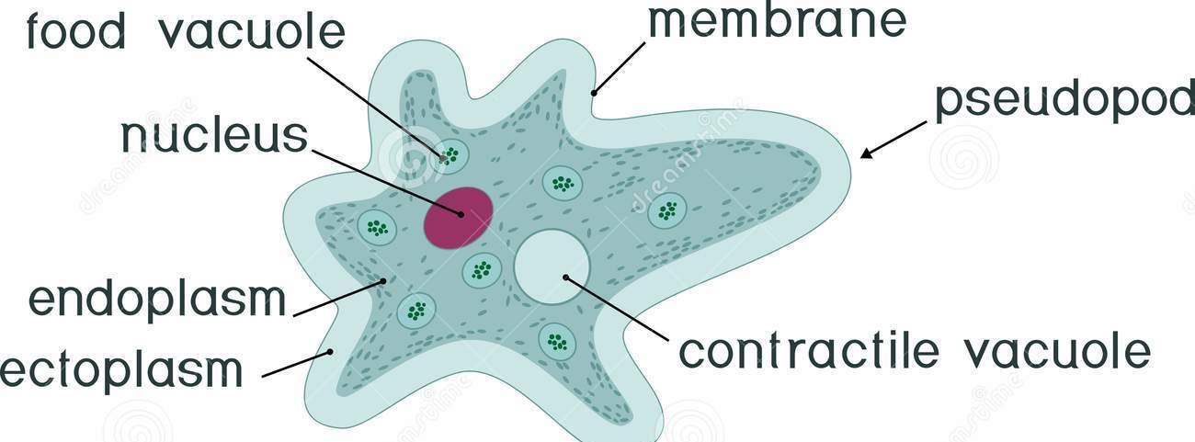
*Protozoa
found in natural waters
unicellular EUKARYOTE!
can cause some diseases
Unlike bacteria, protozoa has several internal organelles that perform specific tasks

Slide 6
http://www.fox46charlotte.com/home/166567906-story

Slide 7
M.I.M – amoeba start at 17mins
http://www.dailymotion.com/video/x57k7wl

Slide 8
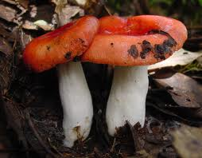
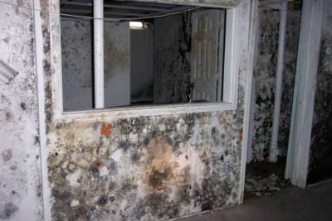
*Fungus
molds & mushrooms
multicellular, non-photosynthesizing EUKARYOTES
can reproduce asexually (spores) OR sexually (exchanging genetic info with a neighboring fungi)
Sometimes attack living tissue, causing disease
Mold spores are released by fungi and cause allergic reactions in humans

Slide 9
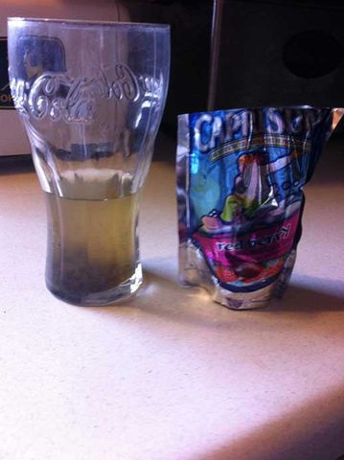
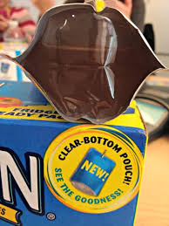
Have you ever wondered why Caprisun’s offer a see through bottom on their juice packs

Slide 10
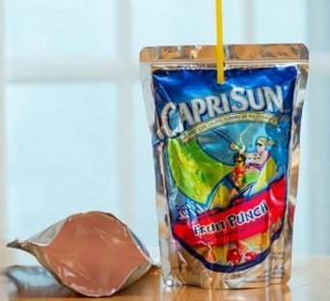
http://www.wsoctv.com/news/news/local/mooresville-boy-find-worm-caprisun-drink/nHGK3/
https://www.youtube.com/watch?v=VIDHRMJsLq4
http://parents.caprisun.com/faq

Slide 11
Mold in pillow
http://abcnews.go.com/GMA/video/hidden-bacteria-mold-pillows-making-sick-26650887

Slide 12
Cell size and scale
http://learn.genetics.utah.edu/content/cells/scale/

