Slide 1
Geologic Time Scale Notes
Pg 22 in TOC

Slide 2
Match each number to corresponding letter
An animal builds an underground habitat which got preserved over time
a 3-deminsional model of organism
Minerals soaked into buried remains making them harden into rock
Trapped air bubbles tells use about past atmosphere and climate
Tilting and folding
This organism was found in various places in Africa, Asia, and South America. These fossils are only found from 278 million years - 280 million years ago
Rare fossil found shows the soft parts that usually don’t get preserved
This organism was only found in Antarctica and existed for over 100 millions of years
Impression left after dino died and decayed away
Small insects get trapped in amber which lets us see small life forms in past
Mold
Index fossil
Preserved remain/Original remain
Cast
Petrified fossil
Trace fossil
Carbonized fossil

Slide 3
Divisions of time
*Eons – Are the largest unit of time which are divided into smaller parts below.
*Eras – divides of the eons are called eras. Ex.- Paleozoic, Mesozoic, and Cenozoic
*Periods –Are the subdivisions of eras that shows blocks of time when an unique rock series was laid down.
*Epoch – most recent period divisions. Starts in the Cenozoic Era

Slide 4
Precambrian Time
*Consists of the Earth's first 3 eons of time.
It began with the creation of the Earth around 4.6 billion years ago.
*Makes up about 90% of the Earth’s History (the first 4 billion years!!!)
*The fossils mostly had soft bodies which rarely formed into fossils.
*Near the end of Precambrian Time, life appeared as small unicellular organisms (like bacteria).

Slide 5
Precambrian Time
5 major events occurred during this time:
the formation of the Sun and light
the creation of the Earth
the creation of the atmosphere through volcanic out-gassing
the creation of the oceans
the creation of life.

Slide 6
Paleozoic Era
*Life consisted mostly in the ocean
*Fish were the 1st animals with backbones
*Toward end of era life moved onto land. → reptiles, insects, ferns
* A mass extinction ended the era and caused most ocean life and amphibians to disappear.
*The cause of this extinction is not understood

Slide 7
Mesozoic Era
*Reptiles were the dominant animals of this era, including the various dinosaurs.
*Small mammals and birds also appeared.
Toward the end of the era, flowering plants appeared and the different types of mammal species increased.
*A mass extinction ended this era and caused the dinosaurs to become extinct.
Does anyone know what was theorized to kill the dinos?

Slide 8
Cenozoic Era
*Most recent era. Began 65 million years ago and continues today!
*Mammals dominant this era
Diversity of life forms increased. New mammals appeared while others became extinct.
*Humans are part of the most recent period of this era.

Slide 9
Recap
What is the geologic time scale and why is it important?
What is the order from largest to smallest: period, eon, epoch, era
Each era ended due to what?

Slide 10
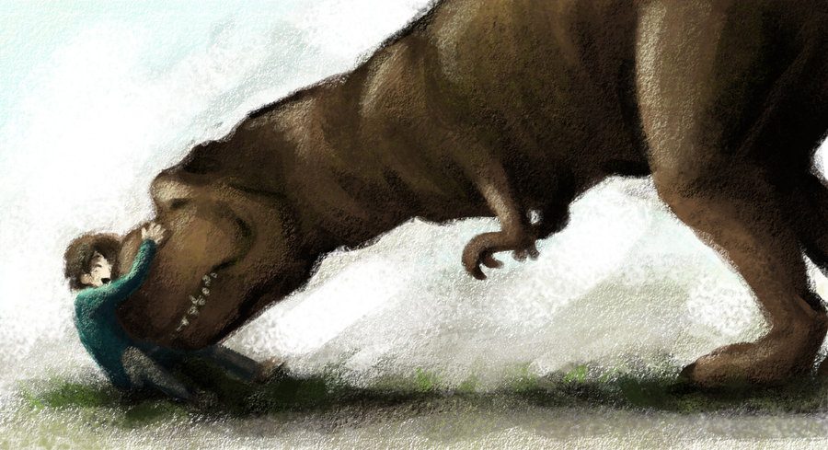
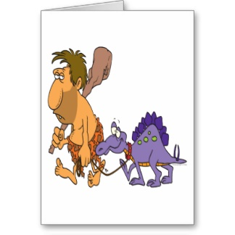
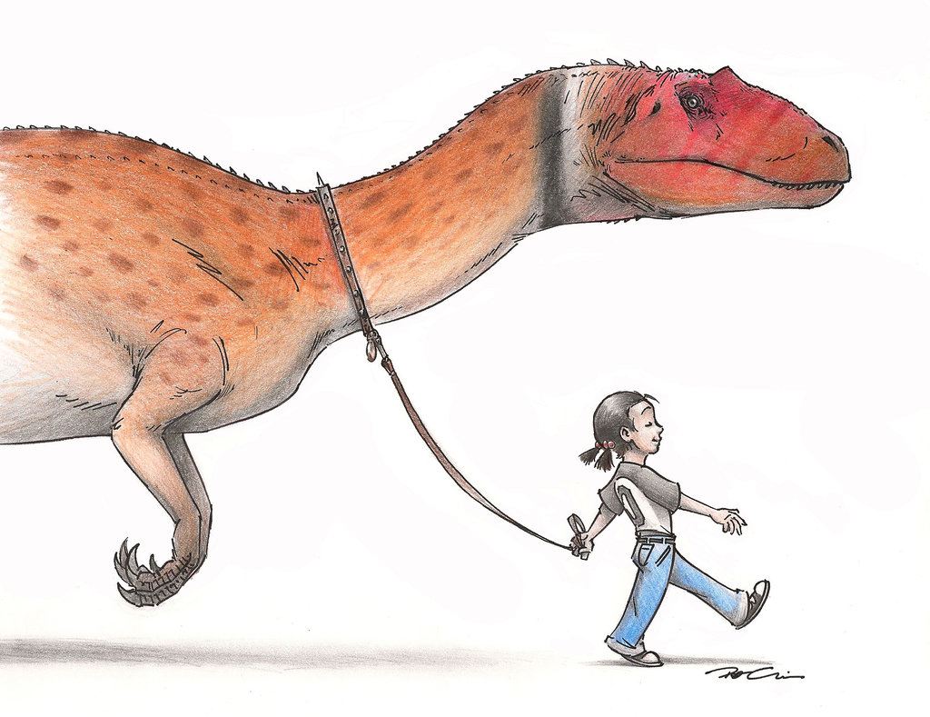
Knowing what we do about the geologic time, what’s wrong with these pictures

Slide 11
Warm up
When looking at the geologic time scale, explain if humans were here for a minute period of time or long period of time. Justify your answer. (look in textbook to help A64)
What are fossils and what can they tell us?
Use the following words:
Paleontologist
Index fossil
Sedimentary rock
Layer

