Slide 1
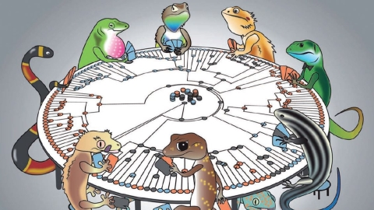
#74 Geological and biological evolution

Slide 2
Warm-up
Define the root words:
  Geo
  Bio
Explain what geological factors prove evolution has taken place on Earth. What about biological factors?

Slide 3
Warm-up
Explain in detail how this represents superposition. Tell the order in which came first to the most recent
Car, motorcycle, bike, man with dog, woman
Notes:
Someone took the last cookie in the cookie jar last night.
The last person to leave the scene is the culprit.
Who was it?___________________________________
Clues:
The Butler walks to work
The Handyman rides a bike
The Cook rides a motorcycle
The Maid drives a car
The Nephew has a seeing-eye dog

Slide 4
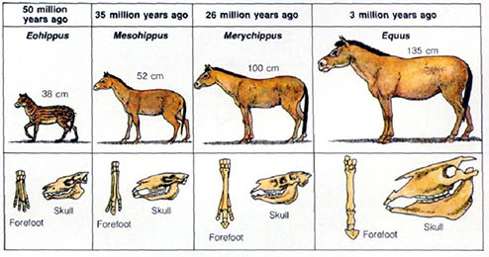
*Evolution
The process by which different kinds of living organisms have changed and branched out from earlier forms of life throughout the history of the earth.

Slide 5
How can we prove evolution happened?
This brings us back to a certain law we learned back in September…

Slide 6
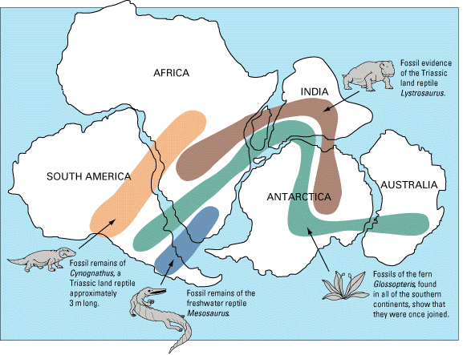
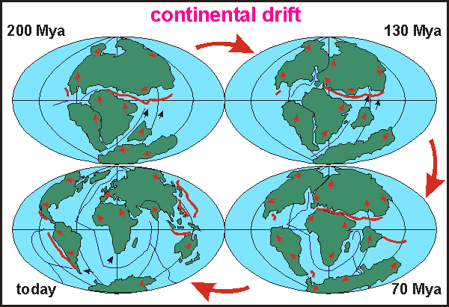
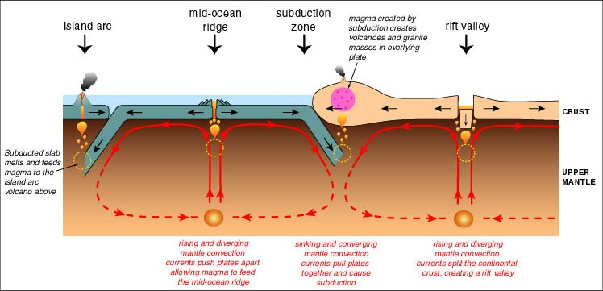
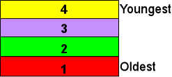
Think back to our Geology unit in the 1st Quarter…

Slide 7
We learned Geological Evolution
*Geological Evolution is how the EARTH changes over millions of years!!!
?

Slide 8
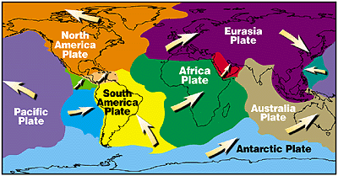
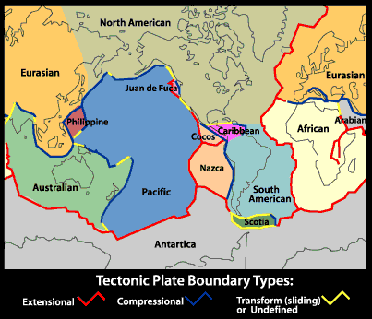
*What THEORY do we follow regarding GEOLOGICAL EVOLUTION?
The THEORY of PLATE TECTONICS!!!!!!
The theory states that the Earth is made up of pieces of crust called PLATES that slowly move around the earth due to convection(heat from the earths core).

Slide 9
The Theory of Continental Drift
All the continents originated from one super-continent, and then drifted apart.

Slide 10
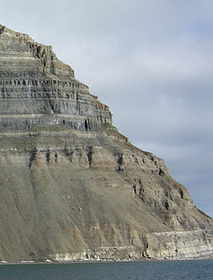
The Law of Superposition
Each rock layer is older than the layer above it.

Slide 11
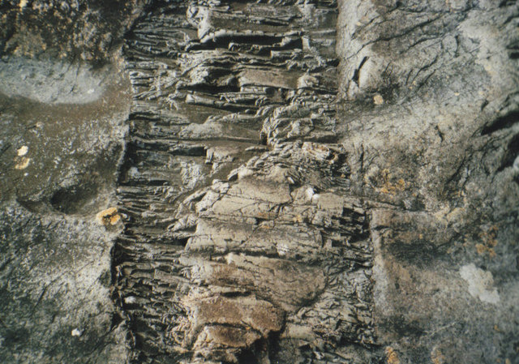
Youngest Top, Oldest Bottom!
Unless something happens….

Slide 13
Biological Evolution is how life changes over several thousands of years!
*What about BIOLOGICAL EVOLUTION?
?

Slide 14
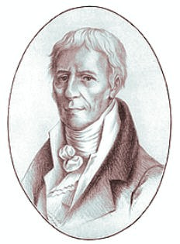
*What THEORY do we follow regarding BIOLOGICAL EVOLUTION?
Lamarck’s proposed a theory of Acquired Characteristics which said
Living things can acquire (get) new traits throughout their lifetime to help them carry out and make certain tasks easier.
And when the individual reproduced, those new changes would be passed down to their offspring
Jean Baptiste Lamarck

Slide 15
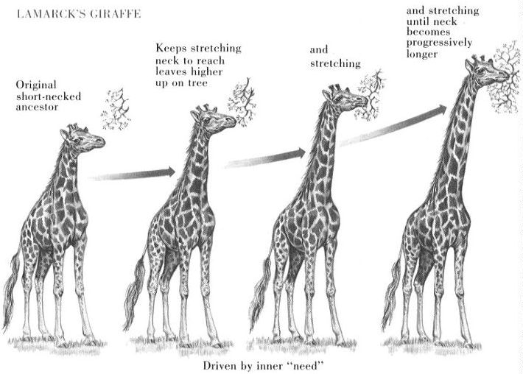

Slide 16
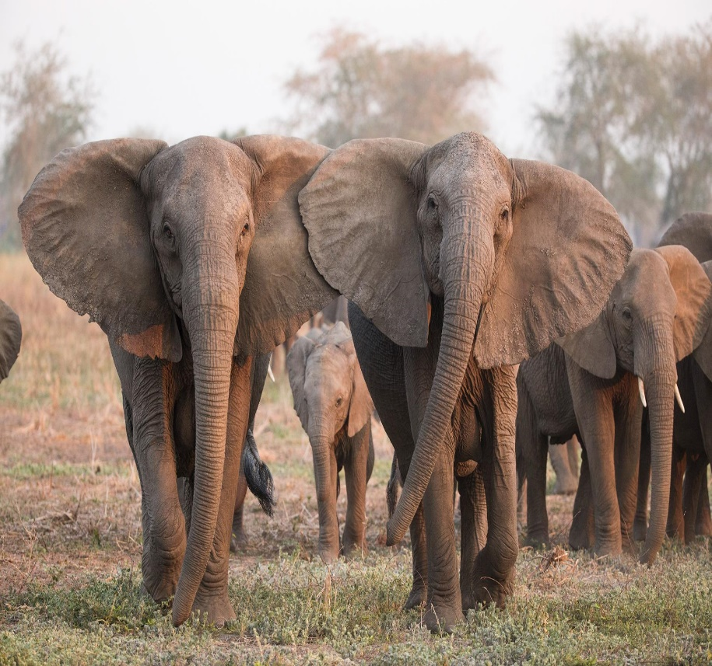
Another Lamarck Example
Lamarck believed elephants all used to have short trunks. When their was no food or water that they could reach with their short trunks, they had to do something in order to survive. He believed that they stretched out their trunks a little bit, and then were able to reach more food and water.
When they had babies, he said they were born with their trunks already stretched out a little longer, and the next time they needed to reach food and water they could continue to stretch their necks a little further each time and eventually over many generations evolve to become the long trunked elephants that we know today

Slide 17
Explain in your own words
What’s the difference between geological and biological evolution?
Explain Lamarck’s theory of Acquired traits

Slide 18
Major Biological and Geological Events Classification
Event | Geological or biological?
The earth began
Oceans form and cover the earth
Bacteria appeared
Shallow seas cover most of land
Great explosion of invertebrates in the sea
Pangea forms
Land plants appear
Insects and spiders appear
Age of the fish begins
Event | Geological or biological?
Hot, dry conditions dominate Pangea
Dinosaurs appear
Pangea splits
Widespread volcano activity
Dinosaurs become extinct
Rocky Mountains and Himalayas form
Continental glaciers cover over Antarctica
Mammals and flowering plants dominate
Humans appear

Slide 19
Extra…

Slide 20
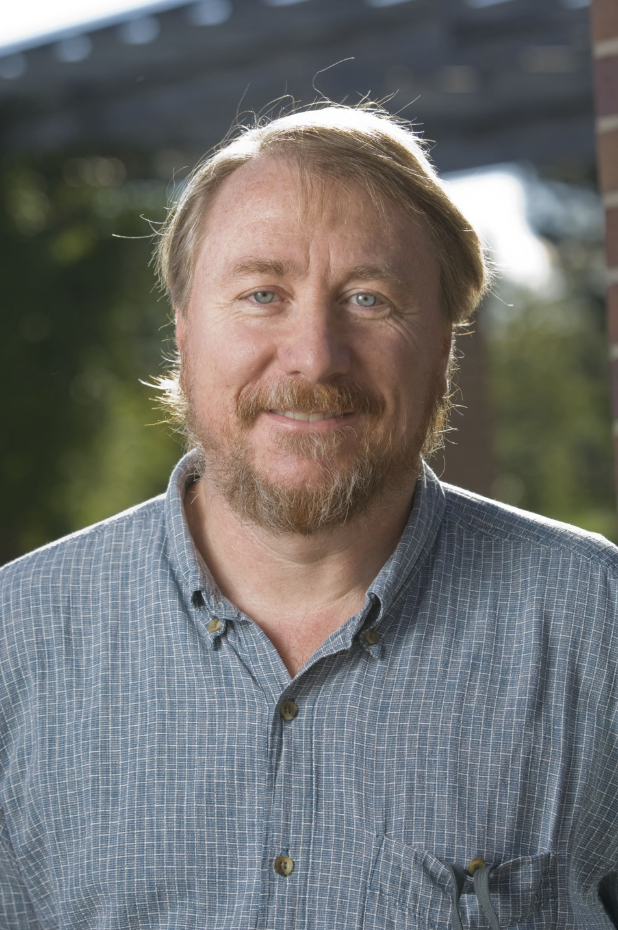
So evolution, how do we prove it?
Well there’s this scientist named Richard Lenski and in 1988 he started an experiment to prove that evolution can happen. This experiment was called the E. coli long-term evolution experiment.

Slide 21
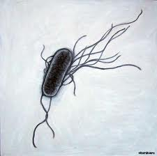
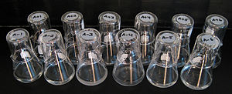
So what is the E. Coli Long Term Experiment?
It’s exactly what it sounds like: Take some E. Coli bacteria…
Place them in their own individual incubators and take 1% of their population out each day to place in a different environment (to see how it evolves).
Also, every 75 days, freeze large majorities of a population with similar traits (to compare to the original as well as other types later)

Slide 22
E. Coli Long Term Experiment
So after 20 years, what’s the verdict?
Between the 12 original populations, there were about 10-20 beneficial mutations. Additionally, all populations evolved to be much larger than the first generation.
But what if you want some other kind of evidence? Well it won’t be as recent or easily observable…

Slide 23

What’s your Evolution Of…

Slide 24
Literacy Activity
Writing Prompt (create a timeline of your evolution of )
  Evolution of Dance or
  Evolution of technology
  Your choice
Evolution of Earth
  6-8 facts about Earth’s past
Compare and Contrast
  Compare and contrast the
  evolution of EARTH to the evolution
  of DANCE OR TECHNOLOGY
Essay
  Write a 3 paragraph essay comparing and contrasting the evolution of Earth to your evolution of.
  Each paragraph must be a minimum of 5-8 sentences each.

Slide 25
Evolution Writing Prompts
Choose ONE of the following topics and write a 3 paragraph essay to answer ALL of the bullets for that article. Be sure to provide a short introduction and conclusion to your essay. Be sure to use information from the video clips as well as information from our class discussion when writing your essay.
Evolution of Dance
Explain how each of the dancing styles have evolved over time. (movement, music, clothing). Explain why each these dance styles may have been popular during their time.
Explain why these types of dance styles may have been replaced with new styles of dance.
Evolution of Technology
Explain how technology has evolved over time (from your childhood, your parents childhood, maybe even your grandparents childhood). Explain how each of you may have had to adapt to changes with technology.
Some questions you might want to answer include but are not limited to: What are some ways technology has changed education? How has communication changed? How has travel become easier?

Slide 26
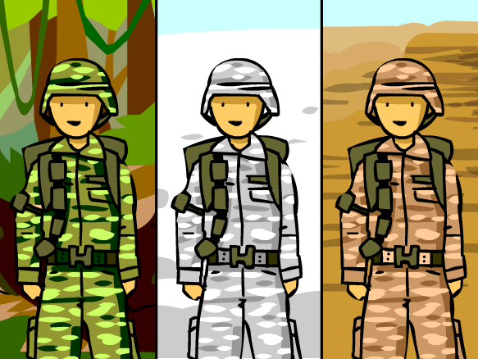
Brain Pop - Mutations

Slide 27
Visual Vocab (definition and pics)
Geological evolution | Biological evolution | Evolution | Mass extinction
Isolation (evolution) | Natural selection | Speciation | Variation
overproduction | Vestigial organs | Selection (competition) | adaptation
Captured thoughts
In a MINIMUM of 3 well developed sentences EACH, explain the following:
Explain the main idea
Explain how this connects to your life
Explain what you found interesting and why
Explain anything you wonder or want additional information on.
Darwin vs Lamarck
Explain both theories
Give examples of each in way you can remember (besides the ones I gave)
Include pictures of both

