Slide 1
Upcoming Dates
Thursday 10/19 - Science Interim/7 week assessment
Friday 10/20 – G/L Quiz 4 Flashcards due
Monday 10/23 – Hydrology Pt 1 Post Quiz
Wed. 10/25 – Hydrology Pt 1 Test
Wed 10/25 – LAST DAY TO TURN IN MISSING/MAKE-UP WORK
Friday 10/27 –G/L Quiz 4
Friday 10/27 – Last day of 1st Quarter

Slide 2
#26 Groundwater and Aquifers

Slide 3
Mrs. Thomas wanted your help making her usual morning cup of English Tea.
She then decided to see how smart you were and asked:
You to identify the parts: Solute, solution, and solvent
Explain a way you can separate the water from the other contents after its already been mixed

Slide 4
*Groundwater is found almost everywhere under the ground. Groundwater fills in spaces between sand, rock, and soil.
*Groundwater accumulates in permeable soil known as aquifers.
*Permeable -A substance that liquids can flow through.
*Impermeable - A substance that liquids cannot flow through.

Slide 5
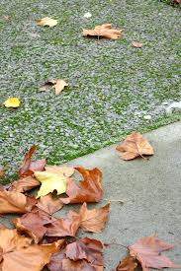
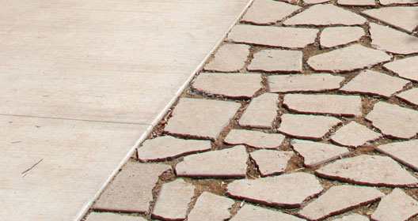
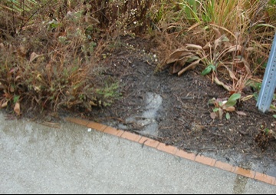
P
I
P
I
P
I

Slide 6
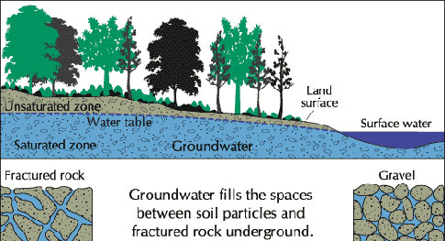
*The water table is the highest point in which water fills underground
Notes:
Talk about saturated vs unsaturated water

Slide 7
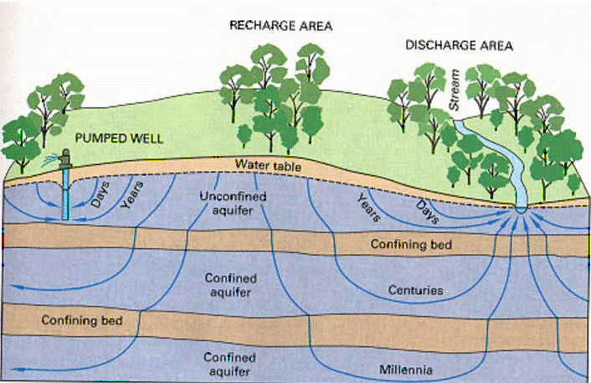
*Unconfined aquifer
An unconfined aquifer allows water to seep into the ground directly through permeable rock.
Unconfined Aquifer
Confined Aquifer
Notes:
Think about using another picture in the future****

Slide 8
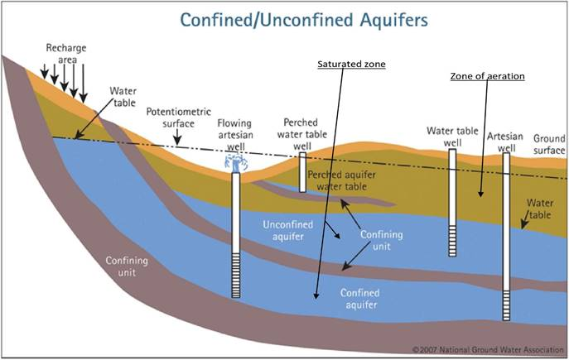
*Confined aquifer
Confined aquifers consists of water sandwiched in between two impermeable rock layers.
Water enters confined aquifers at the recharge zone.
Notes:
Think about using another picture in the future****

Slide 9
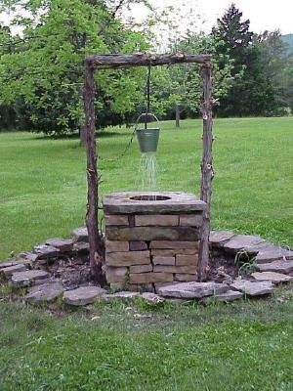
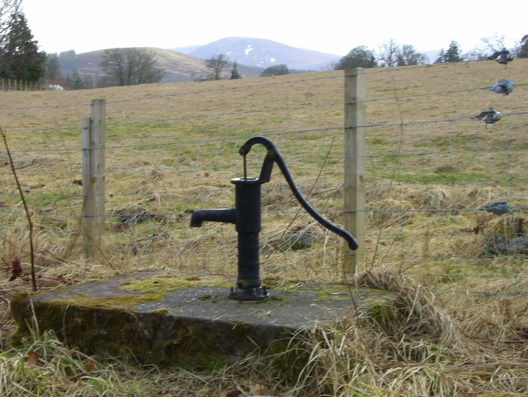
*Ways to get groundwater to surface
Man-made Well – pipe dug into ground to extract water from aquifer

Slide 10
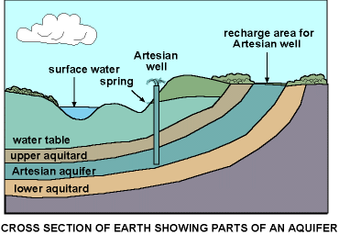
*Ways to get groundwater to surface
Man-made Well – pipe dug into ground to extract water from aquifer
Artesian Well – water flows naturally to surface because it’s under pressure
Spring – water flows to surface because surface of land dips below water table
Hot Spring/Geyser – water heated up by rocks, pushes up to surface due to pressure

Slide 11
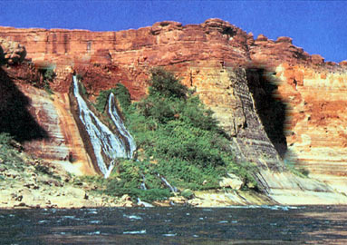
Here’s another example of a spring that must be holding back some water beyond this impermeable rock

Slide 12
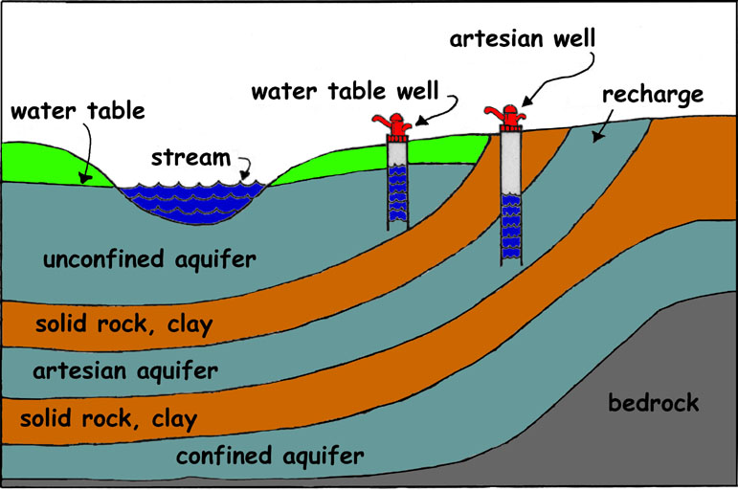
Impermeable rock
confined
Impermeable rock

Slide 13
In textbook
Read pages C24-31
Answer questions #1-5 on a separate sheet of paper

