Slide 1
#23 Groundwater and Aquifers

Slide 2
*Groundwater is found almost everywhere under the ground. Groundwater fills in spaces between sand, rock, and soil.
*Groundwater accumulates underground in permeable soil known as aquifers.
*Permeable -A substance that liquids can flow through.
*Impermeable - A substance that liquids cannot flow through.

Slide 3
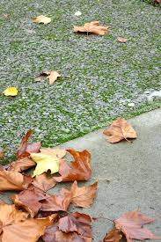
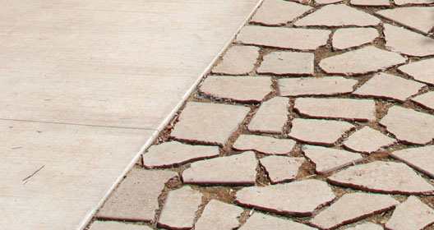
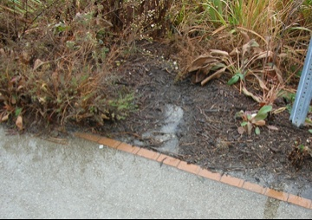
P
I
P
I
P
I

Slide 4
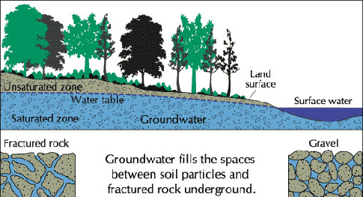
*The water table is the highest point in which water fills underground
Notes:
Talk about saturated vs unsaturated water

Slide 5
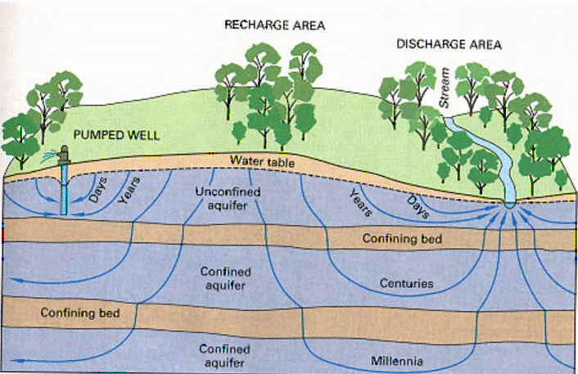
*Unconfined aquifer
An unconfined aquifer allows water to seep into the ground directly through permeable rock.
Unconfined Aquifer
Confined Aquifer
Notes:
Think about using another picture in the future****

Slide 6
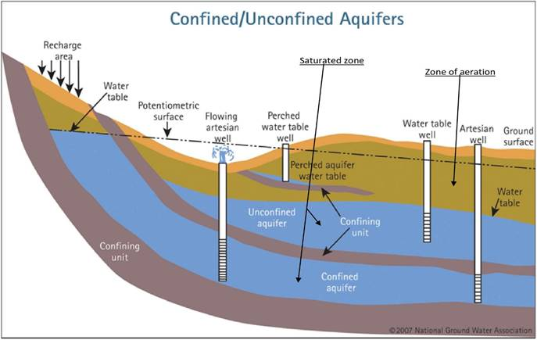
*Confined aquifer
Confined aquifers consists of water sandwiched in between two impermeable rock layers.
Water enters confined aquifers at the recharge zone.
Notes:
Think about using another picture in the future****

Slide 7
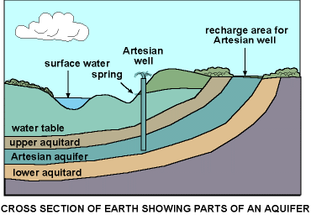
*Ways to get groundwater to surface
Man-made Well – pipe dug into ground to extract water from aquifer
Artesian Well – water flows naturally to surface because it’s under pressure

Slide 8
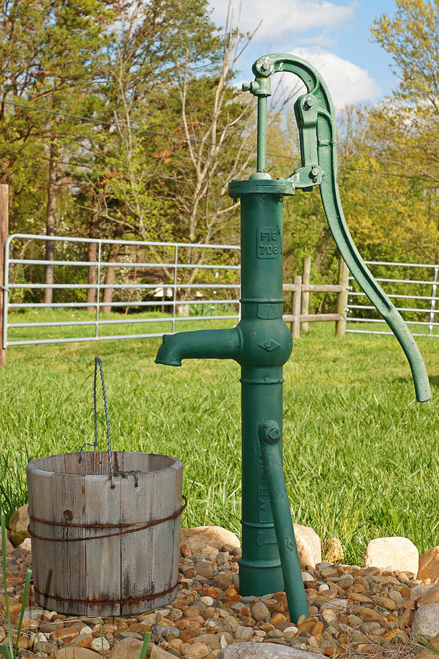

Slide 9
*Ways to get groundwater to surface
Man-made Well – pipe dug into ground to extract water from aquifer
Artesian Well – water flows naturally to surface because it’s under pressure
Spring – water flows to surface because surface of land dips below water table
Hot Spring/Geyser – water heated up by rocks, pushes up to surface due to pressure

Slide 10
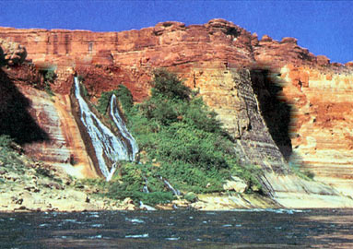
Here’s another example of a spring that must be holding back some water beyond this impermeable rock

Slide 11
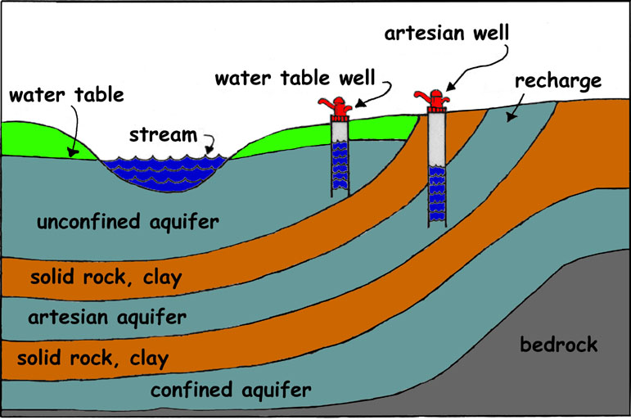
Impermeable rock
confined
Impermeable rock

Slide 12
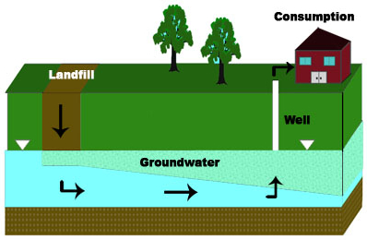
Is the land above a water table permeable or impermeable? How do you know?
Is the land below the water table permeable or impermeable? How do you know?
According to this diagram, how do we access groundwater?
Explain what the diagram is trying to environmentally warn us about?

Slide 13
Go to https://learn.concord.org/
Click login in the top right corner. Sign-in by hitting G+ icon
Click student and enter class-word:
Click do by myself and then Complete Activity #2 – Availability of fresh water
Block | Classword
Red | Smartred
Yellow | Smartyellow
Green | Smartgreen
Blue | smartblue

Slide 14
Videos
Contaminated Water (AEIOU Video)
https://www.youtube.com/watch?v=DKi9_jMSITI
Watch the first 10 mins
Groundwater recap
https://www.youtube.com/watch?v=oNWAerr_xEE

Slide 15
#27 Groundwater A-E-I-O-U and questions
8.E.1.1

Slide 16
A-E-I-O-U
A – AIM (What is the purpose of this video? How does it relate to what we are learning?)
E – EMOTION (describes how a part of the video made you feel)
I – INTERESTING
O – OH! (A fact or something said that surprised you.)
U – UMM? (a question you may still have after watching the video)
Grab a copy of the AEIOU Chart
You will be filling this out as we watch the video clip on Wake County, NC well-water

Slide 17
Extras….

Slide 18
In textbook
Read pages C24-31
Answer question #1-5 on a separate sheet of paper

Slide 19
Warmup
Explain where and how we access majority of our drinking water. Minimum of 4 sentences

Slide 20
Porosity demo
*If time permits

Slide 21
A-E-I-O-U
A – ADJECTIVE (describes something you saw or learned)
E – EMOTION (describes how a part of the video made you feel)
I – INTERESTING
O – OH! (makes you say “oh” or a part that you thought a little longer about)
U – UMM? (a question you may still have after watching the video)
Copy the chart for your warm-up. Write only what's in parenthesis if you don’t know the term.
You will be filling this out as we watch the video clip on Wake County, NC well-water

Slide 22
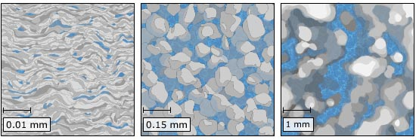
Fresh Earth under our feet can be measured 3 ways:
grain size (size of the bits)
porosity (space between the bits)
permeability (how fast something passes through)

Slide 23
Make a quick table
substance | grain size (large, small, super fine) | porosity (high, medium, low) | permeability (fast, slow, none)
gravel
sand
clay

Slide 24
Questions to answer
Which sample was more permeable to water?
Which sample was least permeable?
Why did water move faster through some materials then others. GIVE FULL EXPLAINATION
If I were trying to create an aquifer, in what order would these materials be arranged? Explain
What did you learn from this demo?

Slide 25
You should have this…
substance | grain size (large, small, super fine) | porosity (high, medium, low) | permeability (fast, slow, none)
gravel | large | high | fast
sand | small | medium | slow
clay | super fine | low | not permeable (none)

