Slide 1
Group properties notes

Slide 2
#34 – Group properties notes D26-32
Color hydrogen –red
Group 1 –yellow
Group 2 - orange
Groups 3-12 – light brown
Group 17 – green
Group 18 – blue
Bottom two rows - purple
Notes need to be organized like so:
Carbon family (Group 14)
Information about this group written here.
Nitrogen family (Group 15)
Information about this group written here.

Slide 3
Group # | Group Name | Group Characteristics | Element Uses | Elements found in the Group
1 | Alkali Metals | -Plays an essential role in the functioning of living cells -Reacts very rapidly to oxygen and water vapor | -Lithium is used for batteries -Potassium is an element that helps relieve muscle cramps | H, Li, Na, K, Rb, Cs, Fr
2 | Alkaline Earth Metals | -less reactive than group 1 but more reactive than most other metals | -Magnesium is used to build airplane frames -Calcium is essential for healthy bones and teeth | -Be, Mg, Ca, Sr, Ba, Ra
3-12 | Transition Metals | -shiny, ductile, malleable, good conductors | -zinc is used to coat copper pennies -used to make jewelry | Au, Si, Ti, Hg, Ag
17 | Halogen | -Very reactive nonmetals -Greek word meaning “forming salts” | -chlorine is used to kill bacteria in pools -iodine is used in medicines | F, Cl, Br, I, At
18 | Noble Gases | -Inert: do not react with other elements | -Used in making neon signs -Argon gas is used to make lightbulbs | He, Ne, Ar, Kr, Xe, Rn

Slide 4
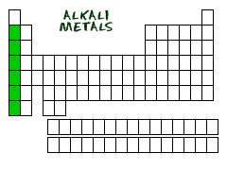
Alkali Metals (group 1)
Most reactive metals
React rapidly with oxygen and water vapor
Vital role in functioning of living cells

Slide 5
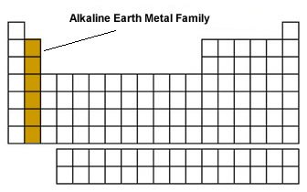
Alkaline Earth metals (group 2)
Less reactive than alkali metals (group 1) but more reactive then most metals

Slide 6
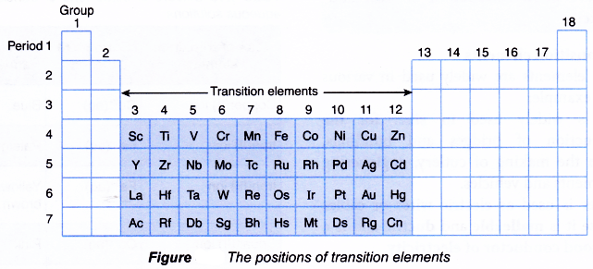
Transition metals
Generally less reactive than other metals
Earliest known elements, used for 1000+ yrs
Major component in industrial uses
Used in pipes and wires because they are easier to shape than pure metals
Two or more transition metals combine to make alloy, which are less likely to corrode (i.e. – brass)

Slide 7
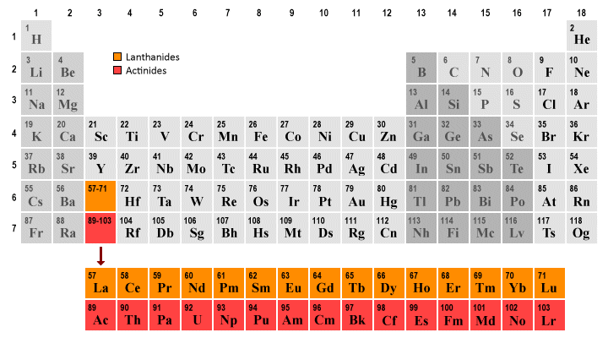
Rare earth metals
These are actually not rare – just hard to isolate (find alone)
Located in the Earths crust
Nicknamed lanthanides and actinides

Slide 8
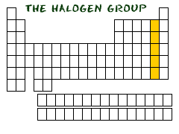
Halogens (group 17)
Very reactive non-metals
Used to kill harmful microorganisms
Forms salts with other metals

Slide 9
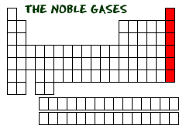
Noble gases (group 18)
Does not react with other elements
Very small amounts of argon gas is found in atmosphere

