Slide 1
#32 Groups and Period Periodic Table Properties

Slide 2
Important Features of the Periodic Table: Period (Row)
each horizontal row of elements on the periodic table
How many
periods (rows)
are on the
Periodic Table
Of Elements?
FROM LEFT TO RIGHT OR RIGHT TO LEFT

Slide 3
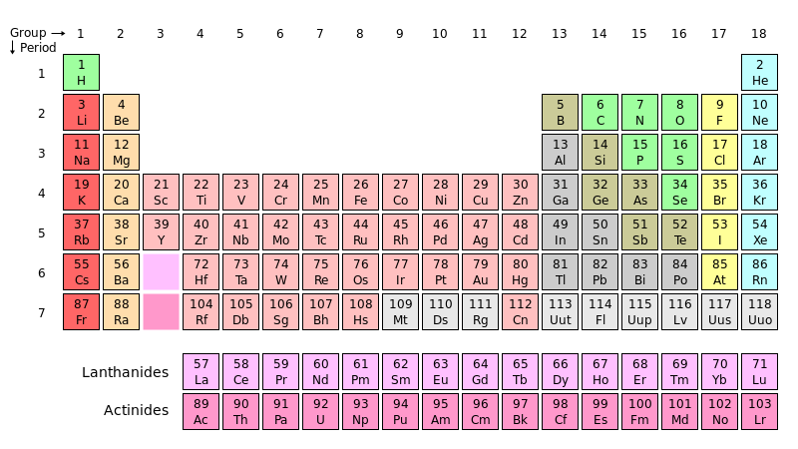
Period
A horizontal row in the Periodic Table.

Slide 4
*Period (Row) Properties
There are seven horizontal periods on a periodic table (numbered from the top down)
Atomic numbers and atomic masses increase as you move from the left to the right in a period
All atoms of the elements in the same period have the same number of shells
Example
Period 1 = 1 shell
Period 2 = 2 shells
Period 3 = 3 shells
Etc…

Slide 5
Important Features of the Periodic Table: Group (Family)
each column of elements on the periodic table
How many groups (families)
are on the
Periodic Table
Of Elements?
FROM TOP TO BOTTOM OR BOTTOM TO THE TOP

Slide 6
Group
A vertical column in the Periodic Table.

Slide 7
*Group (Family) Properties
There are eighteen vertical groups on the periodic table (numbered from left to right)
Atomic numbers and atomic masses increase as you move from the top down in a group (family)
Atoms of elements in the same group have the same number of valence electrons
Exceptions:
Transition elements (3-12)
Hydrogen (could be similar to groups 1 or 17)
Helium (actually has 2 valence electrons)

Slide 8
*How can I remember this…
Purple Periods Pull
Green Groups Grow

Slide 9
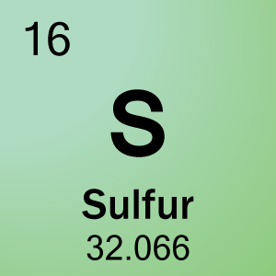
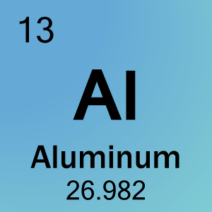
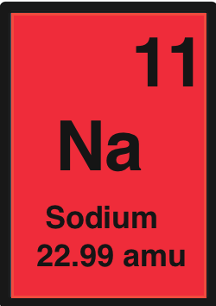
Round each atomic mass to the nearest whole number then find the P, N,E for each
P:
N:
E:
P:
N:
E:
P:
N:
E:

Slide 10
#33 Bohr Model and Electronic Configuration

Slide 11
*If you know the elements period and group location, then that helps determine how many shells the atom has, and the number of electrons in each shell.
For example: Lets look at Lithium
How many shells does it have?
Electrons?
End Goal:
Li

Slide 12
*Period # | # of shells | *Maximum Electrons
1
2
3
4

Slide 13
*ELECTRONIC CONFIGURATION
*Electronic configuration is a short-hand way of telling you how many electrons you have in each shell of an atom.
*You must completely fill the first shell before moving to the next shell.

Slide 14
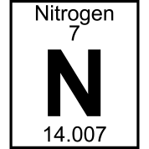
Remember
1st shell - 2 electrons max
2nd shell - 8 electrons max
3rd shell - 8 electrons max
4th shell - 18 electrons max
And so on…
How many electrons does it have?
How many shells will it have?

Slide 15
*ELECTRONIC CONFIGURATION
Nitrogen has 7 electrons
Configuration:
N= 2,5
7
N
2 in 1st shell
5 in 2nd shell
2 + 5 = 7
14

Slide 16
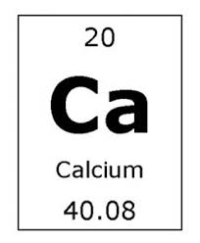
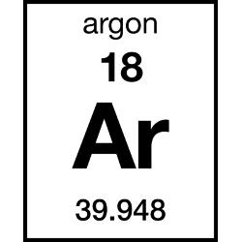
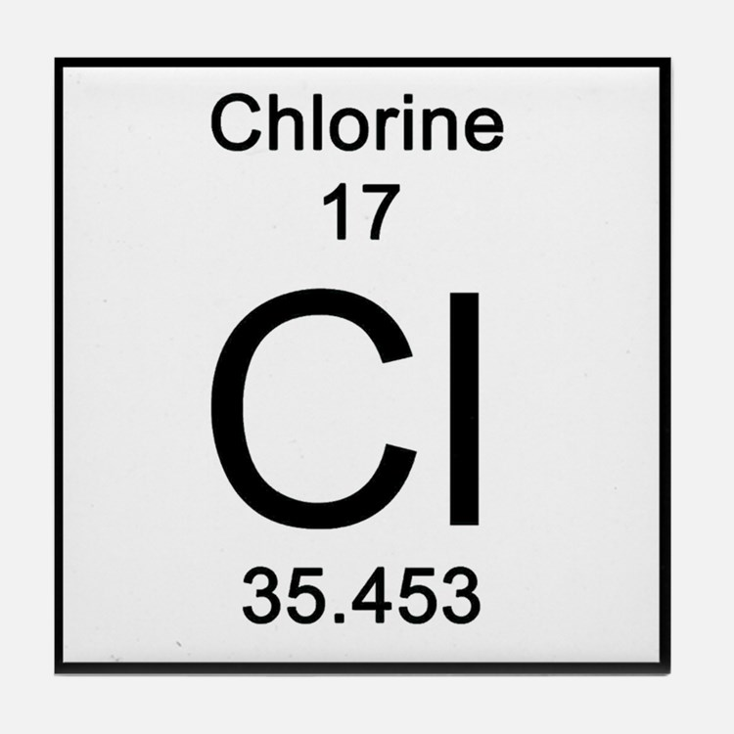
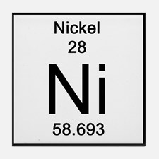
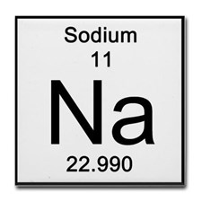
Write the Electronic configuration for these

Slide 17
Bohr Model
When drawing out an atom it is important to understand electronic configuration.
*The Bohr model is a visual representation of an atom showing all protons, electrons, neutrons, and electron cloud.
Ex: Beryllium Bohr model:
Configuration:

Slide 18
Bohr Model
When drawing out an atom it is important to understand electronic configuration.
*The Bohr model is a visual representation of an atom showing all protons, electrons, neutrons, and electron cloud.
Ex: sulfur Bohr model:
Configuration:

Slide 19
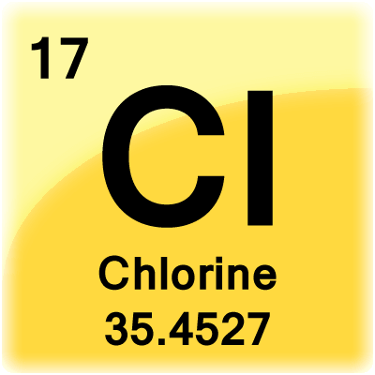
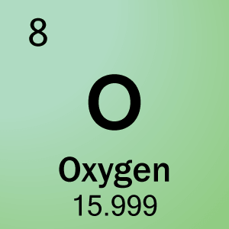
Bohr Models

Slide 20
Bohr Models

Slide 21
Bohr Models

Slide 22
Bohr Models

