Slide 1
#11 Hotspot Volcano Notes

Slide 2
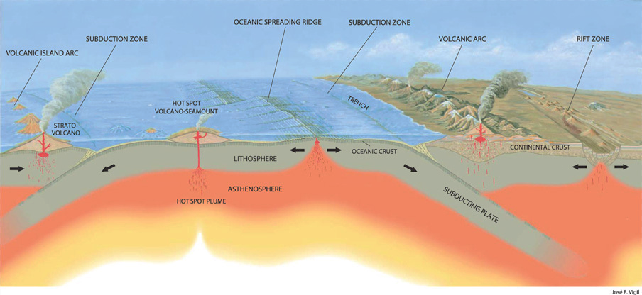
Warm-up: fill in the blanks about the type of crust and plate boundaries
2.
____ and ____ crust, ________ boundary
1.
____ and ____ crust, ________ boundary
3.
____ and ____ crust, ________ boundary
4.
____ and ____ crust, ________ boundary

Slide 3
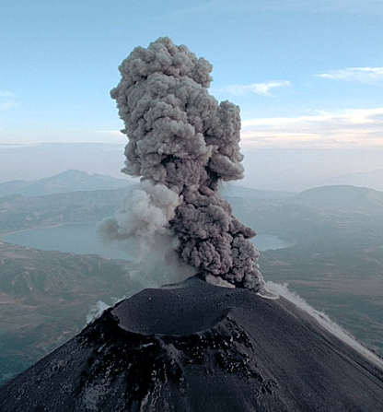
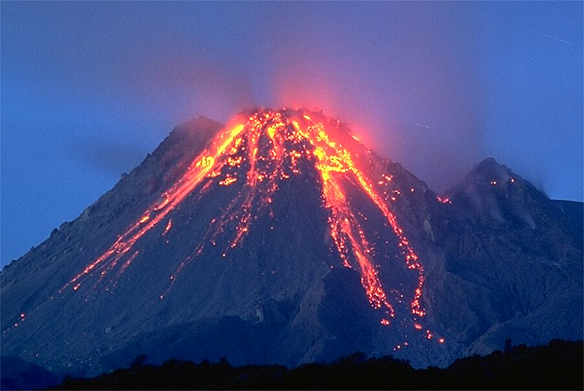
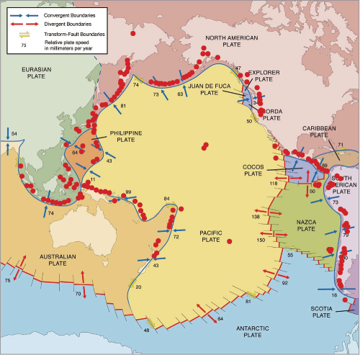
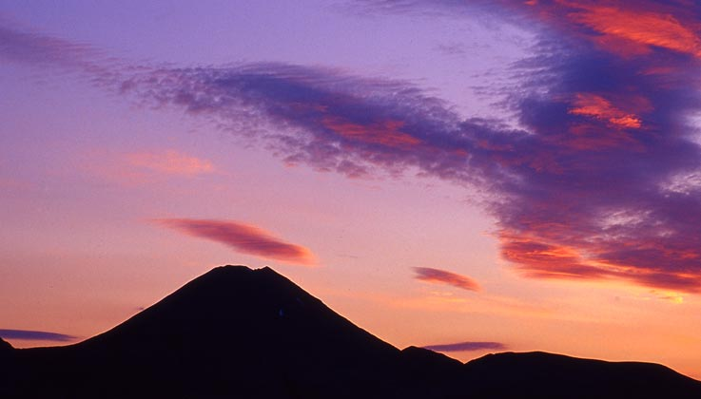
Pacific Ring of Fire
Volcanism is mostly focused at plate margins
Notes:
This map shows the margins of the Pacific tectonic plate and surrounding region. The red dots show the location of active volcanism. Notice how the majority of the volcanism is focused in lines along the plate boundaries? For this region this area is known as the “Pacific Ring of Fire”.
But why are all of the volcanoes located at the plate margins?

Slide 4
New crust forms along the ___ _____ ______.
But how?
Scientists have discovered underwater mountain ranges that are located on the ocean floor. These mountain ranges formed over time from hot magma spewing out of volcanoes, cooling and hardening into new rock.

Slide 5
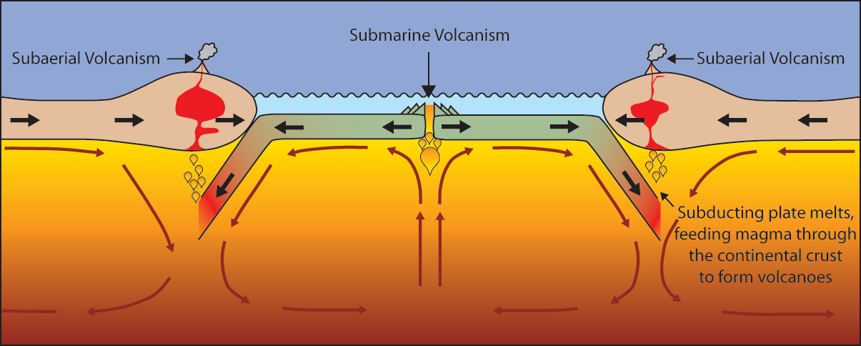
*Volcanoes can be formed by:
1. Subduction –
when a more dense crust sinks below less dense crust, melting the crust and forcing magma to surface
2. Rift valleys –
when plates move in opposite directions thus allowing magma to rise to the surface
3. Hotspots –Any place where a volcano can form, not necessarily on plate boundary
Notes:
Volcanoes can be formed in three ways:
Via subduction. The subducting slab dehydrates to form new melt that will rise through the crust to be erupted at the surface.
Via rifting. When two plates pull apart magma rises, producing volcanic eruptions at the surface.
At “Hotspots”….hotspot do not necessarily occur along a plate boundary. So hotspot volcanoes can form in the middle of tectonic plates….Click for example.

Slide 6
Pacific Ring of Fire… can anyone guess where these volcanoes are?
Hotspot volcanoes
Notes:
Hotspot volcanoes in the middle of the Pacific plate.
Can anyone guess where they are?
Answer: Hawaii

Slide 7
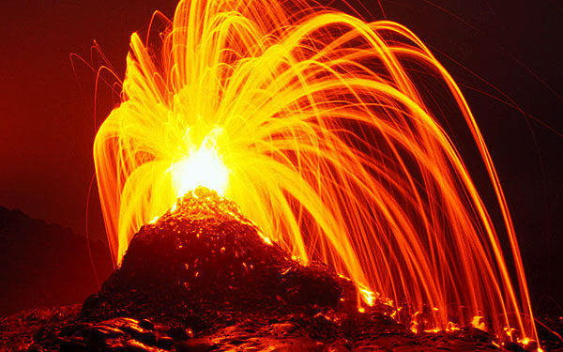
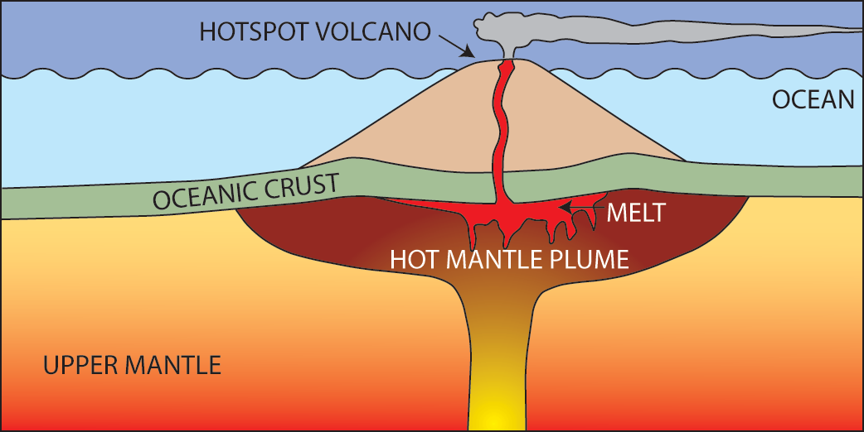
*What are Hotspot Volcanoes?
A hotspot is a location on the Earth's surface that has experienced active volcanism for a long period of time.
Hot mantle plumes are areas where magma collects and rises from the mantle to the surface inside tectonic plates.
The Hawaiian island chain are examples of hotspot volcanoes.
Notes:
Firstly, what are hotspot volcanoes and how do they form?
A hotspot is a location on the Earth's surface that has experienced active volcanism for a long period of time.
The source of this volcanism is a mantle plume of hot mantle material rising up from near the core-mantle boundary through the crust to the surface (see left diagram).
A mantle plume may rise at any location in the mantle, and this is why hotspot volcanoes are independent from tectonic plate boundaries.
The Hawaiian island chain are an example of hotspot volcanoes (see right photograph).

Slide 8
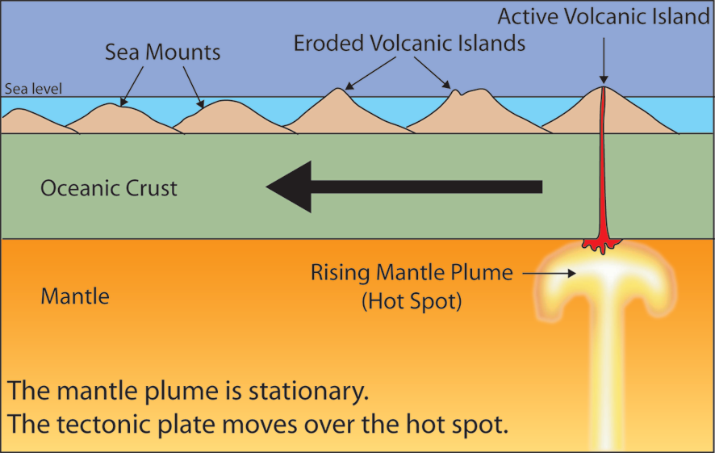
*So why do we have chains of underwater mountains?
Since tectonic plates are moving and a hotspot plume is not, volcanoes will eventually move off the plume and erode over time.
The youngest and active volcano sits directly on top of the plume, while older volcanoes are located further away from the hotspot
Notes:
Hotspot’s commonly form volcanic island chains (like the Hawaiian islands). These result from the slow movement of a tectonic plate over a FIXED hotspot.
Persistent volcanic activity at a hotspot will create new islands as the plate moves the position of the “old” volcanic island from over the hotspot.
Therefore at one end of the island chain you see the youngest, most active volcanic islands (directly over the hotspot) and along the island chain the extinct volcanoes become older and more eroded (see diagram).
This way geologists can use hotspot volcano chains to track the movement of the tectonic plate through time.

Slide 9
Warm-up/ concept check
You are about to watch a spoof clip about some of the topics we learned about in class so far. Write about 3 different topics covered in the class that are portrayed in the clip.
https://www.youtube.com/watch?v=zocutif0cQY&t=14s
2:40
Notes:
Ice age movie trailer movie trailer

Slide 11
Old…

Slide 12
Concept check…
Explain how mid ocean ridges show sea floor spreading.

Slide 13
*Cool things found in new crust at the mid-ocean ridge
As the magma on the sea floor cools and hardens by the mid ocean ridge, iron in the magma align in the direction based off the Earth’s magnetic poles.
Normal polarity = aligns with north magnetic pole
Reversed polarity= aligns with south magnetic pole

Slide 15
*Magnetic reversals
Over time scientist have looked at the seafloor and found evidence showing magnetic reversals happen throughout the history of the Earth.
The youngest rock records are located the closest to the mid ocean ridge and the oldest near the ocean trench

Slide 16
Magnetic Reversals Videos
Magnetic field 100 greatest discoveries (2:34)
https://youtu.be/igGsuDYxhEA
What happens when the poles reverse (3:02)
https://youtu.be/Ou1BiorYRNU

