Slide 1
#60 Energy from Macromolecules
Types: carbohydrates, lipids (fats), proteins, and nucleic acids

Slide 2
Cells!
https://www.youtube.com/watch?v=gFuEo2ccTPA
Starting on page D154 in textbook, assign students carbs, proteins, lipids, nucleic acids
Students are to summarize their topic in 3-5 bullet point sentences

Slide 3
Cells need to absorb and use energy in order to grow and reproduce…but where is this energy coming from?
*All cells use chemical energy within the cell to carryout life’s function.

Slide 4
*Types of molecules within the cell
Large molecules made up of smaller molecules linked together that are used to keep your body functioning are called macromolecules.
The subunits(types) of macromolecules are carbohydrates, lipids (fats), proteins, and nucleic acids
All macromolecules contain carbon. Carbon is present in all living things.

Slide 5
Carbohydrates
Group share

Slide 6
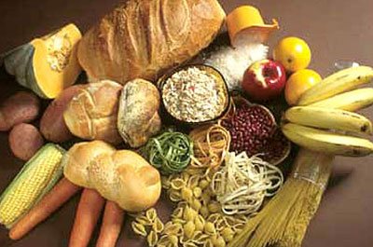
*Carbohydrates
Carbs are made of sugars and starches that are broken down in cells which provide usable energy in animals and structural materials in plants.
Carbs are usually found in cell membranes and cytoplasm

Slide 7
*Carbohydrates
Examples of carbs are:
soda
cereals
pastas & breads (starches)
candy
chips
FRUITS!!!
PRIMARY SOURCE of QUICK ENERGY!
https://www.youtube.com/watch?v=--DCJxequd0

Slide 8
Proteins
Group share

Slide 9
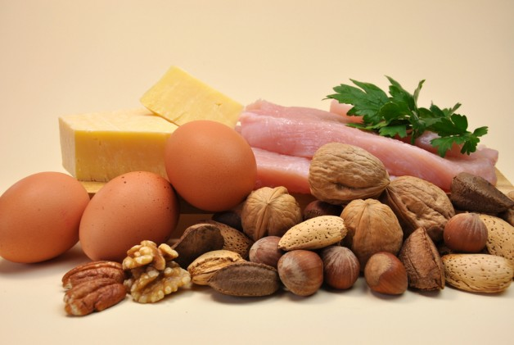
*Proteins
Macromolecules that are used for repair, building, and chemical reactions (digestion).
Proteins can be found everywhere in a cell and proteins are needed in order for your body to makes its own proteins.

Slide 10
*Proteins
Examples of proteins:
Lean meats
chicken (no skin)
beef jerky
lean pork chops
low-fat milk
seeds
tofu
https://www.youtube.com/watch?v=k9fLrtI4RKo

Slide 11
Nucleic acids
Group share

Slide 12
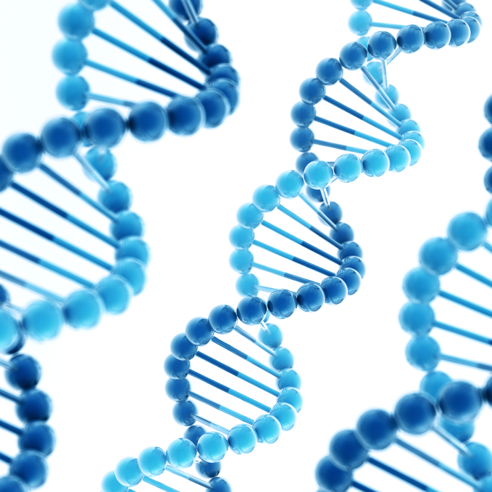
*Nucleic acids
Macromolecules, such as DNA that helps control all cells in an organism and are the “instructions” for producing more proteins
Holds instructions for maintenance, growth, and reproduction (mitosis) of cells
Located in the nucleus

Slide 13
*Nucleic acids
Examples of nucleic acids are:
DNA
http://www.npr.org/2013/01/24/170082404/shall-i-encode-thee-in-dna-sonnets-stored-on-double-helix

Slide 14
Lipids
Group share

Slide 15
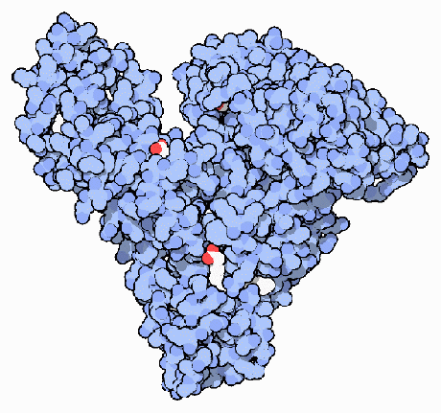
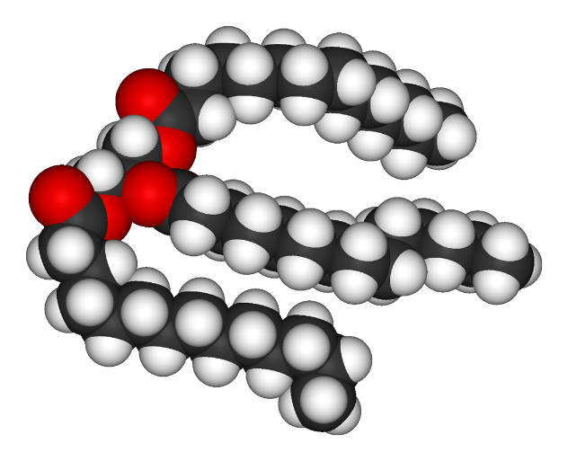
Ponder on this…
Why does fat jiggle and muscle does not?
Protein
Fat

Slide 16
*Lipids
Fats, oils, and waxes are also known as Lipids.
Lipids make up the cell membranes surrounding the cell and organelles and helps with the overall structure of the cell.
Lipids provide cushion, structure, and stored energy

Slide 17
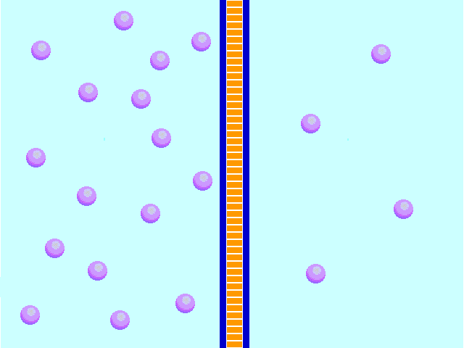
*Lipids
Fatty (lipid) cell membranes regulate/control the flow of nutrients in and out the cell through osmosis or diffusion.
The membranes pass water/nutrients in order to balance the inside with the outside of the cell
If more water is on the outside of the cell, the membrane will allow more water to pass through

Slide 18
*Lipids
Examples of lipids are:
cheese
BUTTER
OILS
chocolate
egg yolks
some nuts
avocados
http://www.cnn.com/2014/01/18/health/fish-oil-recovery/

Slide 19
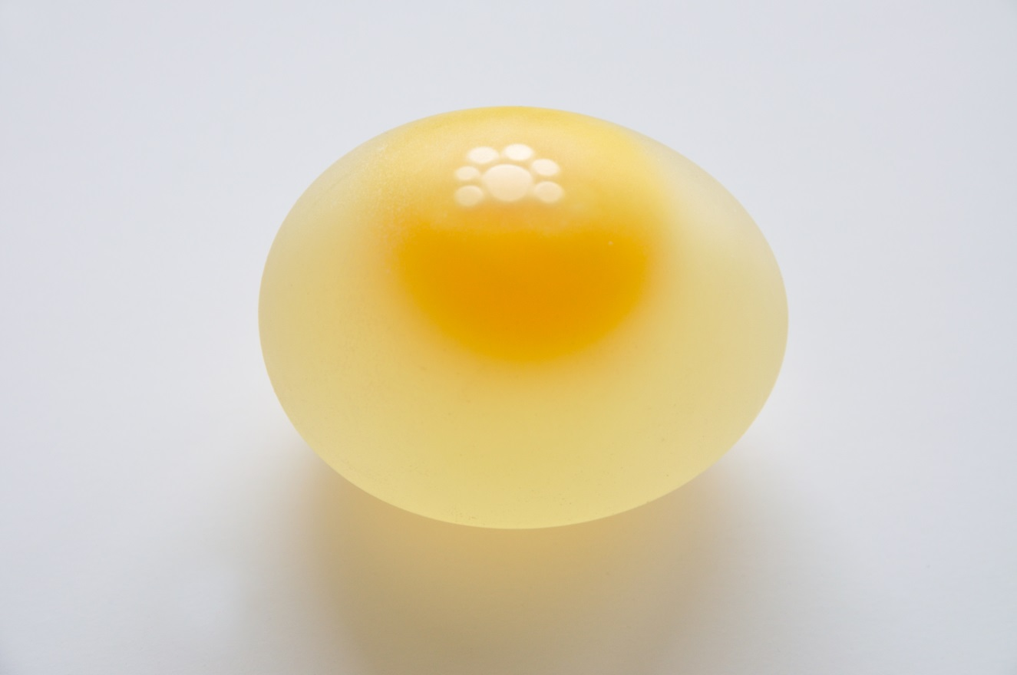
Dissolving an Egg Shell
CaCO₃+ 2H → Ca + H₂O + CO₂

Slide 20
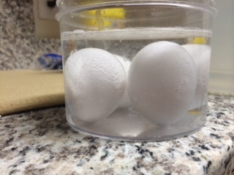

Slide 21
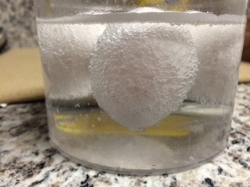

Slide 22
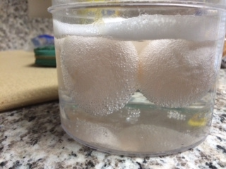

Slide 23
*Diffusion
The spreading of molecules from areas of high concentration to areas of low concentration.

Slide 24
*Osmosis
The selective diffusion of water molecules across a membrane.

Slide 25
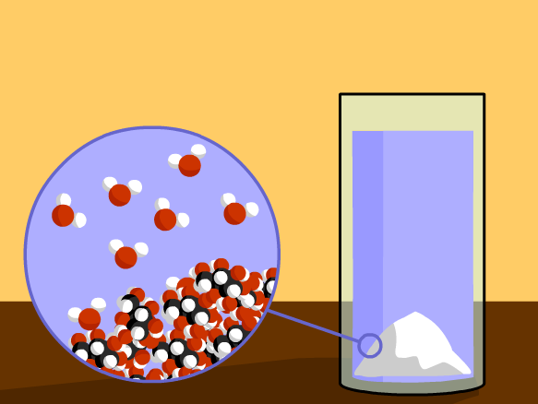
Brain Pop - Diffusion

Slide 26
Extra! Extra! Read all about it..

Slide 27
Lipids
Lipids are arranged in a special way.
Front – water loving
Tail – water hating
Lipids do not dissolve in water
They separate the inside of the cell from the outside of the cell

Slide 28
Audience participation
Using your computer or textbook answer the questions:
Explain polarity and give an example.
Why is it important that cell membrane contain lipids?
Which part of the lipid is polar and non-polar?

Slide 29
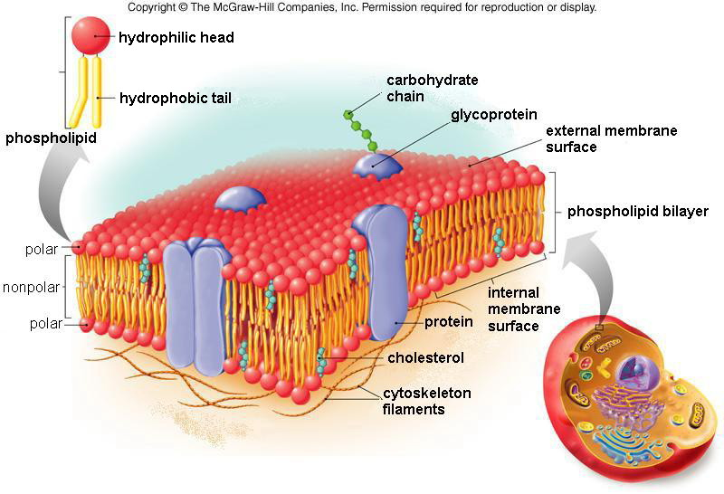

Slide 30
Random yet useful….
Electrical Conductivity of oil:
Using controlled conditions an test was assembled together using a digital volt/ohm/ammeter, a sample of engine oil, transmission oil, water and an automotive battery. The three test liquids were put in paper cups. They were tested for continuity in the three samples with the ohmmeter starting with the lowest setting and progressively switching to the highest most sensitive settings. Results: water passes current at some of the higher resistance settings while the 2 two respective oil samples did not have any continuity, even when the meter was on its most sensitive setting. This test was conducted multiple times and the expected result was obtained: electricity will flow thru water but the oil samples did not allow any measurable current to flow. So in conclusion… oil is in fact an insulator

Slide 31
Lorenzo’s oil…
http://www.youtube.com/watch?v=41v9TuIFu_s
followed by fish oil for brain traumas!
http://www.cnn.com/2014/01/18/health/fish-oil-recovery/

Slide 32
Warm-up
Explain how photosynthesis and cellular respiration can portray a continuous cycle.
What is the difference between a cell and an atom?

