Slide 1
#64 Metabolism and Health

Slide 2
Warm-up
Cells : Organelles as
Riverbasins: _______________
Cells : Organelles as
Molecules : ________________

Slide 3
*Metabolism
Metabolism is a set of chemical reactions involved in storing food molecules and converting them into energy.
We call this energy calories.

Slide 4
*Where Does All
This ATP energy
Go?
60%
Basic Functions
(blinking, breathing, etc.)
30%
Physical Activity

Slide 5
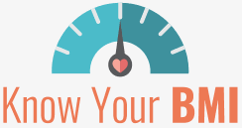
*Humans require energy to function
Each person uses a different amount of energy to perform and maintain their minimum life functions (breathing, blinking, heart beating, etc.), this is called your Basal Metabolic Rate (BMR).
So how do I calculate this?
BMR is calculated in calories.
A calorie is the amount of energy in food

Slide 6
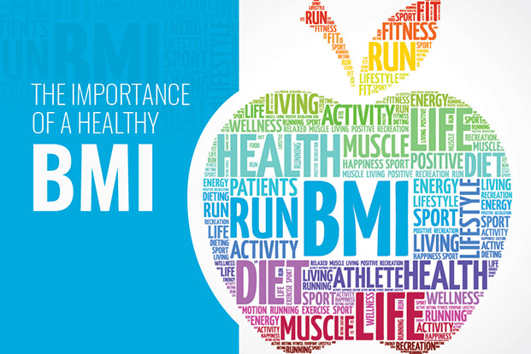
*Basal metabolic rate is the minimum calories your body burns in ATP energy to keep your organs functioning
Find your BMI
http://www.bmi-calculator.net/bmr-calculator/
http://bodybalancemaui.com/bmi-bmr-calculator/

Slide 7
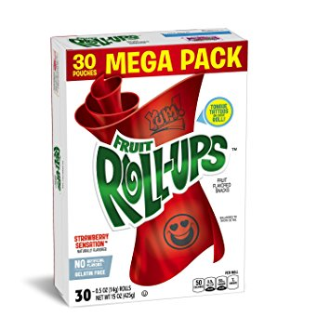
Reading Food Labels – look at the label and calculate macros
Name of food | Fruit Roll-up
Protein (g x 4)
Carbs (g x 4)
Fats ( g x 9)
Serving size
Total calories
Calories on label

Slide 8
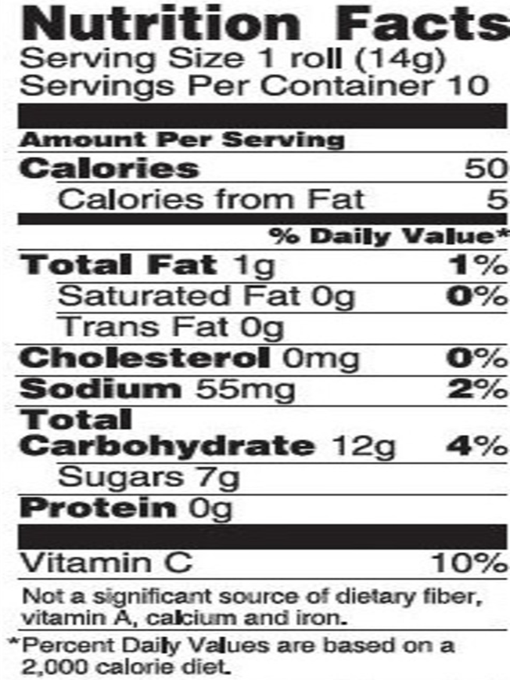
Name of food | Fruit Roll-up
Protein (g x 4)
Carbs (g x 4)
Fats ( g x 9)
Serving size
Total calories
Calories on label

Slide 9
Try it before you look at answers…

Slide 10
Reading Food Labels – Answers
Name of food | Fruit Roll-up
Protein (g x 4) | 0g x 4 = 0 g
Carbs (g x 4) | 12g x 4 = 48g
Fats ( g x 9) | 1g x 9 = 9g
Serving size | 1 roll
Total calories | 0g + 48g+ 9g = 57g
Calories on label | 50 g

Slide 11
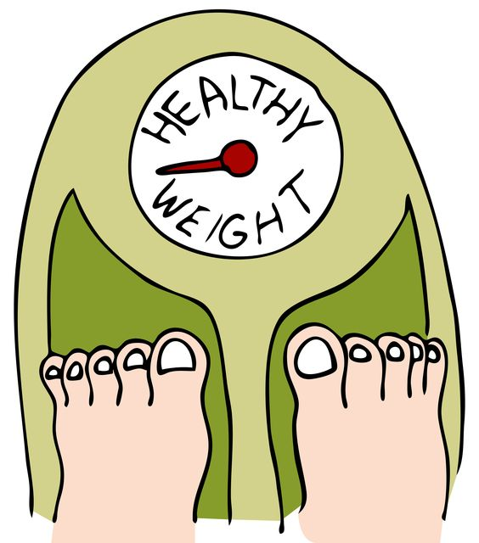
*Why Do Calories Matter?
If you consume more calories than your body uses, then all excess will be stored and weight will be gained.

Slide 12
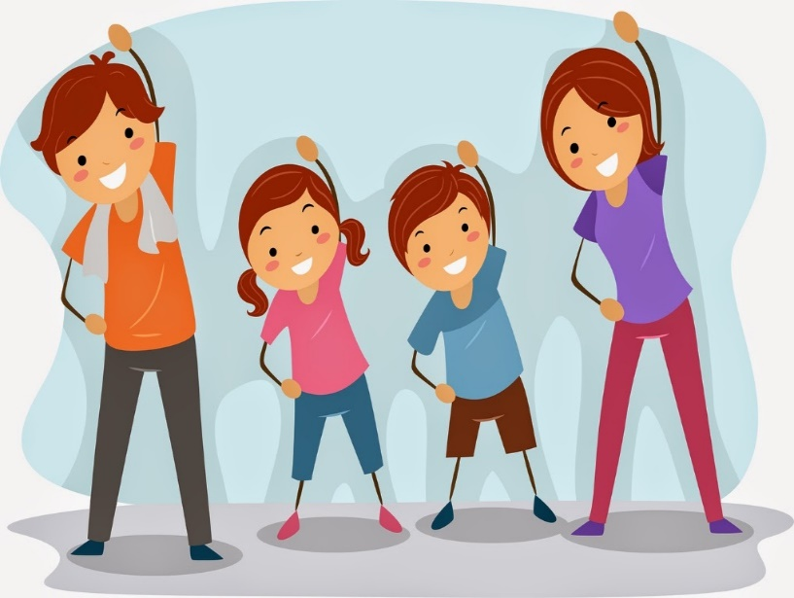
*In order for your body to work properly
Exercise to maintain a healthy heart and lungs
Maintain a balance in calories that go in your body with the amount of calories that get used/burned by your body (go out your body).
Do NOT smoke – this may cause respiratory and cardiovascular system failures
Do NOT drink alcohol – this may affect your liver.

Slide 13
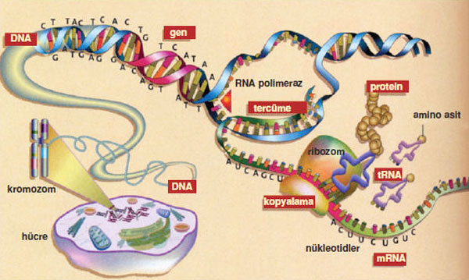
Protein Synthesis
The process that takes place in ribosomes where proteins create different organelles.

Slide 14
Food Label Activity
Google a specific food label item and copy on the sheet provided.
Example – “pepsi nutritional label” “oreo food label”
Count the calories on the label and answer the questions below
Was the calories listed on the nutritional label the same or different then what you calculated when you added the 3 macromolecules together?
Why do you think food labels are misleading? How can this potentially be a problem if you are trying to lose weight?

Slide 15
extra

Slide 16
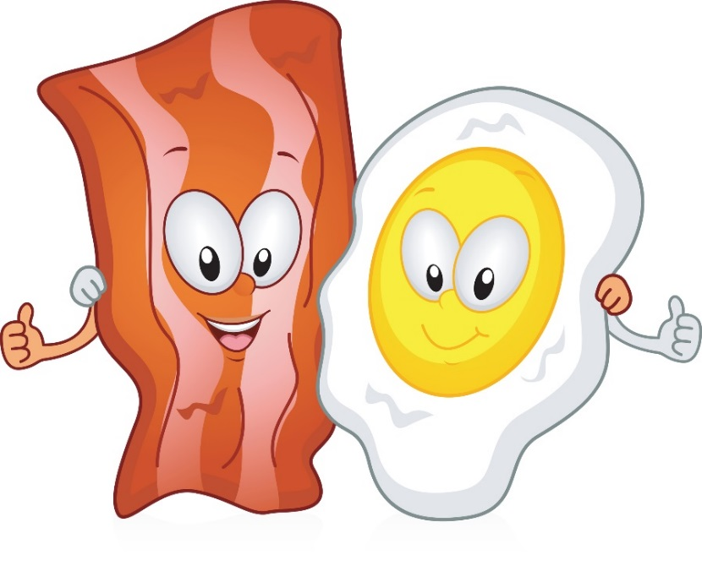
Reading Food Labels
Name of food
Protein ( g x 4)
Carbs ( g x 4)
Fats ( g x 9)
Serving size
Total calories
Calories on label

Slide 17
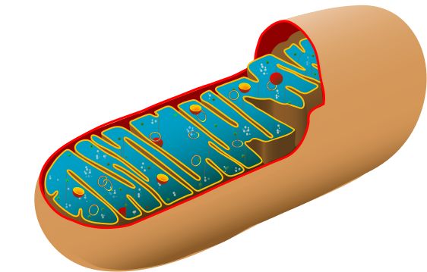
Light energy
Plant cell (chloroplast)
Photosynthesis
Glucose
+ O₂
H₂O
+ CO₂
Animal and Plant cells
(mitochondria)
Energy
Cellular Respiration

