Slide 1
#75 Natural Selection Notes
POST QUIZ - Wed 4/3
EVOLUTION TEST - Fri 4/5

Slide 2
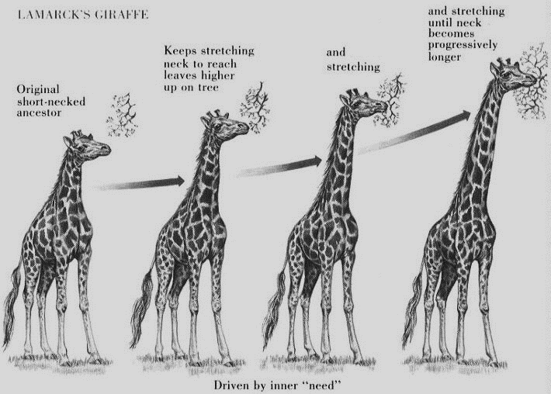
Like this giraffe…

Slide 3
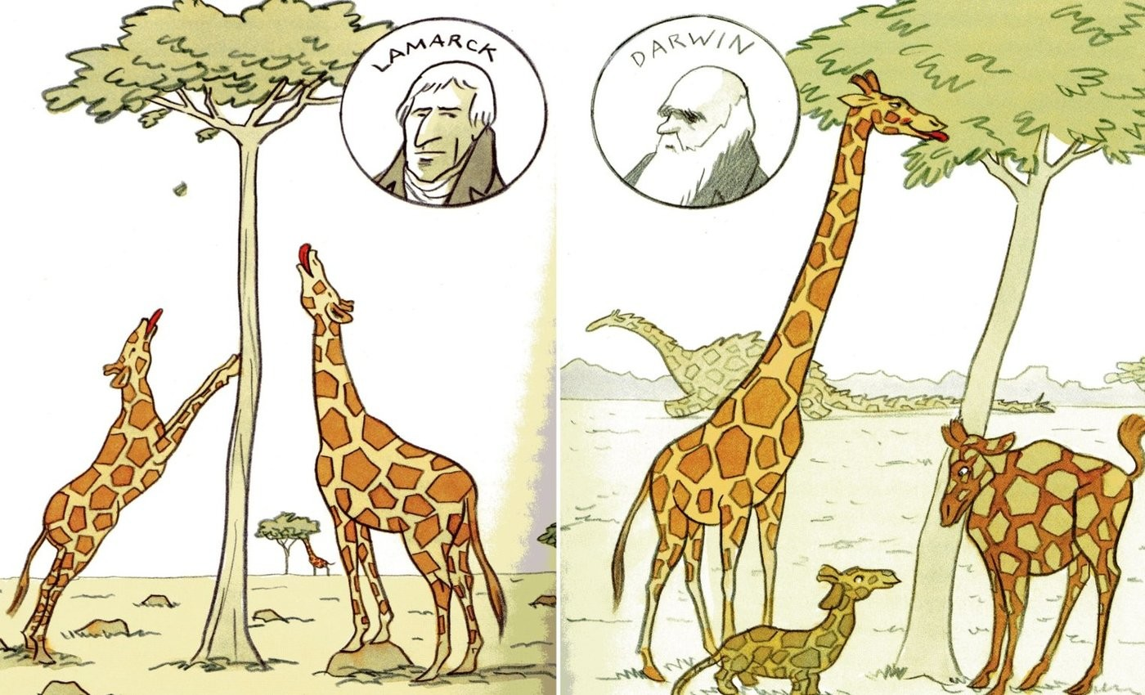
Darwin didn’t quite agree with Lamarck
Charles Darwin didn’t believe that the inner need of animals had anything to with how they evolved.

Slide 4
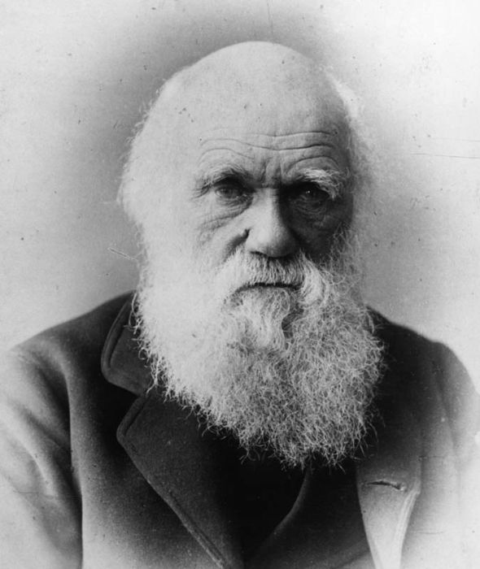
*Charles Darwin’s Theory
Darwin believed that all organisms, even ones of the same species, have differences amongst them.
And it is those differences that will determine if an individual will adapt, survive, and be able to reproduce over time.

Slide 5
Charles Darwin’s Theory
*He proposed our current theory of biological evolution
*We call it the theory of Natural Selection
His theory of natural selection has 4 parts

Slide 6
*4 Principles of Natural Selection:
1. OVERPRODUCTION
Where organisms have more offspring (babies) than will normally survive.

Slide 7
Here’s some examples of OVERPRODUCTION:
Snapping turtles can lay 30 to 80 eggs at a time!

Slide 8
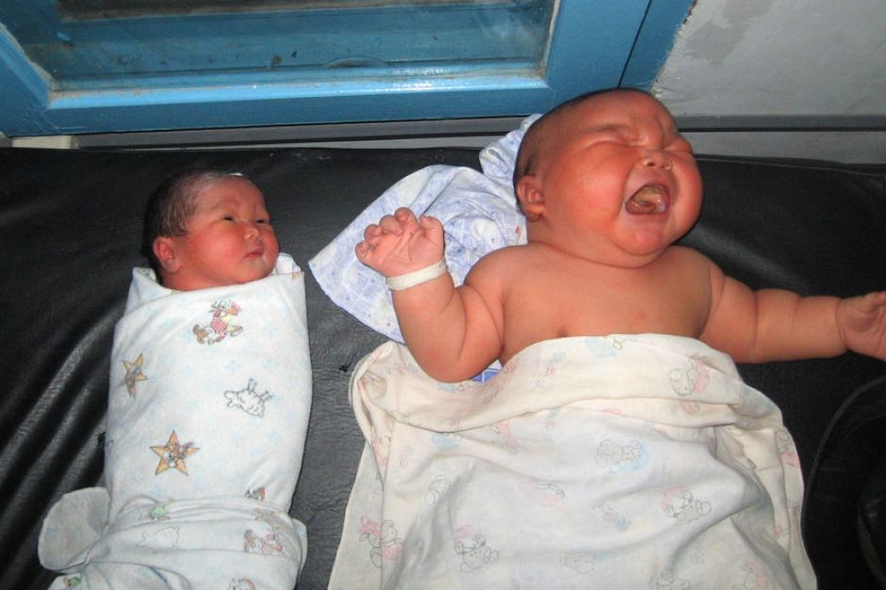
*4 Principles of Natural Selection:
#2 Variation
differences amongst offspring

Slide 9
With too many living things around, things are going to get rough which creates a lot of
*4 Principles of Natural Selection:
#3 COMPETITION!!!
Competition is the selection of a winner

Slide 10
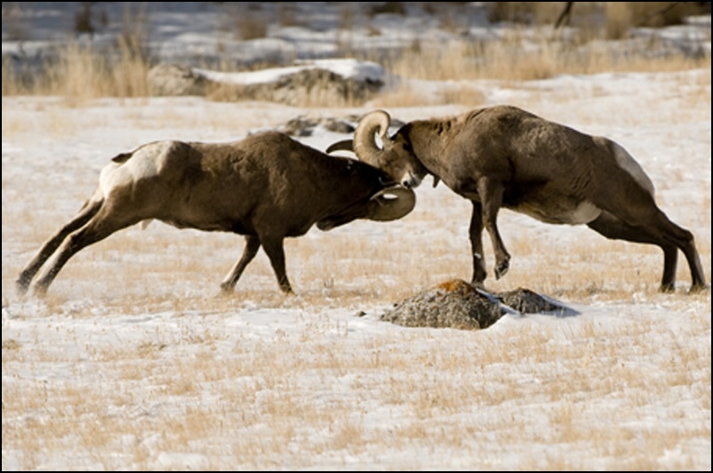
THERE’S LOTS OF
COMPETITION!!!
…for status,

Slide 11
THERE’S LOTS OF
COMPETITION!!!
…for space …opportunities,

Slide 12
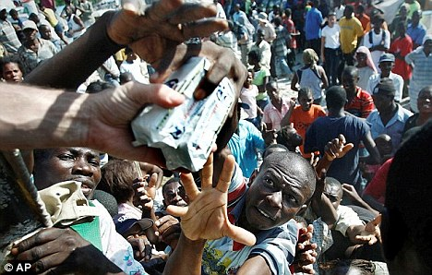
THERE’S LOTS OF
COMPETITION!!!
…for food!

Slide 13
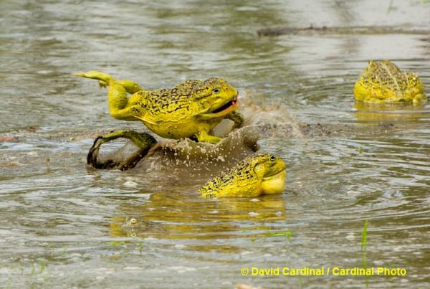
THERE’S LOTS OF
COMPETITION!!!
…for mates!

Slide 14
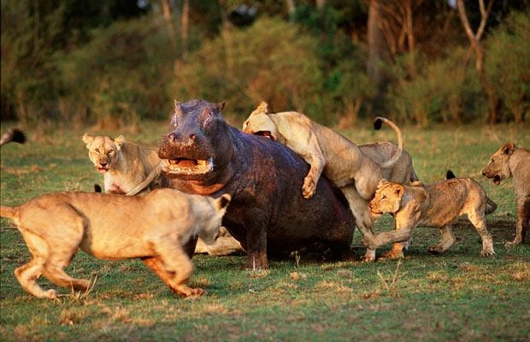
THERE’S LOTS OF
COMPETITION!!!
…for LIFE!

Slide 15
*In nature, COMPETITION does NOT always favor the mighty.
Sometimes it is the MOST PREPARED who win
This is known as Survival of the Fittest

Slide 16
THIS GOES ON FOR GENERATION AFTER GENERATION and so on…
Organisms undergo NATURAL SELECTION. This is where a single species OVERPRODUCES has VARIATIONS OF OFFSPRING (some with mutations) WHO THEN MUST COMPETE TO survive and reproduce!

Slide 17
*4 Principles of Natural Selection:
(#4) ADAPTATION where organisms entire population takes on fresh characteristics / traits
The most successful competitors selected of its kind are the ones chosen to reproduce!!!

Slide 19
Warm-up
You’ve learned the four principles of natural selection. Define natural selection in one sentence without using the following words: variation, competition, overproduction, adaptation, evolve, and “Survival of the fittest”
How do mutations relate to natural selection?

Slide 20
Key words for the THEORY of NATURAL SELECTION:
OVERPRODUCTION (more offspring than will survive)
VARIATION (all with different traits plus occasional genetic mutations)
COMPETITION (selection of a winner)
ADAPTATION (over numerous generations the most beneficial traits endure (last)!)

Slide 21
Extra…

Slide 22
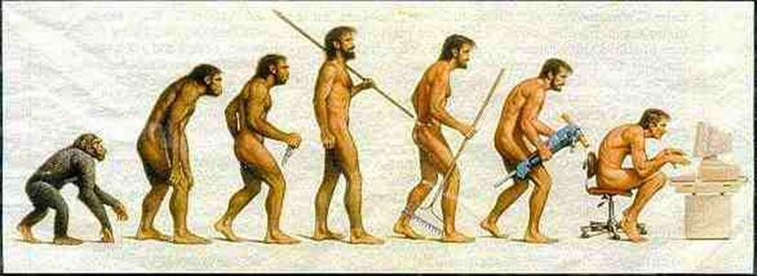
Warm-up
Explain what is going on in this picture in a short narrative format. Be creative with your story. Include why this species has to change and what you think their next change will be

Slide 23
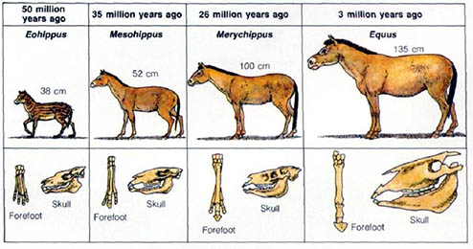
Warm Up
What is evolution?
Explain how bacteria evolved over time?
How does this illustration portray the evolution of a horse?

Slide 24
Visual Vocab (definition and pics)
Geological evolution | Biological evolution | Evolution | Mass extinction
Isolation (evolution) | Natural selection | Speciation | Variation
overproduction | Vestigial organs | Selection (competition) | adaptation
Captured thoughts
In a MINIMUM of 3 well developed sentences EACH, explain the following:
Explain the main idea
Explain how this connects to your life
Explain what you found interesting and why
Explain anything you wonder or want additional information on.
Darwin vs Lamarck
Explain both theories
Give examples of each in way you can remember (besides the ones I gave)
Include pictures of both

