Slide 1
Neritic Zone
Neritic Zone
Made by Brogan Sinclair, Jaden Hill, and Bridget Anderson

Slide 2
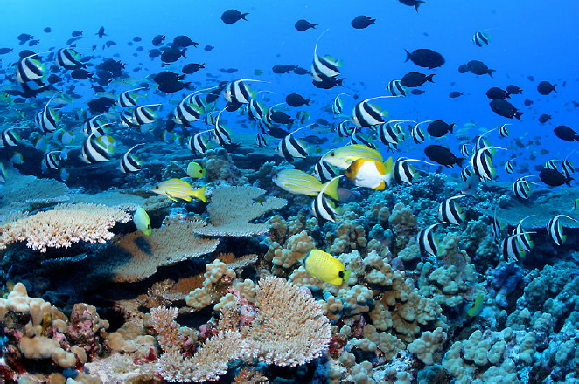
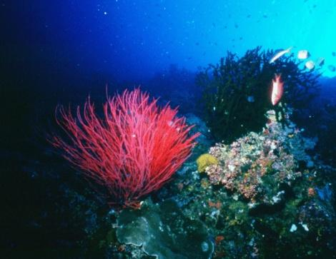
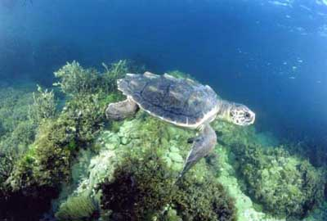
*What is the Neritic Zone?
The Neritic Zone is an area near coasts, usually before the ocean drop-off (When the ocean starts to dip towards the bottom).
The Neritic zone can usually get to about 656 FT in depth, The water is usually full of nutrients.
Most animals live near this area in the ocean, because of the big amount of nutrients and sunlight.
Notes:
https://www.google.com/search?q=what+is+the+neritic+zone&source=lnms&tbm=isch&sa=X&ved=0ahUKEwiDm6H6lpvXAhVDbiYKHaMDC_IQ_AUICigB&biw=1366&bih=677&safe=active&ssui=on#imgrc=VQg61vk1DcGaKM:
https://en.wikipedia.org/wiki/Neritic_zone
https://www.britannica.com/science/neritic-zone
study.com/academy/lesson/neritic-zone-definition-organisms-climate.html

Slide 3
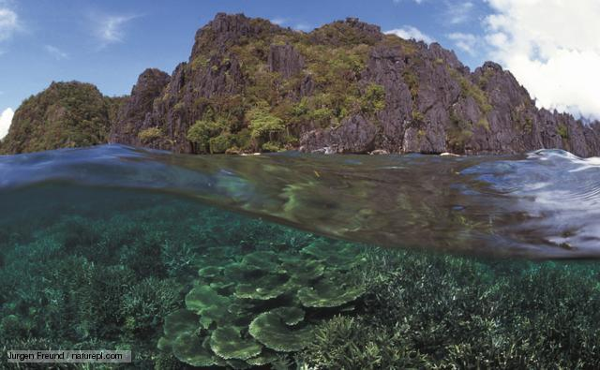
What is the depth of the Neritic Zone?
The Neritic Zone is a fairly shallow environment, it extends from the low-tide level to 200 meters (656.168 feet) down.

Slide 4
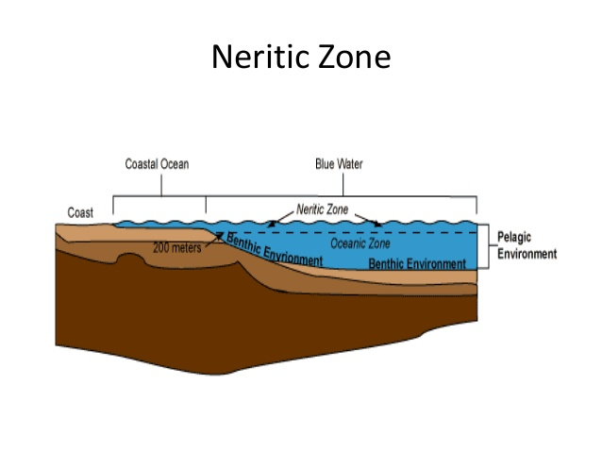
*Location
The Neritic zone is located from the low tide line to the edge of the continental shelf.
The Neritic zone reaches down to about 200 meters (656 FT).
Most ocean life lives here.
Lots of sunlight shines into this layer which is useful for photosynthesis.

Slide 5
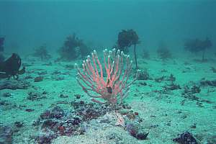
How much sunlight does the Neritic Zone get?
Sunlight reaches the ocean floor in the Neritic Zone.
This helps plants thrive at the lower parts of the Neritic zone.
Since sunlight is constantly hitting the water, the water is on average 75.2 Degrees Fahrenheit (25 C).

Slide 6
Facts
The Neritic Zone inhabits most marine life, but only covers about 8-10% of the ocean.
This layer contains a rich amount of oxygen, that makes it easier and more habitable to organisms.
Since this zone always has sunlight available, it generates enough energy for photosynthesis to happen.
Another name for the Neritic zone is the sunlit Zone or Sublittoral Zone.

Slide 7
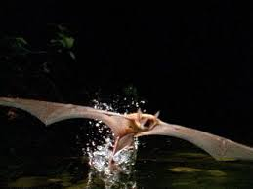
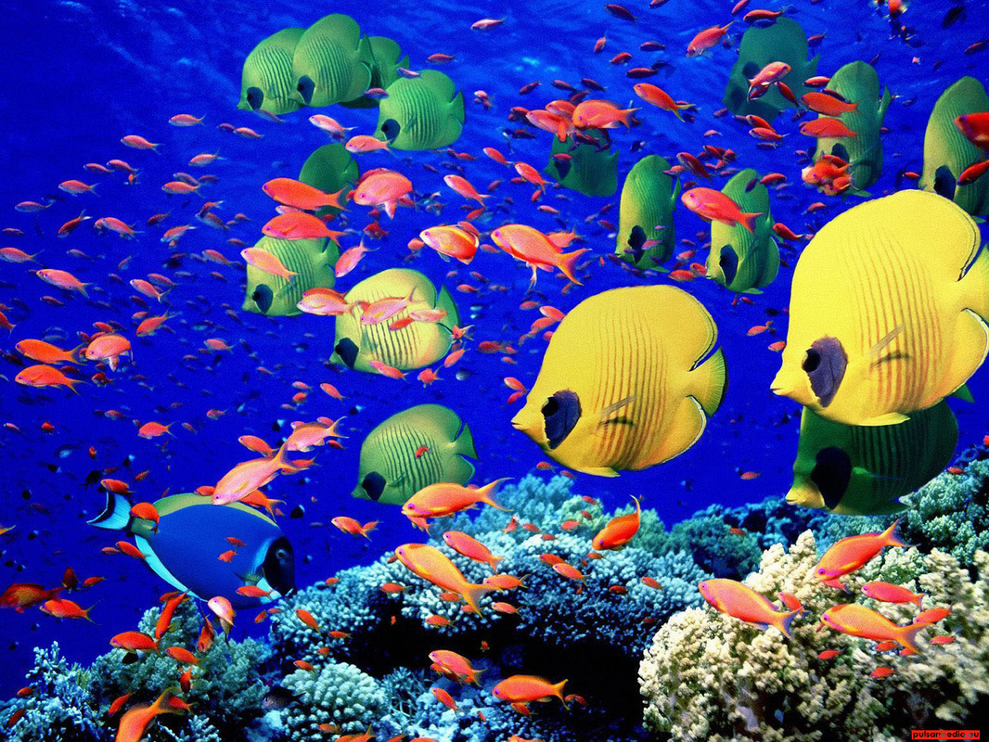
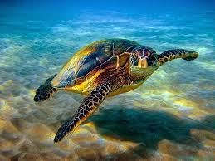
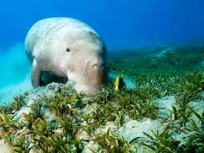
Animal Life
The neritic zone contains the most marine life out of all ocean zones.
Various types of small fish
Dolphins
Porpoises
Whales
Bats
Dugongs
Manatees
Sea turtles

Slide 8
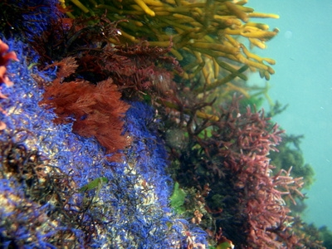
Plant Life
The following plants live in the neritic zone:
Kelp
Algae
Seaweed
Seagrass
Phytoplankton
Coral
Notes:
https://www.quora.com/What-are-some-examples-of-plants-in-the-Neritic-zone
http://study.com/academy/lesson/neritic-zone-definition-organisms-climate.html

Slide 9
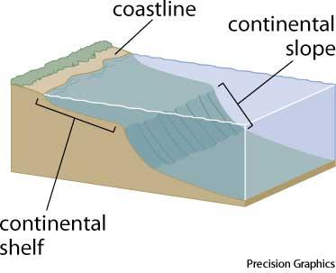
Continental Shelf
A continental shelf is the beginning of the sea where the land is flat or sloping very slightly.
It extends from the shore line (the beginning of the beach) all the way to the continental slope.

Slide 10
Continental Slope
A continental slope is land that drops suddenly right after the continental shelf.
Imagine a water slide that looks somewhat like this, there is the platform (the continental shelf), then all of a sudden the slide drops very steeply (hundreds to thousands of feet) this is your continental slope. On this water slide you would be underwater the entire time.

Slide 11
How deep does the neritic zone go?
200 meters / 656 feet

Slide 12
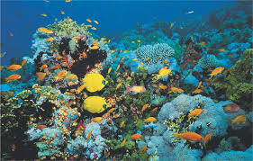
Why does the Neritic Zone carry most marine life?
The Neritic zone carries most marine life because it contains much oxygen and the sunlight shines into the zone making it easier for photosynthesis. The zone is full of nutrients, which is good for plants and animals.

Slide 13
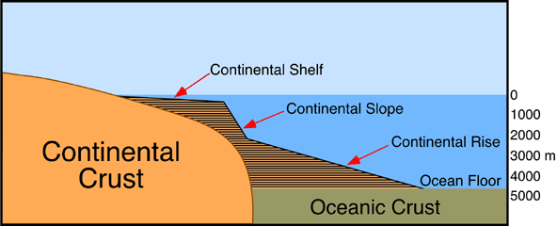
Where is the continental slope and continental shelf?

Slide 14
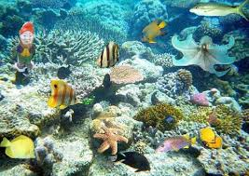
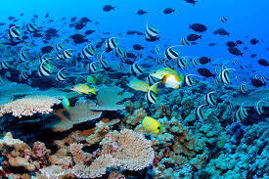
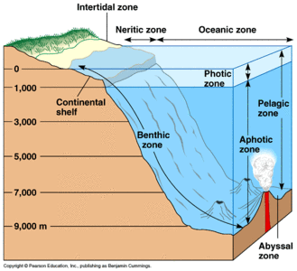
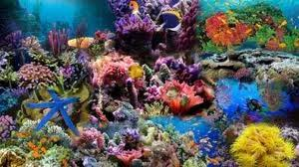
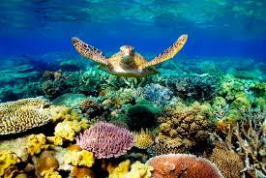
Pictures

Slide 15
Cites used
Works Cited
Study.com, Study.com, study.com/academy/lesson/neritic-zone-definition-organisms-climate.html.
Study.com, Study.com, study.com/academy/lesson/neritic-zone-definition-organisms-climate.html.
“Neritic Zone.” Wikipedia, Wikimedia Foundation, 26 Sept. 2017, en.wikipedia.org/wiki/Neritic_zone.
The Editors of Encyclopædia Britannica. “Neritic Zone.” Encyclopædia Britannica, Encyclopædia Britannica, Inc., 25 Mar. 2014, www.britannica.com/science/neritic-zone.
“Neritic Zone.” Neritic Zone - DESCRIPTION, www.neriticzone22.weebly.com/.
Textbook pg. C80

