Slide 1
Neritic Zone
By: Emma Mitchiner, Zoie Davis, Maren Goodman, Andrea Cabrera

Slide 2
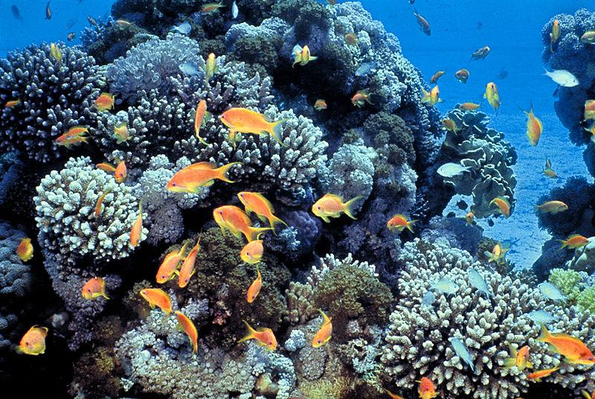
Neritic Zone (coastal ocean, sublittoral zone)
The Neritic Zone is the shallow marine area, that is in between the shore (Low tidemark) and the continental slope (drop-off). This is where the coast and the ocean meet. There's an abundance of oxygen and plenty of sunlight in this zone.
Most water activities happen here. This is where the Great Coral Reef is located.

Slide 3
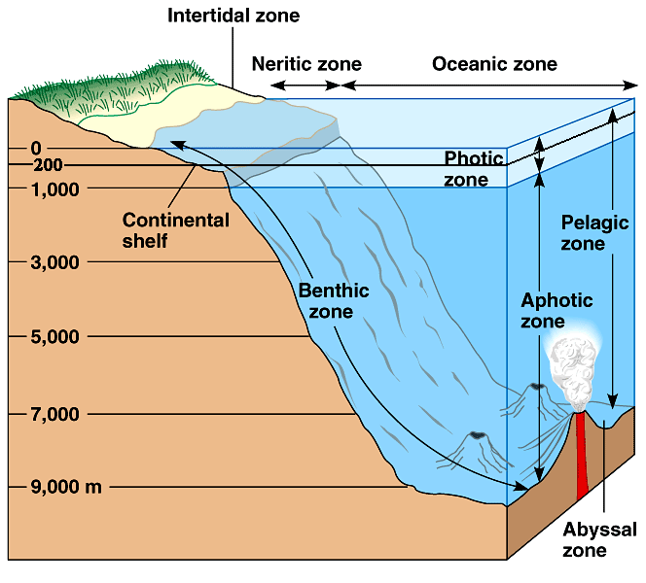
“Between the coastal and the deep, is where you’ll find ME”
The Neritic Zone is located near the tidal region,
which is the shallow region of ocean before the drop-off.

Slide 4
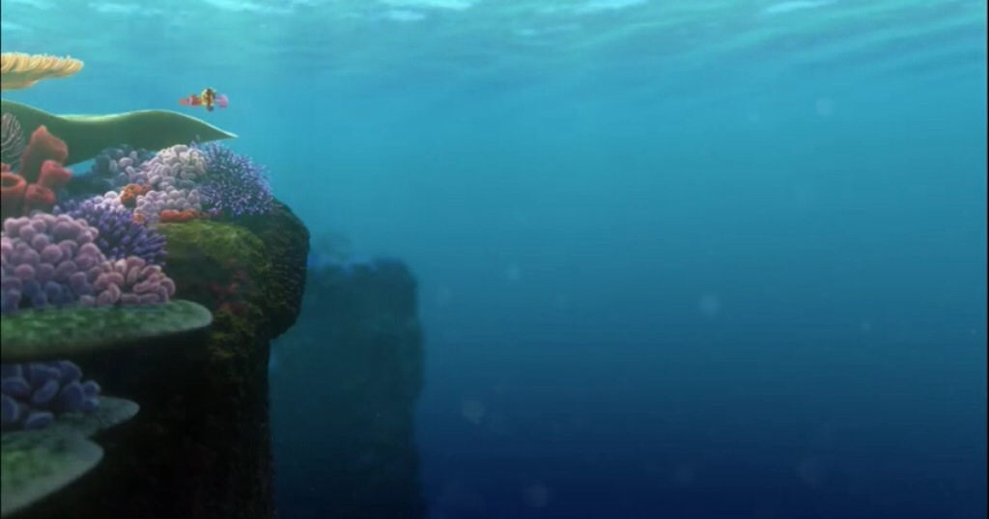
Depth
The Neritic Zone is the shallow part of water right before the drop-off. It can get up to 660ft below the surface.
The drop off is where the sand floor on the bottom starts to go down further. So, when you go to the beach you’ll see the floor starting to get deeper more quickly, and that's where you will find the end of the Neritic zone.

Slide 5
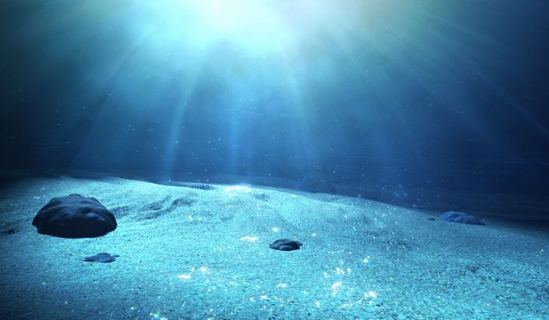
Then how much sunlight does it really get?
The Neritic Zone gets a reasonable amount of sunlight, which helps the marine life get more nutrients.

Slide 6
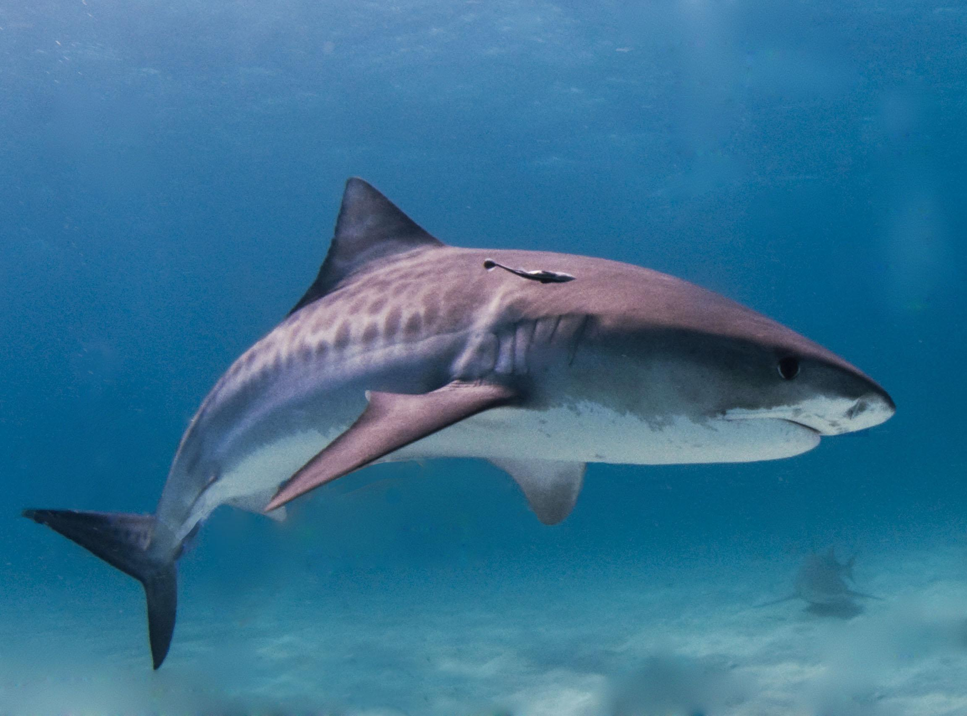
3 interesting facts:
A lot of seafood comes from this zone. (crabs, oysters, sea snails)
Most oceanic activities (snorkeling, tubing) happens in this zone.
Sharks are one of the largest predators in this zone.

Slide 7
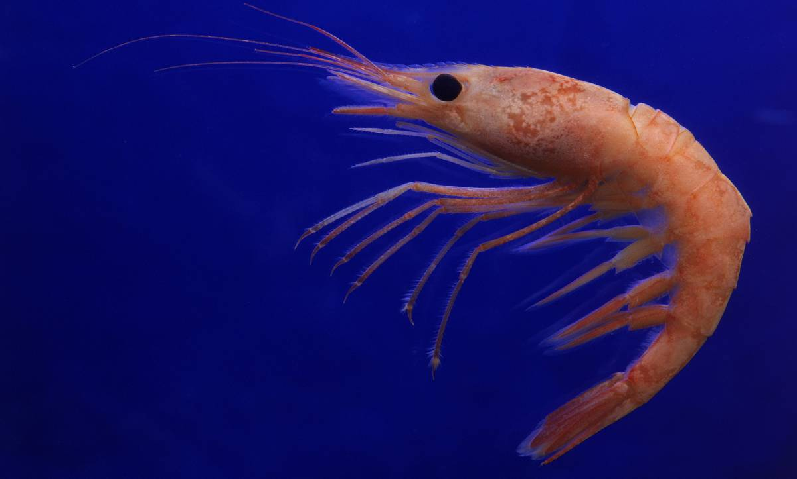
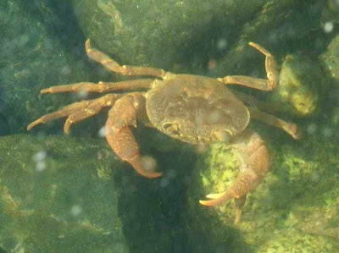
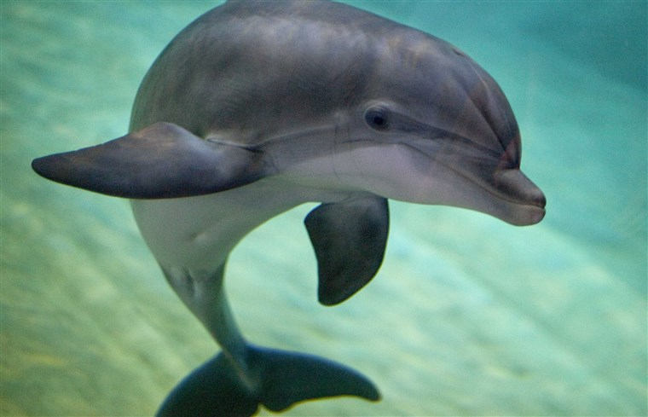
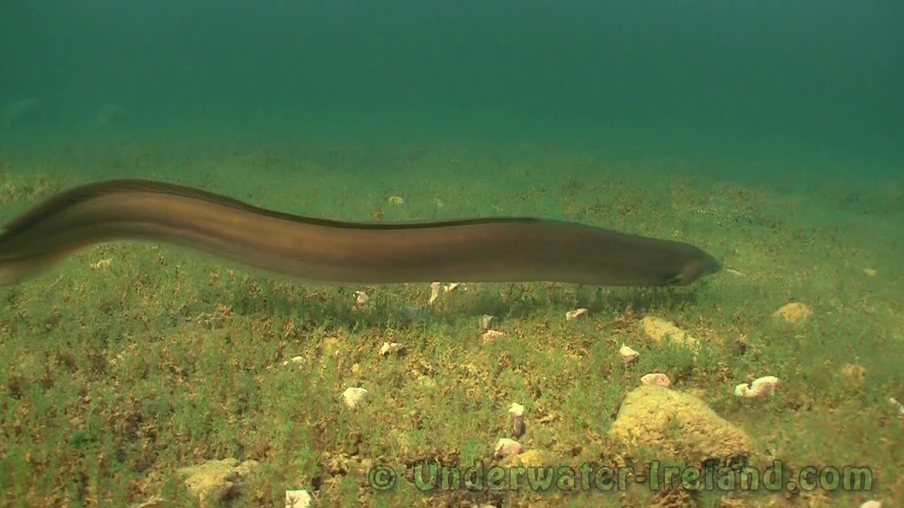
Animal Life
Some of the different animals that live in this zone are
Shrimp
Dolphin
Crab
Eel

Slide 8
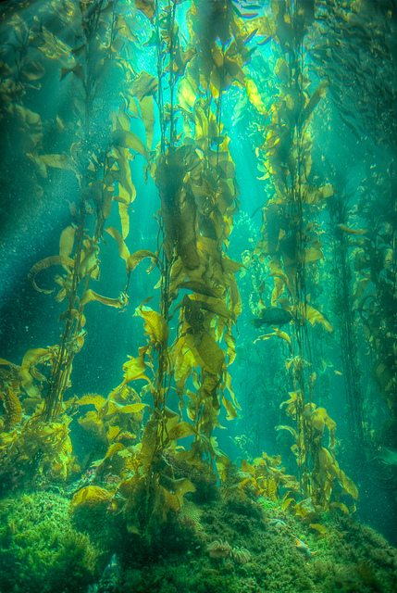
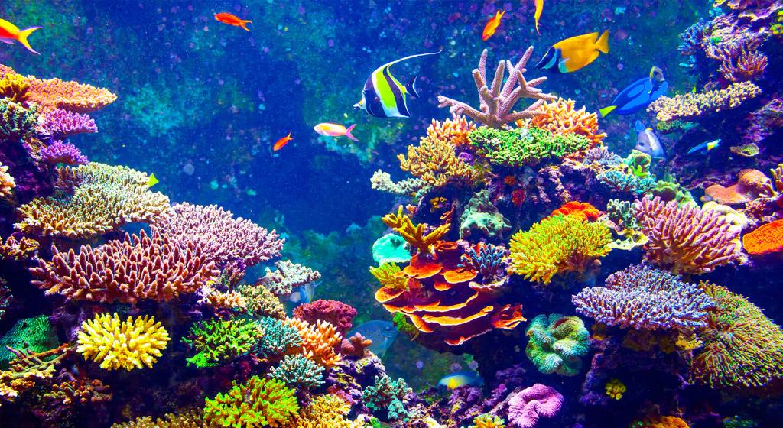
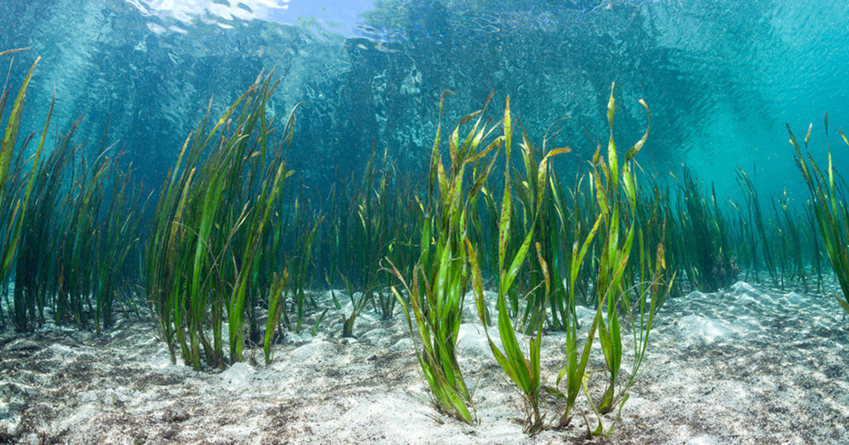
Plant life
Some of the different plants located here are
Kelp
Coral
Seaweed

Slide 9
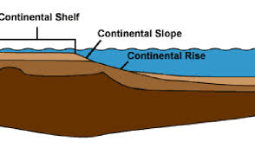
Continental shelf and slope
The continental shelf is the area right before the land starts to drop. At the beach, it is the shallow area where you can play in the waves, surf, and collect seashells.
The continental slope is where the land starts to dip down and decrease. It can usually be very deep and is where most of the larger animals are found.

Slide 10
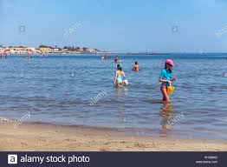
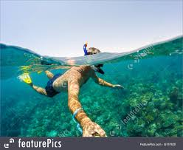
Just think of it like this....
Continental Shelf-
Continental- Land
Shelf- surface for objects
Continental Slope-
Continental- Land
Slope- A decrease or increase
Land where objects/activity is held
A decrease
in land

Slide 11
Based off what we shared!!
What animals live here?
Shrimp, dolphin, crab, eel
Why is the Neritic Zone the most productive zone in the ocean?
Because sunlight can reach the entire zone
What other names does this zone go by?
a. Abyssal Zone
b. Coastal Ocean
c. Pelagic Layer
d. Intertidal Zone
The answer is B. Coastal Ocean

Slide 12
Cites:
Neritic Zone Definition- https://www.britannica.com/science/neritic-zone
Neritic Zone Location- https://www.encyclopedia.com/earth-and-environment/ecology-and-environmentalism/environmental-studies/neritic-zone
Neritic Zone Depth and Sunlight Amount- https://www.thoughtco.com/neritic-zone-4767613
Interesting facts- https://neriticzone22.weebly.com/facts.html
Animal Life- https://sciencing.com/adaptations-animals-neritic-zone-8758787.html
Plant life- https://www.quora.com/What-are-some-examples-of-plants-in-the-Neritic-zone
Continental Shelf/Slope- https://en.wikipedia.org/wiki/Continental_shelf

