Slide 1
Ocean Exploration Red Block
David R , Carson P, Shakira R, Danielle J,
Sarah D, & Jack K

Slide 2
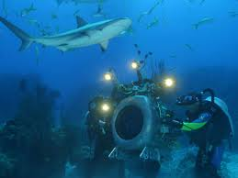
What is ocean exploration and why do we do this?
Researchers study the deep ocean to leave more about organisms that live there, the resources available, how nutrients travel, and how the ocean affects the Earth’s climate.

Slide 3
What have researchers found in the deep ocean?
Animals such as sea turtles and killer whales.
Plants such as red algae and kelp.
What do they eat? Nutrients move throughout to ocean creating a food web. Researchers study these nutrients and food webs.
Large amounts of heat energy move in the ocean affecting Earth’s climate.
Researchers study the ocean environment to learn how organism live together and how their habitats exist.

Slide 4
Submarine
A submarine is an enclosed underwater vessel that can carry passengers to the ocean floor.
It is built to protect the crew from the intense water pressure and freezing temperatures in the deep ocean.
Submarines are used to examine the deep ocean, see what lives there, and what environment lives there. They are built with robot-like arms that can pick up things on the ocean floor for better observation.
It is important to use manned submarines to give a human touch to the exploration. Humans can decide what they want to search and observe.

Slide 5
ROVs
ROV stands for Remotely Operated Vehicle and they are highly maneuverable underwater robots.
No one is aboard the ROVs, they are operated by someone at the water’s surface often with a joystick much like playing a video game.
There are cameras aboard that can transmit images and video back to land.
ROVs are simpler and safer because human are not on board. They can also go into deeper areas where humans cannot travel.

Slide 6
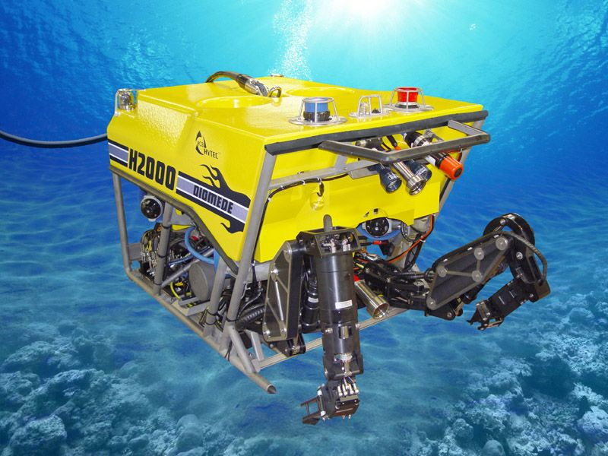
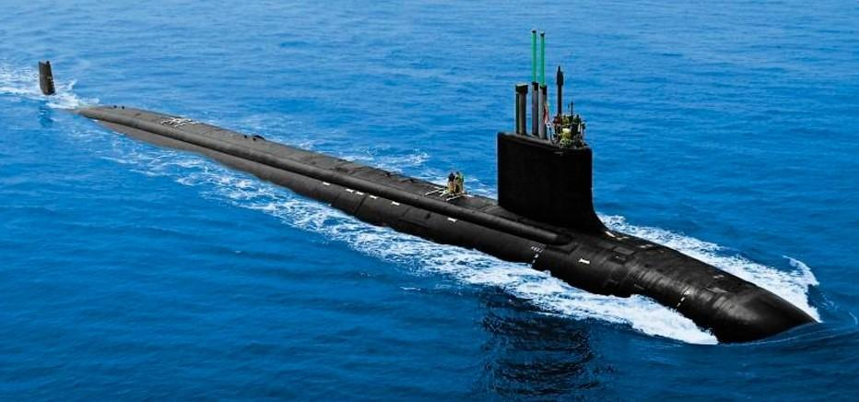
ROV
Submarine

Slide 7
Overfishing
What does it mean to overfish?
Overfishing is catching fish at a faster rate than they can reproduce. This is the main cause of the decrease in fish populations
What does this do to food chains?
Overfishing harms the ocean food chains because it causes a decrease in population of the species affected.
The ocean is unable to renew the about of fish being consumed at a fast enough rate.

Slide 8
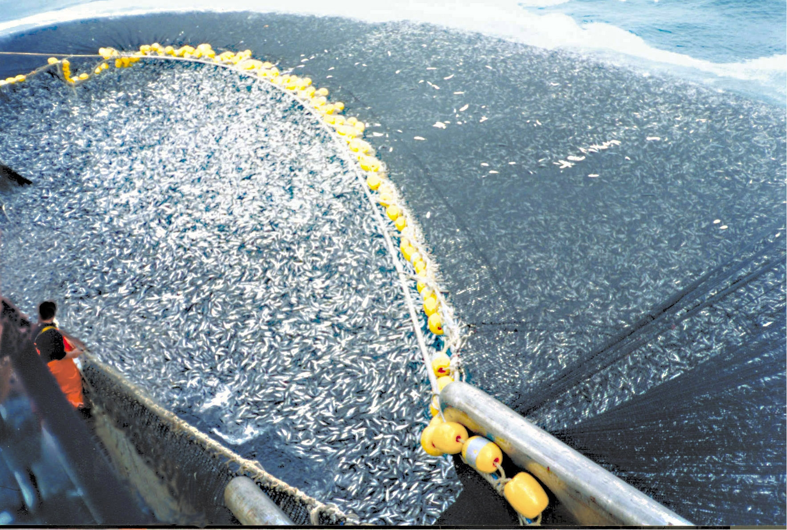

Slide 9
By-catching
What is bycatching?
The portion of unintended animals that are caught in a net and then thrown away as unwanted.
Why is by-catching fish a problem?
Its messing up the population because they are killing so many animals that fishermen didn’t mean to catch.
More than 15 percent of shark species are threatened with extinction because of by-catching.

Slide 10
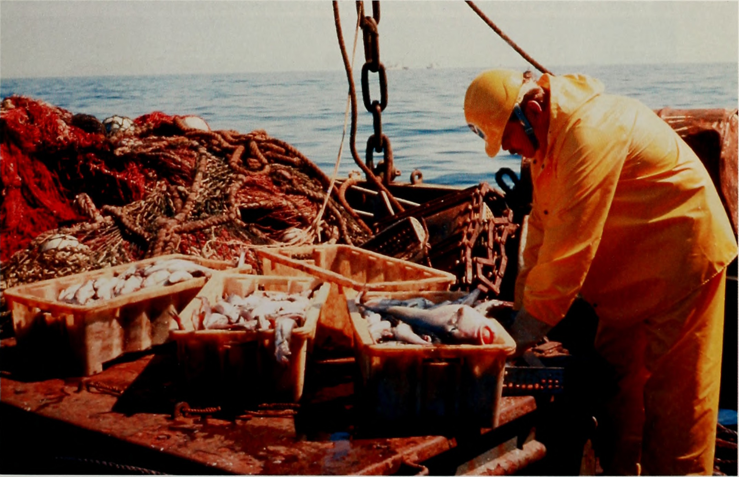
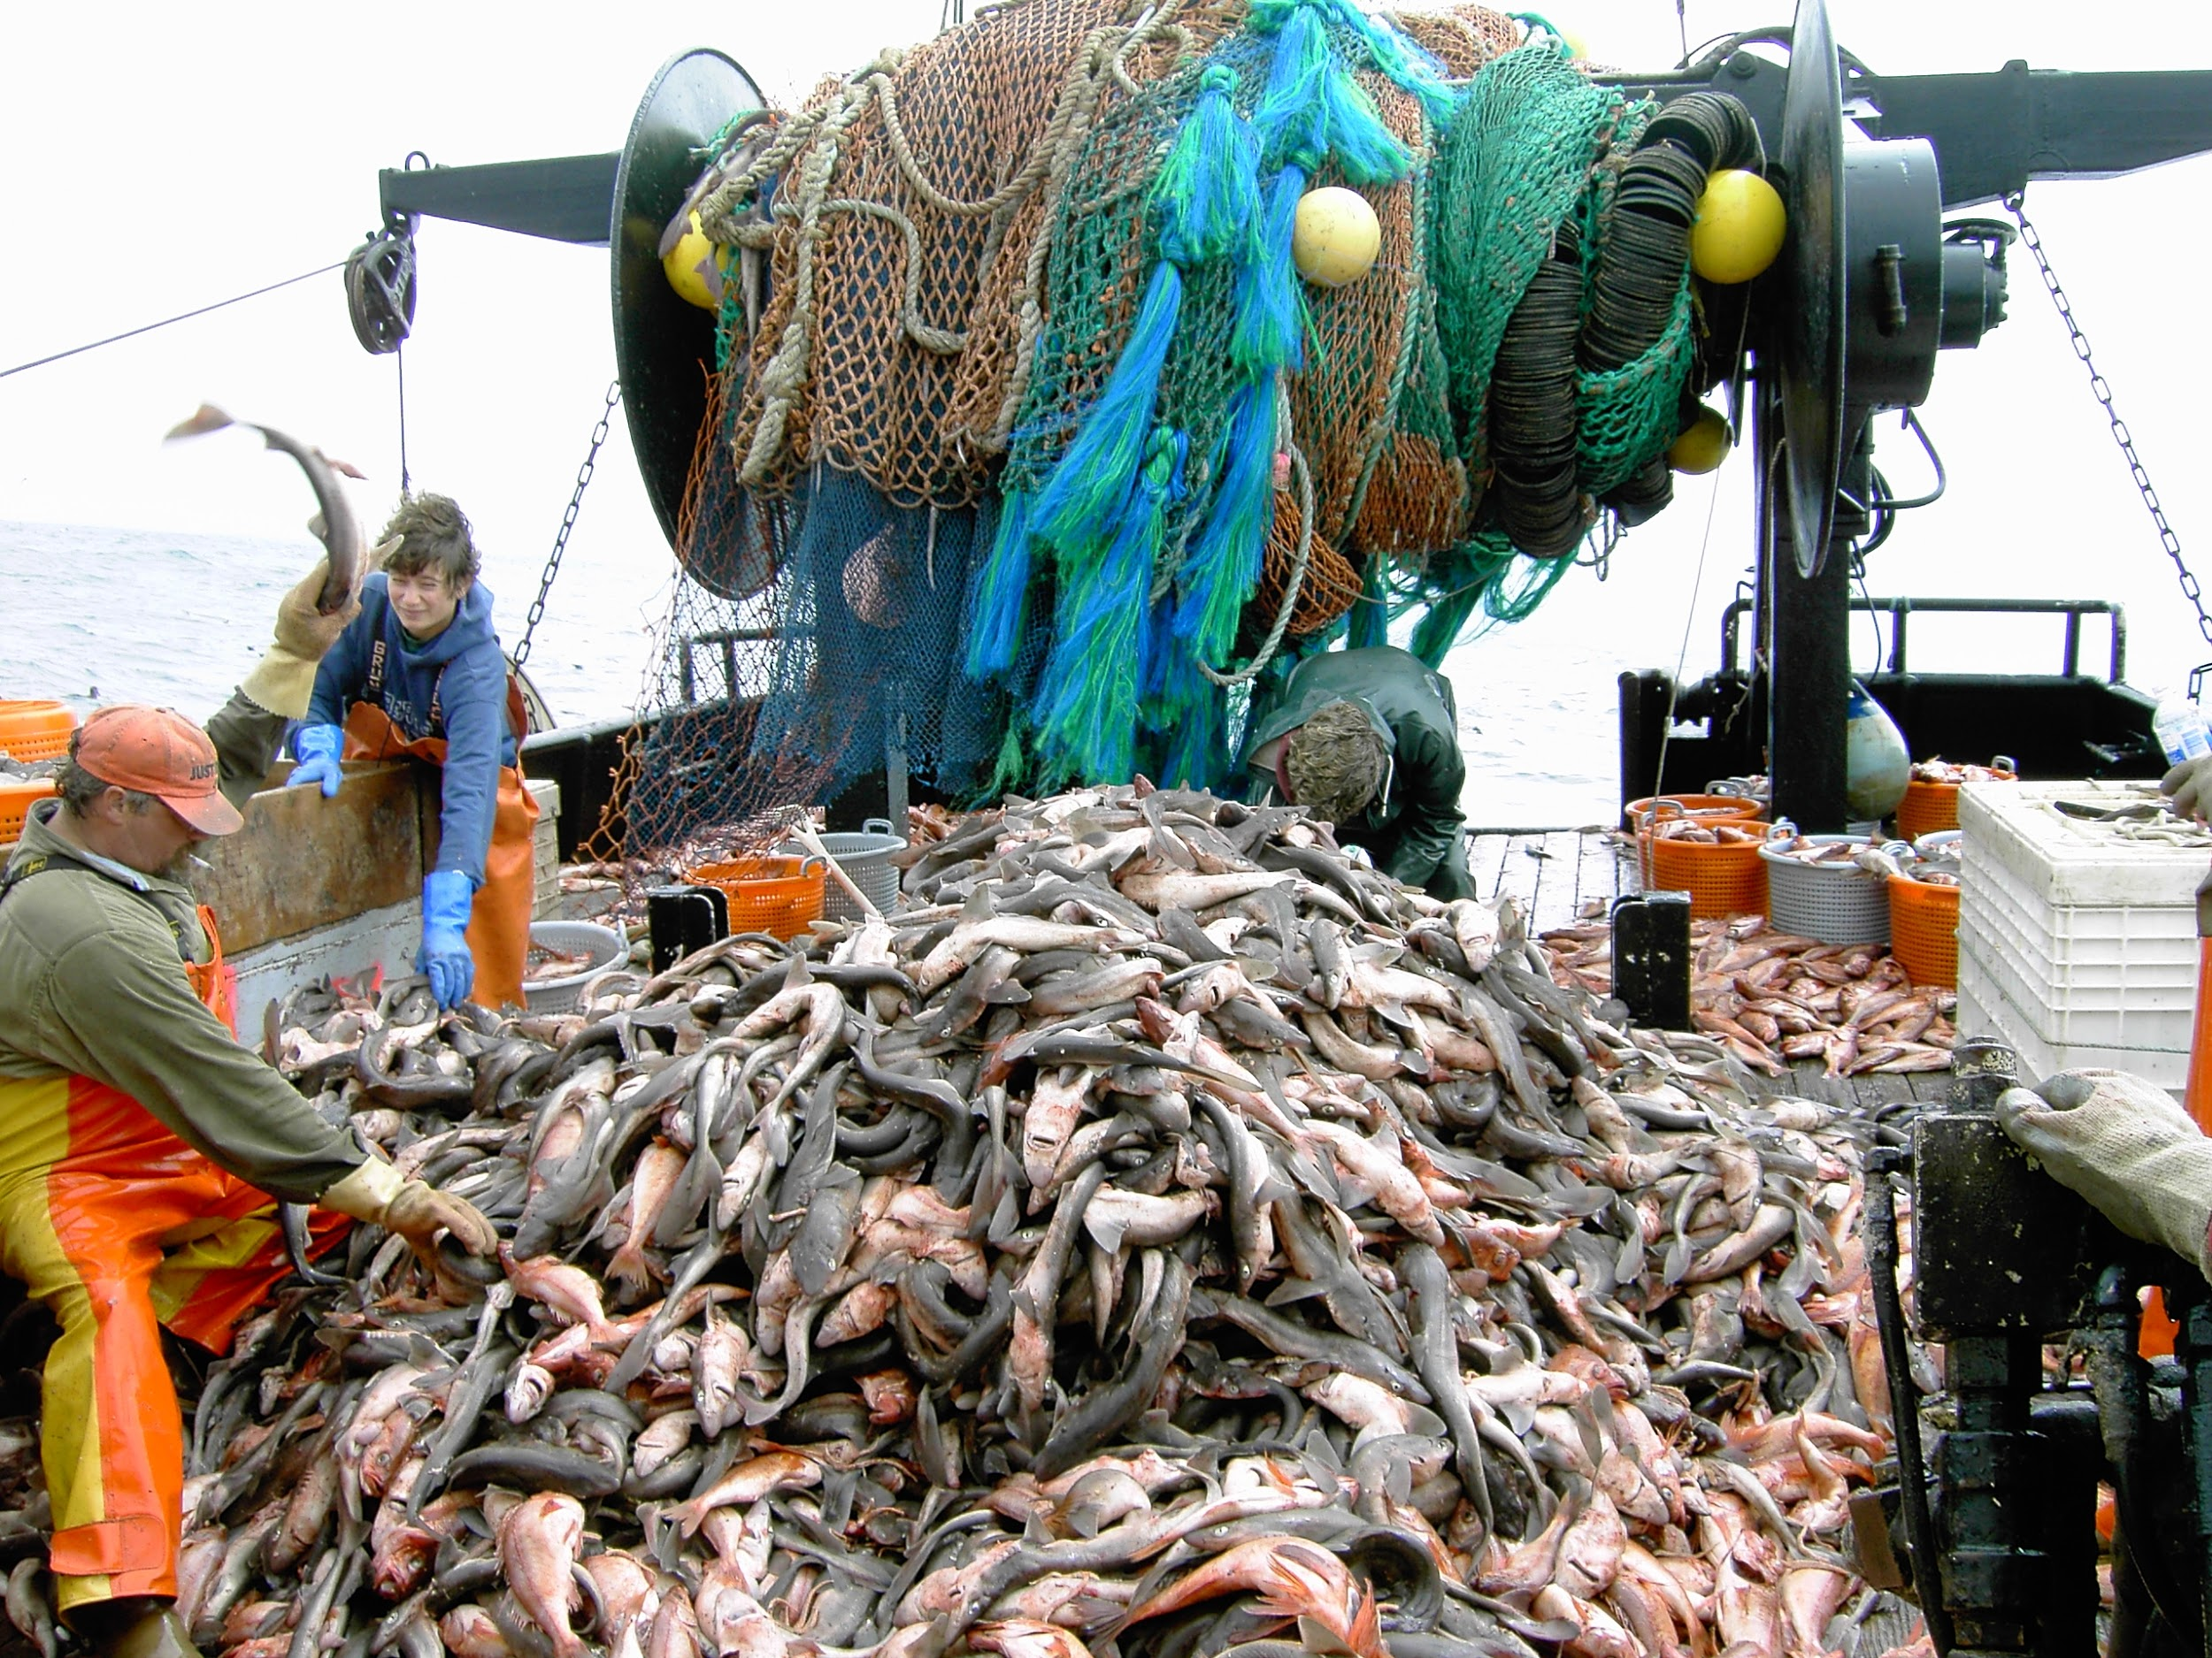

Slide 11
Ocean pollution
What is Ocean Pollution?
Pollution is trash,bad air,or harmful chemicals that affect the aquatic ocean biome. Pollution can hurt ocean life. This could all harm or kill aquatic life. An estimated 14 billion pounds is dumped into our oceans every year!
How does humans pollute the water?
Humans pollute water by trash being dumped into the water, toxic chemicals could affect water or even air pollution. fertilizers and even needles! In conclusion humans are polluting the oceans and harming/ killing sea life.

Slide 12
How does ocean pollution impact/hurt animals?
This could hurt ocean life because they could swallow trash or get tangled or caught in the trash or get sick from chemicals. Humans could also be affected because if we eat an infected fish we could get sick.
https://www.cbsnews.com/news/u-s-polluting-ocean-trash-alarming-rate/

Slide 13
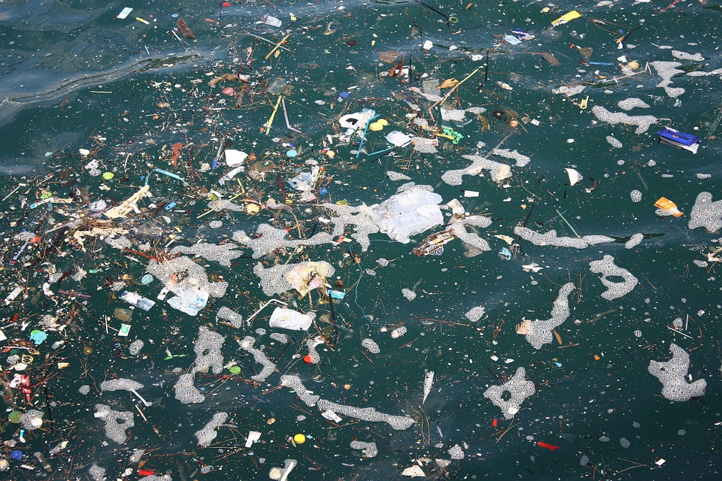

Slide 14
What is the EPA
What does EPA stand for and what do they do EPA stands for Environmental Protection Agency. And sets standards for safe, clean drinking water.
When was it established December 2nd 1970 and response to widespread public environmental concerns.
What is the clean water act and how does It protect our waters It helps control the pollution in waterways, the US congress passed the Clean Water Act in 1972. And sets standard limits in what you can put in our rivers, lakes and streams.

Slide 15
Who is causing most of the ocean pollution?
A.dogs
B. plants
C. humans
D. cows
E. air

Slide 16
The Answer is C: humans

Slide 17
When was the EPA established in?
November, 2nd, 1970
November,15th, 1970
December, 1st,1970
December,2nd.1970

Slide 18
The correct answer is D) December,2nd,1970

Slide 19
When a portion of unintended animals are caught in a net and then thrown away as unwanted is called what?
a. By-Catching
b. Overfishing
c. Underfishing
d. Upwelling

Slide 20
Answer is a: By-catching

Slide 21
Works cited
What website or resource did we use? (website address) | What did it help us with
Science Textbook | Definitions, Ocean Exploration Intro
www.worldwildlife.org | Overfishing, By-Catching
www.factsfornow.scholastic.com | ROV, Submarines
www.oceanexplorer.noaa.gov | ROV, Submarines
www.marinebio.org | Submarines
www.investopedia.com | EPA
www.tvakids.com | Clean Water Act

