Slide 1
Open ocean and sea currents
By: Molly McGoldrick, Maden McMahan-Waters, Akasha Berry

Slide 2
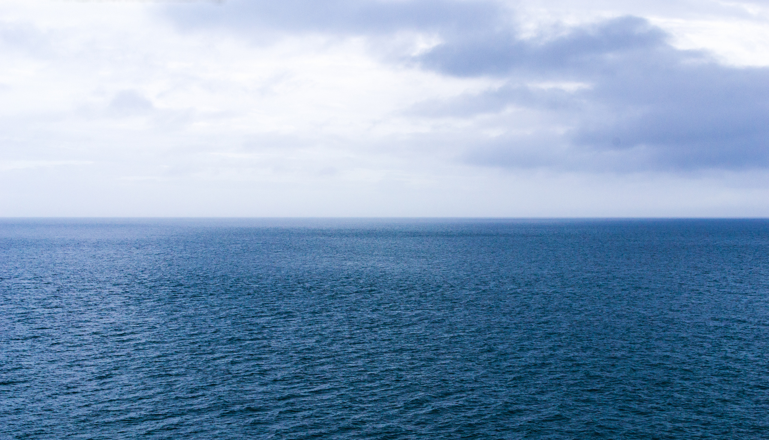
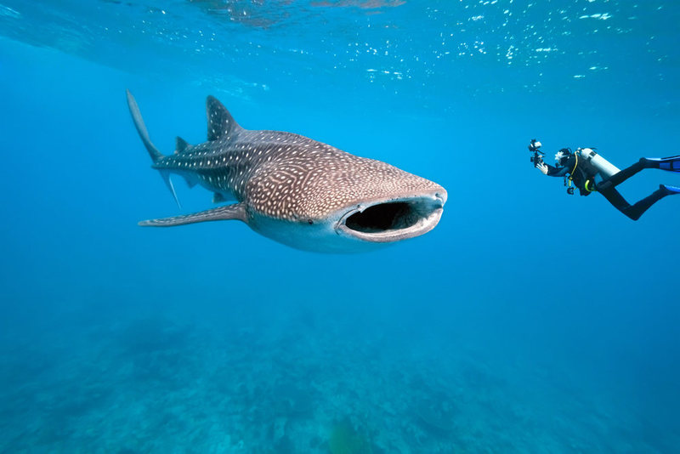
Open ocean
The open ocean is all of the world’s oceans except for the places that are near the shore and the deep ocean.
The Epipelagic Zone (656 ft)- This is the surface layer also known as the sunlight zone because this is where most of the light is and also where photosynthesis can occur. There are widespread temperatures throughout this layer because of the light shining on it.
The Mesopelagic Zone (656-3281 ft)- This is right below the Epipelagic zone and also known as the Twilight zone because of the limited sunlight that is found here and there is not a lot of oxygen available.
Notes:
Open ocean consists of many layers mesopelagic zone is called twilight zone because of limited light but still has light the epipelagic zone has a lot of light and is mostly home to creatures that use photosynthesis.

Slide 3
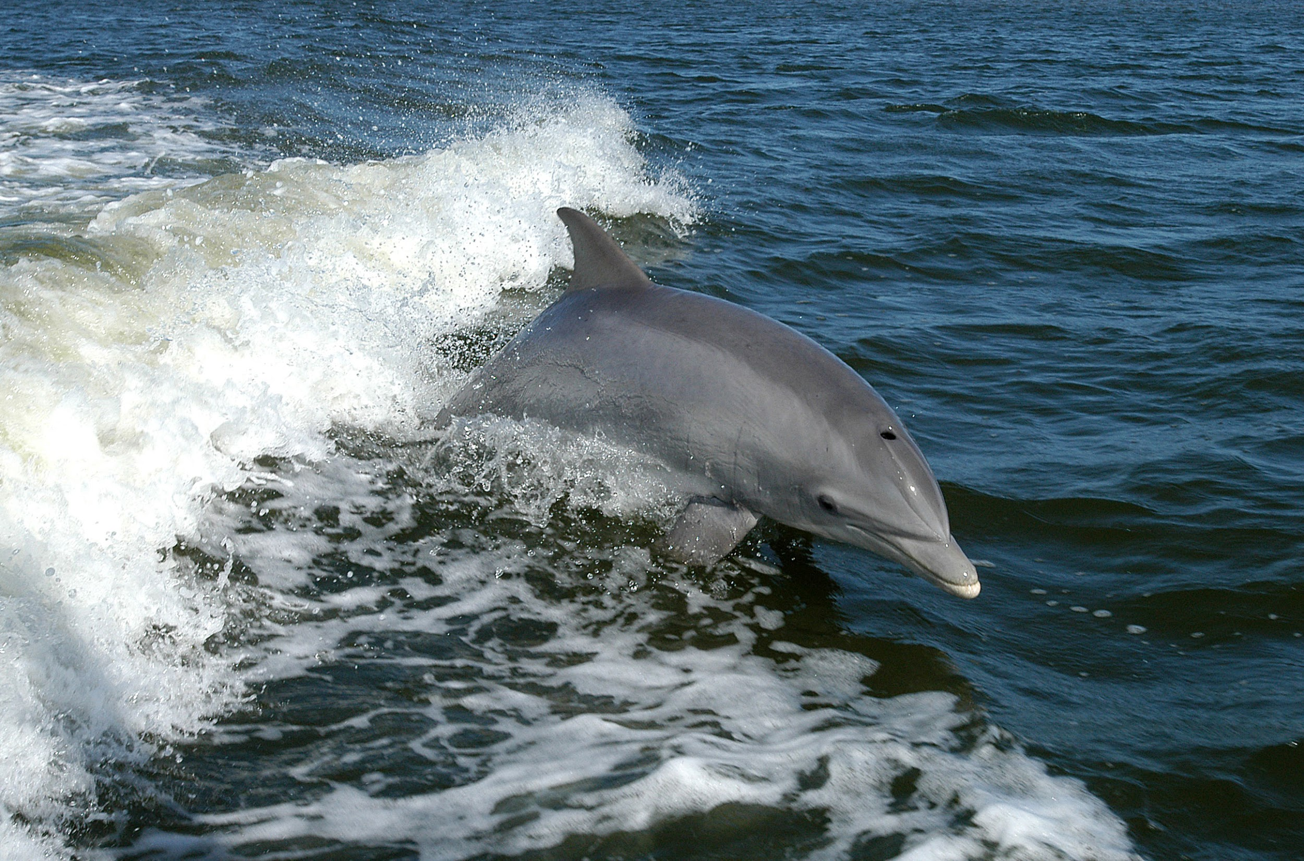
Animal life in each zone
Animals found in the Epipelagic zone are most types of sharks, dolphins, coral and other types of ocean plant that photosynthesize, Like algae and phytoplankton.
Animals found in the Mesopelagic zone, Seeing as it has less light than Epipelagic zone it can’t hold the same plant life most of the things here are like swordfish, squid, cuttlefish ect. But some of these smaller fish swim higher up at night to feed.
Notes:
Animals in epipelagic zone is full of creatures

Slide 4
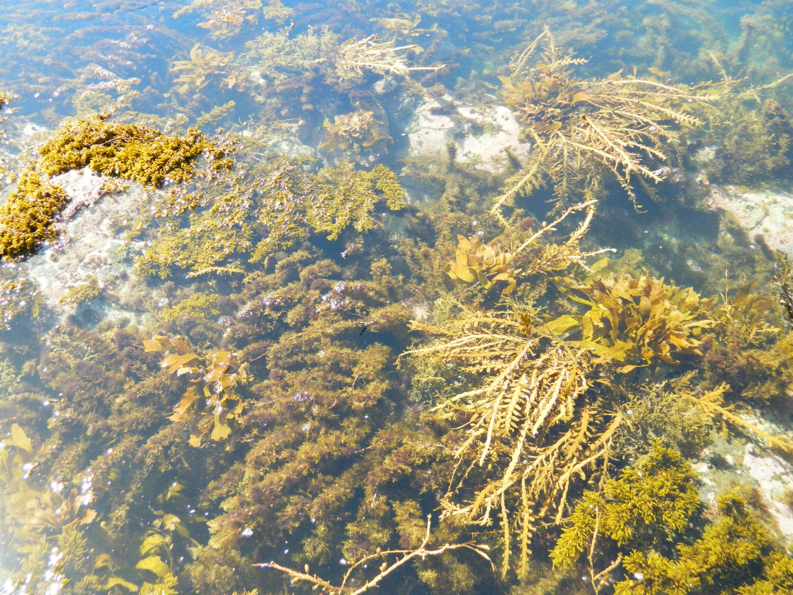
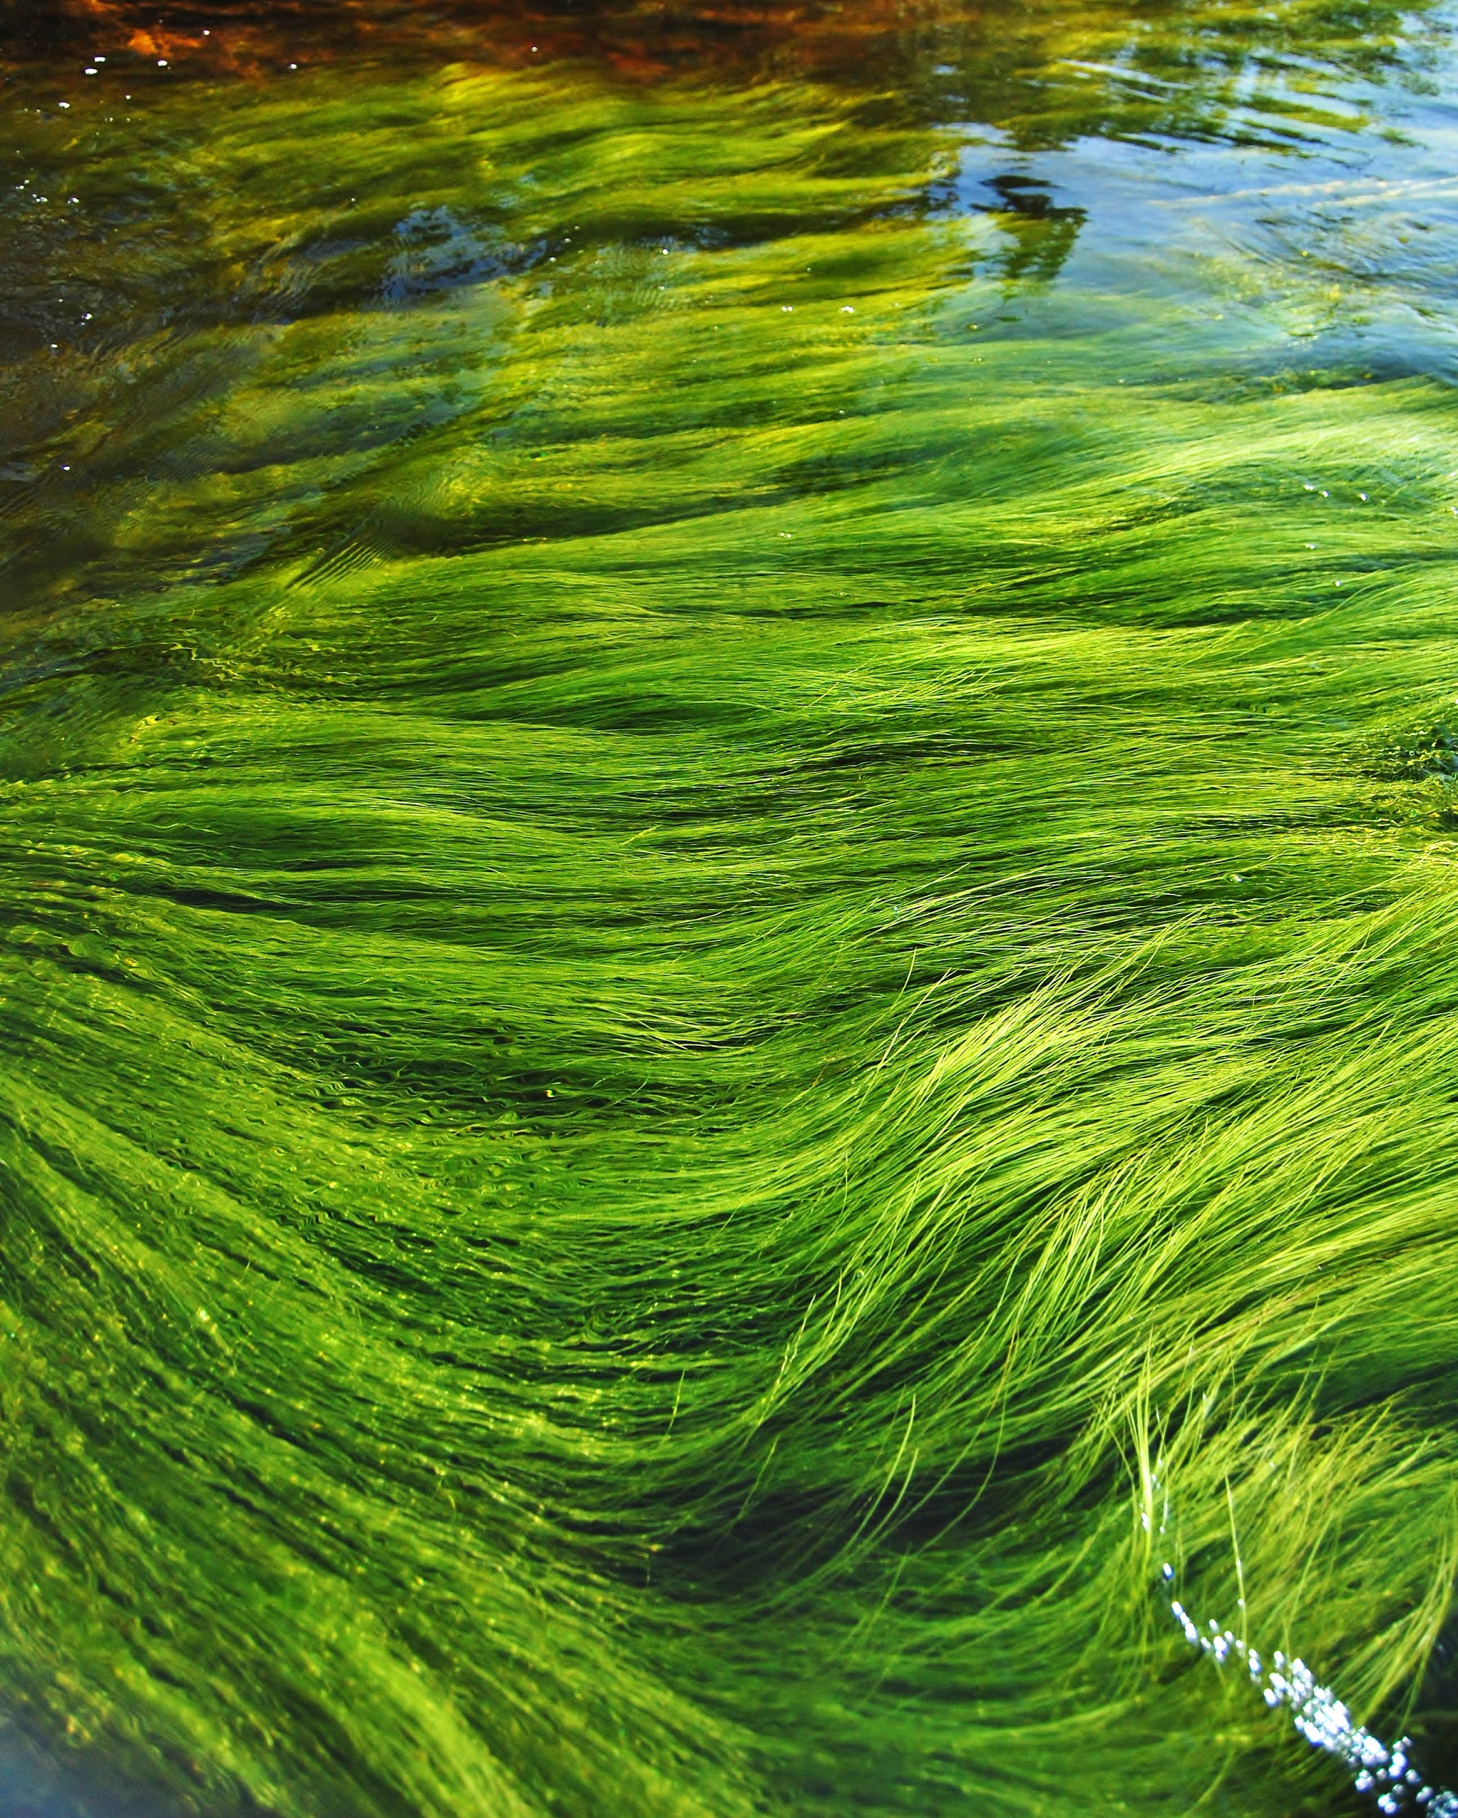
Plant life in each zone
The epipelagic zone is from the surface down to around 650 feet, since most light is found in the zone there is a lot of marine life. Some of the plants in this zone are…
Seaweed- This is only able to grow in the open ocean because it uses photosynthesis and needs sunlight to grow
Algae-This is very important to marine life, they take in carbon dioxide and releasing it back into the atmosphere. Also, when there is a disturbance in the balance it leads to growth of algae and it is called algal blooms.

Slide 5
Plant life in each zone pt 2
Phytoplankton- This is microscopic marine algae and also need sunlight to survive. They need inorganic nutrients (which don’t have carbon in them) and convert them into proteins, fats and carbohydrates. They also provide food for many other types of sea creatures.
Corals- They grow in the Epipelagic zone because they also require light to survive and they can only grow in warm waters but the water can’t be too warm or else it can affect the whole community. Coral protects the shoreline from waves and storms.
There are no plants in the Mesopelagic layer because little to no light is shown here and there is less oxygen.

Slide 6
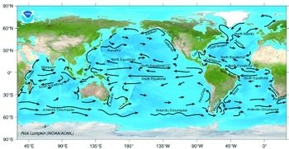
Ocean currents
An ocean current is a continuous movement of ocean water, These are greatly affected by the temperature of the water, wind obviously the saluntity, and the density.
The ocean currents are taking the top layer of surface water and moving them so the water underneath that can come up and cycle through nutrients. So when something dies at the bottom of the ocean the nutrients is carried up to the surface to help keep everything alive and healthy.
Notes:
AKASHA

Slide 7
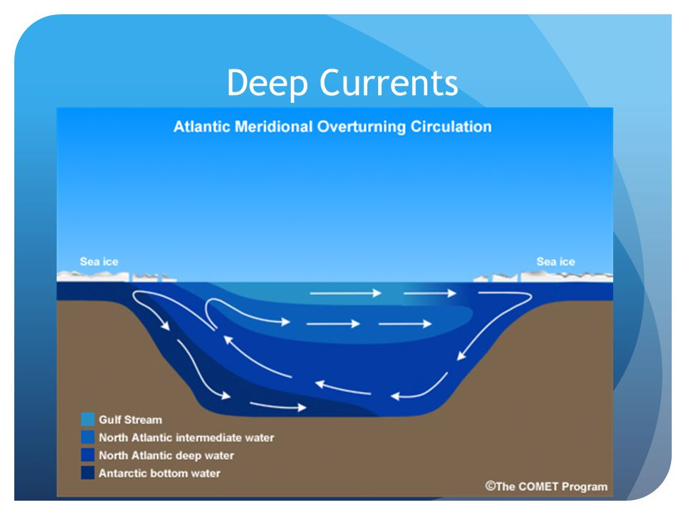
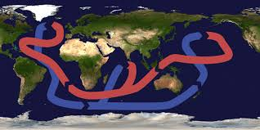
Deep currents
. Deep ocean currents come from large amounts of sinking surface water. They make up 90% of the oceans currents and are caused by a mix of temperature and water density.
. When surface water becomes cold, the lower temperature and extra salt causes the surface water to become more dense than the water below it, the surface water sinks down into deep water in a circulation process which is called thermohaline circulation.

Slide 8
Upwellings
Wind likes to move warm water on the surface, New cooler water from the bottom of the ocean that’s full of nutrients, rises up to replace this water in a process known as an Upwelling.
A lot of this nutrients is from where sea life has died and sunk to the bottom of the ocean and decomposed there, then is given a new life as bacteria and nutrients that plankton eat. The plankton then, get eaten by phytoplankton. This is basically the animal kingdom
Notes:
Akasha

Slide 9
FUN FACTS!
Deep ocean currents are driven by the sinking and rising of waters of different densities.
Cold polar currents bring large Icebergs to the North Atlantic ocean, southward
Coastal upwelling regions account for only one percent of the ocean surface
Bonus:
There are more historic artifacts under
the sea than in all of the worlds museums.

Slide 10
Motto
LIfe’s a easy with an ocean breeze to keep us going!

Slide 11
Quiz time
1- What is not part of the open ocean?
Places near the shore an deep oceans
2- Sharks, dolphins, coral and other types of ocean plants that photosynthesis are apart of which zone?
A- Mesopelagic zone
B- epipelagic zone
C- Benthic zone
B- Epipelagic
3- Deep ocean currents are made up of ___% of the oceans currents.
90%

Slide 12
WEBSITES
https://wwf.panda.org/our_work/oceans/open_ocean/
https://www.nps.gov/subjects/oceans/open-ocean.htm
https://oceanservice.noaa.gov/facts/upwelling.html Used for upwellings and what they are.
https://blog.trafalgar.com/10-unbelievable-facts-ocean/ This slide was used to get the fun facts.
http://www.seasky.org/deep-sea/ocean-layers.html- This is where I found a lot of the information for the layers of the ocean
Used for the animals in each zone slide and plants in each zone.
https://kids.kiddle.co/Ocean_current
https://sciencing.com/oceanic-zone-plants-animals-8174254.html

