Slide 1
Overfishing
By:Julia,Carly,and Catherine

Slide 2
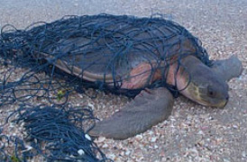
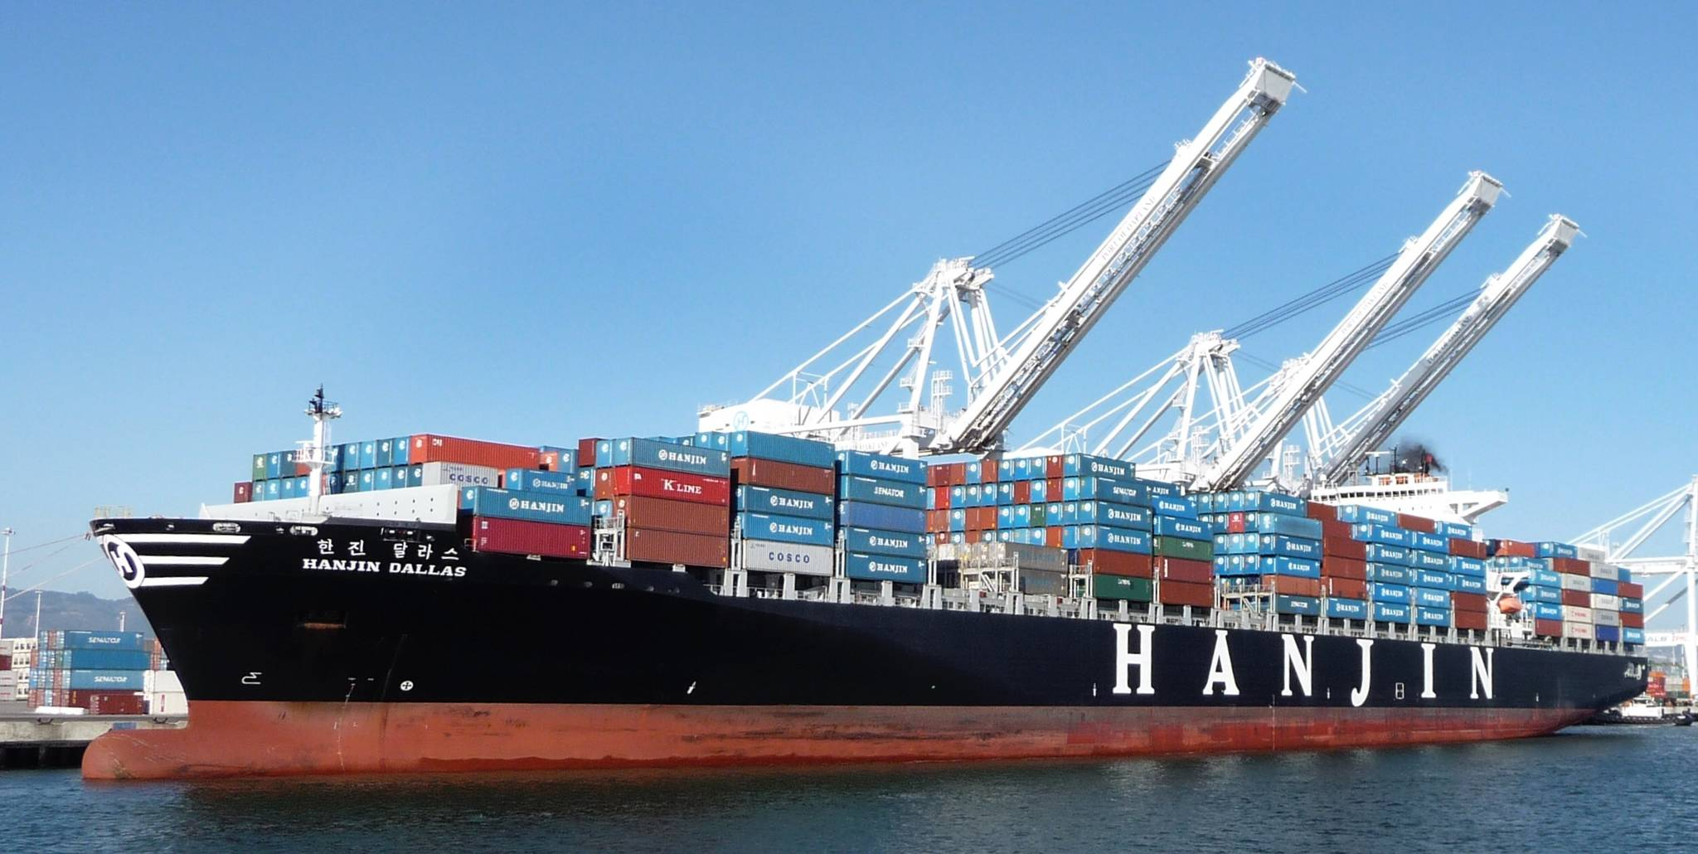
What is Shipping?
Shipping is sending packages and mail to other people or places.
This can be a problem for ocean pollution because gas from the boats can leak into the water or trash from the boat can fall into the water.

Slide 3
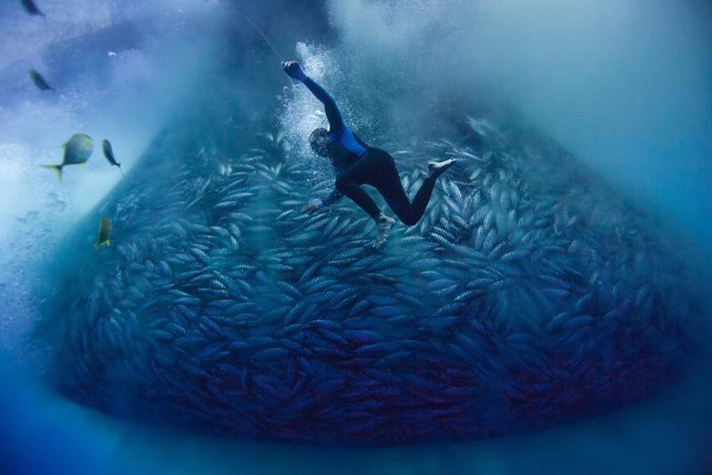
What is Overfishing?
Overfishing occurs when people are catching more fish than the population can reproduce.
This is a problem for oceans (or any water body) because many people and other animals rely on fish for food and this disturbs the food chain.

Slide 4
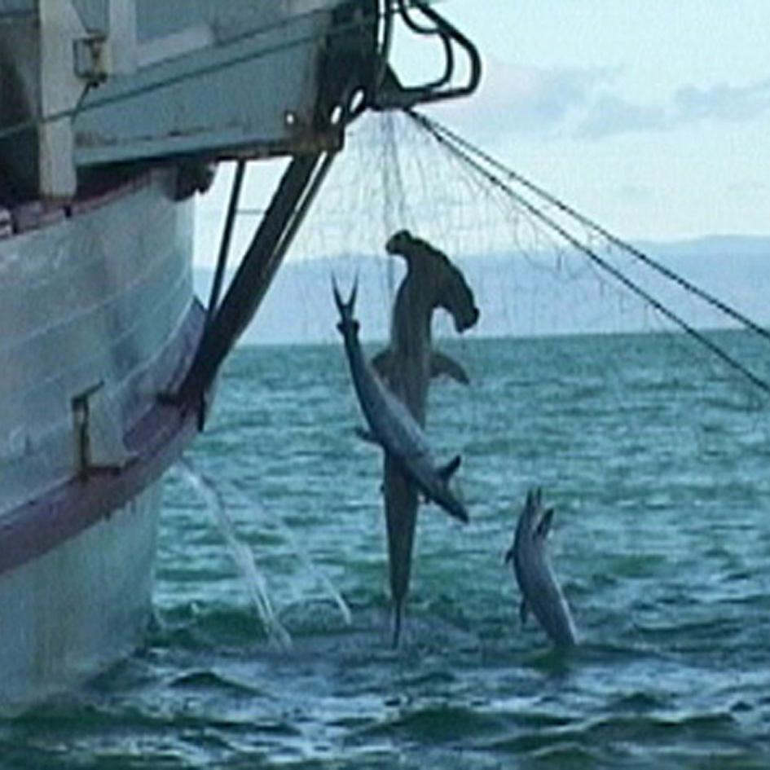
What is By-Catching? Why is it a problem?
By-Catching is the amount of animals that are caught on accident in fishing nets and then thrown back to the water source they came from.
This is a problem because some animals are thrown back into the sea and they are already dead or almost dead. In result the amount of animals thrown back trumps the amount kept.
Notes:
The fishermans were not hunting for sharks, they were caught and ended up dying by being caught in a net.

Slide 5
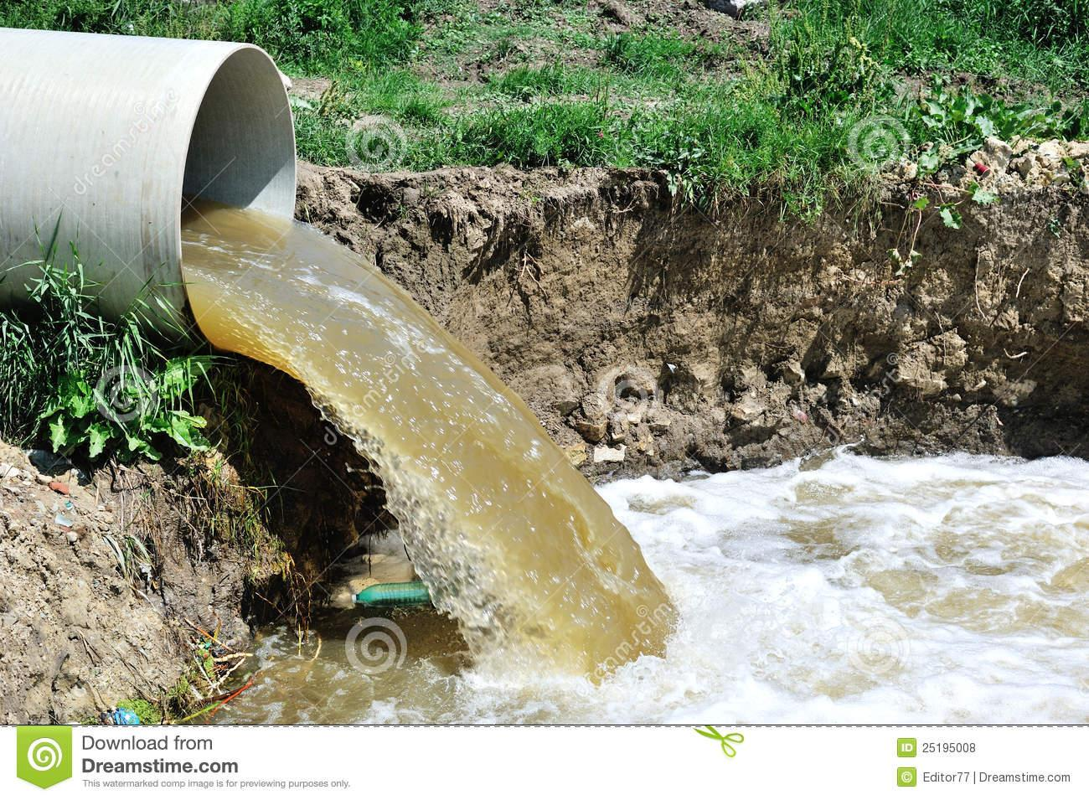
Nonpoint and Point Sources
A point source is a spot of pollution that enters the water from a known source.
A non-point source is a pollution whose source is hard to find or is scattered.
What is an example of a point source?
An example of a point source is water treatment plant discharge.
Notes:
A polluted sewage

Slide 6
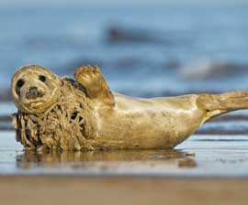
How does ocean pollution affect animals and marine life?
ocean pollution such as plastic waste can trap marine animals
Ocean pollution like debris can cause the oxygen levels to decrease, because the debris does not decompose making it hard for animals like whales ,sharks , dolphins ,turtles and other marine life to thrive and live
Marine animals can mistake trash for food and it can slowly kill them
Notes:
Debris does not decompose so it makes the oxygen levels go down

Slide 7
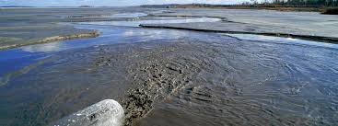
How does ocean pollution affect humans?
Ocean pollution can pollute our water sources
Humans eat fish and animals who have been exposed to poison and chemicals so it can poison humans too
When humans are exposed to poisonous chemicals for long periods of time it can cause health problems.

Slide 8
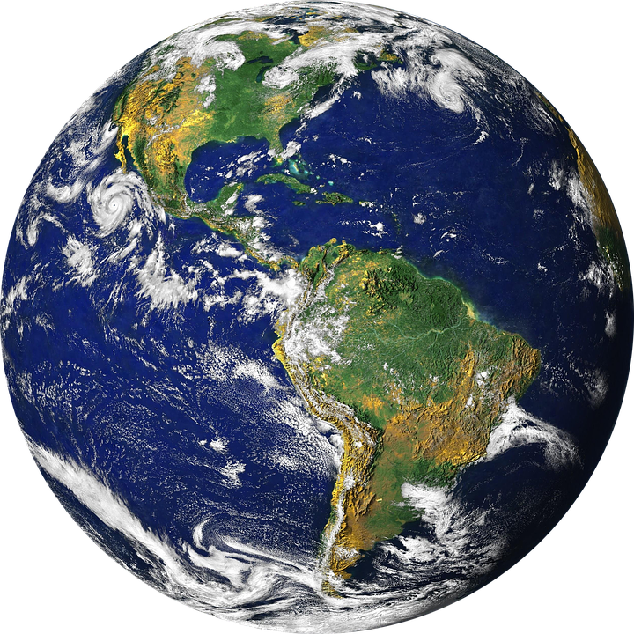
What is the EPA and what do they do?
Environmental protection agency
Sets standards for safe drinking water
Ensure the levels of pollution and chemicals are within a safe amount

Slide 9
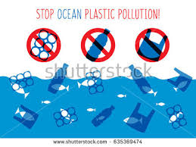
Which is an example of a toxic chemical?
A.) a piece of wood
B.)salt water
C.)lead
D.)animal remains
Answer: C. Lead

Slide 10
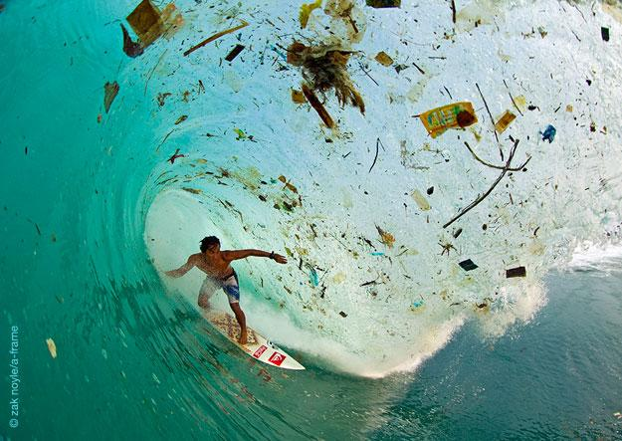
https://www.youtube.com/watch?v=HQTUWK7CM-Y
Do you have any ideas on how you can help prevent ocean pollution?
Use less plastic products
Try and keep your beach clean
Don’t purchase items that exploit Marine Life
-This is very important, it will help our ocean stay clean and save animals lives. We can fix our polluted oceans by paying more attention to our surroundings.
https://www.youtube.com/watch?v=HQTUWK7CM-Y

Slide 11
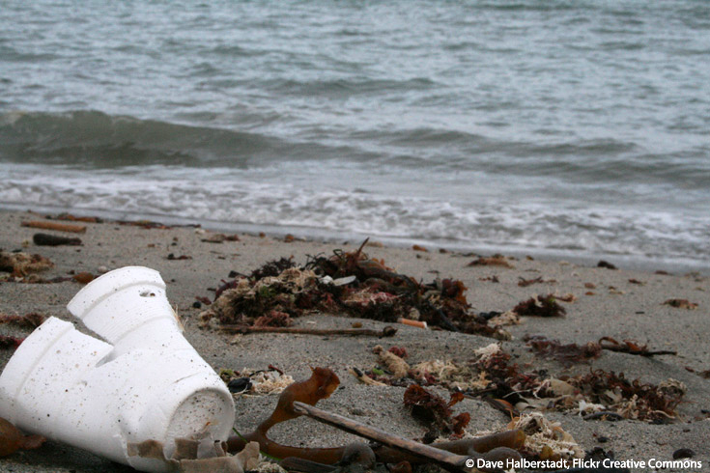
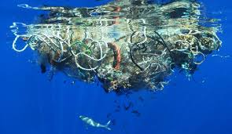
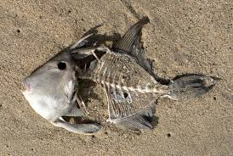
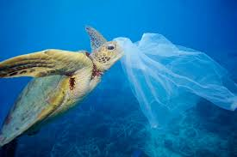
Which is not an example of pollutions?
A.) a plastic bag
B.)a net for fishing
C.)a styrofoam cup
D.) a dead fish
Answer:D.) a dead fish

Slide 12
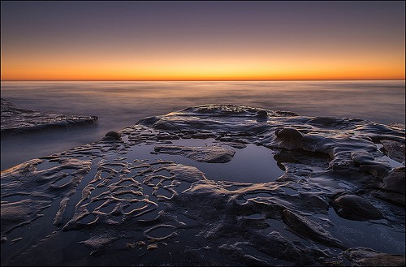
Interesting Facts!
Discarded fishing nets kill approximately 300,000 dolphins and porpoises annually.
Everyday thousands of pounds of trash are dumped into our oceans
Although oil spills pollute the ocean, they only account for approximately 12% of the oil polluting the ocean. The rest reaches the oceans from land, through drainage.

Slide 13
Reference:
https://www.worldwildlife.org/threats/overfishing
http://www.eschooltoday.com/overfishing/what-is-overfishing-for-kids.html
https://www.merriam-webster.com/dictionary/shipping
http://oceana.org/our-campaigns/bycatch/campaign
http://www.softschools.com/facts/holidays/ocean_pollution_facts/1303/
http://www.planetaid.org/blog/how-ocean-pollution-affects-humans
Notes:
http://www.softschools.com/facts/holidays/ocean_pollution_facts/1303/

Slide 14
https://www.conserve-energy-future.com/causes-and-effects-of-ocean-pollution.php
http://soils.ifas.ufl.edu/campuswaterquality/sources/
http://www.investopedia.com/terms/e/environmental-protection-agency.asp

