Slide 1
Overfishing by-catching and pollution
Joselyn C, Evan M, Redford D, and Ben S

Slide 2
What is shipping?
Shipping is when substandard ships (flawed ship) and poor shipping practices lead to massive marine pollution and damage.
Accidental spills or releases of chemicals can lead to the death of sea life and other animals.
Shipping happens most the time because of Weather Hazards, Geographic Hazards, and Technological Hazards.
Weather Hazard: Storms, Rogue Waves, etc.
Geographic Hazard: Icebergs, Coral Reefs, and Sandbars
Technological Hazard: Radar Failure, Engine Failure, etc.
Notes:
Geographic Hazards - Icebergs, Coral Reefs, and Sandbars

Slide 3
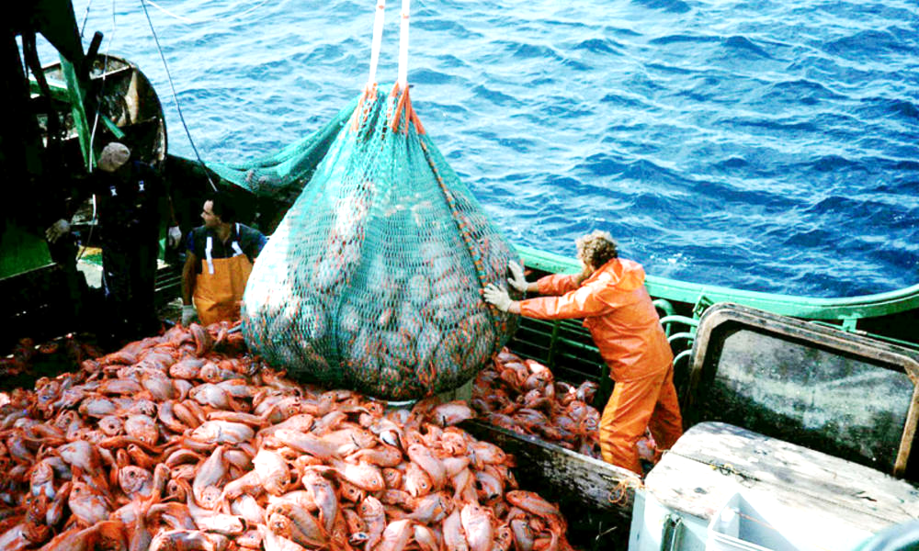
What is Overfishing?
Overfishing occurs when more fish are caught than the population can replace through natural reproduction.
This issue can disrupt marine communities, which leads to an unwanted change in the food chain.

Slide 4
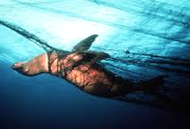
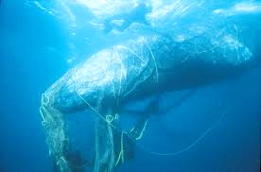
What is by-catching?
By-catching is when fishers nets and other fishing techniques catch marine life that they do not want, such as undesired sex/species/size, and they discard them, killing the fish. Other marine life also gets caught in the nets, killing them as well.
Longlining
Kills 160,000 to 320,000 seabirds each year
Shrimp trawling
Has the highest rate of bycatch deaths out of any other techniques, producing over ⅓ of all bycatch

Slide 5
Why is Ocean Pollution a problem?
Ocean pollution is a problem because it can destroy the ecosystem, which can then affect us on a global scale.
Gulf of Mexico oil spill
Massive oil spill that occurred in the Gulf of Mexico on April 20th, 2010
Killed millions of animals and ruined fishermens businesses
Great Pacific Garbage Patch
Massive patch of garbage the size of North America floating in the Pacific
Hundreds of animals die each year from consuming trash

Slide 6
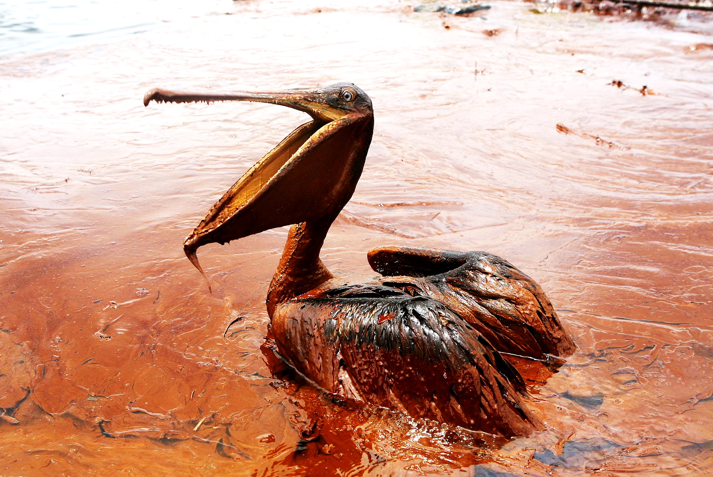
This is what happened during an oil spill. The pelican is covered in oil.

Slide 7
What is the EPA? What do they do?
The EPA stands for the “Environmental Protection Agency” and it is run by the government. It sets standards for our drinking water.
The standards are considered to be the guidelines for protecting natural water sources.
The EPA also enforces their federal laws on protecting human health and the environment.
The EPA also tries to protect everyone in the nation.

Slide 8
The human impact on this Earth
https://www.youtube.com/watch?v=3zyizEz9XUs pause from 1:44 to 2:03. Pause again at 4:00 to 4:13

Slide 9
Questions
What can we do to help prevent pollution?
What does the EPA stand for?
Extra Protective Assistants
Environmental Pollution Apprehension
Environmental Protection Agency
Encrusted Pearl Agency

Slide 10
List of sources
https://www.epa.gov/aboutepa/our-mission-and-what-we-do
https://en.wikipedia.org/wiki/Bycatch
http://wwf.panda.org/about_our_earth/blue_planet/problems/shipping/
http://www.worldwildlife.org/threats/overfishing
Page C51

