Slide 1
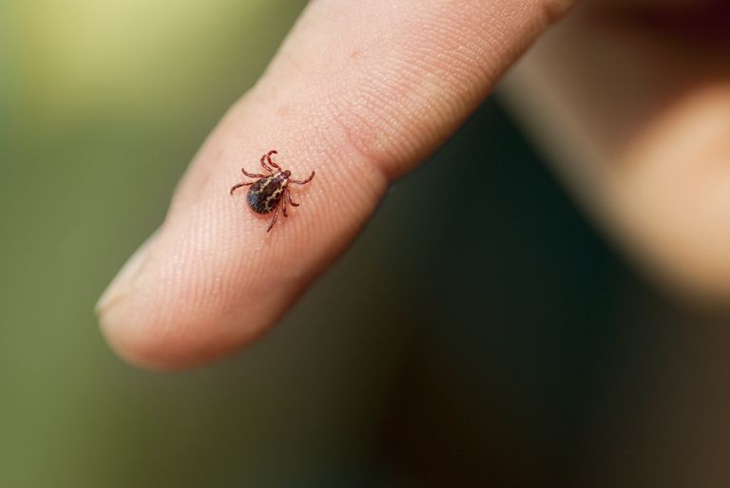
#70 Parasitic Pathogens
REMINDERS:
G/L quiz Friday
Your yellow course sheet needs to be filled out by Thursday

Slide 2
Warm-up – YOU NEED TO SHOW WORK
If you have 12 bacteria and they reproduce every half-hour, how many bacteria will you have in 3 hours?
If you have 5 bacteria and they split every ½ hour, how many hours will it take to get more than 1,200 bacteria cells?
Challenge problem:
You start out with 200 staph bacteria on your skinned knee that divide and split every 20 minutes. After 3 hours you worry about an infection so you wash your wound with anti-bacterial soap which kills 90% of this staph infection. How many staph bacteria do you have left?
Notes:
#1 – 12(0), 24 (.5), 48 (1), 96 (1.5), 192 (2), 384 (2.5), 768 (3) = 768 at 3 hours

Slide 3
Cell size and scale
http://learn.genetics.utah.edu/content/cells/scale/

Slide 4
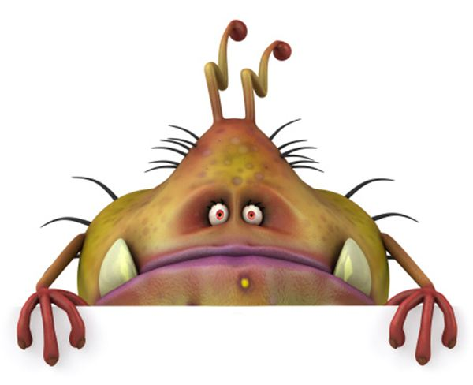
*Parasites
A parasite is an organism that feeds on another individual, known as the host.
Parasites either live on or in their host’s body.
Organisms of two different species that live together in direct contact with each other form a symbiotic relationship.

Slide 5
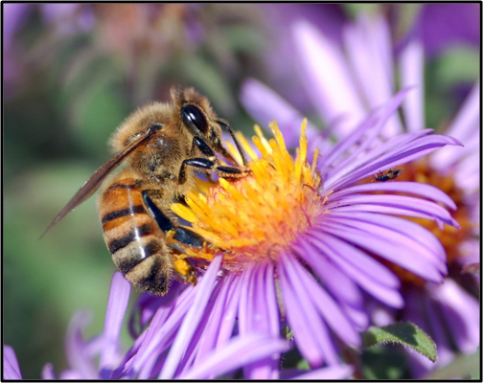
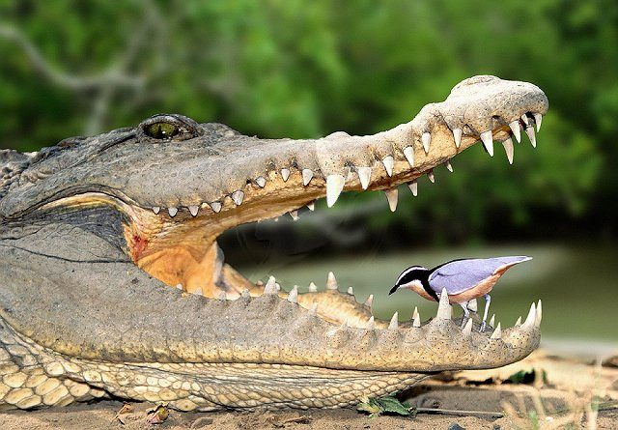
*Symbiotic Relationships
Mutualism – one organism lives closely with another organism, to the benefit of both

Slide 6
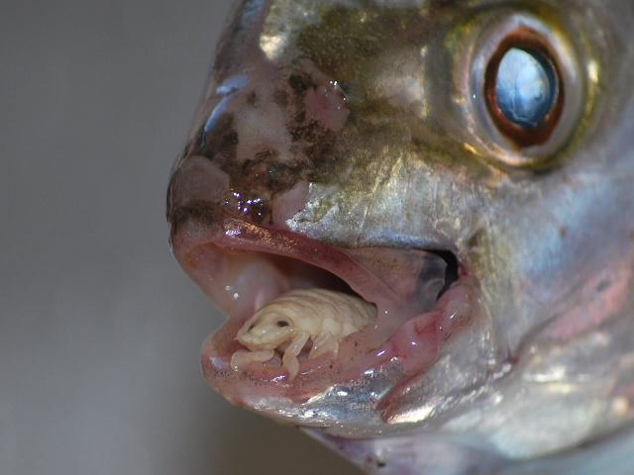
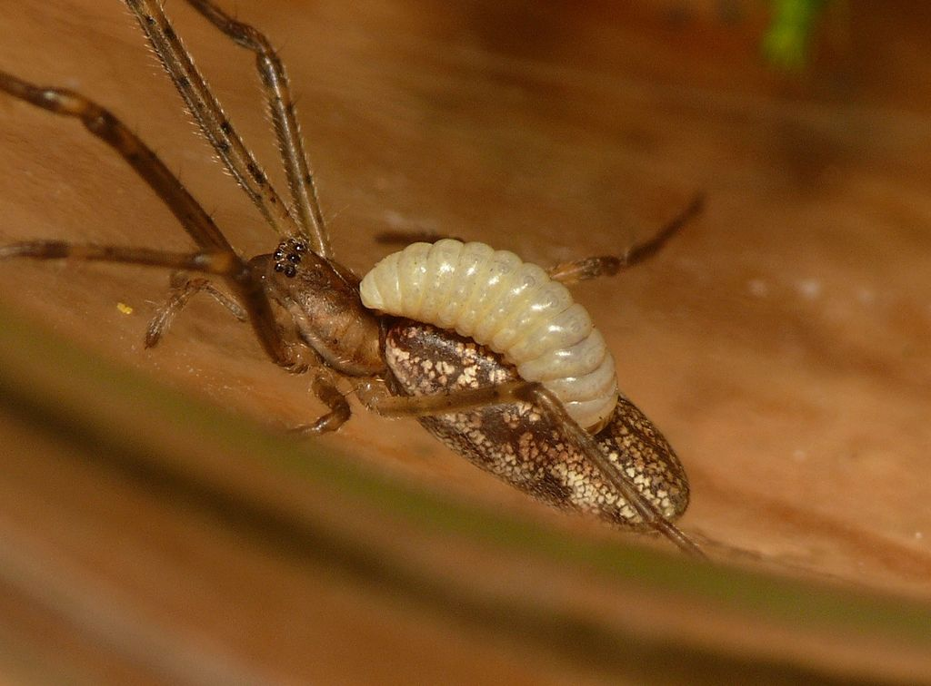
*Symbiotic Relationships
Parasitism - one organism lives closely with another organism where one organism benefits and the other is harmed
https://www.nationalgeographic.com/science/phenomena/2013/02/28/tongue-eating-fish-parasites-never-cease-to-amaze/

Slide 7
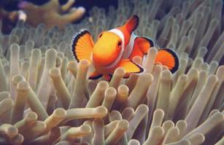
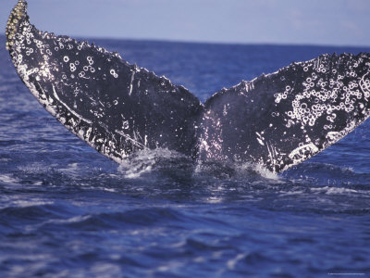
*Symbiotic Relationships
Commensalism - one organism lives closely with another organism where one organism benefits and the other is NOT harmed

Slide 8
Mapping Death Assessment questions
Describe what you see on the map you have marked with the locations of the deaths. Explain any trends you noticed about the placement of dots. (are they scattered, clumped, random, uniform)
Explain any other clues about the cause of disease.
Look at the information that you know about the victims, such as their ages and occupations. Are there any similarities in victims?
Based on the evidence of the cholera death locations shown on the map, state 3 hypothesizes or reasons that might explain how the disease spread. (A hypothesis is an idea or theory about how or why something happens).
Explain possible solutions to resolving the Cholera death problem

Slide 9
#71 – Infectious Disease spreadsheet

Slide 10
Warm-up
In your notebook define and explain a way these relate to our current unit.
Pathology
Epidemiology
Biotechnology
Microbiology

