Slide 1
Part 2 of # 8 Continental Drift and Plate Tectonic Notes

Slide 2
*So how did the continents get to their current position?
The force responsible for moving tectonic plates in the asthenosphere are convection currents.
Convection Currents occur within the asthenosphere when hot magma rises to the crust and pushes plates in separate directions. As the magma cools, it sinks back to the core to be heated up once again, continuing the cycle

Slide 3
Convection Explained
https://www.youtube.com/watch?v=MmMX83diwl0

Slide 4
How did they prove how continents drift apart?
An American scientist named Harry Hess drilled down in the sea floor and proposed the seafloor spreading theory in 1962.
*The Sea floor spreading theory states that new crust is being created at mid-ocean ridges (which are large underwater mountains) and destroyed at deep sea ocean trenches.
This proved why the Earth isn’t growing in size. New crust is being created at the same rate that it is being destroyed.

Slide 5
*What else did we learn by looking at the sea floor?
As the magma on the sea floor cools and hardens by the mid ocean ridges, iron in the magma align in the direction based off the Earth’s current magnetic poles.
Scientist looked at the seafloor crust and found evidence that throughout Earth’s history, the north and south magnetic poles have changed places several times

Slide 6
*Magnetic reversals
A magnetic reversal occurs when Earth’s magnetic field reverses, causing the iron in the magma to align in the opposite direction.
The youngest rock records are located the closest to the mid ocean ridge and the oldest near the ocean trench

Slide 7
Magnetic Reversals Videos
Magnetic field 100 greatest discoveries (2:34)
https://youtu.be/igGsuDYxhEA
What happens when the poles reverse (3:02)
https://youtu.be/Ou1BiorYRNU

Slide 8
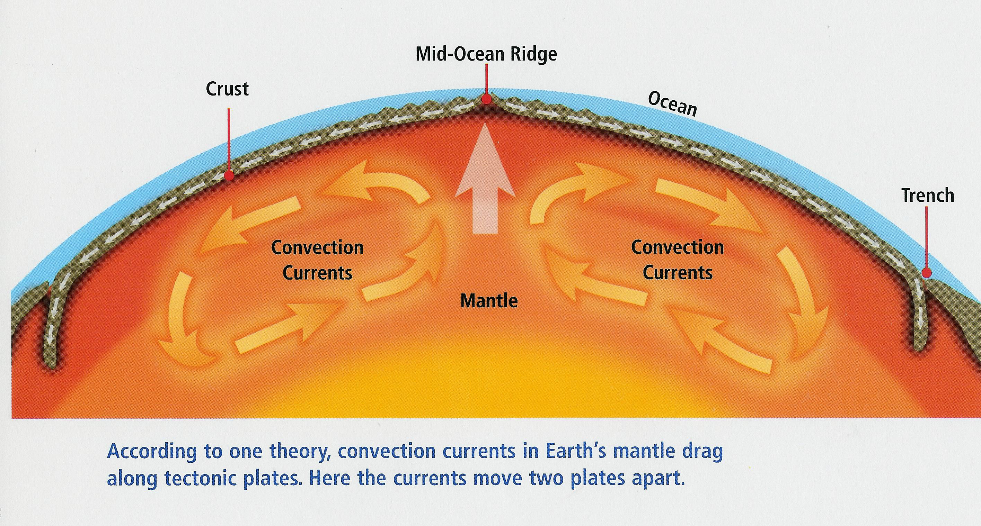
How and where is crust being destroyed?
*A process called subduction takes place at the ocean trenches. Here, oceanic crust gets pushed beneath continental crust towards the mantle and melts. This process destroys oceanic crust.

Slide 9
Warm-up
When Wegener first published his theory on continental drift, several scientists rejected his theory. Explain why?
Years later they accepted it because of a process called ____________.

