Slide 1
45. Physical and Chemical Properties Reading passage 46. Physical and Chemical Properties Notes

Slide 2
*What is a property?
A property is a characteristic of a substance that can be observed

Slide 3
*Physical property
A property that can be used to describe a substance using your 5 senses (see, touch, hear, smell, taste)
Physical Properties can be identified without changing what the substance is

Slide 4
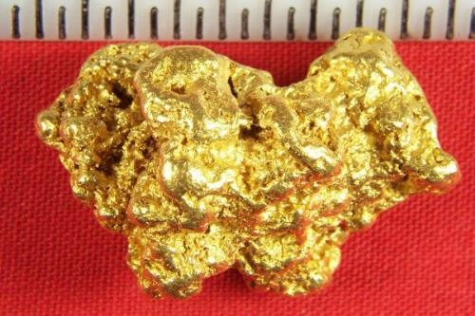
*Examples of Physical Properties
Color
Shape
Texture – how something feels when it’s touched
Smell/odor (good/or bad)

Slide 5
*Physical Properties Cont.
State (physical form) - solid, liquid, gas
Melting, freezing, condensing, and boiling/evaporation points
Electrical conductivity - ability for a substance to conduct electricity
Magnetism – ability to attract iron

Slide 6
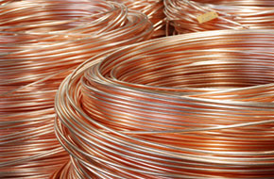
*Physical Properties Cont.
Solubility – ability to dissolve in another substance
Ductility – ability to be pulled into wire
Malleability - the ability to be rolled or pounded into sheets. Ex – aluminum

Slide 7
*Physical Change
A physical change affects one or more physical properties (like size, shape, state, color, etc), but DOES NOT change the chemical property (identity or composition of substance)
Ex. Cotton can be dyed red. This cotton will still be flammable and it is still cotton so you’ve only changed the color of the cotton when you dyed it

Slide 8
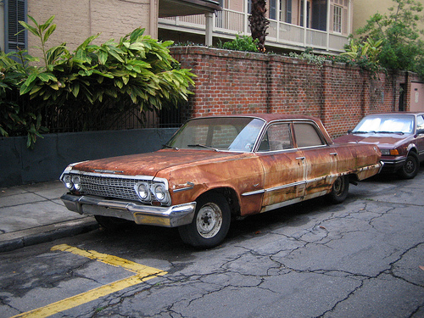
*Chemical Properties
A chemical property is something that can only be observed by changing the identity of a substance

Slide 9
*Examples of Chemical Properties
Energy released (in form of sound, heat, or light)
Flammability – ability to burn. Ex. Wood
Non flammability – inability to burn Ex. Ash and smoke
Reactivity – ability to combine with one or more substances and form one or more new substances
Ex. Iron is reactive to oxygen, creating rust. (iron + oxygen= rust)
Non-reactivity – inability to combine with one or more substances to form new substances.
Ex. Chromium + oxygen = chromium + oxygen
(when combine nothing happens)

Slide 10
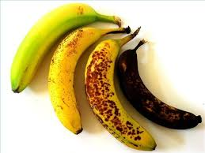
Chemical change
When matter changes into a new substance with new properties.
Ex. – banana rotting

Slide 11
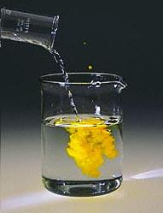
*Examples of Chemical Changes
Bubbling or clouding in mixture
Precipitate forms
Color change
Odor produced or changed

